Slide 1
Trees for Net Zero
Scotland’s Curriculum Third Level Maths

Slide 2
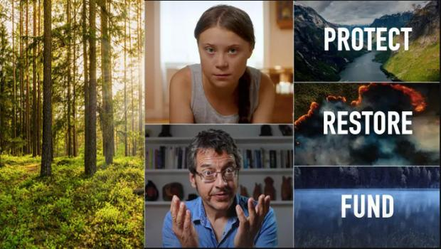
Trees for ‘Net Zero’
Watch this video:
What do you notice?
What do you wonder?
Notes:
Watch the video twice:
On first viewing, ask students how it makes them feel. Do students agree or disagree with the statement: “What you do counts”?
On second viewing, ask students to make a note of any facts or statistics they find interesting or surprising.
Tropical forests are being cut down at a rate of 30 football pitches per minute – what does this mean? How many trees is this? How significant is the carbon stored by a tree? What does this mean for CO₂ in the atmosphere? How does this compare to the numbers of trees being planted around the World? We will explore these questions in this session.

Slide 3
Tree planting pledges
The Woodland Trust aim to plant 50 million trees by 2025.
The National Trust aim to plant 20 million trees by 2030.
Notes:
Positive ways forward and potential ways for students to contribute.
It is worth exploring with students how 50 million trees compares with 30 football pitches of forest. This is explicitly mentioned on slide 10.

Slide 4
Put these things in order of CO₂ released, from highest to lowest
Driving 1000 miles in a petrol car
Average UK household in 1 year
A flight from London to New York, per passenger
Notes:
Answers: UK Household 17.1 tonnes, Flight London to New York (per passenger) 0.6 tonnes Driving 1000 miles 0.22 tonnes.
It would be worth discussing whether students are surprised by any of these and how they compare.
One implication of this is that what we do as individuals, and within our households, can have a big impact on our environment.

Slide 5
Put these things in order of CO₂ released, from highest to lowest
Average UK household in 1 year
A flight from London to New York, per passenger
Driving 1000 miles in a petrol car
Notes:
Answers: UK Household 17.1 tonnes, Flight London to New York (per passenger) 0.6 tonnes Driving 1000 miles 0.22 tonnes.
It would be worth discussing whether students are surprised by any of these and how they compare.
One implication of this is that what we do as individuals, and within our households, can have a big impact on our environment.

Slide 6
Which numbers go where?
0.6
17.1
0.22
0.6
7.5
Description | Tonnes
Amount of CO₂ released by average UK household in 1 year
Amount of CO₂ released by driving 1000 miles in a petrol car
Amount of CO₂ stored by an oak tree in its lifetime
Amount of CO₂ released by a flight from London to New York, per passenger
Amount of methane released by 1 cow in its lifetime
Notes:
It would be worth discussing whether students are surprised by any of these and how they compare.
This session is on trees, so this allows students to compare the CO₂ stored by a tree with some other more meaningful and imaginable scenarios. One implication is that trees can potentially have a significant impact on the CO₂ in our atmosphere, but we will find out more about this throughout this lesson.
This potentially sets up a question later in the session about whether it’s okay to fly if the CO₂ is offset by planting trees.
Answers: UK Household 17.1 tonnes, Driving 1000 miles 0.22 tonnes, Oak tree 7.5 tonnes, Flight London to New York (per passenger) 0.6 tonnes, 1 cow 0.6 tonnes.

Slide 7
Which numbers go where?
0.6
17.1
0.22
0.6
7.5
Description | Tonnes
Amount of CO₂ released by average UK household in 1 year
Amount of CO₂ released by driving 1000 miles in a petrol car
Amount of CO₂ stored by an oak tree in its lifetime
Amount of CO₂ released by a flight from London to New York, per passenger
Amount of methane released by 1 cow in its lifetime
Notes:
It would be worth discussing whether students are surprised by any of these and how they compare.
This session is on trees, so this allows students to compare the CO₂ stored by a tree with some other more meaningful and imaginable scenarios. One implication is that trees can potentially have a significant impact on the CO₂ in our atmosphere, but we will find out more about this throughout this lesson.
This potentially sets up a question later in the session about whether it’s okay to fly if the CO₂ is offset by planting trees.
Answers: UK Household 17.1 tonnes, Driving 1000 miles 0.22 tonnes, Oak tree 7.5 tonnes, Flight London to New York (per passenger) 0.6 tonnes, 1 cow 0.6 tonnes.

Slide 8
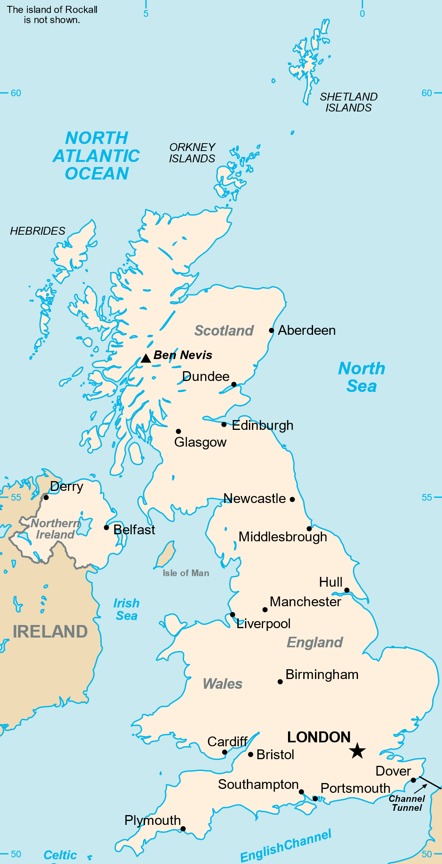
Estimations
The area of the UK is 242,495km².
Round this value to 2 significant figures
Why do we use rounded values when we are making estimations?
TIP: Count significant figures from the left hand side
Notes:
Map image: CIA, Public domain, via Wikimedia Commons

Slide 9
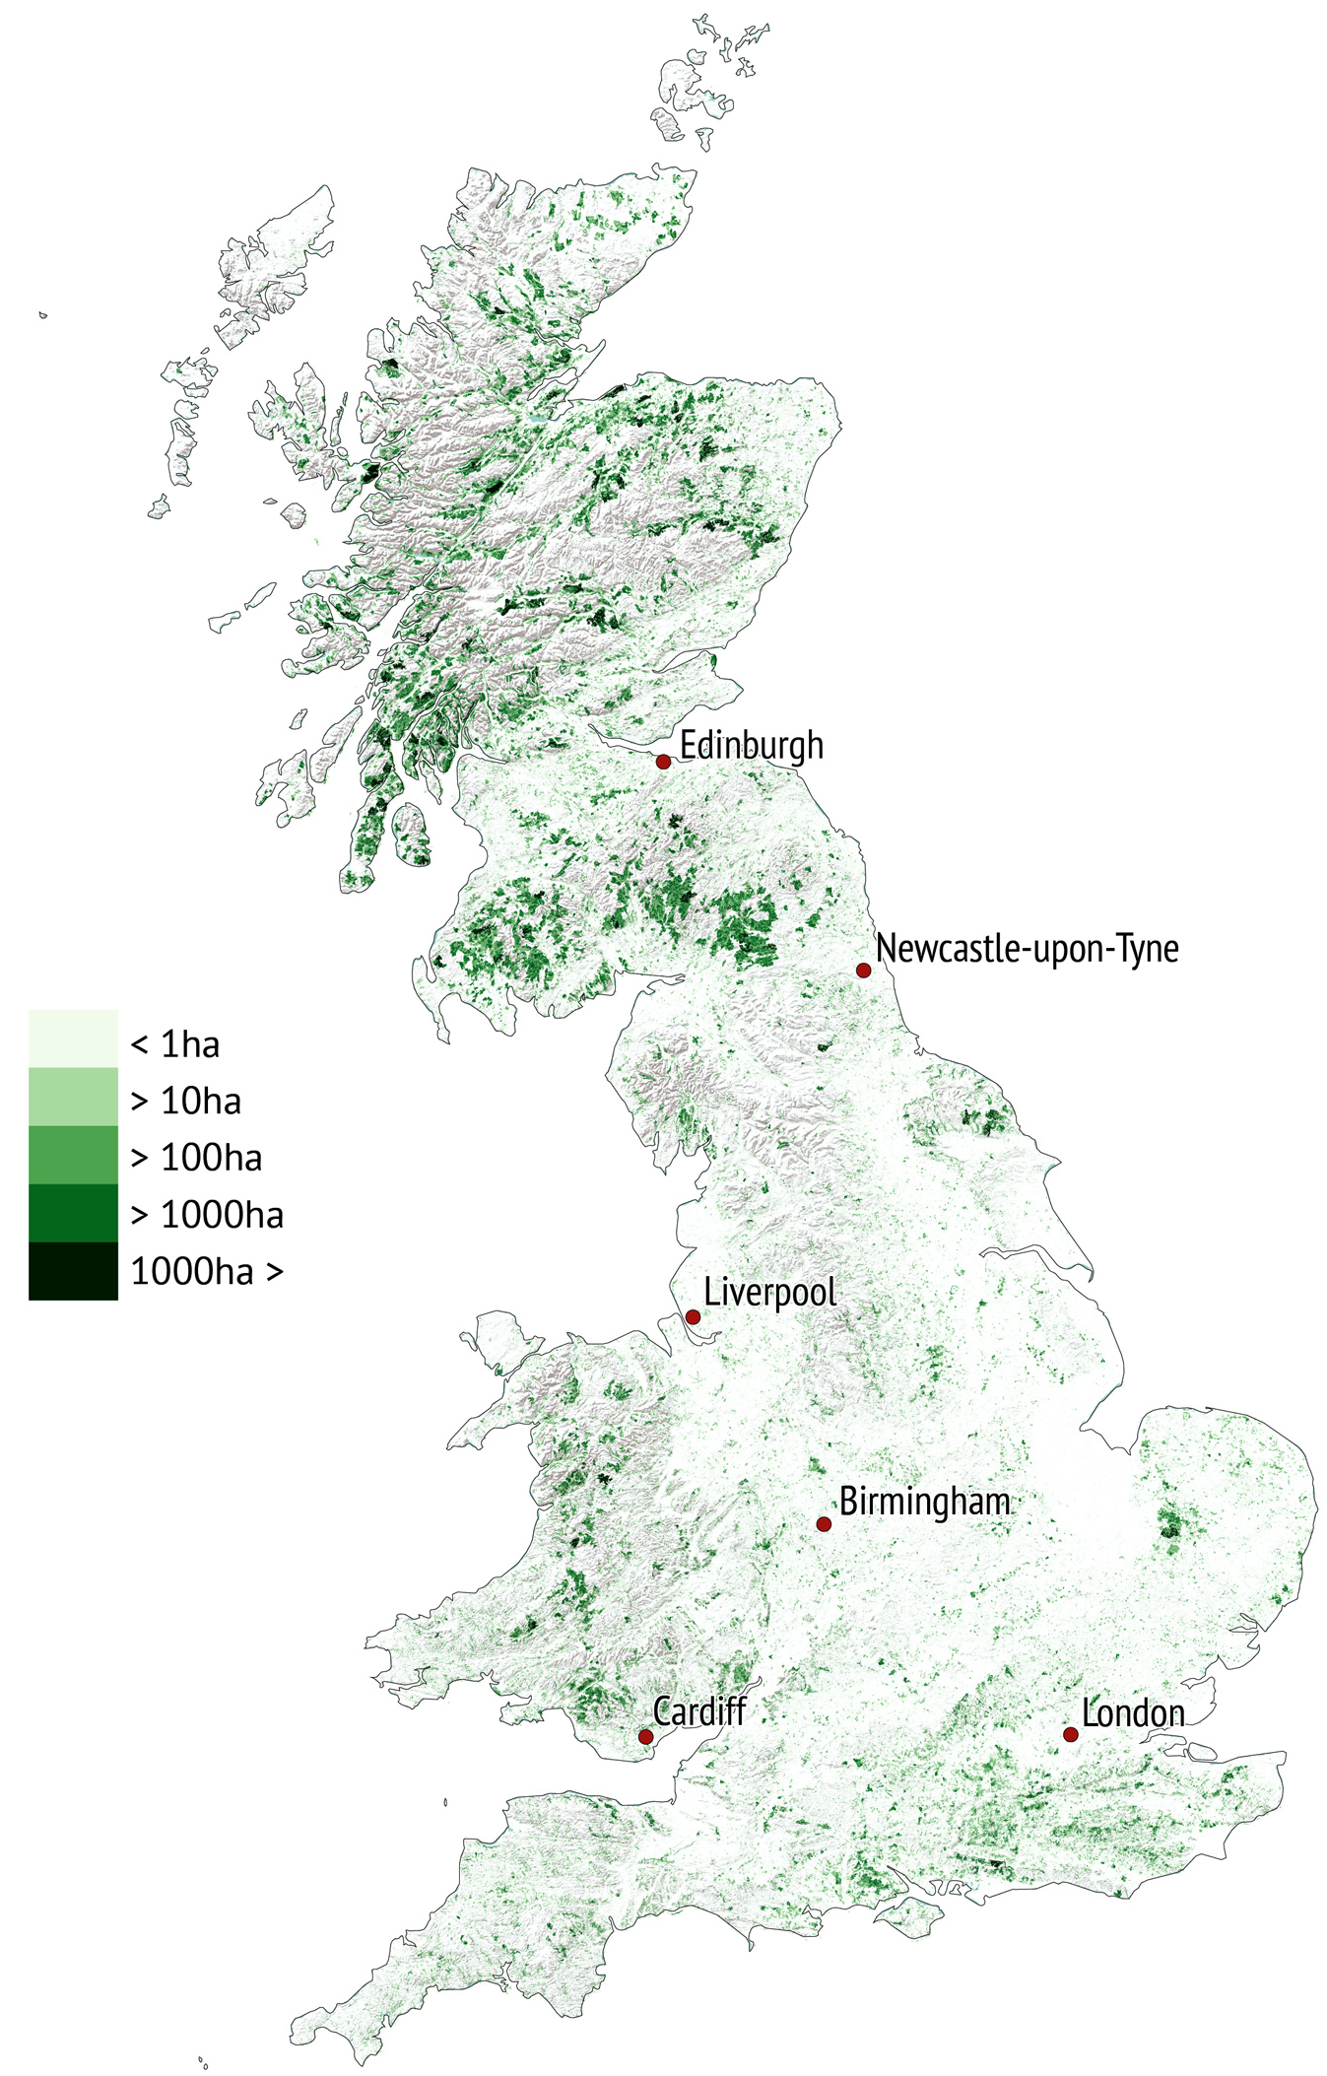
Estimations
Approximately 13% of the UK is classified as woodland.
If the area of the UK is approximately 240,000km², what is the approximate area of woodland?
Woodland cover in Great Britain in 2018
TIP: Can you use a multiplier?
Notes:
Map image: CIA, Public domain, via Wikimedia Commons
The TIP box can be edited to include a hint for the method teachers would like to highlight, or removed completely if needed.

Slide 10
Complete the table
 | Area (km²) | Area rounded to 2 significant figures | % of woodland | Approximate area of woodland
United Kingdom | 242,495 | 240,000 | 13% | 31,200
England | 130,279 |  | 10%
Wales | 20,779 |  | 15%
Scotland | 77,910 |  | 19%
Northern Ireland | 14,130 |  | 9%

Slide 11
Answers
 | Area (km²) | Area rounded to 2 significant figures (km²) | % of woodland | Area of woodland (km²)
United Kingdom | 242,495 | 240,000 | 13% | 31,200
England | 130,279 | 130,000 | 10% | 13,000
Wales | 20,779 | 21,000 | 15% | 3,150
Scotland | 77,910 | 78,000 | 19% | 14,820
Northern Ireland | 14,130 | 14,000 | 9% | 1,260
Notes:
Rectangles animate to reveal answers on click, rounded values first, then % calculations.

Slide 12
Estimations
The numbers we’ve calculated are hard to imagine – what does 31,200km² actually look like?
We can use something we CAN imagine to help us.
A common area that is used for comparisons is the AREA OF A FOOTBALL PITCH
How many pitches do you think 31,200km² would compare to?

Slide 13
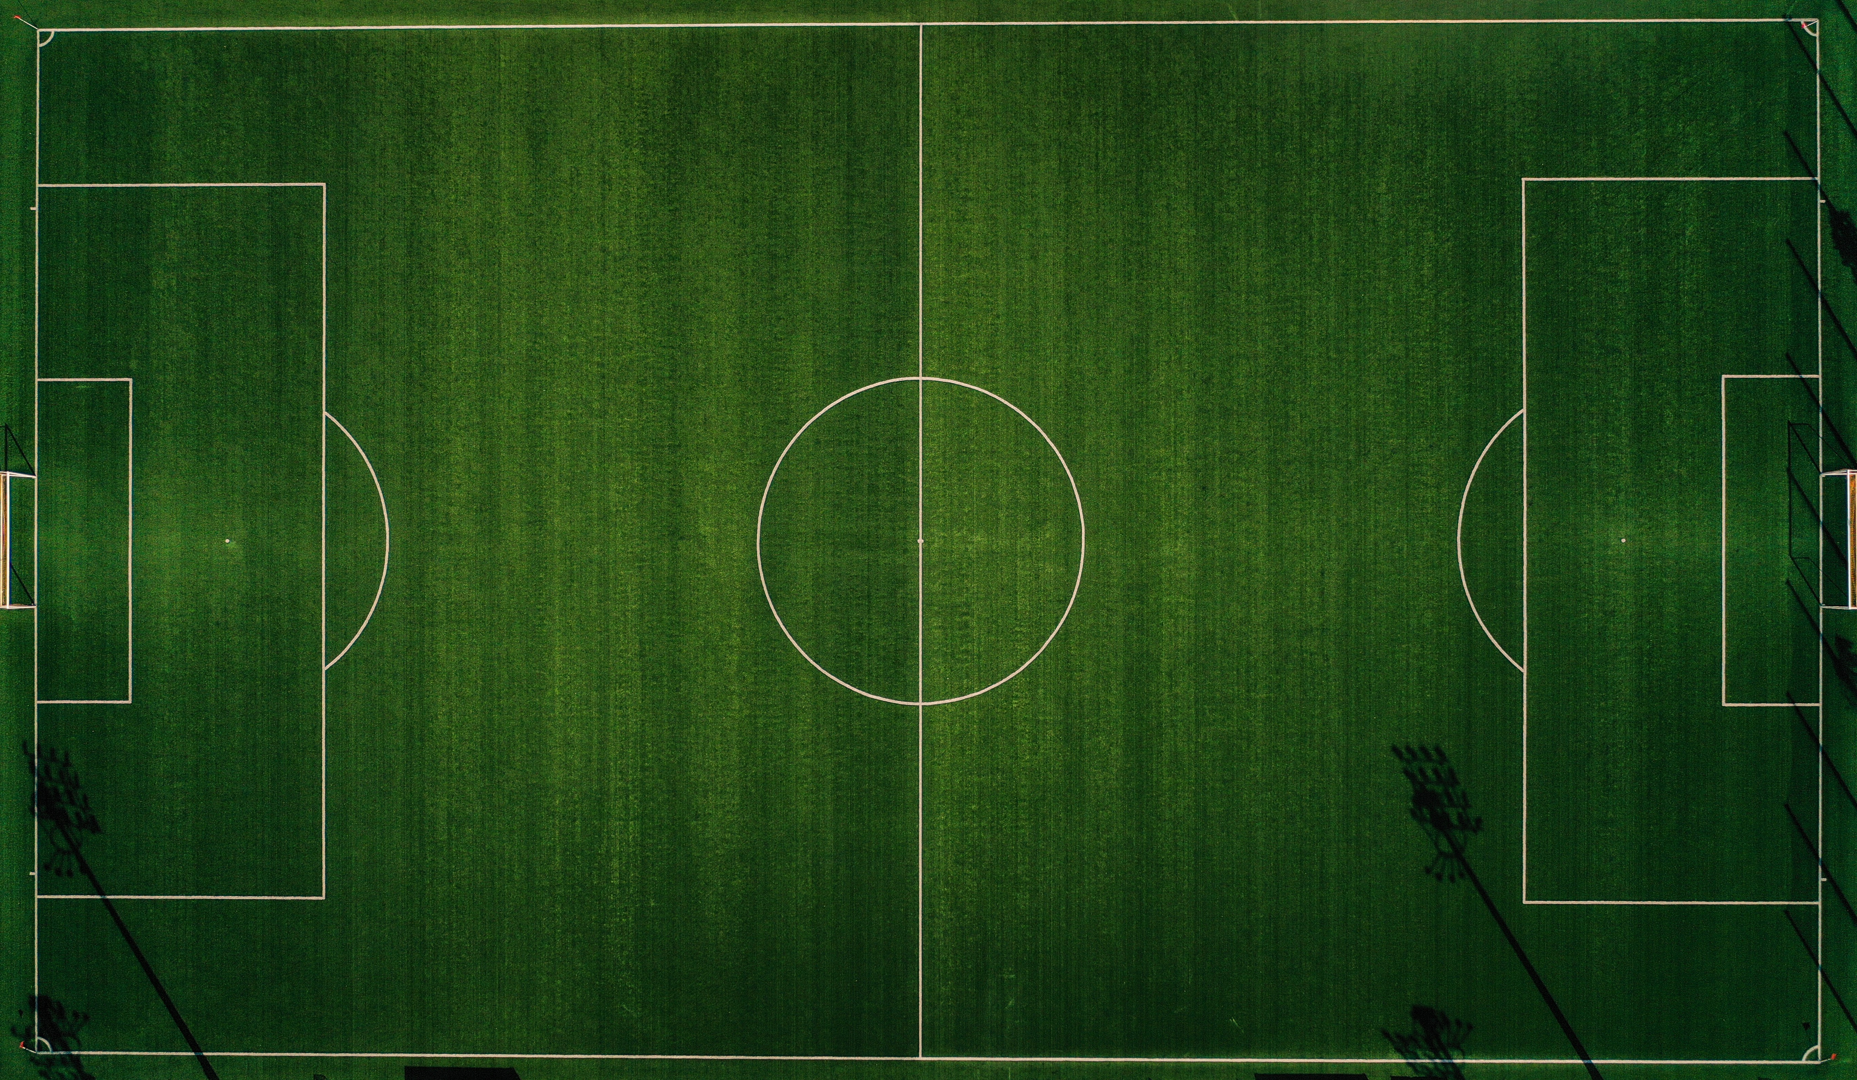
What is the area of a typical football pitch?
0.07 × 0.1 = 0.007km²
Why have we used kilometres instead of metres in this calculation?
0.07km
(70m)
0.1km (100m)
TIP: Area of a rectangle = length × width
Notes:
Photo by Timothy Tan on Unsplash
Possible extension here to upper/lower bounds if required.

Slide 14
Woodland in the UK covers approximately 31,200km²
A football pitch covers 0.007km²
How can you calculate the number of pitches that would fit into 31,200km²?
Woodland cover in Great Britain in 2018

Slide 15
Complete the table
 | Area of woodland (km²) | Approximate number of football pitches
United Kingdom | 31,200 | 4,500,000
England | 13,000
Wales | 3,150
Scotland | 14,820
Northern Ireland | 1,260
Notes:
Rectangles animate to reveal answers on click, rounded values first, then % calculations.

Slide 16
Answers
 | Area of woodland (km²) | Approximate number of football pitches
United Kingdom | 31,200 | 4,500,000
England | 13,000 | 1,900,000
Wales | 3,150 | 450,000
Scotland | 14,820 | 2,100,000
Northern Ireland | 1,260 | 180,000
What do you notice about the total of these values?
Why has that happened?
Notes:
Rectangles animate to reveal answers on click
Probing question – why do the students think the values don’t total 4,500,000?

Slide 17
How does 50 million trees compare with the number of trees in 30 football pitches of forest?
Estimate the number of trees you could fit in 30 football pitches
Notes:
Note that, 50 million trees is how many the Woodland Trust are proposing to plant by 2025. According to the initial video, 30 football pitches is how much tropical forest is being cut down every minute.
This website may give students a starting point for their estimate: https://www.espn.co.uk/football/austria/story/3936111/soccer-stadium-pitch-becomes-300-tree-forest

Slide 18
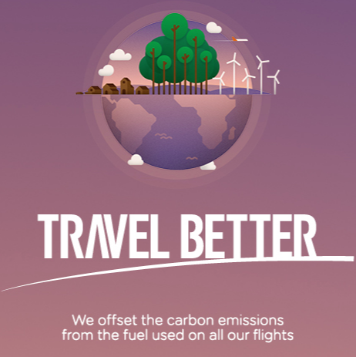
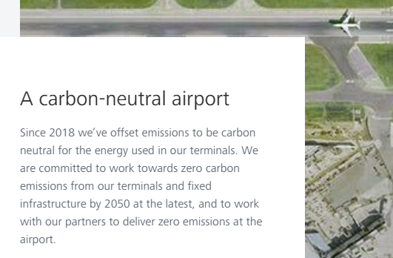
Carbon offsetting
Some airlines offer to offset the carbon emissions of their flights.
Let’s investigate how many trees need to be planted to offset a flight from London to New York.
Notes:
In order to consider this question we need to investigate how trees absorb CO₂ from the atmosphere and how this changes over the lifespan of a tree.
If appropriate for the class (you may want to avoid making students who have flown feel bad), it may be worth raising a social justice issue: Is it okay for people to continue to fly regularly if they can afford to pay for their carbon emissions to be offset?

Slide 19
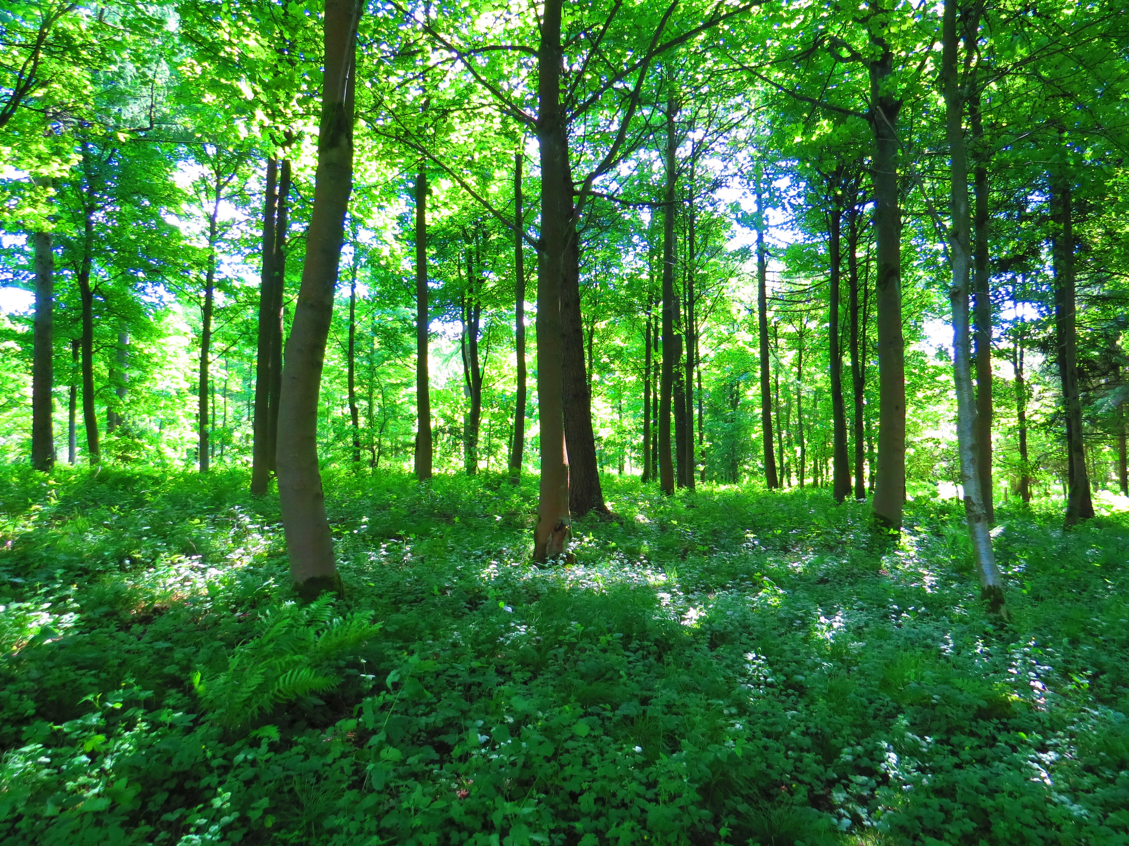
Carbon Capture and Storage
Through photosynthesis, trees convert carbon dioxide and water into sugar and oxygen using energy from light.
The sugar produced contains carbon and is used by the tree to grow.
Any sugar that isn’t needed right away is stored in the tree’s trunk and roots as starch.
A tree is only increasing the carbon it stores if it is growing.
Notes:
Photo by trevor pye on Unsplash

Slide 20
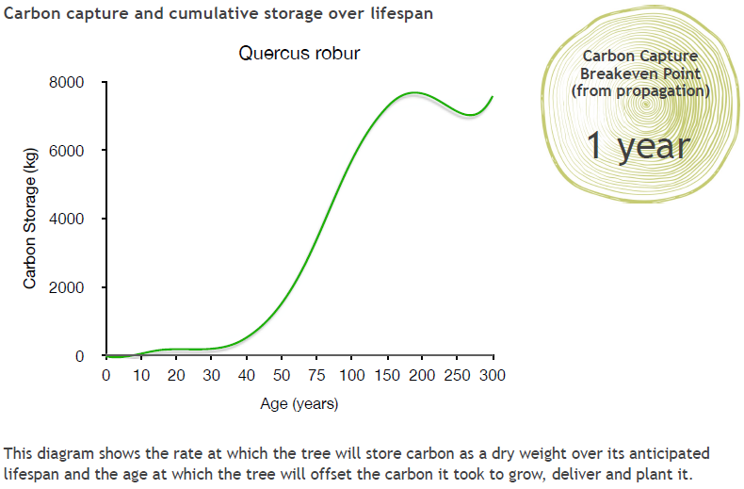
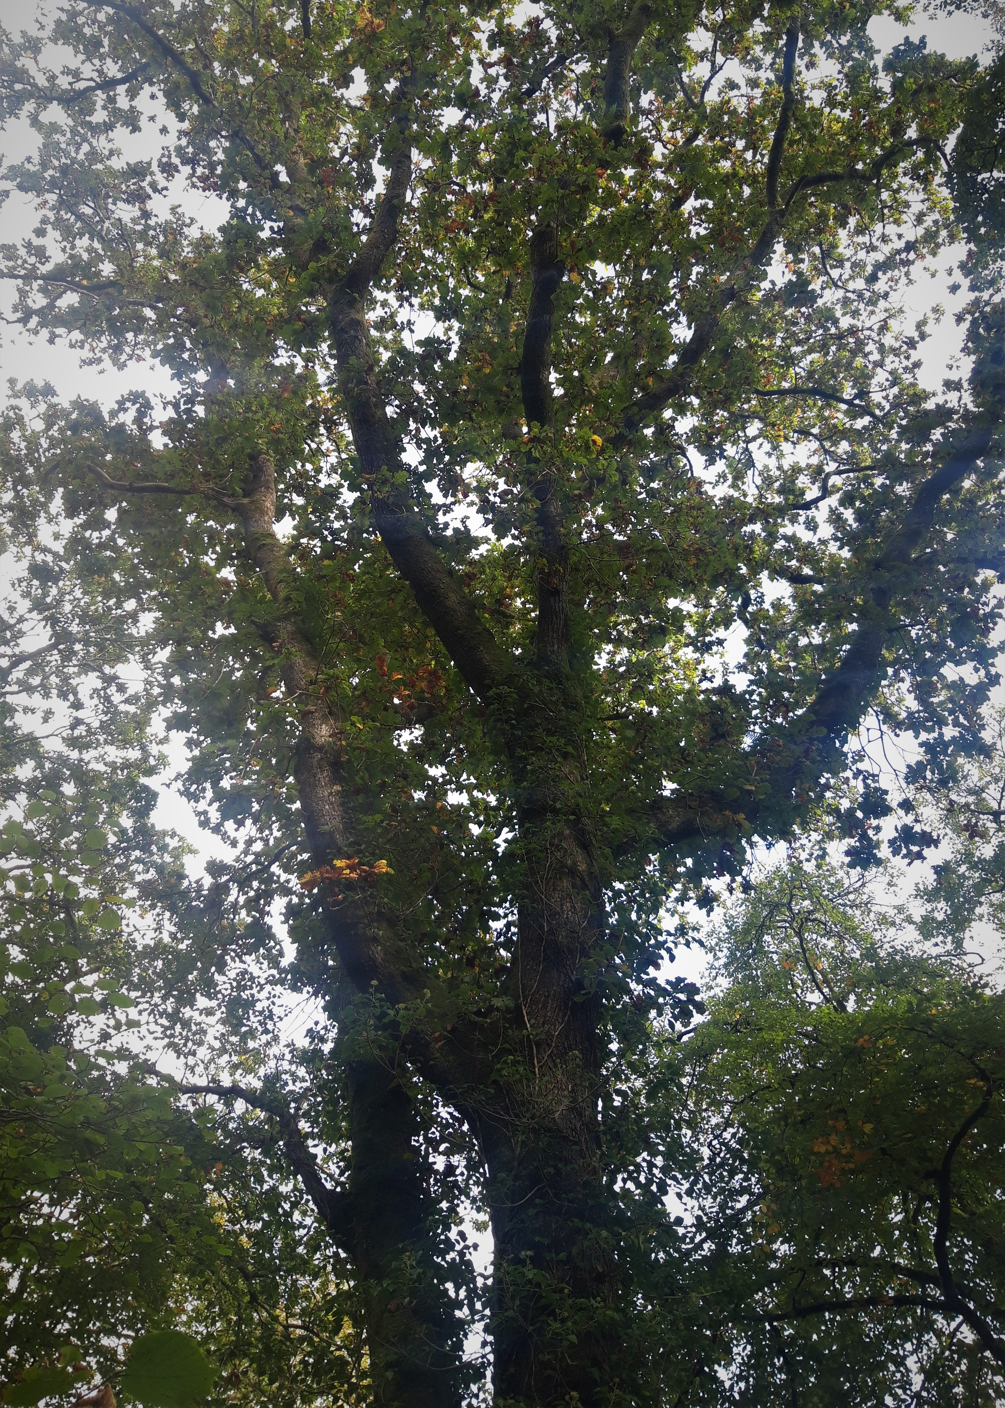
English Oak
Oak
Notes:
Slides 20-23 show how three species of tree store carbon over their lifespan. We will use this information to help us decide how many trees are needed to offset a flight from London to New York, and whether it matters what kind of tree you plant.
What do you notice about the scale on these graphs?
Information about how this data was collected is available here: https://www.treeconomics.co.uk/projects/barchamcarbonperformanceproject/ and here: https://www.barcham.co.uk/store/. Each tree in the Barcham shop has a certificate. The negative carbon storage in the first few years of each graph are explained by taking into account the carbon emissions in driving to collect the tree before planting it.

Slide 21
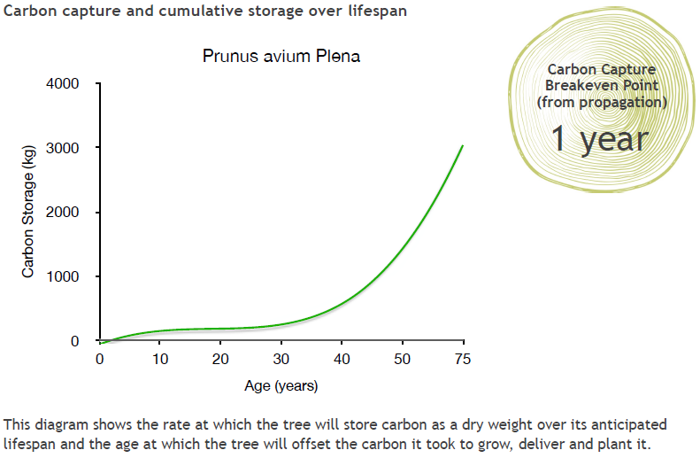
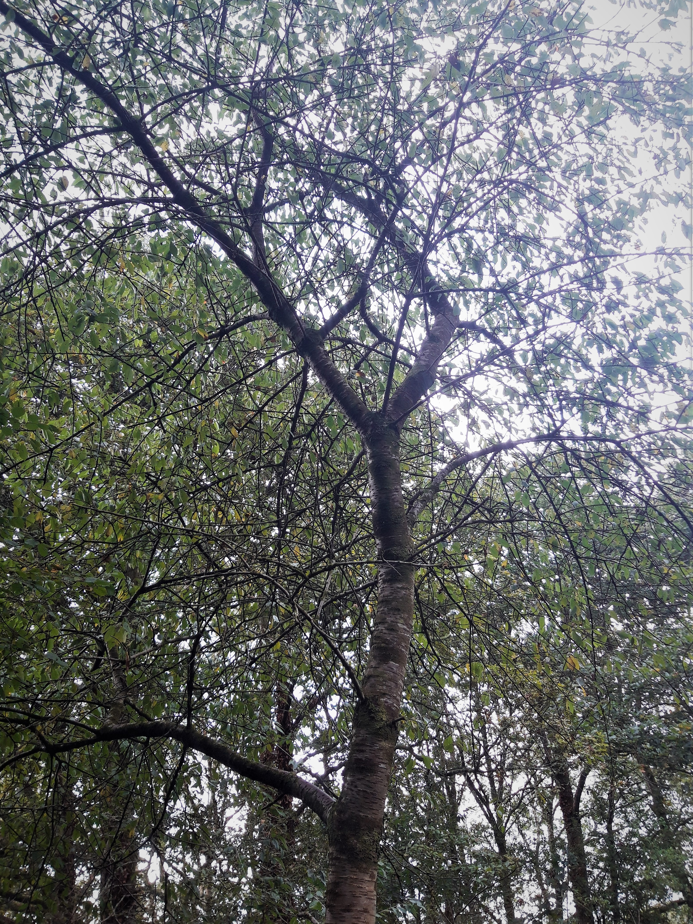
Wild Cherry
Cherry

Slide 22
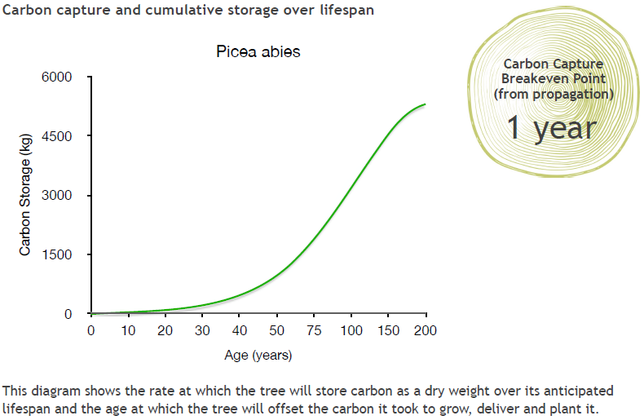
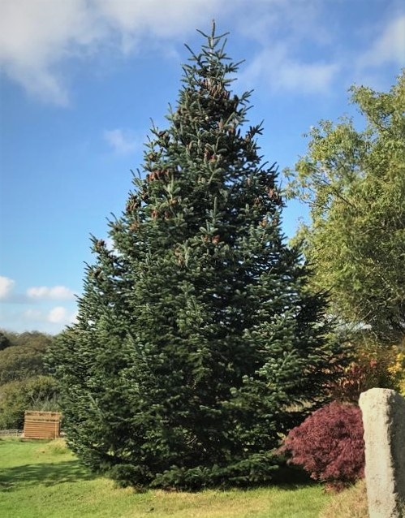
Norway Spruce
Spruce
Notes:
The Norway Spruce is a common variety of Christmas Tree.

Slide 23
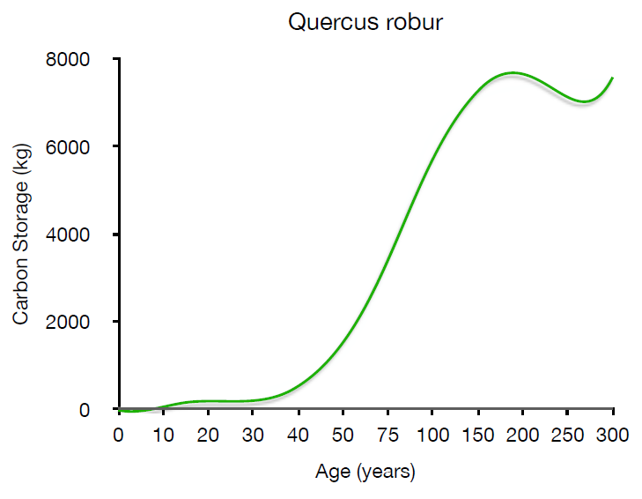
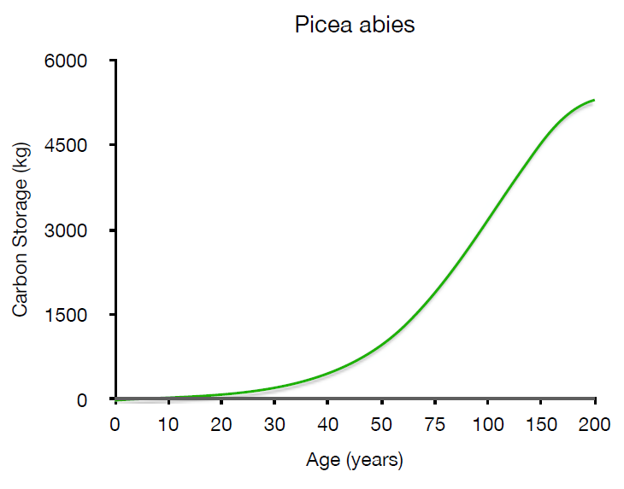
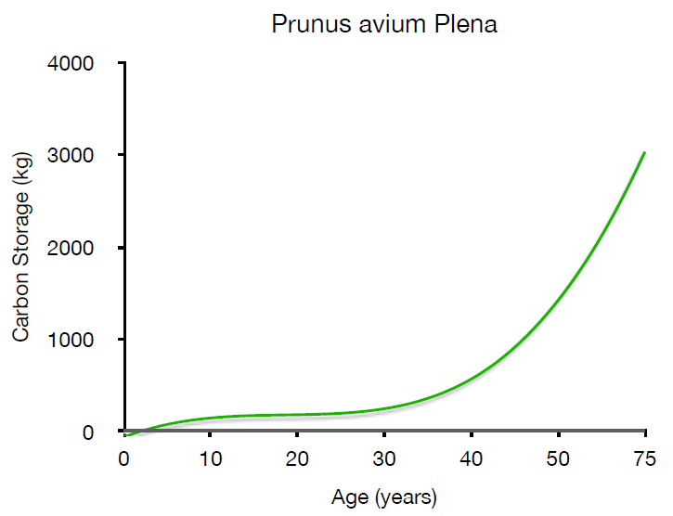
How do they compare?
Oak
Spruce
Cherry
Notes:
It is difficult to compare these graphs in this form – can your students say why? What do they notice about these graphs?
One problem is that the axes are different for each graph. Not only that, but the scales for AGE are not linear – the intervals on the x axes vary. Invite students to explain what they would need to do in order to compare these graphs effectively.

Slide 24
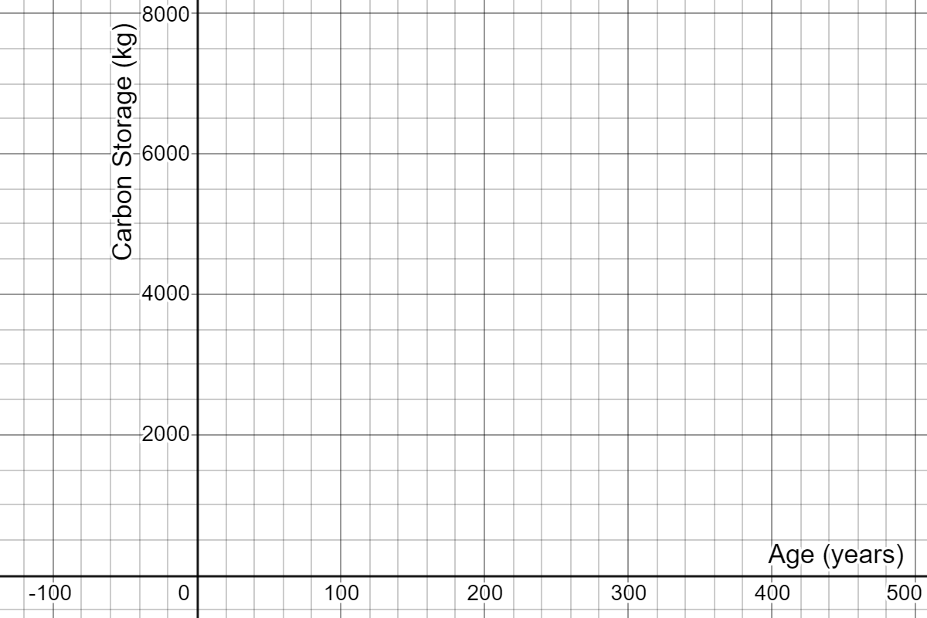
How do they compare?
Use the data from the graphs to redraw them on one set of axes so that we can compare them.
Oak
Cherry
Spruce
Notes:
Students to be handed the data sheets in groups. After 15 minutes they need to present their argument for which trees they would choose to plant and why.
Here are the three sets of data plotted on the same set of axes, in Desmos: https://www.desmos.com/calculator/rci87lp05w

Slide 25
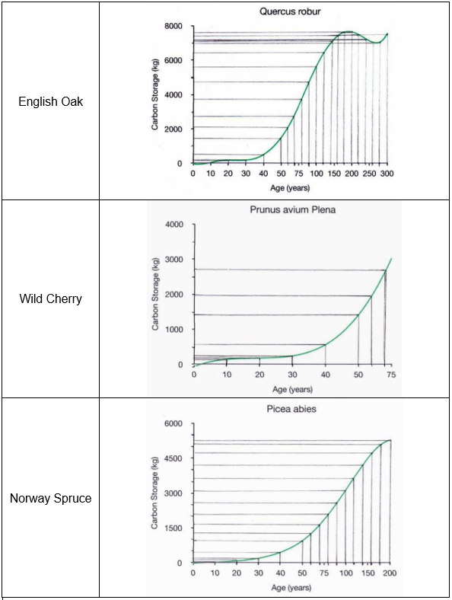
Data from the graphs
Age of tree |  | Carbon stored, in kg, by:
 |  | English Oak | Wild Cherry | Norway Spruce
0 |  | 0 | -100 | -50
10 |  | 0 | 200 | 50
20 |  | 200 | 250 | 150
30 |  | 250 | 300 | 250
40 |  | 550 | 600 | 450
50 |  | 1400 | 1400 | 950
60 |  | 2100 | 2000 | 1300
70 |  | 2750 | 2700 | 1700
80 |  | 3750 |  | 2100
90 |  | 4700 |  | 2600
100 |  | 5600 |  | 3150
120 |  | 6400 |  | 3650
140 |  | 7150 |  | 4200
160 |  | 7450 |  | 4750
180 |  | 7600 |  | 5150
200 |  | 7600 |  | 5300
220 |  | 7450
240 |  | 7250
260 |  | 6950
280 |  | 7000
300 |  | 7500
Oak
Cherry
Spruce
Notes:
Students to be handed the data sheets in groups. After 15 minutes they need to present their argument for which trees they would choose to plant and why.
Here are the three sets of data plotted on the same set of axes, in Desmos: https://www.desmos.com/calculator/rci87lp05w

Slide 26
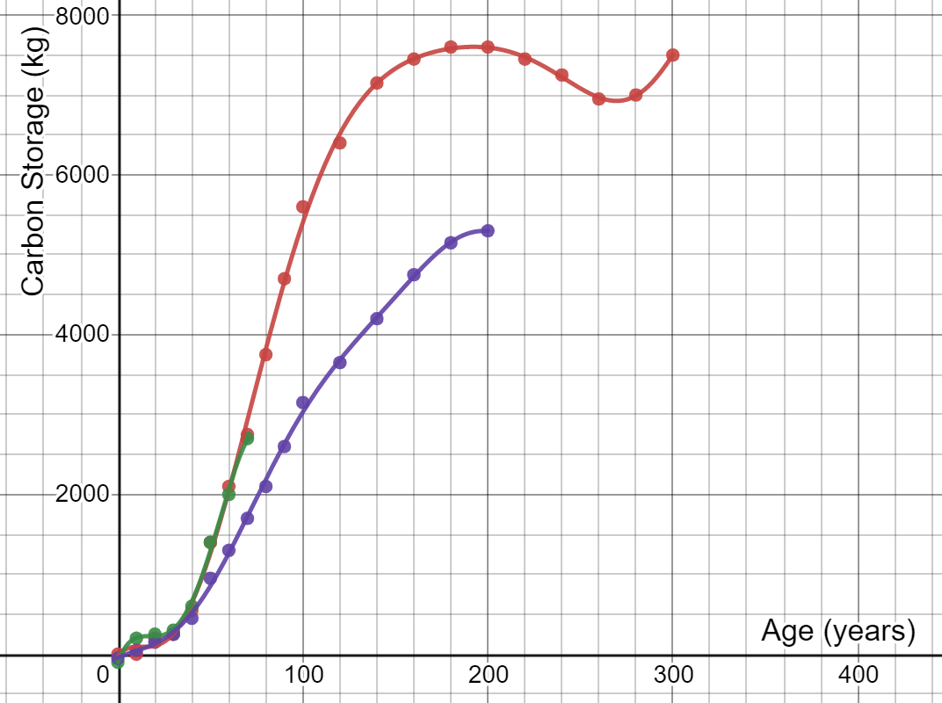
How do they compare?
Oak
Cherry
Spruce
Notes:
Students to be handed the data sheets in groups. After 15 minutes they need to present their argument for which trees they would choose to plant and why.
Here are the three sets of data plotted on the same set of axes, in Desmos: https://www.desmos.com/calculator/rci87lp05w

Slide 27
How do they compare?
Oak
Cherry
Spruce
Which trees would you plant?
Notes:
Students to be handed the data sheets in groups. After 15 minutes they need to present their argument for which trees they would choose to plant and why.
Here are the three sets of data plotted on the same set of axes, in Desmos: https://www.desmos.com/calculator/rci87lp05w

Slide 28
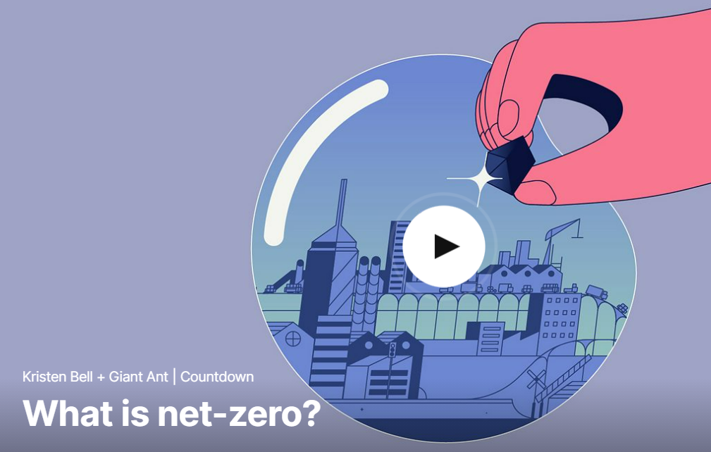
Trees for ‘Net Zero’
Watch this short video that explains what ‘Net Zero’ means:
Notes:
https://www.ted.com/talks/kristen_bell_giant_ant_what_is_net_zero#t-40608
‘Net Zero’ is introduced here in order to allow us to consider the contribution planting trees might make towards achieving Net Zero.

Slide 29
What happens to trees and their carbon after they die?
Trees are burned
Trees rot naturally
Trees are cut down and used, for example, for timber, or to make cardboard
What is the effect of these different possibilities on the carbon captured and stored from the atmosphere?
Notes:
Collect students’ initial and intuitive responses to the title question first.
The Trees for Life website (https://treesforlife.org.uk/into-the-forest/habitats-and-ecology/ecology/) has much information about decomposition and decay of trees, as well as information about the importance of dead wood. It suggests that it might take around 40 years for a dead tree to completely decompose, whereas the leaves a tree drops will decompose completely within a year.
This article from Science Direct: https://www.sciencedirect.com/science/article/pii/S1364032116306050 has much information about trees being used to produce timber for construction.
Trees being burned quickly released carbon back into the atmosphere. Trees rotting slowly releases some of the carbon into the atmosphere, but some would be absorbed into the ground. Using trees for for building effectively ‘locks’ the carbon out of the atmosphere, provided the product built remains intact.

Slide 30
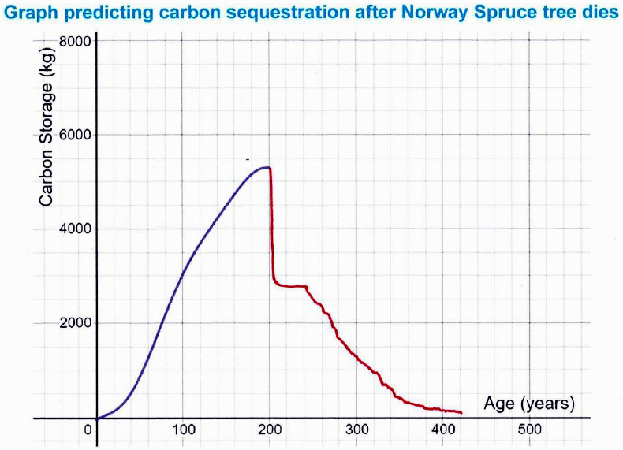
What happened to the carbon captured and stored by this tree?
Notes:
Ask your students to explain the key parts of this graph. What do they think the tree was used for after it died?

Slide 31
What happened to the carbon captured and stored by this tree?
Approximately 50% of a tree can be turned into usable timber. The rest might be used as biofuel and burned, releasing CO₂ back into the atmosphere.
The usable timber might be made into furniture, which stores carbon.
Over time, furniture deteriorates and is thrown away or burned.
Notes:
It is worth noting here that even a tree that is used for production purposes is likely to only store carbon for a limited period. Over time, the products deteriorate and so the wood is burned or rots, returning the CO₂ to the atmosphere. It’s worth considering whether this can be avoided. Some tree litter from dead trees may get covered and preserved, or continue to store carbon as soil.

Slide 32
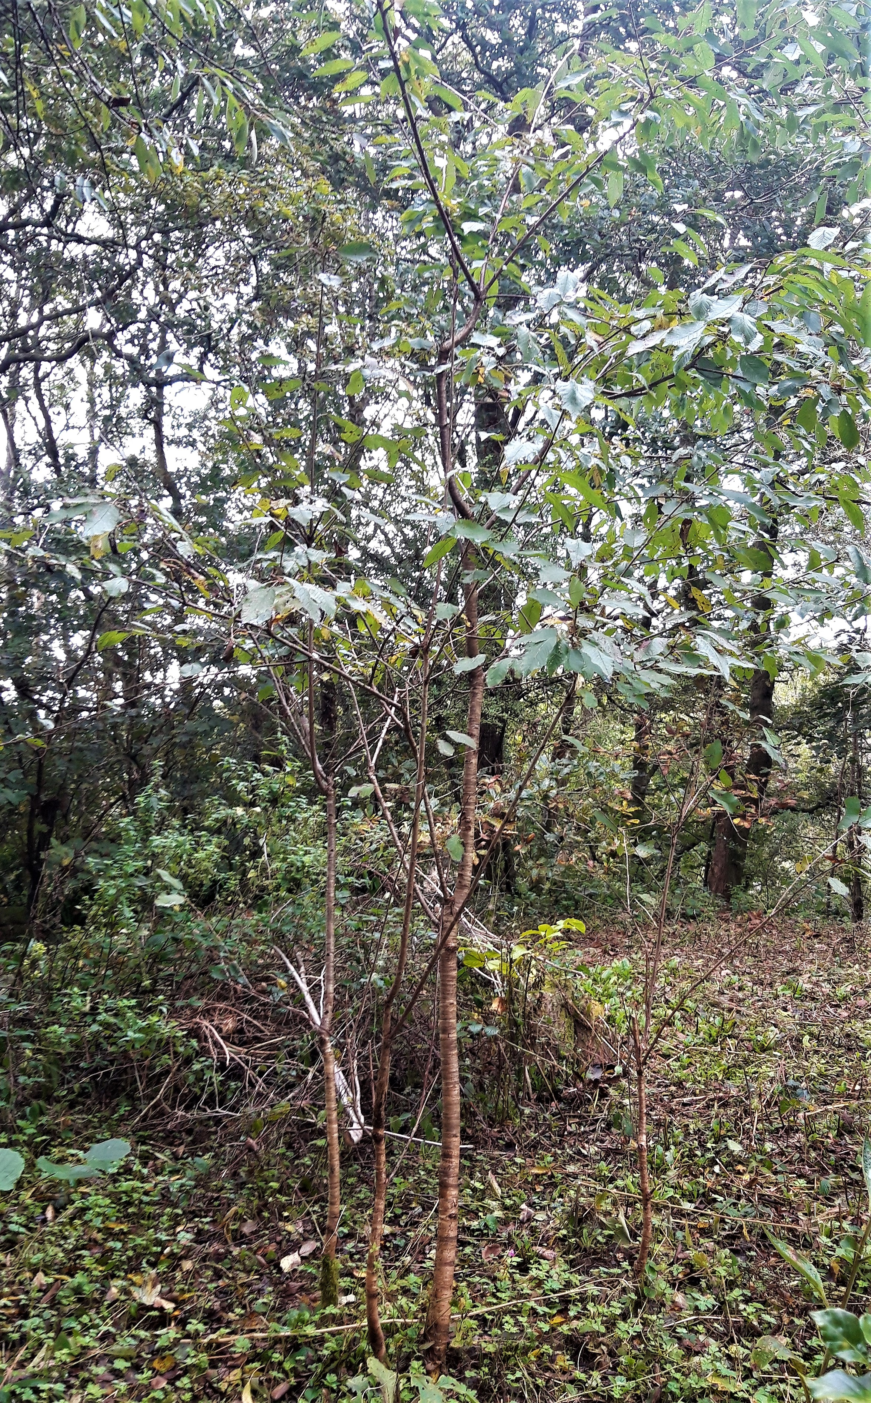
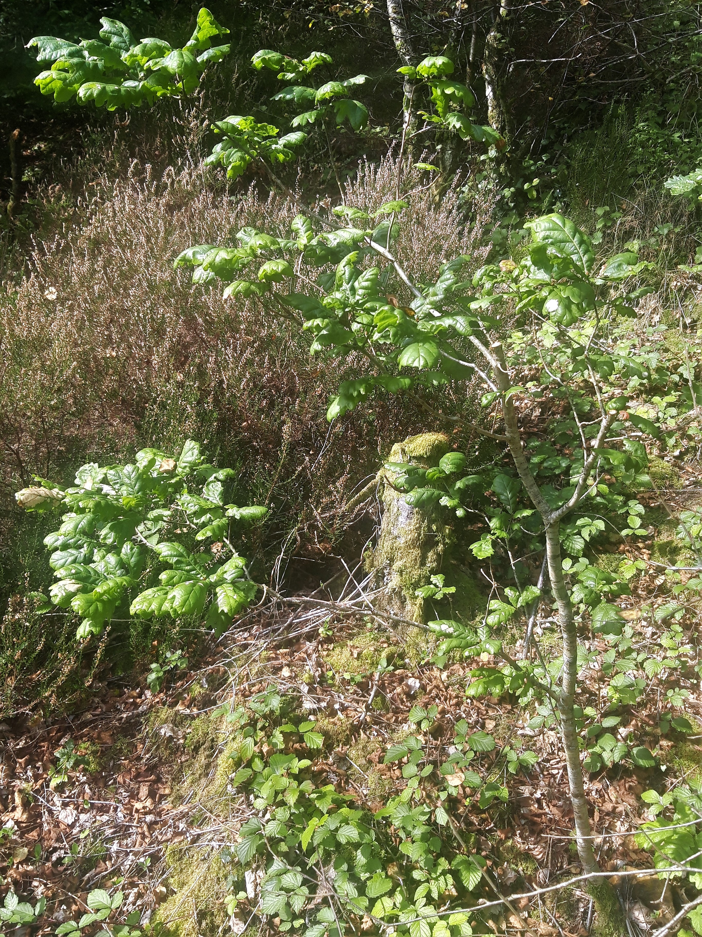
Trees for ‘Net Zero’
The majority of carbon captured and stored by trees eventually returns to the atmosphere as CO₂
Cherry
Saplings
To what extent can planting trees offset the carbon emissions for a flight from London to New York?
Oak Sapling
Notes:
The conclusion that should be reached is that, to offset one flight, you need to keep replacing the tree that you planted. It may be worth also considering the implications for land use if planting trees is going to be used to offset ongoing carbon emissions.

Slide 33
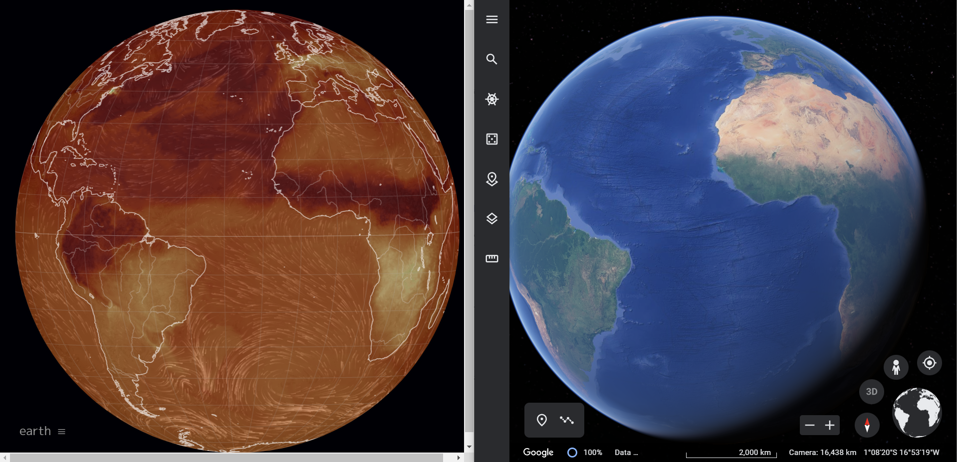
Trees for ‘Net Zero’
CO₂ concentration
What do you notice?
What do you wonder?
Notes:
Students may want to explore the links between CO₂ concentration on Earth and the location of rainforests by playing with the following websites:
https://earth.nullschool.net/
https://earth.google.com/web/

