Slide 1
Trees for Net Zero
Scotland’s Curriculum National 5 Applications of Mathematics

Slide 2
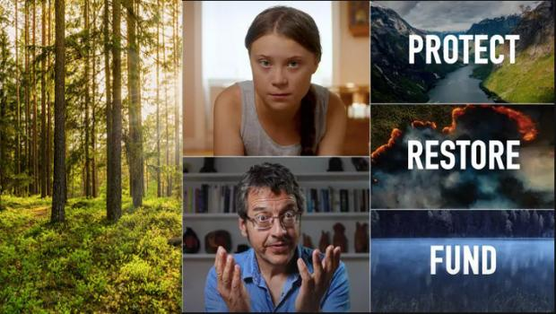
Trees for ‘Net Zero’
Watch this video:
What do you notice?
What do you wonder?
Notes:
Watch the video twice:
On first viewing, ask students how it makes them feel. Do students agree or disagree with the statement: “What you do counts”?
On second viewing, ask students to make a note of any facts or statistics they find interesting or surprising.
Tropical forests are being cut down at a rate of 30 football pitches per minute – what does this mean? How many trees is this? How significant is the carbon stored by a tree? What does this mean for CO₂ in the atmosphere? How does this compare to the numbers of trees being planted around the World? We will explore these questions in this session.

Slide 3
Tree planting pledges
The Woodland Trust plan to plant 50 million trees by 2025.
The National Trust plan to plant 20 million trees by 2030.
Notes:
Positive ways forward and potential ways for students to contribute.
It might be worth exploring with students how 50 million trees compares with 30 football pitches of forest. This is explicitly mentioned on slide 10.

Slide 4
Put these things in order of CO₂ released, from highest to lowest
Driving 1000 miles in a petrol car
Average UK household in 1 year
A flight from London to New York, per passenger
Notes:
Answers: UK Household 17.1 tonnes, Flight London to New York (per passenger) 0.6 tonnes Driving 1000 miles 0.22 tonnes.
It would be worth discussing whether students are surprised by any of these and how they compare.
One implication of this is that what we do as individuals, and within our households, can have a big impact on our environment.

Slide 5
Put these things in order of CO₂ released, from highest to lowest
Average UK household in 1 year
A flight from London to New York, per passenger
Driving 1000 miles in a petrol car
Notes:
Answers: UK Household 17.1 tonnes, Flight London to New York (per passenger) 0.6 tonnes Driving 1000 miles 0.22 tonnes.
It would be worth discussing whether students are surprised by any of these and how they compare.
One implication of this is that what we do as individuals, and within our households, can have a big impact on our environment.

Slide 6
Which numbers go where?
0.6
17.1
0.22
0.6
7.5
Description | Tonnes
Amount of CO₂ released by average UK household in 1 year
Amount of CO₂ released by driving 1000 miles in a petrol car
Amount of CO₂ stored by an oak tree in its lifetime
Amount of CO₂ released by a flight from London to New York, per passenger
Amount of methane released by 1 cow in its lifetime
Notes:
It would be worth discussing whether students are surprised by any of these and how they compare.
This session is on trees, so this allows students to compare the CO₂ stored by a tree with some other more meaningful and imaginable scenarios. One implication is that trees can potentially have a significant impact on the CO₂ in our atmosphere, but we will find out more about this throughout this lesson.
This potentially sets up a question later in the session about whether it’s okay to fly if the CO₂ is offset by planting trees.
Answers: UK Household 17.1 tonnes, Driving 1000 miles 0.22 tonnes, Oak tree 7.5 tonnes, Flight London to New York (per passenger) 0.6 tonnes, 1 cow 0.6 tonnes.

Slide 7
Which numbers go where?
0.6
17.1
0.22
0.6
7.5
Description | Tonnes
Amount of CO₂ released by average UK household in 1 year | 17.1
Amount of CO₂ released by driving 1000 miles in a petrol car | 0.22
Amount of CO₂ stored by an oak tree in its lifetime | 7.5
Amount of CO₂ released by a flight from London to New York, per passenger | 0.6
Amount of methane released by 1 cow in its lifetime | 0.6
Notes:
Answers: UK Household 17.1 tonnes, Driving 1000 miles 0.22 tonnes, Oak tree 7.5 tonnes, Flight London to New York (per passenger) 0.6 tonnes, 1 cow 0.6 tonnes.

Slide 8
Estimate
Estimate how many trees there are in your nearest town
What assumptions did you make in your estimation?
Notes:
Some things to consider or try: Bring up Google Maps or Google Street View. Consider how many trees might be within 100 metres of the classroom. Can this be scaled up? What’s the area of the town? It might be that it helps to look this up. Are there any parts of the town which have lots of trees? How densely are they planted?

Slide 9
Estimate – possible response 1
According to https://www.bbc.co.uk/news/science-environment-41551296 13% of UK is covered by trees
Nearest city Sheffield is about 400 square km (google)
10% of this is 40 square km, or 40,000,000 square m
Assume 1 tree = 10 square m
So about 4 million trees (40,000,000 / 10 )
As a check I looked at https://ourworldindata.org/grapher/number-of-trees-per-km
Which gives UK as 12,264 trees per square km
12,264 x 400 = 4,905,600 or about 5 million

Slide 10
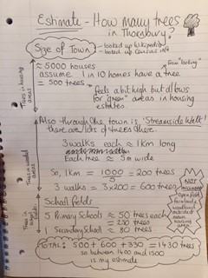
Estimate – possible response 2

Slide 11
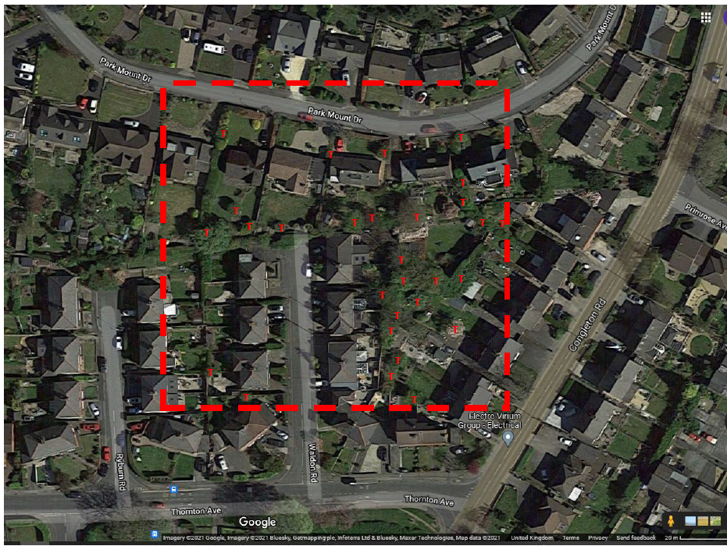
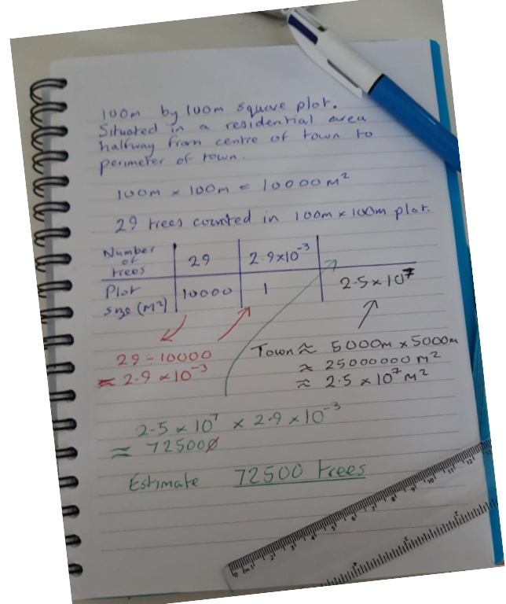
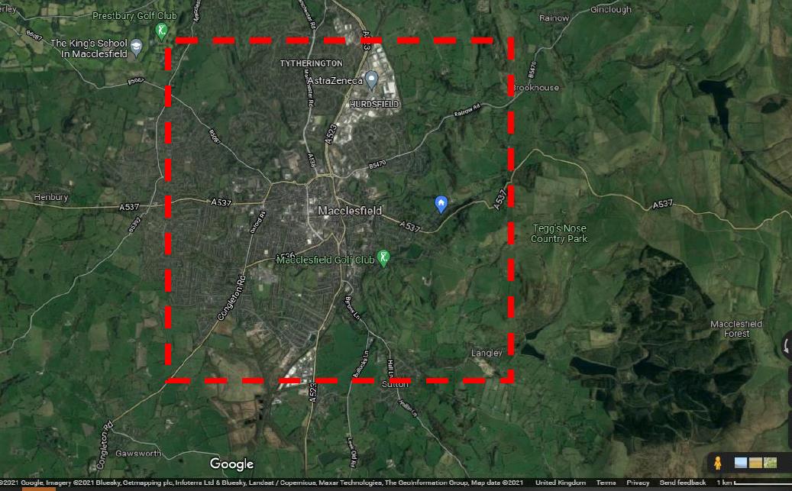
Estimate – possible response 3

Slide 12
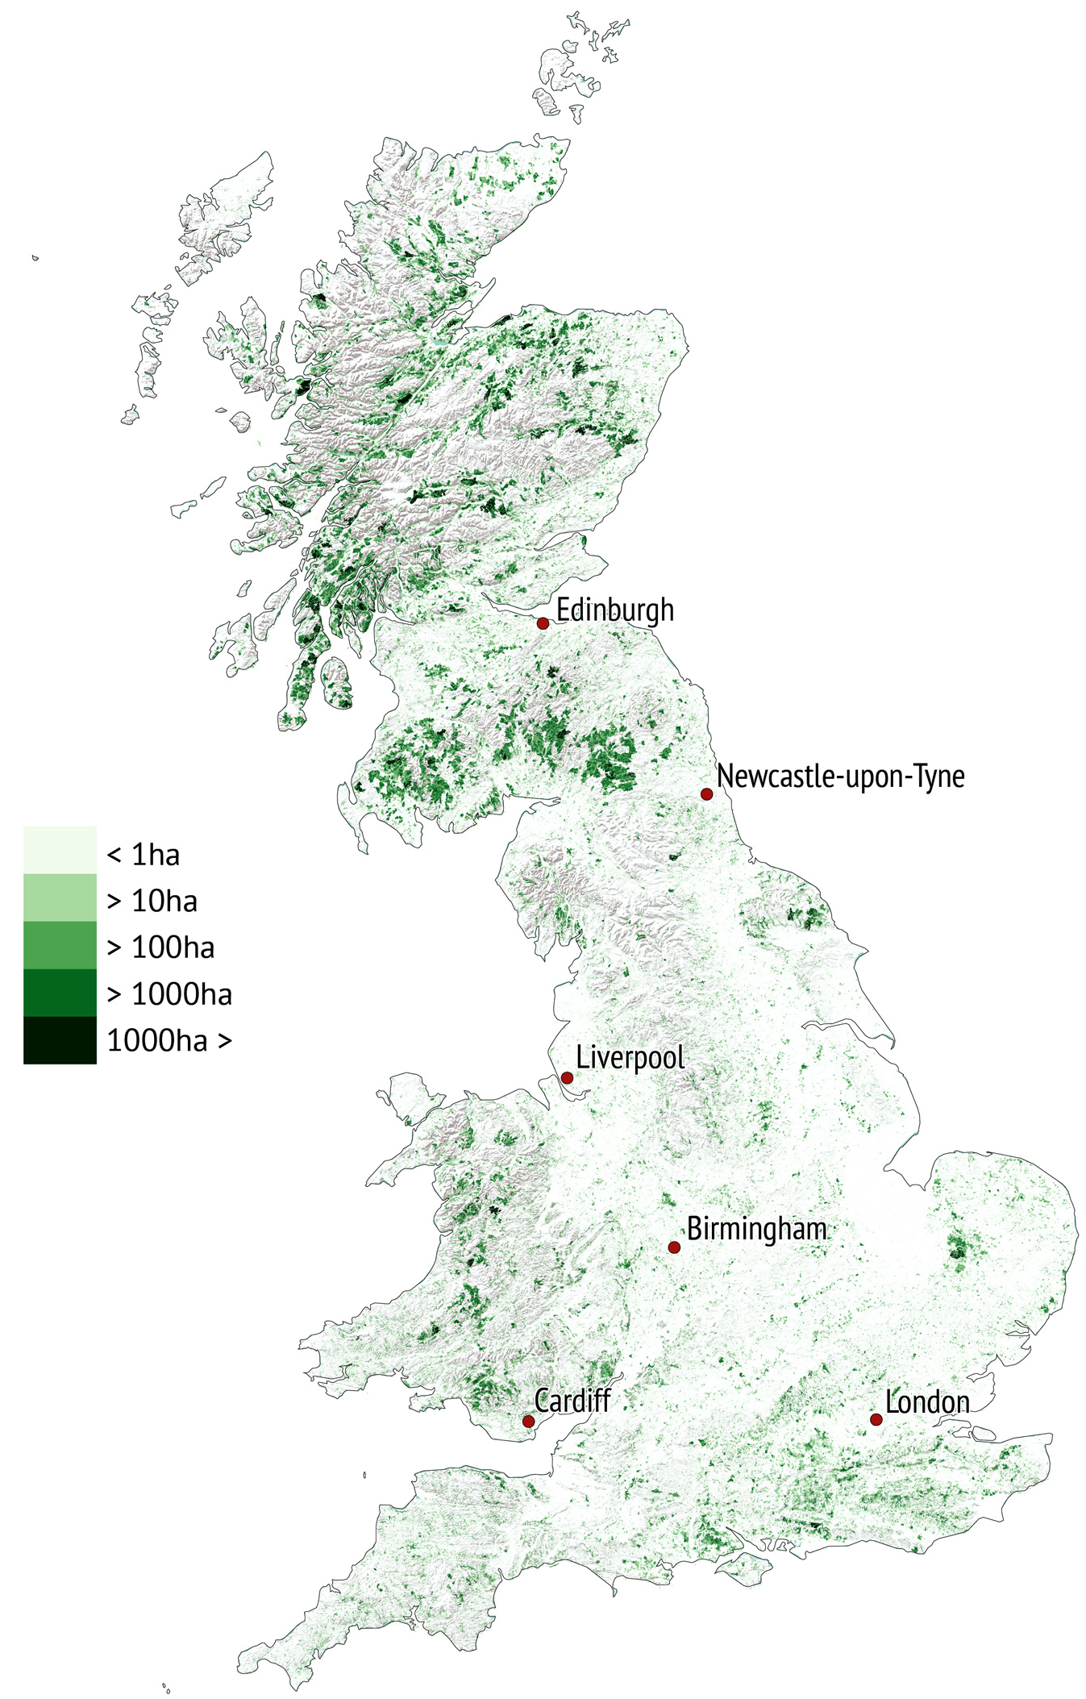
Estimate
The area of the UK is 242,495km².
Estimate how many trees there are in the UK.
Woodland cover in Great Britain in 2018
What affect do all of these trees have on the levels of CO₂ in the atmosphere?
Notes:
Students often make mistakes when converting between km² and m². Given that 1km = 1000m, 1km² = 1000000m².
This diagram offers an indication of the density of trees in different regions of the UK, but it is far from obvious how it works. Students could discuss its limitations.
Students are unlikely to have a sense of the affect these trees might have on levels of CO₂ at this stage in the lesson, but it may be worth collecting some intuitive (and possibly naïve) responses at this stage, in order to revisit them later in the lesson.
Image info: Woodland cover in Great Britain in 2018. The definition of woodland used here is a minimum area of 0.5 hectares under stands of trees with, or with the potential to achieve, tree crown cover of more than 20% of the ground. Source: National Forest Inventory. Graphic by Carbon Brief. Available from: https://www.carbonbrief.org/in-depth-qa-how-will-tree-planting-help-the-uk-meet-its-climate-goals

Slide 13
Estimate
How does 50 million trees compare with the number of trees in 30 football pitches of forest?
Estimate the number of trees you could fit in 30 football pitches
Estimate the land required to plant 50 million trees.
Notes:
Note that, 50 million trees is how many the Woodland Trust are proposing to plant by 2025. According to the initial video, 30 football pitches is how much tropical forest is being cut down every minute.
This website may give students a starting point for their estimate: https://www.espn.co.uk/football/austria/story/3936111/soccer-stadium-pitch-becomes-300-tree-forest

Slide 14
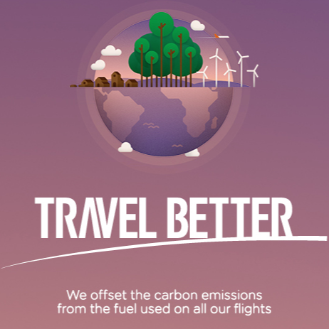
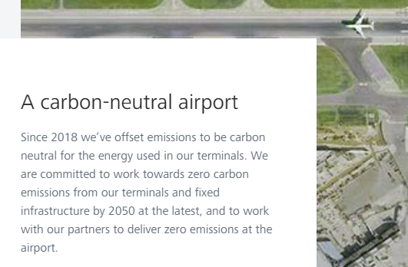
Carbon offsetting
Some airlines offer to offset the carbon emissions of their flights.
How many trees need to be planted to offset a flight from London to New York?
Notes:
In order to consider this question we need to investigate how trees absorb CO₂ from the atmosphere and how this changes over the lifespan of a tree.
If appropriate for the class (you may want to avoid making students who have flown feel bad), it may be worth raising a social justice issue: Is it okay for people to continue to fly regularly if they can afford to pay for their carbon emissions to be offset? Or, in other words, should people with more money be able to buy themselves a bigger carbon footprint?

Slide 15
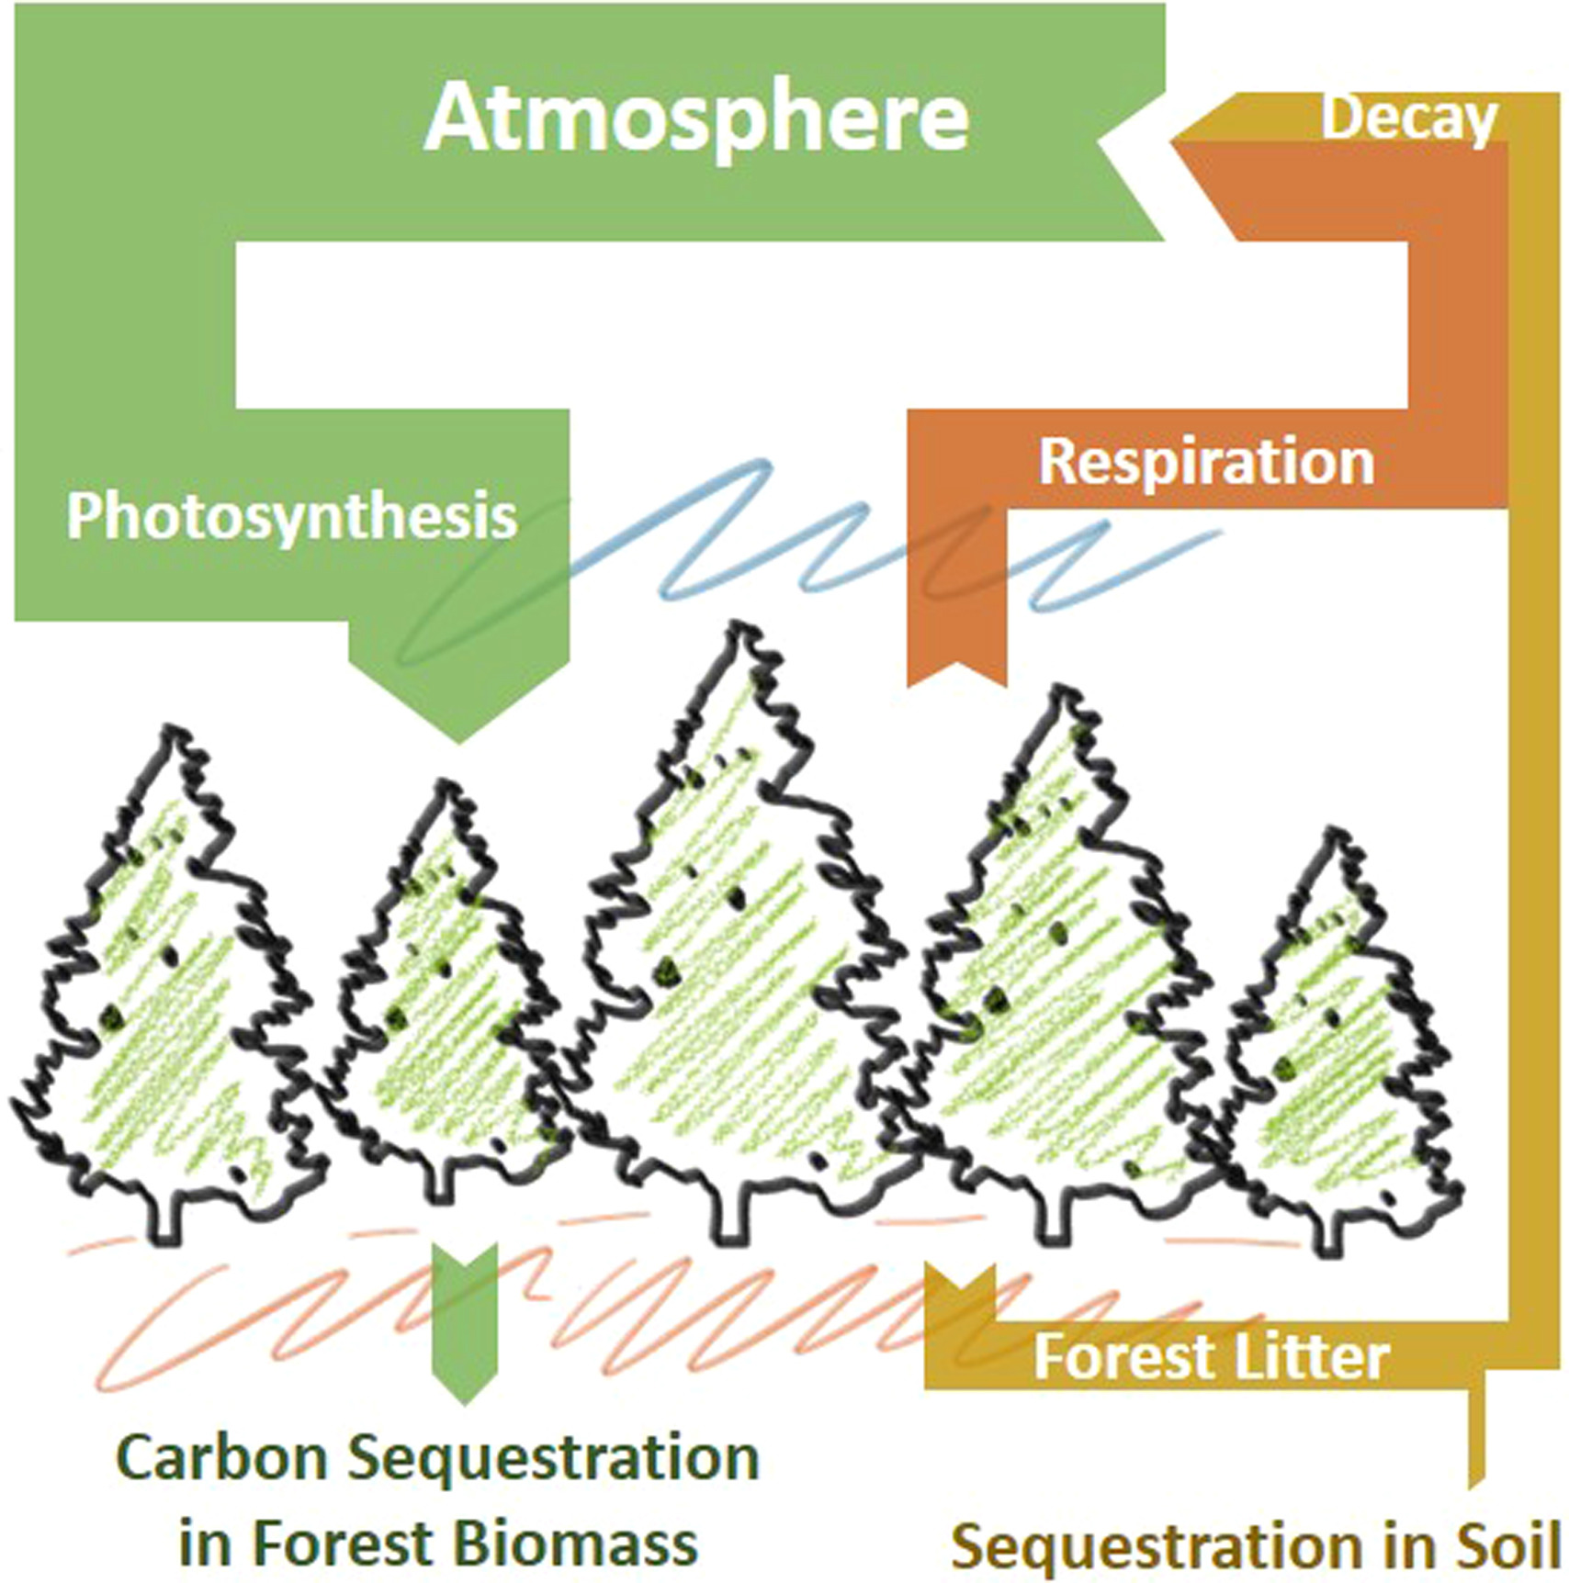
Carbon sequestration
Carbon sequestration is the process of capture and long-term storage of atmospheric carbon dioxide.
All of the CO₂ absorbed by trees is converted into sugar by a process of photosynthesis.
This sugar is used by trees either to grow leaves, or to grow wood.
If a tree is fully grown, it sheds as much carbon in Autumn as it absorbs in Spring.
A tree is only increasing the carbon it stores if it is growing.
Notes:
Image taken from: https://www.sciencedirect.com/science/article/pii/S1364032116306050
Schematic illustration of the carbon cycle within a mature unmanaged forest. The width of the arrows indicate the approximate relative scale of the carbon exchanges based on the values of Broadmeadow and Matthews [reference available in article linked above]. We note that sustainable harvesting of forestry timber (with suitable usage, e.g. in construction) would add a significant pathway to carbon sequestration in addition to those shown in the illustration.

Slide 16
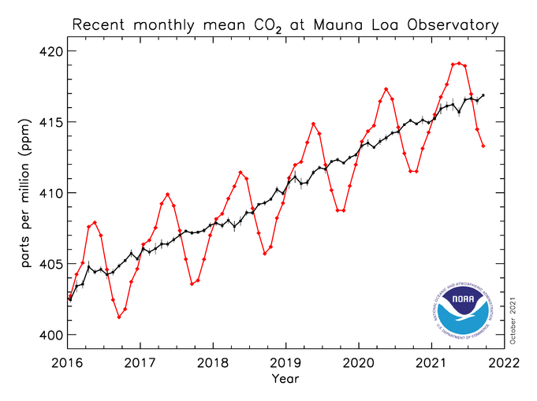
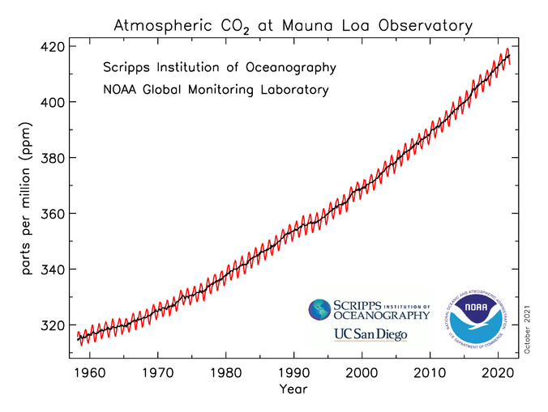
What do these graphs show?
Notes:
Graphs taken from: https://gml.noaa.gov/ccgg/trends/mlo.html
The graphs show monthly mean carbon dioxide measured at Mauna Loa Observatory, Hawaii.
The red lines and symbols represent the monthly mean values, centered on the middle of each month. The black lines and symbols represent the same, after correction for the average seasonal cycle. Note that the red lines demonstrate that trees absorb CO₂ from the atmosphere in Spring and use it to grow leaves, but in the Autumn they shed the leaves, which decay and release CO₂ back into the atmosphere.

Slide 17
The Great Divide
What kinds of trees should we be planting?
Stand where best represents your view.
Trees for production purposes
Untamed Woodlands
Notes:
The Great Divide classroom activity. Set up one side of the classroom as Untamed Woodlands. Set up the opposite side as Trees for Production Purposes. Ask your students to stand and move to where they think represents their view of the kinds of trees that should be planted. When they have all decided, ask individual students to explain why they are stood where they are. Allow students to change their position as they hear different students’ justifications. If you feel that your students will be influenced too much by each others’ views then there are websites and apps available that allow students’ views to be offered anonymously. For example, Plickers (see: https://get.plickers.com/) or Mentimeter (see: https://www.mentimeter.com/).
Untamed woodlands would be planted without any intention of cutting the trees down. There would typically be a variety of species.
Trees for production purposes would typically be one species of fast-growing trees, planted with the intention of cutting them down once they are past their fastest rate of growing. The wood produced might be used as building material, fuel, or to produce paper or cardboard. Note that 83% of UK forests are managed for production purposes.
Reasons for untamed woodlands include protecting habitats for animals and encouraging diversity. Reasons for production purposes are that mature woodland actually emits as much carbon dioxide as it absorbs, but newly growing woodlands absorb more than they emit. When trees are used for building then the carbon they contain is then locked out of the atmosphere. These reasons will be explored further throughout this activity.

Slide 18
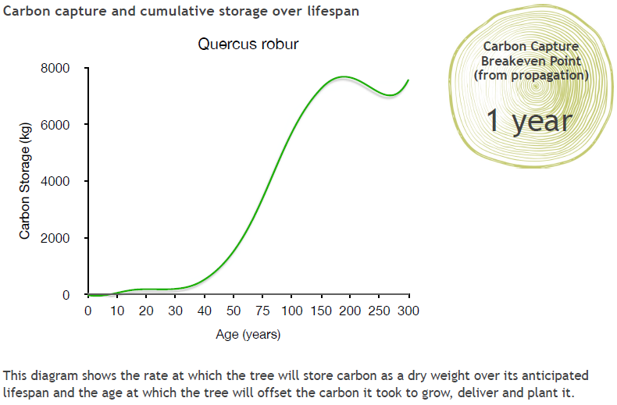
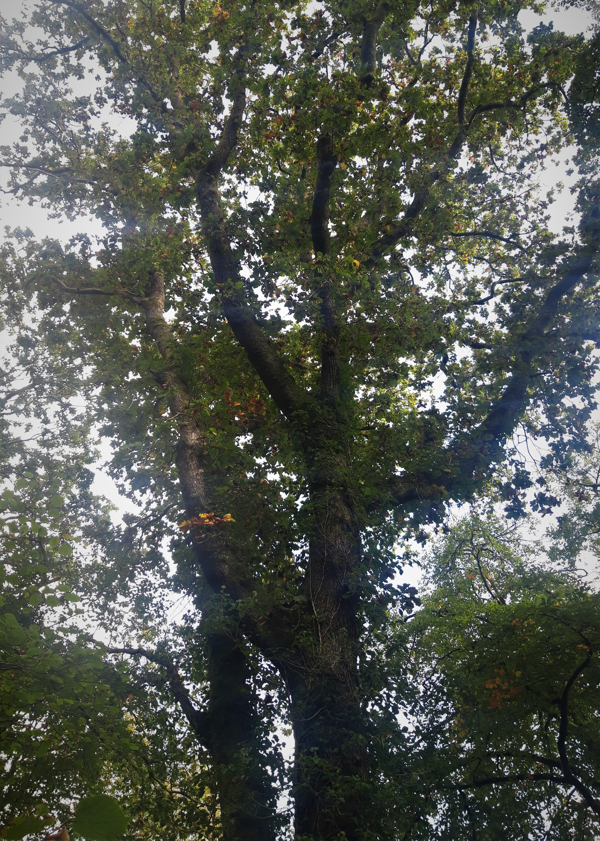
English Oak
Oak
Notes:
Slides 15-18 show how three species of tree store carbon over their lifespan. We will use this information to help us decide how many trees are needed to offset a flight from London to New York, and whether it matters what kind of tree you plant.
What do you notice about the scale on these graphs?
Information about how this data was collected is available here: https://www.treeconomics.co.uk/projects/barchamcarbonperformanceproject/ and here: https://www.barcham.co.uk/store/. Each tree in the Barcham shop has a certificate. The negative carbon storage in the first few years of each graph are explained by taking into account the carbon emissions in driving to collect the tree before planting it.

Slide 19
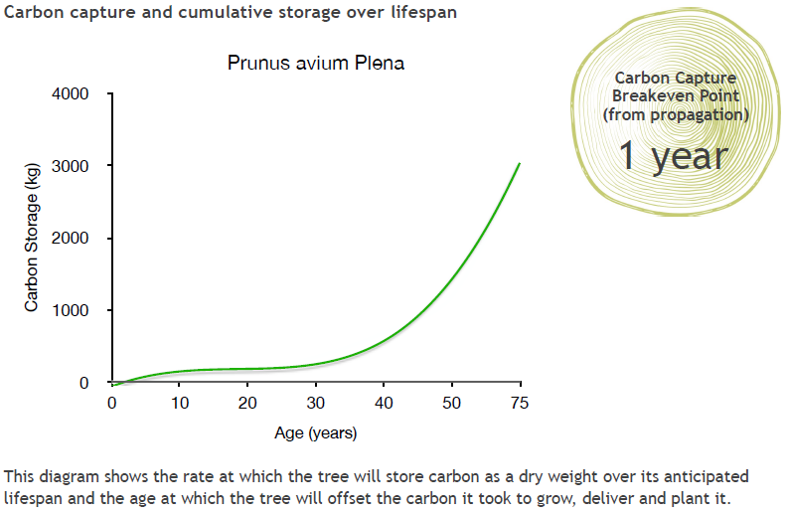
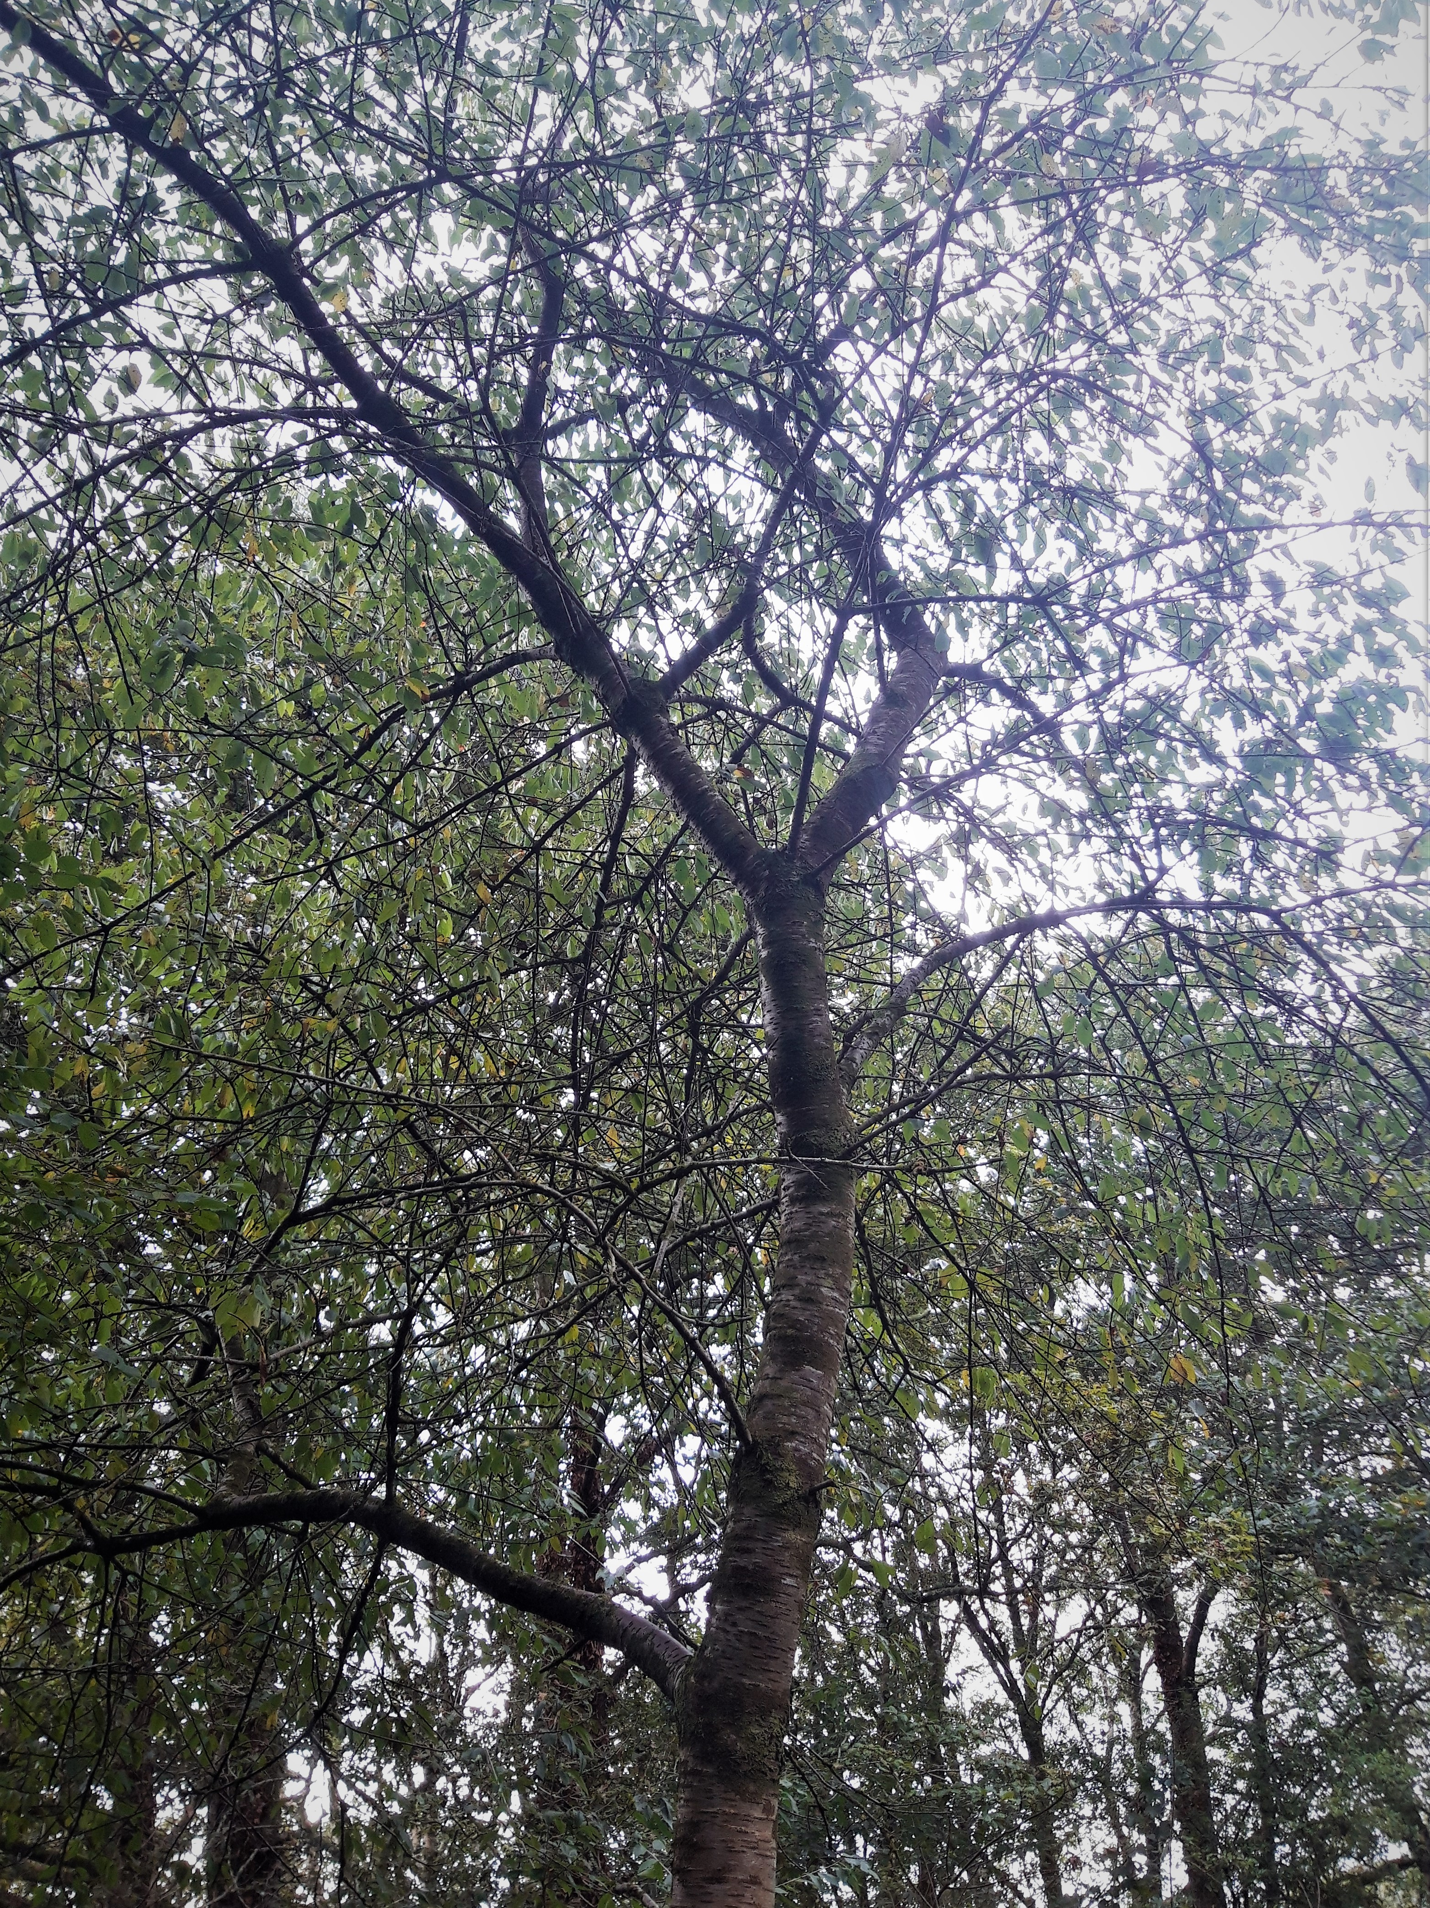
Wild Cherry
Cherry

Slide 20
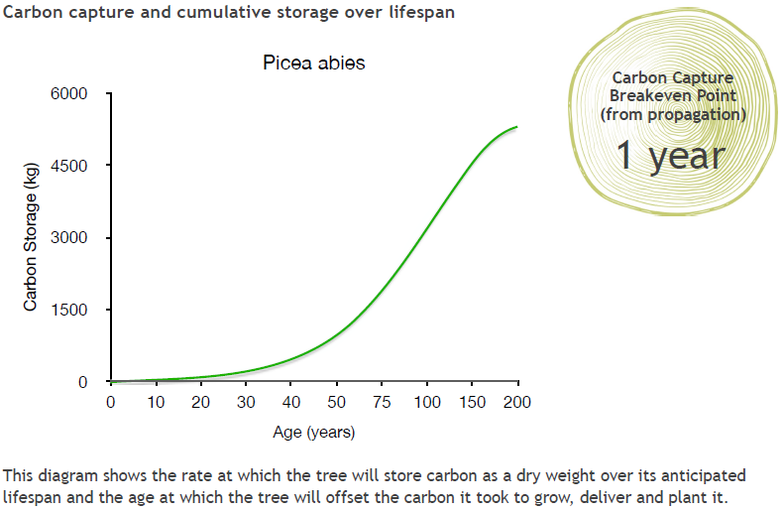
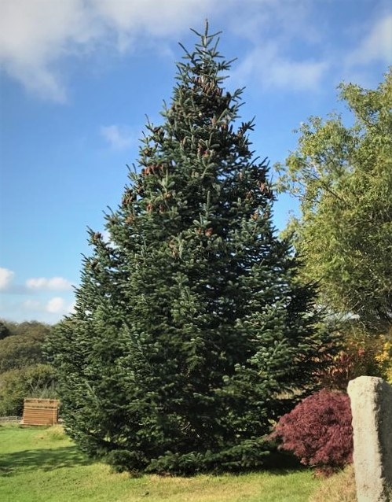
Norway Spruce
Spruce
Notes:
The Norway Spruce is a common variety of Christmas Tree.

Slide 21
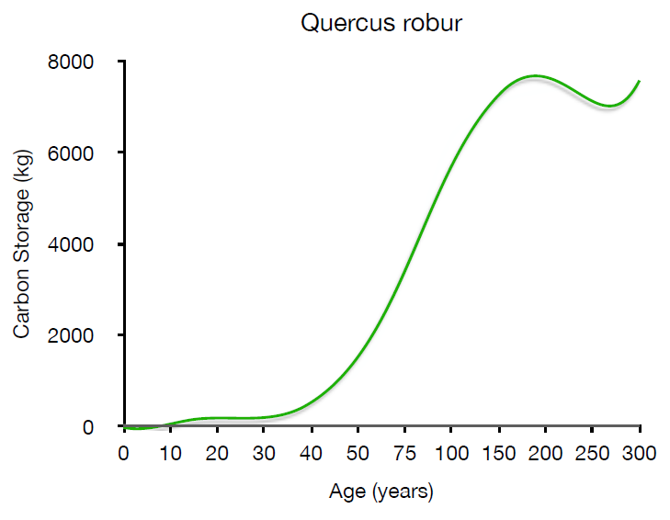
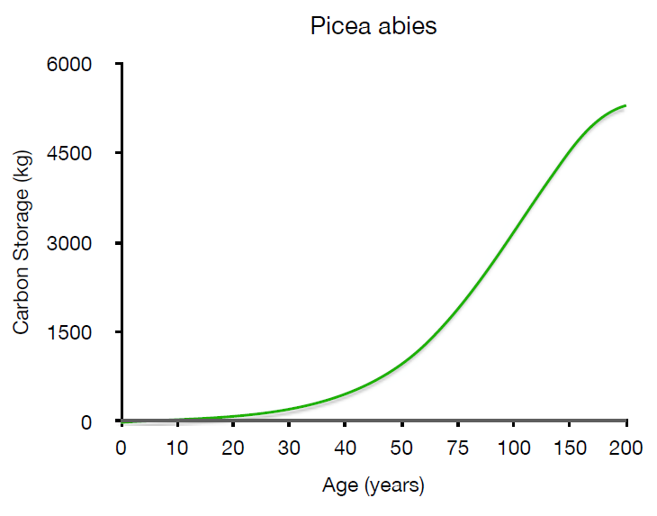
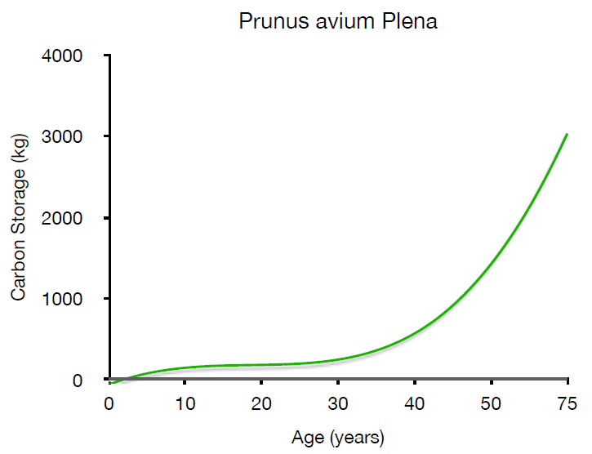
How do they compare?
Oak
Spruce
Cherry
Notes:
It is difficult to compare these graphs in this form – can your students say why? What do they notice about these graphs?
One problem is that the axes are different for each graph. Not only that, but the scales for Age are not linear – the intervals on the x axes vary. Invite students to explain what they would need to do in order to compare these graphs effectively.

Slide 22
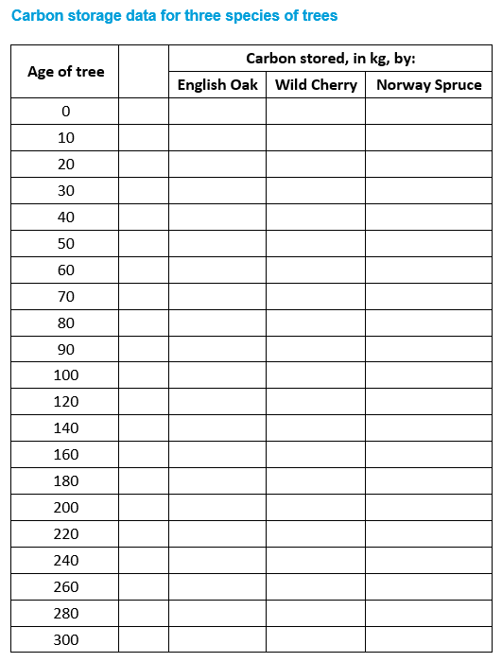
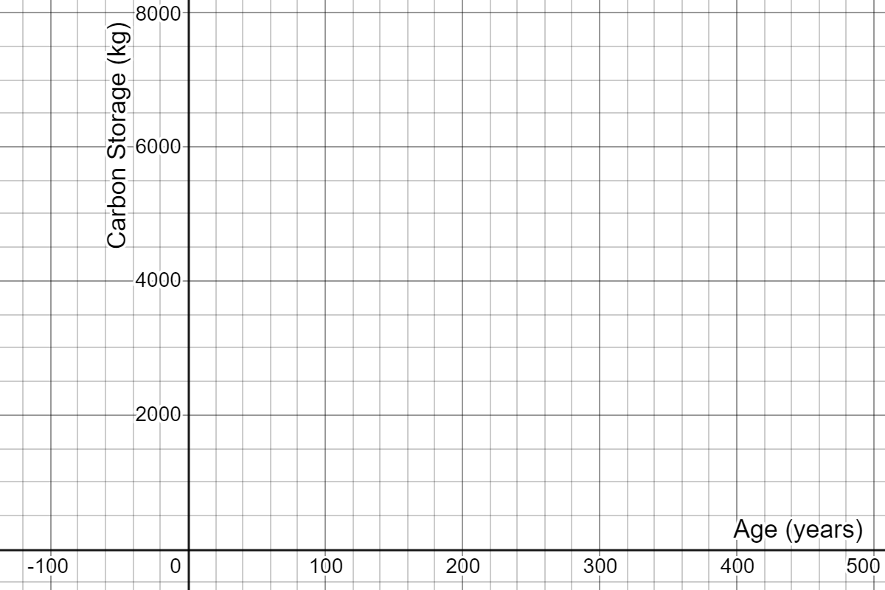
How do they compare?
Use the graphs to record the carbon stored by each of the tree species. Then re-draw these graphs on one set of axes.
Oak
Cherry
Spruce
Notes:
Students to be handed the data sheets in groups. After 15 minutes they need to present their argument for which trees they would choose to plant and why.
Here are the three sets of data plotted on the same set of axes, in Desmos: https://www.desmos.com/calculator/rci87lp05w
Some more data students might use is the Yield Class of trees, the volume (in m³) of wood produced per hectare per year. broadleaves generally grow with a YC of between 4-8, meaning they grow 4-8 cubic metres per hectare per year. Oak grows at around 6, Wild Cherry at 8 and Poplar achieving rates of up to 12. How does this relate to the data in the graphs? Note that the graphs consider mass of carbon, not volume, and they don’t take into account the density of planting. However, Yield Class doesn’t take into account the varying growth rates of trees.
For more information on Yield Class, see: https://www.carbonbrief.org/in-depth-qa-how-will-tree-planting-help-the-uk-meet-its-climate-goals

Slide 23
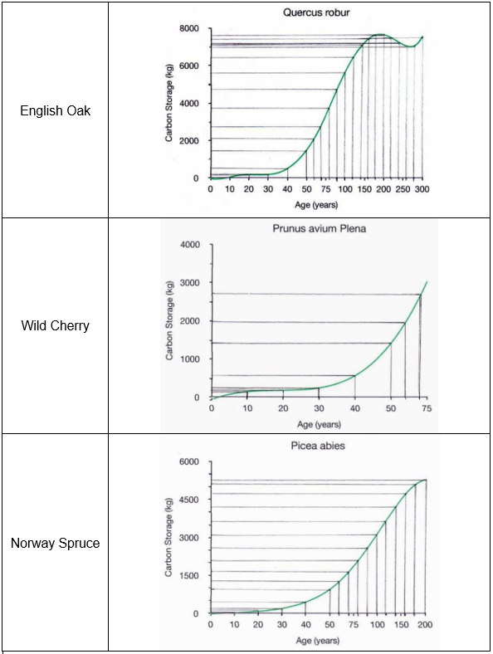
Possible approach
Age of tree |  | Carbon stored, in kg, by:
 |  | English Oak | Wild Cherry | Norway Spruce
0 |  | 0 | -100 | -50
10 |  | 0 | 200 | 50
20 |  | 200 | 250 | 150
30 |  | 250 | 300 | 250
40 |  | 550 | 600 | 450
50 |  | 1400 | 1400 | 950
60 |  | 2100 | 2000 | 1300
70 |  | 2750 | 2700 | 1700
80 |  | 3750 |  | 2100
90 |  | 4700 |  | 2600
100 |  | 5600 |  | 3150
120 |  | 6400 |  | 3650
140 |  | 7150 |  | 4200
160 |  | 7450 |  | 4750
180 |  | 7600 |  | 5150
200 |  | 7600 |  | 5300
220 |  | 7450
240 |  | 7250
260 |  | 6950
280 |  | 7000
300 |  | 7500
Oak
Cherry
Spruce
Notes:
Students to be handed the data sheets in groups. After 15 minutes they need to present their argument for which trees they would choose to plant and why.
Here are the three sets of data plotted on the same set of axes, in Desmos: https://www.desmos.com/calculator/rci87lp05w

Slide 24
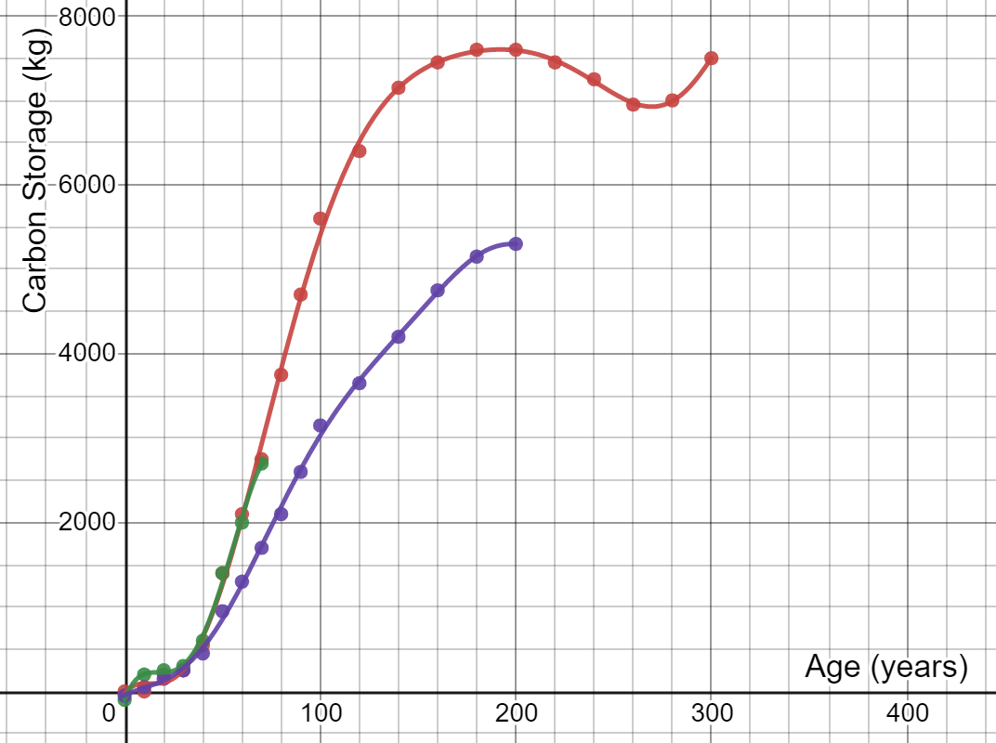
How do they compare?
Oak
Cherry
Spruce
Notes:
Students to be handed the data sheets in groups. After 15 minutes they need to present their argument for which trees they would choose to plant and why.
Here are the three sets of data plotted on the same set of axes, in Desmos: https://www.desmos.com/calculator/rci87lp05w
Some more data students might use is the Yield Class of trees, the volume (in m³) of wood produced per hectare per year. broadleaves generally grow with a YC of between 4-8, meaning they grow 4-8 cubic metres per hectare per year. Oak grows at around 6, Wild Cherry at 8 and Poplar achieving rates of up to 12. How does this relate to the data in the graphs? Note that the graphs consider mass of carbon, not volume, and they don’t take into account the density of planting. However, Yield Class doesn’t take into account the varying growth rates of trees.
For more information on Yield Class, see: https://www.carbonbrief.org/in-depth-qa-how-will-tree-planting-help-the-uk-meet-its-climate-goals

Slide 25
How do they compare?
Oak
Cherry
Spruce
Which trees would you plant?
Notes:
Students to be handed the data sheets in groups. After 15 minutes they need to present their argument for which trees they would choose to plant and why.
Here are the three sets of data plotted on the same set of axes, in Desmos: https://www.desmos.com/calculator/rci87lp05w
Some more data students might use is the Yield Class of trees, the volume (in m³) of wood produced per hectare per year. broadleaves generally grow with a YC of between 4-8, meaning they grow 4-8 cubic metres per hectare per year. Oak grows at around 6, Wild Cherry at 8 and Poplar achieving rates of up to 12. How does this relate to the data in the graphs? Note that the graphs consider mass of carbon, not volume, and they don’t take into account the density of planting. However, Yield Class doesn’t take into account the varying growth rates of trees.
For more information on Yield Class, see: https://www.carbonbrief.org/in-depth-qa-how-will-tree-planting-help-the-uk-meet-its-climate-goals

Slide 26
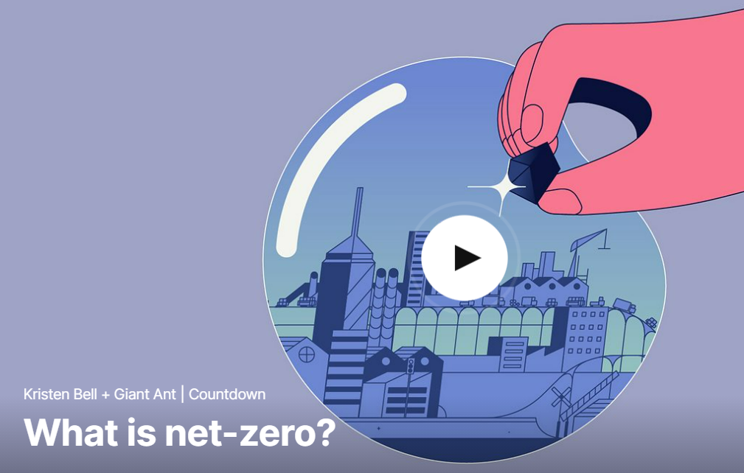
Trees for ‘Net Zero’
Watch this short video that explains what ‘Net Zero’ means:
Notes:
https://www.ted.com/talks/kristen_bell_giant_ant_what_is_net_zero#t-40608
‘Net Zero’ is introduced here in order to allow us to consider the contribution planting trees might make towards achieving Net Zero.

Slide 27
Trees for ‘Net Zero’
How long does each type of tree take to remove 2 tonnes of carbon from the atmosphere?
Spruce
Cherry
How does this compare with the time taken to remove the carbon emissions for a flight from London to New York, for a single passenger?
Oak
Notes:
Note that it would take around 40 years for any of these tree species to absorb the 0.6 tonnes of carbon emissions for a single passenger to fly from London to New York.

Slide 28
What happens to trees and their carbon after they die?
Trees are burned
Trees rot naturally
Trees are cut down and used, for example, for timber, or to make cardboard
What is the effect of these different possibilities on the carbon sequestered from the atmosphere?
Notes:
Collect students’ initial and intuitive responses to the title question first.
The Trees for Life website (https://treesforlife.org.uk/into-the-forest/habitats-and-ecology/ecology/) has much information about decomposition and decay of trees, as well as information about the importance of dead wood. It suggests that it might take around 40 years for a dead tree to completely decompose, whereas the leaves a tree drops will decompose completely within a year.
This article from Science Direct: https://www.sciencedirect.com/science/article/pii/S1364032116306050 has much information about trees being used to produce timber for construction.
Trees being burned quickly released carbon back into the atmosphere. Trees rotting slowly releases some of the carbon into the atmosphere, but some would be absorbed into the ground. Using trees for for building effectively ‘locks’ the carbon out of the atmosphere, provided the product built remains intact.

Slide 29
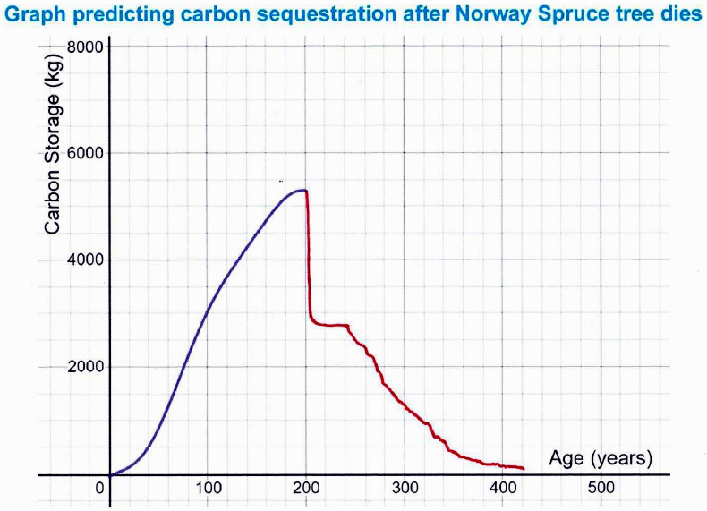
What happened to the carbon sequestered by this tree?
Notes:
Ask your students to explain the key parts of this graph. What do they think the tree was used for after it died?

Slide 30
What happened to the carbon sequestered by this tree?
Approximately 50% of a tree can be turned into usable timber. The rest might be used as biofuel and burned, releasing CO2 back into the atmosphere.
The usable timber might be made into furniture, which stores carbon.
Over time, furniture deteriorates and is thrown away or burned.
Notes:
It is worth noting here that even a tree that is used for production purposes is likely to only sequester carbon for a limited period. Over time, the products deteriorate and so the wood is burned or rots, returning the CO₂ to the atmosphere. It’s worth considering whether this can be avoided. Some tree litter from dead trees may get covered and preserved, or continue to sequester carbon as soil.

Slide 31
What happens to trees and their carbon after they die?
Continue your graphs to show how much of the carbon stored by trees remains sequestered from the atmosphere after they die, in each of these cases:
The tree is left to rot naturally
The tree is used for construction
The tree is used to make paper
What assumptions did you make?
Notes:
The Trees for Life website (https://treesforlife.org.uk/into-the-forest/habitats-and-ecology/ecology/) has much information about decomposition and decay of trees, as well as information about the importance of dead wood.
This article from Science Direct: https://www.sciencedirect.com/science/article/pii/S1364032116306050 has much information about trees being used to produce timber for construction.
Trees being burned immediately releases carbon back into the atmosphere. Trees rotting slowly releases some of the carbon into the atmosphere (over approximately 40 years), but some (approx. 30%) would be absorbed more permanently into the ground. Using trees for for building effectively ‘locks’ the carbon out of the atmosphere, but only while the building products remain intact.

Slide 32
What happens to trees and their carbon after they die?
For each of your graphs:
When would a new tree need to be planted in order to maintain the maximum amount of carbon stored by that tree?
Notes:
For the graph shown on this slide, a new tree would need to be planted when the first is around 100 years old. This would allow the second tree to have stored around 50% of its carbon when the first tree loses 50%. This process would need to keep being repeated.

Slide 33
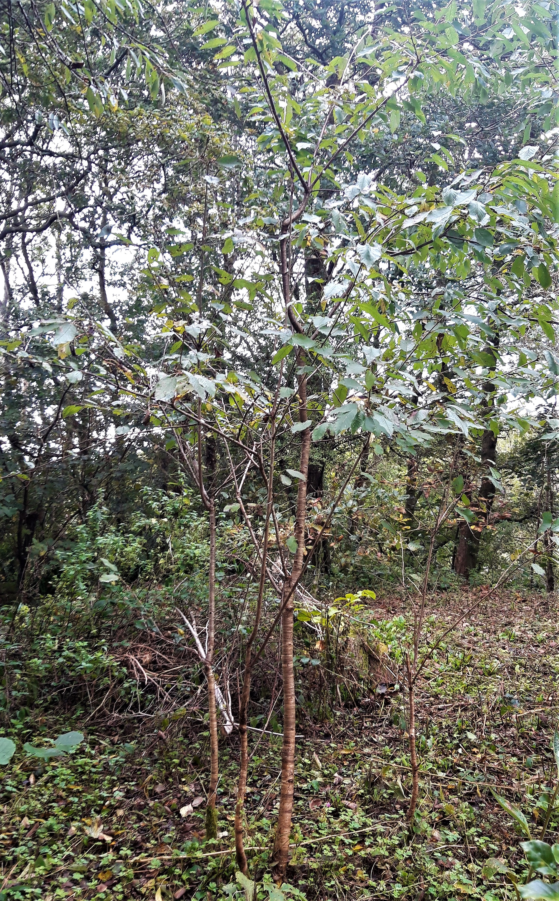
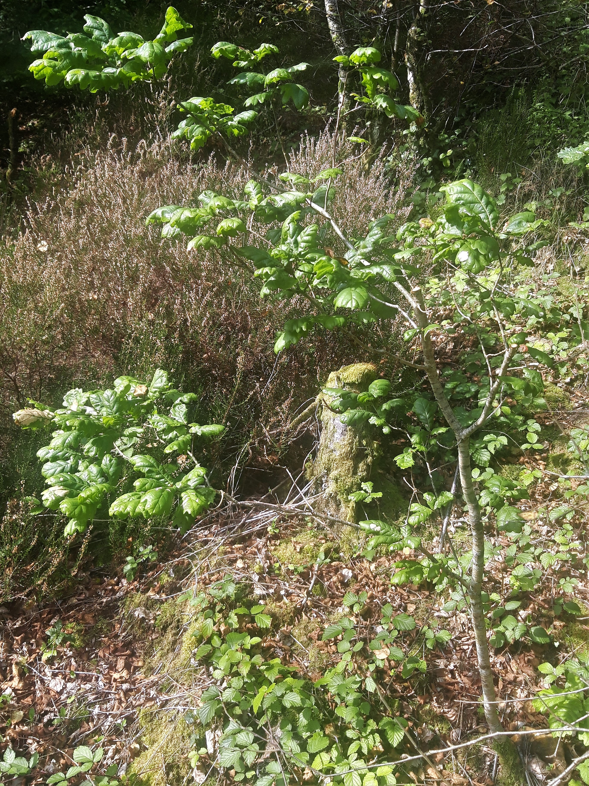
Trees for ‘Net Zero’
The majority of carbon sequestered by trees eventually returns to the atmosphere as CO₂
Cherry
Saplings
Discuss: To what extent can planting trees offset the carbon emissions for a flight from London to New York?
Oak Sapling
Notes:
The conclusion that should be reached is that, to offset one flight, you need to keep replacing the tree that you planted. It may be worth also considering the implications for land use if planting trees is going to be used to offset ongoing carbon emissions.

Slide 34
The Great Divide
What kinds of trees should we be planting?
How have your views changed?
Can trees be used to achieve ‘Net Zero’?
Trees for production purposes
Untamed Woodlands
Notes:
It is worth considering how trees that die can be replaced with new trees, so that the carbon sequestered by the planting of trees doesn’t reduce when they die. In forests managed for production purposes, more trees are typically planted when trees are cut down. In untamed woodlands, tree saplings may grow naturally. It may be worth considering the implications for land use if planting trees is going to be used to offset ongoing carbon emissions and achieve Net Zero.
Note that 83% of UK forests are managed for production purposes.
Reasons for untamed woodlands include protecting habitats for animals and encouraging diversity. Reasons for production purposes are that mature woodland actually emits as much carbon dioxide as it absorbs, but newly growing woodlands absorb more than they emit. When trees are used for building then some of the carbon they contain is then locked out of the atmosphere for longer.

Slide 35
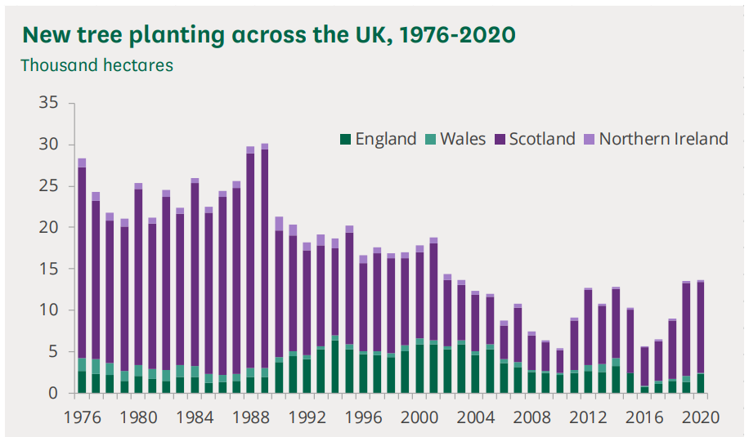
Trees for ‘Net Zero’
What do you notice?
What do you wonder?
Notes:
Image from: https://researchbriefings.files.parliament.uk/documents/CBP-9084/CBP-9084.pdf
Note that England planted many more trees in the 90’s and 00’s than they are doing now. It is also worth noting that 2700-3000 conifer trees are typically planted per hectare, but when conifer trees are mature, the density is more like 300 trees per hectare. See: https://www.carbonbrief.org/in-depth-qa-how-will-tree-planting-help-the-uk-meet-its-climate-goals

Slide 36
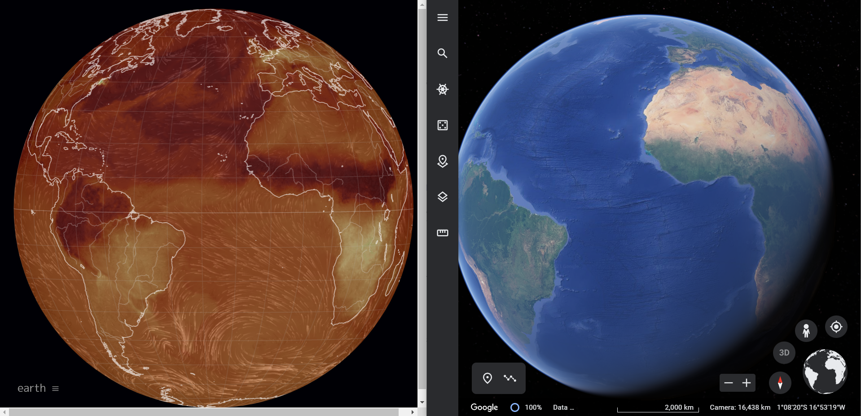
Trees for ‘Net Zero’
CO₂ concentration
What do you notice?
What do you wonder?
Notes:
Students may want to explore the links between CO₂ concentration on Earth and the location of rainforests by playing with the following websites:
https://earth.nullschool.net/
https://earth.google.com/web/

Slide 37
Trees for ‘Net Zero’
In order to achieve ‘Net Zero’, we need to keep removing carbon from the atmosphere in order to compensate for the greenhouse gases which are still being released.
When does a tree have the greatest rate of carbon removal from the atmosphere?
When would you need to plant another tree to maintain that rate of removal or more?

