Slide 1
> Business Area Here
Risky Weather

Slide 2
What is Risk?
Possibility of losing something of value.
Something can be gained or lost when taking risk resulting from action or inaction
Intentional interaction with uncertainty -- potentially unpredictable and uncontrollable outcomes.
How can we deal with risk if we have a prediction, like a weather forecast, to help us?

Slide 3
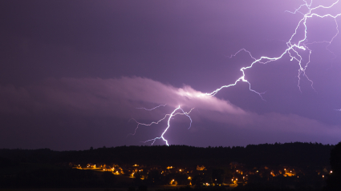
The Weather Risk Game
Divide into 6 teams.
You will be given a business card (farmer, supermarket…)
Come up with a team name.
What are you risking if bad weather should happen? What is ‘bad’ weather for you?

Slide 4
What is Insurance?
Each team will be given £3,000.
We will play the game a number of times until someone’s money runs out.
Each time we play, we will roll a die to see what the likelihood (probability) of an extreme weather event is.
If it shows a 1, there is a 1 in 6 (17%) chance of bad weather.
If it shows a 2, there is a 2 in 6 (34%) chance of bad weather
If it shows a 3, there is a 3 in 6 (50%) chance of bad weather
If it shows a 4, there is a 4 in 6 (67%) chance of bad weather
If it shows a 5, there is a 5 in 6 (84%) chance of bad weather
If it shows a 6, there is NO chance of bad weather

Slide 5
What is Insurance?
You can then choose whether to pay to insure your business, or to risk the weather event not happening.
We’ll then roll another die to see whether the extreme weather event happens.
If bad weather happens, and you are insured, you lose nothing.
If no bad weather happens, and you are insured, you don’t get your money back.
If bad weather happens, and you are not insured, your business will lose money.

Slide 6
Life’s not fair
Insurance costs a different amount for each team:
Team Name | Insurance Cost | Cost of damage
Builder: | £300 | £600
Supermarket: | £300 | £700
Sporting Event: | £500 | £800
Holiday Company: | £500 | £1000
Festival: | £700 | £1200
Farmer: | £700 | £1500
Notes:
Assign each team to a row depending on the perceived vulnerability of their business to the weather.

Slide 7
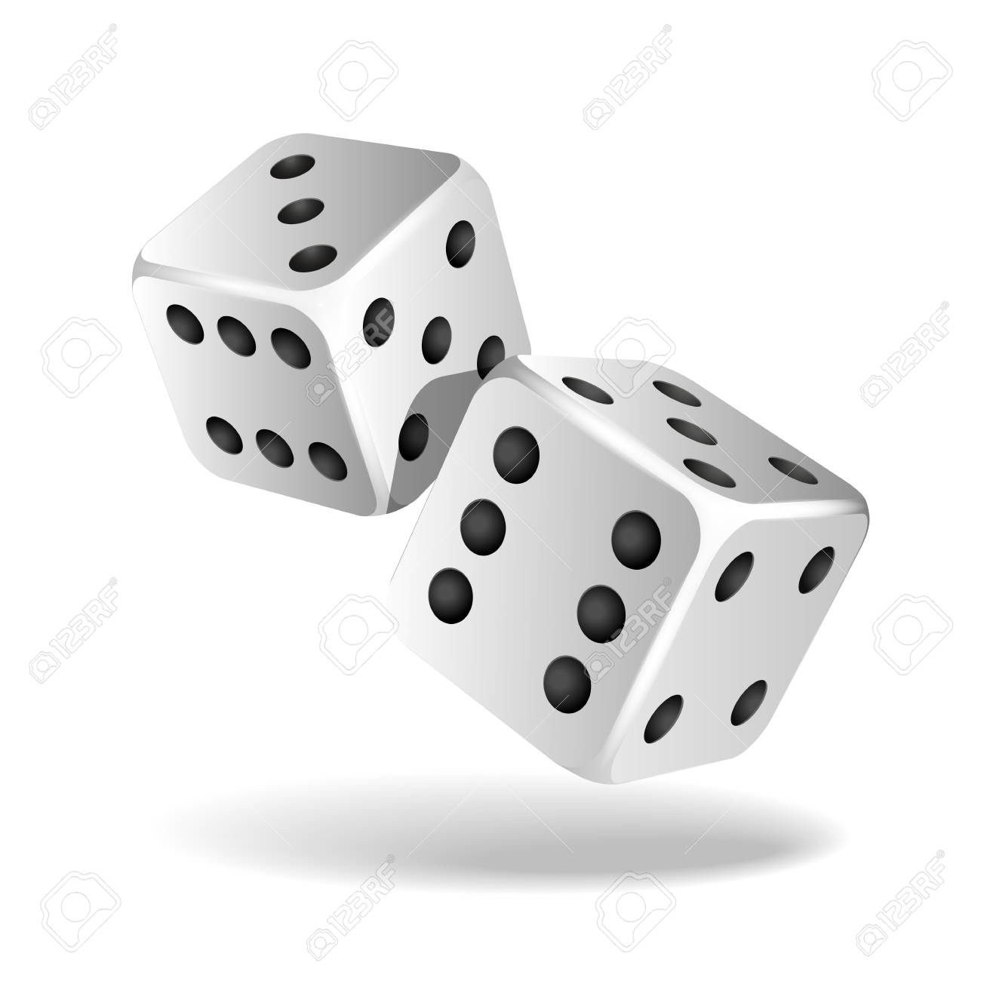
Let’s Play!

Slide 8
Who won?
Did motivation to win the game drive you to take more or less risks?
Did the groups with higher insurance costs play differently to those with lower costs?

