Slide 1
> Business Area Here
Weather
or
Climate?

Slide 2
Presentation Title Here

Slide 3
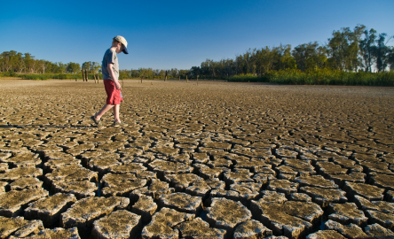
Presentation Title Here

Slide 4
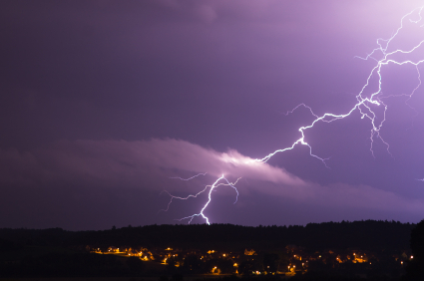
Presentation Title Here

Slide 5
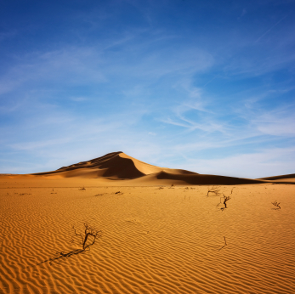
Presentation Title Here
Notes:
This one is tricky – it is weather, but the scenery suggests that this weather is normal, therefore it could be argued that it’s also climate

Slide 6
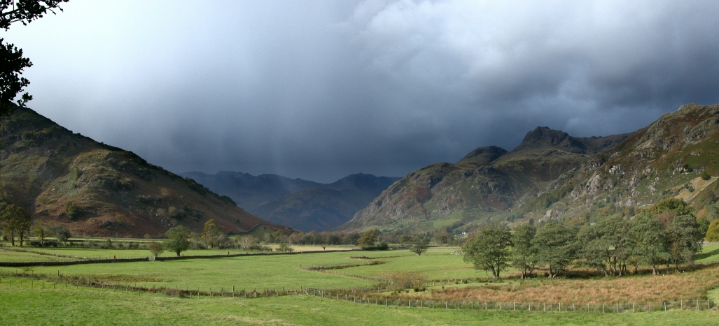
Presentation Title Here

Slide 7
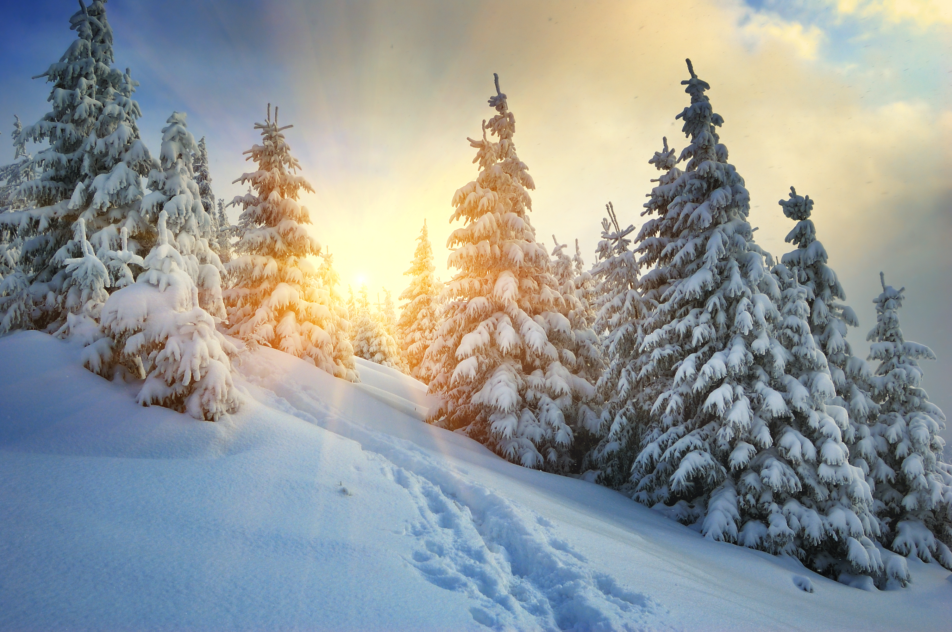
Presentation Title Here

Slide 8
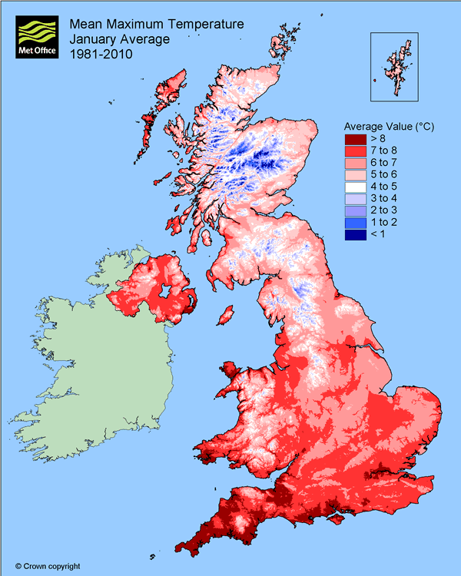
Presentation Title Here

Slide 9
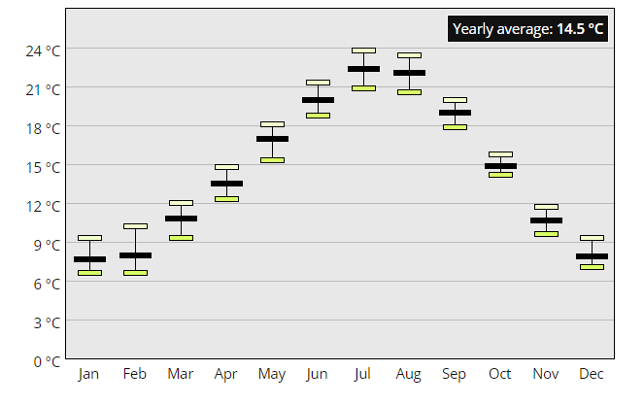
Presentation Title Here
Notes:
This shows monthly average temperatures (in Reading) - climate

Slide 10
Weather and Climate
Climate is what we expect; weather is what we get!

