Slide 1
Climate Change

Slide 2
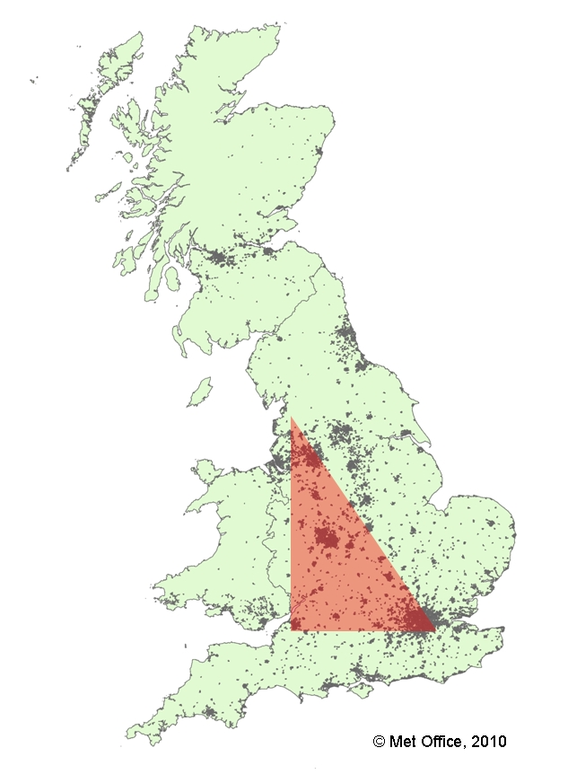
We’ll split into two groups
Global temperature
Central England

Slide 3
Making a temperature graph
Each coloured stick has a date and a temperature written on it.
Arrange the sticks in date order on the graphs.
Align centre of stick with the temperature on y-axis
stick has a date and a temperature written on it.
Arrange the sticks in date order on the graphs.
Align centre of stick with the temperature on y-axis
Rearrange the sticks from the lowest temperature to the highest.

Slide 4
Your Answers
 | Global | SE England
Year of highest temperature
Year of lowest temperature

Slide 5
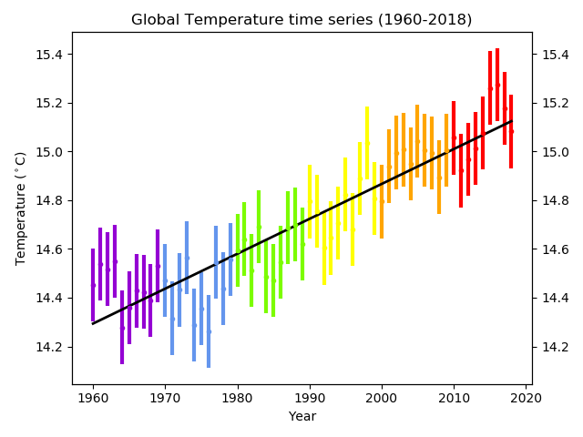
© Crown copyright Met Office

Slide 6
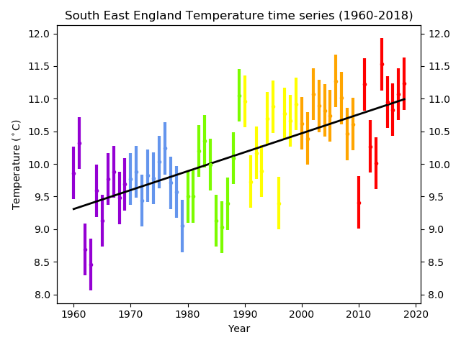
Central England Temperature

Slide 7
Making a Temperature Graph
Rearrange the sticks from the lowest temperature to the highest.

Slide 8
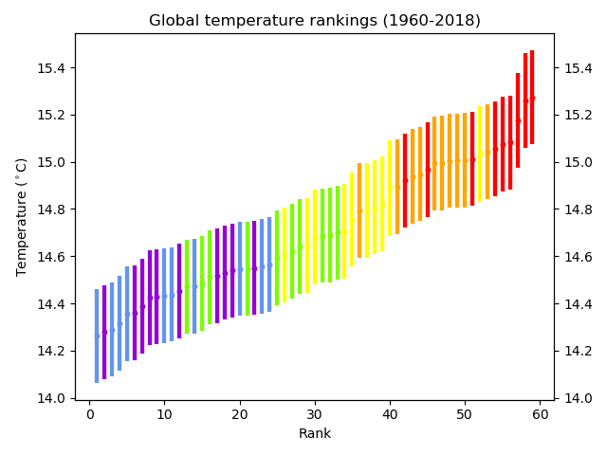
Global temperature rankings

Slide 9
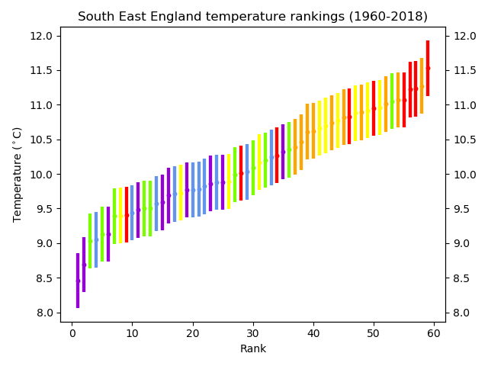
Central England Temperature rankings

Slide 10
Title goes here

Slide 11
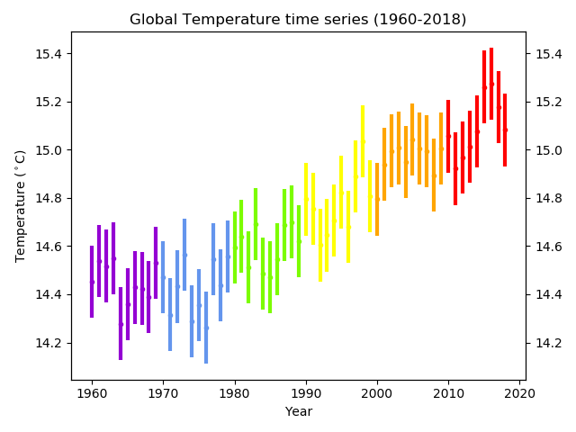
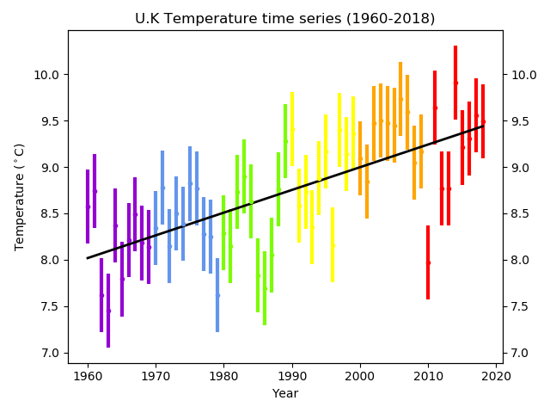
Climate Change
If you had to explain to someone who had no idea about climate change what would you say? You could use these charts to explain it

Slide 12
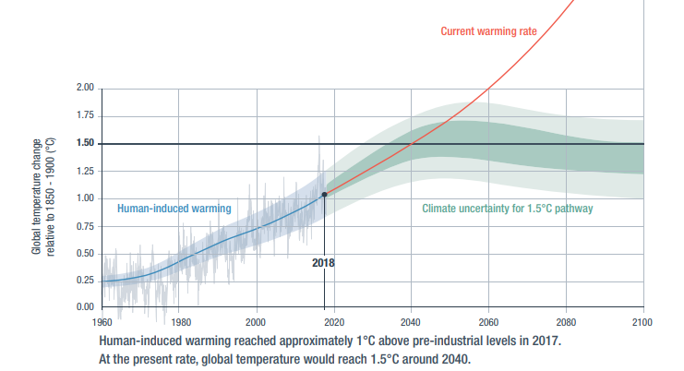
Future Climate Change

