Slide 1
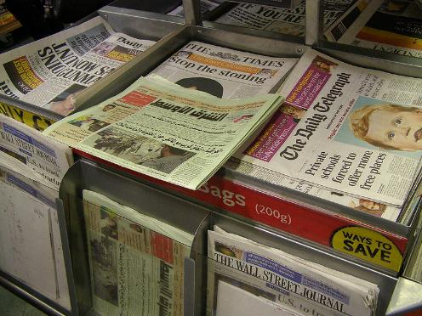
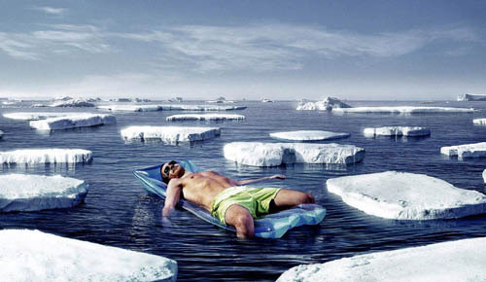
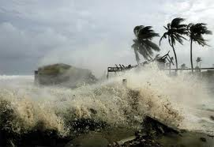
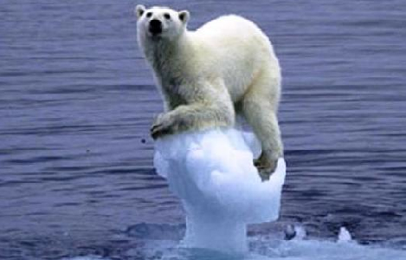

Climate Change Scepticism
… The Great Debate!
Notes:
Slide 1:
Are any of the students able to explain what they think ‘Climate Change Scepticism’ is? – Pictures will act as clues.
Would be a good idea to let a number of students answer but not to explain the actual meaning, leaving them to think.

Slide 2
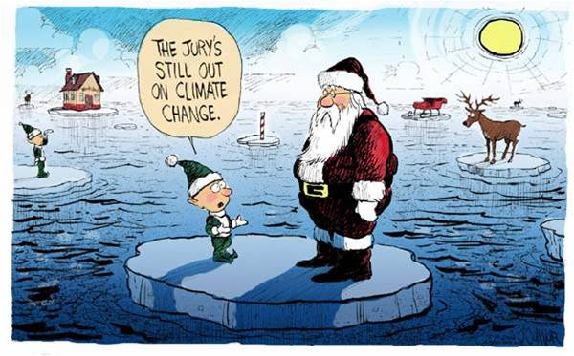
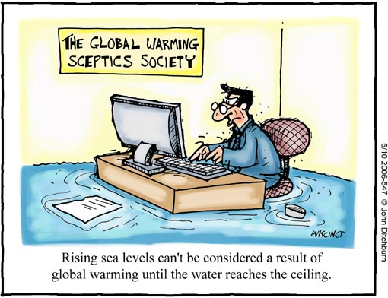
Climate Change Scepticism
There are many Sceptics, and there are certainly many things to be sceptical of…
…but is climate change one of them? Open a newspaper or simply switch on your T.V. and there is likely to be someone who is arguing that climate change is not worth worrying about.
Notes:
Slide 2:
Now ensure the students understand what the word ‘sceptic/ sceptical’ means.
Sceptic- someone who doubts that something is true or does not trust or believe something.
You could ask the class what sorts of things you might be sceptical of (e.g. psychics, diets etc.) or if they themselves are sceptical of something.
Scientific skepticism is healthy. In fact, science by its very nature is skeptical. Genuine skepticism means considering the full body of evidence before coming to a conclusion. However, when you take a close look at arguments expressing climate ‘skepticism’, what you often observe is cherry picking of pieces of evidence while rejecting any data that don’t fit the desired picture. This isn’t skepticism. It is ignoring facts and the science.

Slide 3
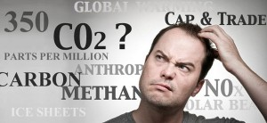
What is Climate Change?
Everyone has heard the phrase, but what does it actually mean?
Climate Change = The change in average conditions of a particular place over a long period of time.
HINT: Climate is what you expect, Weather is what you get!
Notes:
Slide 3:
Are the students able to explain what ‘Climate Change’ is?
Explain that ‘climate’ is different to ‘weather’: Make sure the students understand that the climate=the average temperature + atmospheric pressure + precipitation + humidity + wind of a particular place (long-term...meteorologists usually take 30 years as the average time)
You might need to explain the terms;
-Atmospheric Pressure: The force from the weight of the air (think about how the air pressure is different if you stand at the
top of a mountain).
-Humidity: Amount of moisture in the air.
-Precipitation- Rain, hail, snow.
Do the students know why this is an important topic?

Slide 4
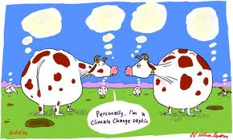
The Sceptics
Notes:
Slide 24:

Slide 5


Sceptics: Who are they?
Anyone can be a sceptic; your next door neighbour, your mum, your teacher or even yourself. It means that you have doubts that something is true.
All scientists are sceptics – they look for evidence to prove whether a theory is true or not.
The name “climate change sceptic” has been given to people who either say climate change is not caused by humans, or that it is but we don’t need to worry about it.
Notes:
Slide 25:
Sceptics who are public figures like politicians, scientists or celebrities have the opportunity to express their opinions on television, in newspapers and on the radio.
Sceptics are not labelled.
Some newspapers and television broadcasters may be ‘biased’ and may give ‘one-sided’ reports.

Slide 6
What’s to be Sceptical of?
Climate IS changing, as there is a multitude of scientific evidence to prove it. What sceptics are saying, however, is that WE (the human race) don’t need to worry about it.
“the warming.. is likely to do more good than harm.”
Nigel Lawson, ex Chancellor of the Exchequer
It is important to understand why these people are saying this and to understand the facts before making up your own mind.
“Climate change is a natural phenomenon that has occurred many times in the past”
Gerhard Lobert, physicist
Notes:
Slide 26:
For the Guardians rated top 10 sceptics, follow this link: http://www.guardian.co.uk/environment/georgemonbiot/2009/mar/06/climate-change-deniers-top-10
(this page dates from 2009 when a lot more people were still denying that there was man made climate change)

Slide 7
‘Climate change is a natural phenomenon’
‘Our climate is very unpredictable’
‘This has been the worst winter in years…and they talk about global warming!’
‘You cannot use computers to predict the future climate’
Notes:
Slide 27:
Some of the arguments a sceptic will use to try and contradict the idea of ‘human induced’ climate change.

Slide 8
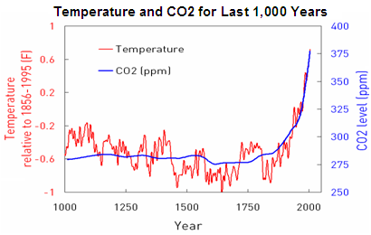
‘Climate change is a natural Phenomenon’
The earth’s climate is not constant, the climate has warmed and cooled for billions of years.
This graph shows the levels of CO2 and the average temperature for the Northern Hemisphere over the past 1000 years. There is a sharp rise in both temperature and CO2 concentration over the past 200 years.
http://blogs.edf.org/climate411/2007/06/29/human_cause-3/
Notes:
Slide 28:
Why might people use this argument?
Denial: ‘Climate change is not our responsibility so we do not need to do anything about it’.
Many people think that scientists are simply ‘scaremongering’ or that governments are trying to gain more money.

Slide 9
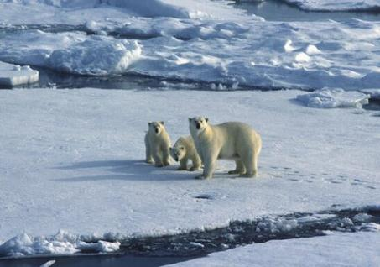

‘Our climate is very unpredictable’
The terms ‘Climate’ and ‘Weather’ are often misused and are not interchangeable. Usually, when someone says that the climate is ‘unpredictable’ they actually talking about the weather.
‘Weather’ is more variable than climate. It is the atmospheric conditions over a short period of time, i.e. it can be hot and sunny today, but cloudy and raining tomorrow. You can have unusually cold weeks in a warmer climate.
Notes:
Slide 29:
You may carry an umbrella around in the summer because there is a chance the ‘weather’ may suddenly turn and it could rain.
You would not carry around your winter coat because you know that it is not going to suddenly drop to temperatures below freezing, because this is not how the ‘climate’ behaves.
In England, we expect it to be warm/ very warm and wet or dry in the summer, and cool/ cold and wet/ dry in the winter. That is our climate.
If the weather in England was hot and sunny during the month of December, you would be surprised.

Slide 10
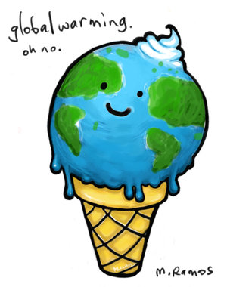
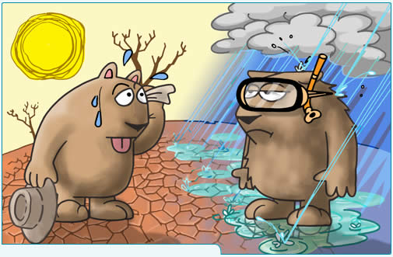
‘This has been the worst winter in years…and they talk about global warming?’
The weather in one season or year can be unusual. That doesn’t mean that the climate has changed! If the weather keeps being different, over many years, then we know the climate has changed.
What people often forget is that climate change does not just refer to the temperature. It is linked to more extreme events and other effects too, including stormier winters, hotter summers, floods and droughts.
Notes:
http://www.theweatherclub.org.uk/video/armstrong-miller-climate-change

Slide 11
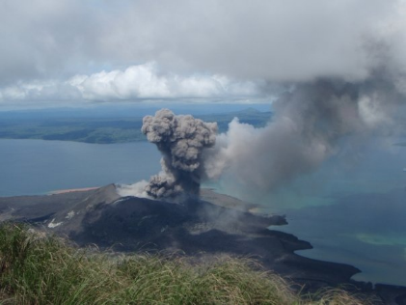
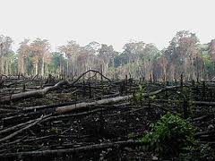
‘Most CO₂ comes from Volcanoes- it’s natural’
Many greenhouse gases in the atmosphere are produced by natural causes such as volcanoes.
The burning of fossil fuels emits far more greenhouse gas into the atmosphere than volcanoes. Explosive volcanoes can have an impact on the climate because of the ash they emit, but it only lasts a couple of years.
Notes:
Slide 31:
See: http://www.skepticalscience.com/human-co2-smaller-than-natural-emissions.htm – contains good scientific explanations of this sceptic argument.

Slide 12

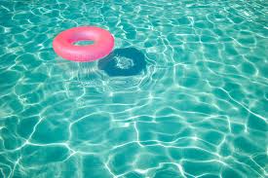
‘We cant predict the weather in a week’s time, how can we predict the climate of the next 100 years?’
Remember the difference between weather and climate? Luckily, the climate is much easier to predict than weather!
A good analogy of the difference between weather and climate is to consider a swimming pool. Imagine that the pool is being slowly filled. If someone dives in there will be waves. The waves are weather, and the average water level is the climate. A diver jumping into the pool the next day will create more waves, but the water level (aka the climate) will be higher as more water has flowed into the pool.
Notes:
Weather is chaotic, climate isn’t.

Slide 13

What have you learned so far?
3. What is the difference between climate change and global warming?
2. Give 2 common arguments of a climate change sceptic.
1. What is a ‘sceptic’?
Answer:
Climate change is a natural occurrence
The climate is unpredictable
Most CO₂ and other greenhouse gas emissions are natural
Winters have been very cold, global warming is not real.
Answer:
A sceptic is someone who doubts that something is true. Anyone can be a sceptic.
Answer:
Global warming refers to global temperature only. Climate change includes all aspects of the climate such as precipitation, humidity and atmospheric pressure, and may lead to increasing extreme events.
Notes:
Slide 32:
Use this slide to check that the students understand scepticism and the common arguments used.

Slide 14
We must ALWAYS challenge what we see on TV, hear on the radio, read in newspapers or even hear on the streets, whether it is a celebrity, a politician, a newsreader, a scientist or even your friend. A fact is not a fact with out some sort of evidence to prove it!
How science works: science is all about testing ideas, and checking conclusions.
You should now understand climate change scepticism and why some people are saying that we don’t need to worry about climate change.
Notes:
Slide 33:
Explain that some sources of information are more reliable than others

Slide 15
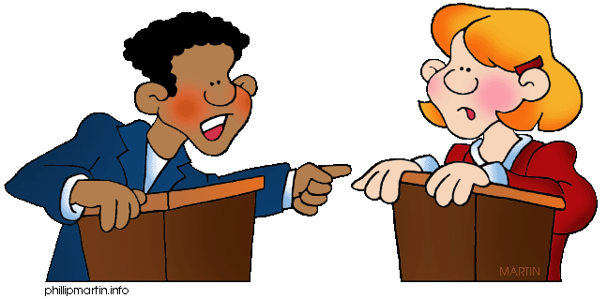
Now it’s YOUR turn!
You are going to test your
new-found knowledge on climate change and climate change sceptics by participating in an organised debate!
This means that you are going to argue your point of view on climate change to another team who disagrees with you.
You must only use FACTS to back you up.
Notes:
Slide 34:
A What?
A debate is where you have two or more different groups of people who each have different ideas or opinions on a particular topic. The idea is to present your ideas and opinions to the opposing teams and usually an audience, using well-structured arguments and evidence to back you up. There is an open discussion where the teams are free to voice their opinions and try to contradict the other team(s), but these must be backed up by real facts.The debate is usually overseen by a chair person who guides the debate by asking questions.

Slide 16
The Great Debate!
Your teacher will split you into 2 teams.
One team will be the ‘climate scientists’ and the others will be the
‘climate sceptics’.
The aim is to convince your audience and maybe even the other teams that your ideas are the right ones.
Team 1
You are going to argue that climate change is real, caused by humans and worth worrying about now.
Team 2
You are going to argue that we haven’t got to worry about climate change.
Each team should consider three points:
Is current climate change natural or caused by human activities?
Do we know enough about what is going to happen in the future?
Will people adapt or even benefit from climate change?
Notes:
Slide 35:

Slide 17
What you need to do.
Once you’re in a team, you will be given a ‘debate card’.
The debate card will tell you which side of the argument you sit on.
It will give you some ideas to use and some suggestions of points you should look at.
As a team, you must take what you already know and do some further ‘investigating’ into your side of the argument.
Make plenty of notes and jot down all of your ideas.
Finally, organise this in a way that you can present to everyone (a flipchart or power-point works well!).
Notes:
Slide 36:

