Slide 1
Connect your learning– Past Climate Change
How can climate change because of natural reasons?
Sun
Sun

Slide 2
Changing climate

Slide 3
CHANGING CLIMATES
Objectives
Outcomes
To be able to DESCRIBE the major changes to temperature and CO₂ over short and longer periods of time.
To be able to explain global warming and HUMAN reasons why climate changes.
To EVALUATE what might happen to CO₂ levels and temperature in the future.
A paragraph describing the link between CO₂ and temperature since 1850.
Video notes and a diagram showing how global warming works and why climate changes because of HUMAN activity.
The ability to discuss verbally what might happen with extra global warming in the future.

Slide 4
How is climate changing globally?

Slide 5
Past GLOBAL climate change – RECENT HISTORY
Describe the patterns on this GLOBAL graph.
What happens to the temperature over time? What are the start and end values for temperature?
What happens to the CO₂ over time? What are the start and end values for CO₂?
Average Temperature between 1850 and 1900
Good words to use – Fluctuating, rising, any figures and dates, Highest, lowest, Long term mean (average)

Slide 6
Why does Climate Change? The HUMAN causes

Slide 7
The Greenhouse Effect
Using the video:
What drives the Earth’s climate system?
What happens to the Sun’s energy when it reaches our atmosphere?
What happens to the Earth’s heat?
Without the Greenhouse gases would we be able to live on Earth?
Finish labelling the copy of the diagram on the next slide
https://youtu.be/lrPS2HiYVp8

Slide 8
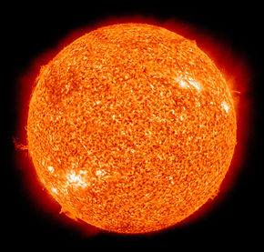
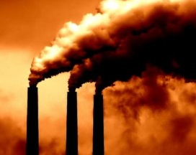
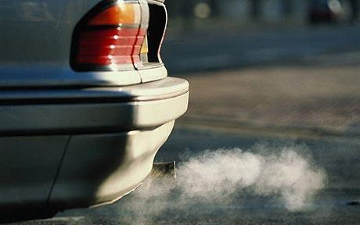
How the Greenhouse Effect works
2. Some of this energy is reflected directly back out to space from dust and clouds
6.Some heat energy escapes to space
1. The Sun sends its energy to Earth as INSOLATION
CO₂, H₂O, CH₄
5. This heat energy is trapped by carbon dioxide, methane and water vapour
The atmosphere
4. Heat rises through the Earth’s atmosphere
7. Human activity adds extra gasses causing EXTRA ANTHROPOGENIC warming
The Earth
3. The light is converted to HEAT at the Earth’s surface

Slide 9
Title
2. Some of this energy is directly back out to space from dust and clouds
6.Some heat energy
1. The Sun sends its energy to Earth as
CO₂, H₂O, CH₄
5. This heat energy is trapped by , Methane and water vapour
7. adds extra gasses causing EXTRA HUMAN CREATED warming
4. Heat rises through the Earth’s atmosphere
The Earth
3. The light energy is converted to in the atmosphere and at the Earth’s surface

Slide 10
The causes of climate change
What has happened over the course of the last century?
What has been the average global temperature?
What does the evidence point to?
What natural events can cause warming of our planet?
What does most evidence suggest about the recent warming we have seen on planet Earth?
Which activities increase the concentrations of greenhouse gases in the atmosphere?
What sources of CO₂ are there?
What sinks of CO₂ are there?
https://youtu.be/uHbxSYDqTR8

Slide 11
Homework
Increasingly severe
impacts
No climate action policies – 4.1 to 4.8°C warmer
Unprecedented heat waves
Kyoto Climate conference 1997
Paris Climate conference 2015
20-30% increase in extreme rainfall
Risk of global mass extinctions
Business as usual– 2.6 to 3.7°C warmer
Historical Carbon Emissions
Global crop decline
Major Amazon die back
2°C warmer than today – Upper end of Paris Agreement in 2015
Millions at risk of losing homes due to sea level rise
Major risk to most coral reefs
1.5°C warmer than today – Goal of Paris Agreement in 2015
Food production losses
Extreme heat waves with severe social impacts

Slide 12
Homework Questions
If there are no climate action policies how much warmer will our planet be in 2100?
If we stick with “current climate action policies” how much warmer will our planet be?
If we meet the goals of the Paris agreement what will happen to the temperature?
The impacts arrow on the right of the diagram matches the climate action policies.
What possible impacts of climate change are there if the world follows “promised (pledged) policies”?
Even if we meet the goals of the Paris Agreement what impacts are there?
Consider these Geographical Futures, take some notes about;
Probable futures – of the 4 lines on the graph what do you think is most likely to happen?
Preferable futures – what would you prefer to happen out of the 4 lines? Why?

Slide 13
Changing Climate- Review
DESCRIBE the major changes to temperature and CO₂ over short and longer periods of time
Explain global warming and reasons why climate changes
In pairs verbally explain both of the key learning points from today’s lesson.
OR https://quizlet.com/_8y58ao?x=1jqt&i=38anvz

Slide 14
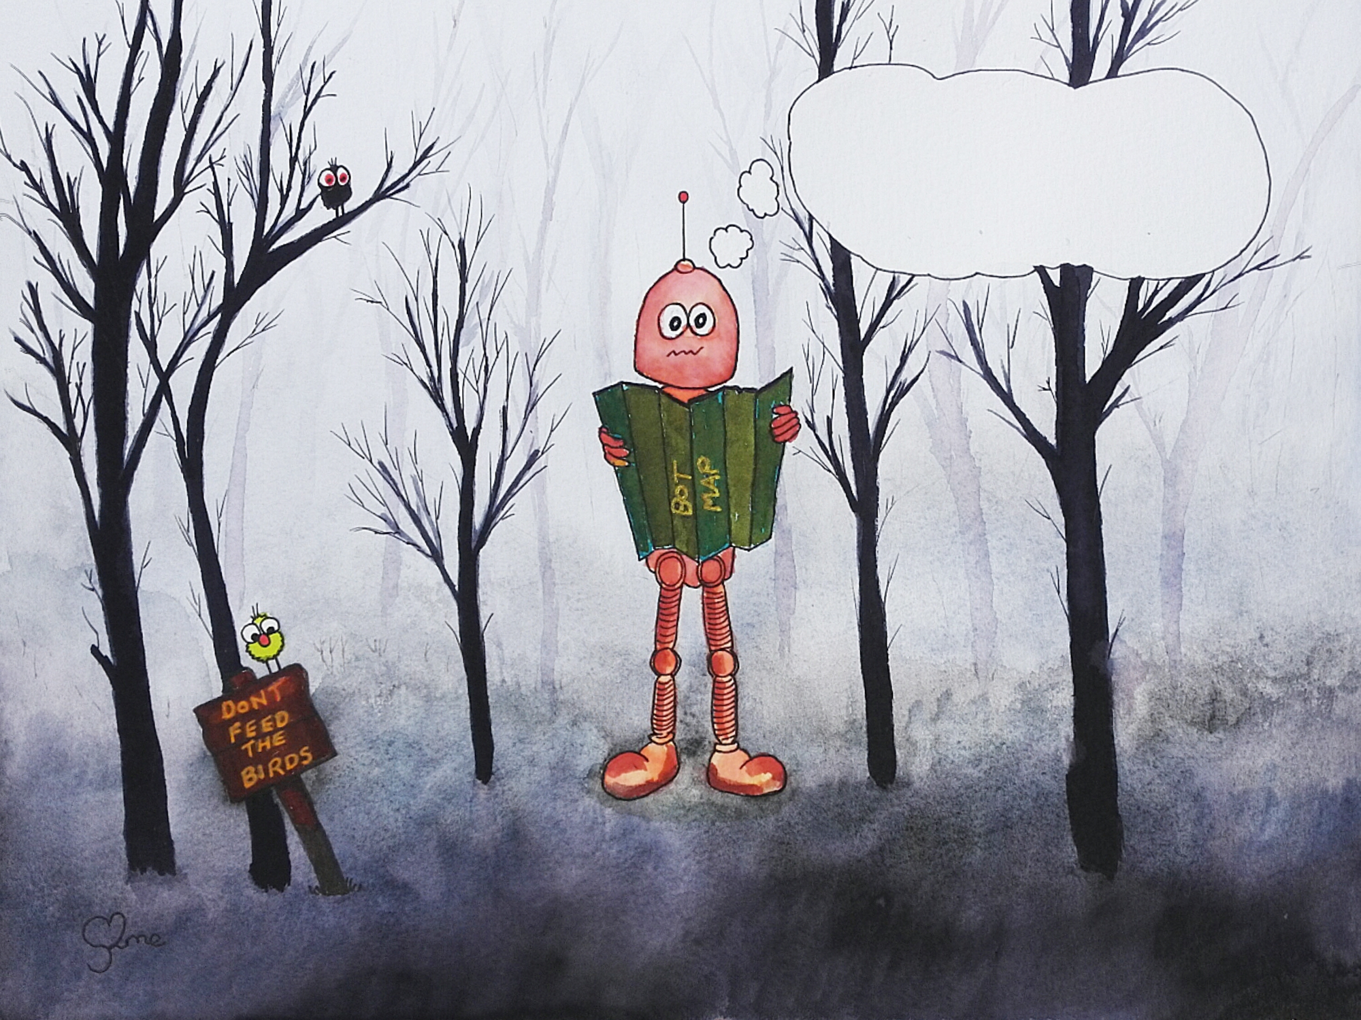
Thunk Question
Is the sunlight ever yours?

Slide 15
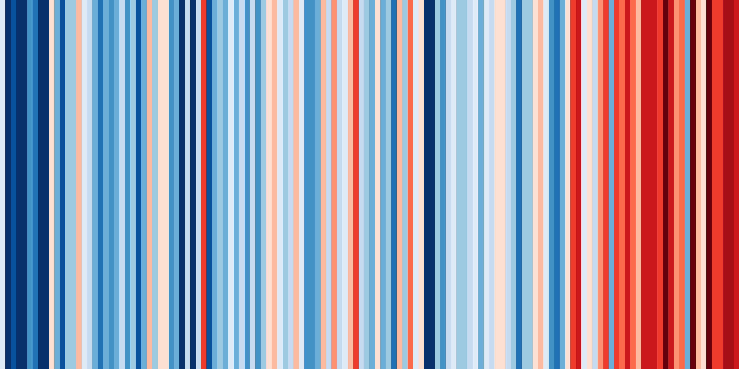
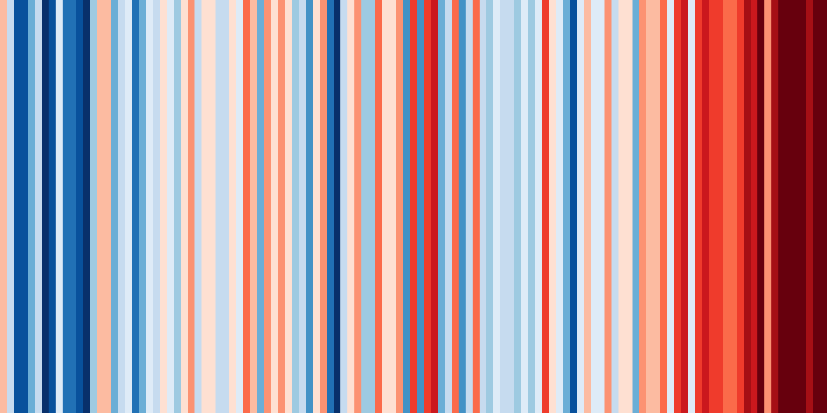
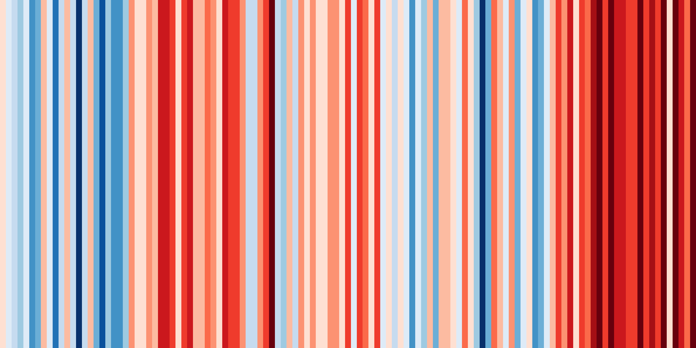
Climate change reflection
1850
1900
1950
2000
2018
England
Compare these climate stripes for England, Egypt and Greenland
Egypt
Greenland
Climate stripes are data graphics that use a series of coloured stripes chronologically ordered to show long-term temperature trends. Blue stripes indicate cooler years and red stripes warmer compared to the 1971-2000 period

