Slide 1
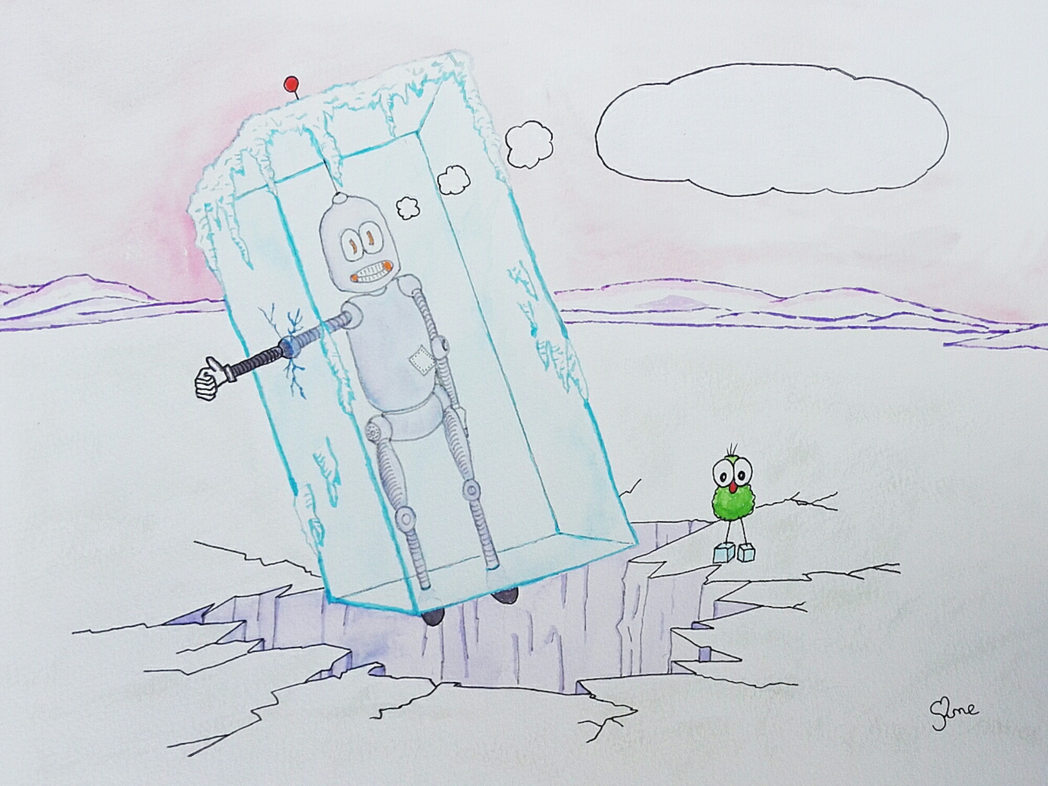
Thunk Question
Where in the world is there most weather?
Thunk question
“A Thunk question is a…simple-looking question about everyday things that stops you in your tracks and helps you start to look at the world in a whole new light.” https://www.independentthinking.co.uk/thunks/
n.b. Thunk in this sense is not an official word in the Cambridge English Dictionary!

Slide 2
Connect your weather learning…
Verbally in pairs;
Define the term ‘Weather’
Name as many different weather variables as possible
Explain how the weather has affected you in the past week
Or attempt this Quizlet set - https://quizlet.com/_8y56zy?x=1jqt&i=38anvz

Slide 3
Weather measurements

Slide 4
Weather measurements
Objectives
Outcomes
To be able to describe the weather instruments and units of measurement for various weather variables (e.g. temperature, wind speed, rainfall).
To evaluate a range of sites for the SUITABILITY to host a weather station.
To understand what we do with weather measurements once we have them.
A completed table of the weather instruments and units of measurement for various weather variables (e.g. temperature, wind speed).
An appropriate choice and written reasons for a weather station at the University of Reading.
A completed Isotherm map.

Slide 5
Reminder of key weather terms and 2 new ones…
Air temperature is a measure of how hot or cold the air is.
Precipitation is any form of water that falls under gravity from clouds such as drizzle, rain, sleet and snow.
Wind is the natural movement of the air, especially in the form of a current of air blowing from a particular direction.
Cloud cover is the fraction of the sky obscured by clouds when observed from a particular location.
Air Pressure is the force exerted by air on any surface in contact with it.
Wind direction is the way the wind is blowing, reported by the direction from which it originates

Slide 6
Weather measurements - Weather variables and how we measure them
Weather element | Instrument | Units | Image
Air pressure
Cloud cover
Precipitation
Temperature
Wind direction
Wind speed
You are to sort out the slips of card so that you can complete the table. There are 6 weather variables. For each variable you need;
An instrument
The units of measurement
An image of what it looks like
Once you have sorted out your information slips, complete the table –this could be written or the slips glued down.
Notes:
Frasmacon CC BY-SA Valentin de Bruyn / Coton CC BY-SA Rolf Gebhardt CC BY-SA 3.0

Slide 7
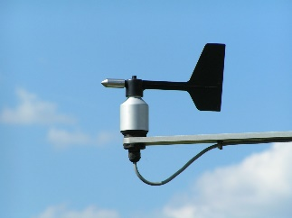
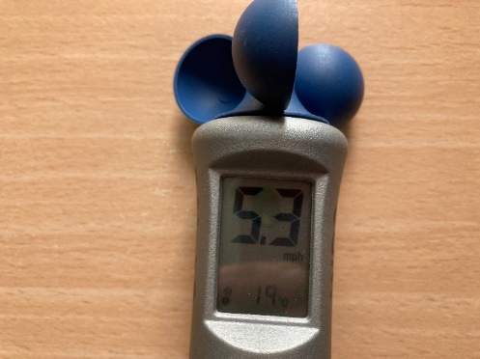
Is your table correct?
Weather element | Instrument | Units | Image
Air pressure | Barometer | mb (millibars)
Cloud cover | Satellite or human sight | Oktas (0 to 8 eighths)
Precipitation | Rain gauge | mm (millimetres)
Temperature | Thermometer | °C (degrees centigrade)
Wind direction | Wind vane | Compass point that the wind is coming from (e.g. north)
Wind speed | Anemometer | m/s or km/h (metres per second or kilometres per hour) or sometimes the Beaufort scale
Give yourself a mark for each correct box – how many points out of 18 did you get?

Slide 8
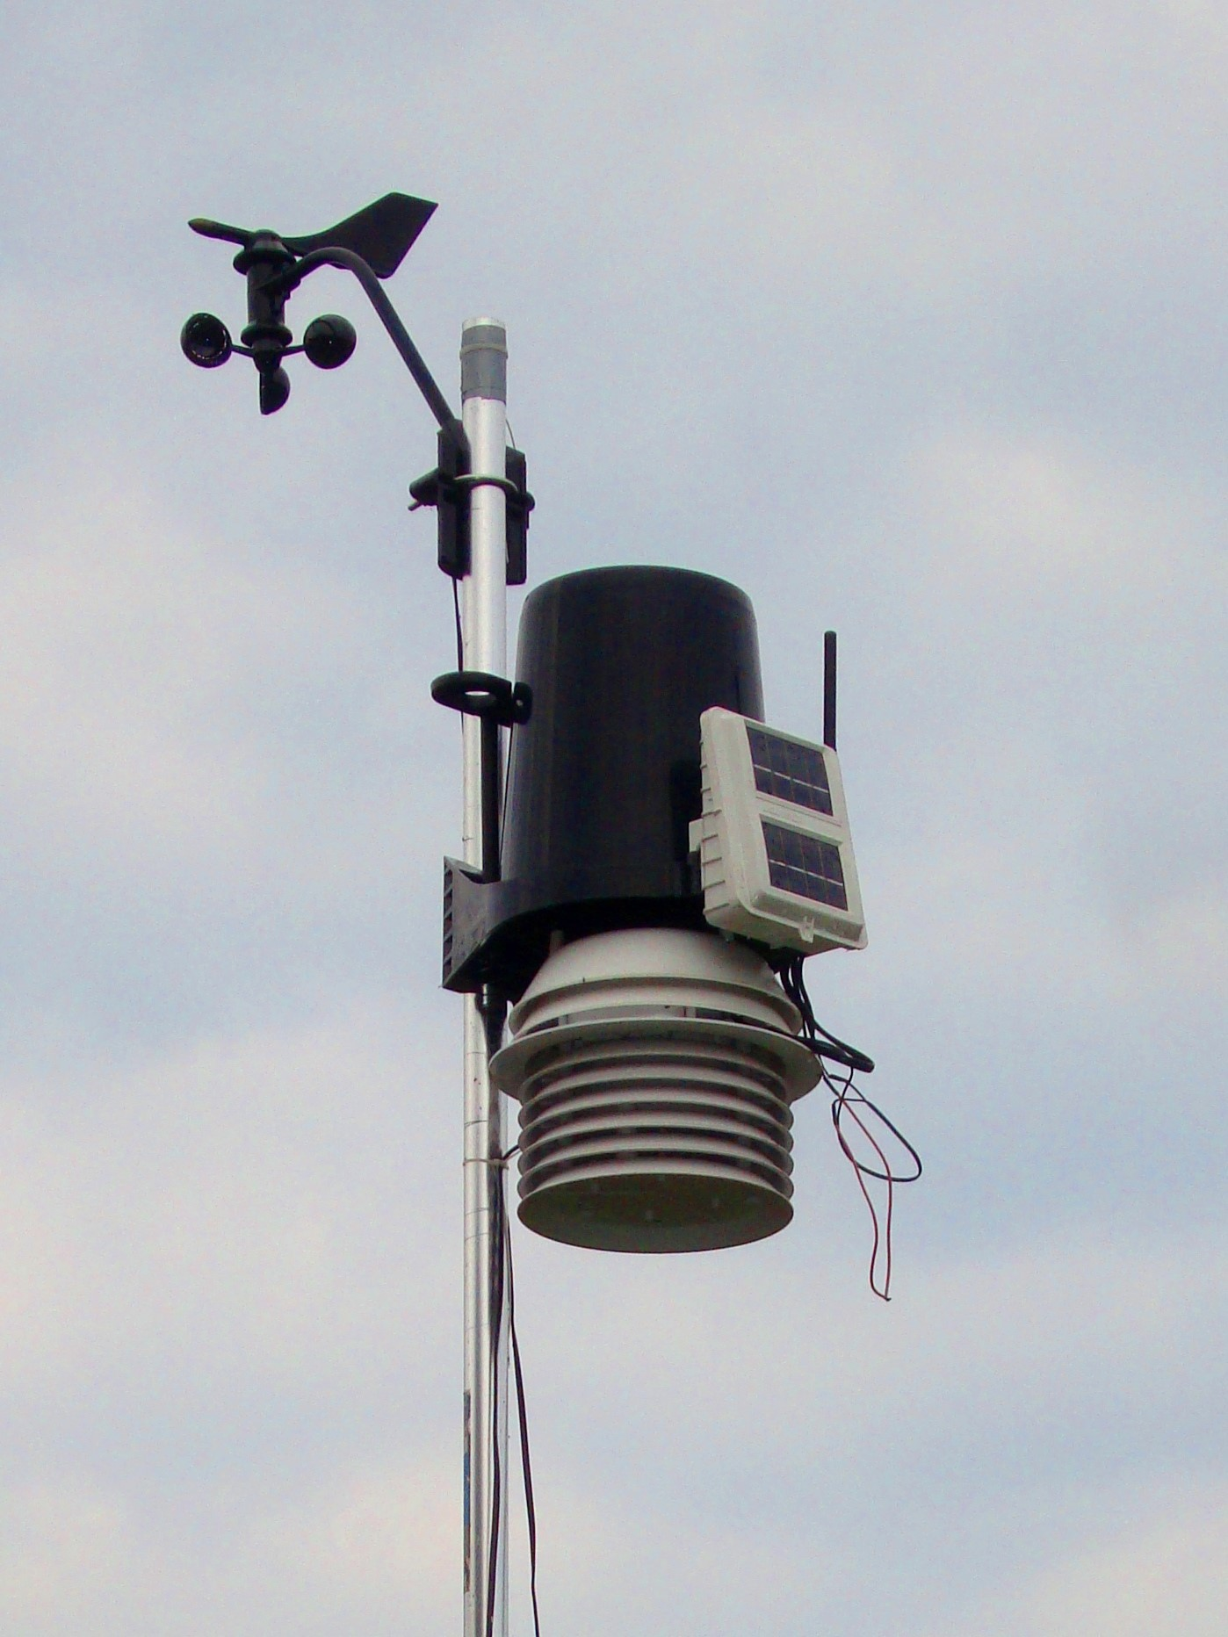
Weather Stations – what they are and where to place them
1. Label the image of a weather station. Which instrument do you think measures;
Temperature (digital thermometer)
Wind speed (Anemometer)
Wind direction (Wind vane)
Rainfall (via a rain gauge)
2. Why do you think that the thermometers are kept within a slatted screen?
3. Attempt the extension activities.
Extension – what do you think is held in this box?
Extension - What is this and why is it needed?

Slide 9
Weather Stations – what they are and where to place them
Wind speed (Anemometer)
Wind direction (Wind vane)
1. Label the image of a weather station. Which instrument do you think measures;
Temperature (digital thermometer)
Wind speed (Anemometer)
Wind direction (Wind vane)
Rainfall (via a rain gauge)
2. Why do you think that the thermometers are kept within a slatted screen?
3. Attempt the extension activities.
Rainfall (via a rain gauge)
This is the data logger
Temperature (digital thermometer) inside a well ventilated screen.
This is a solar panel to power the unit. Ideal for remote use.

Slide 10
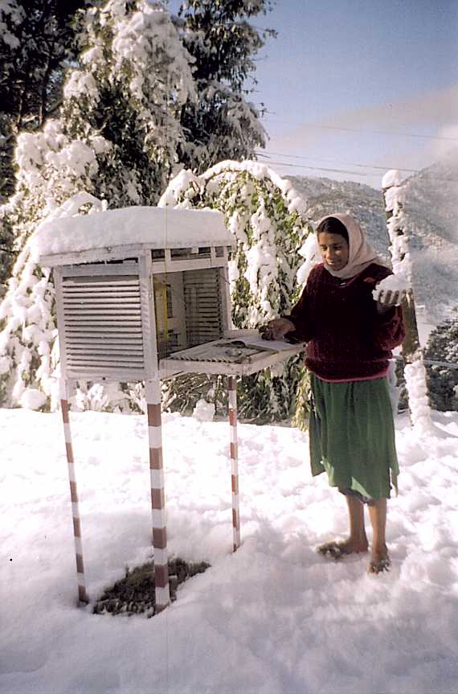
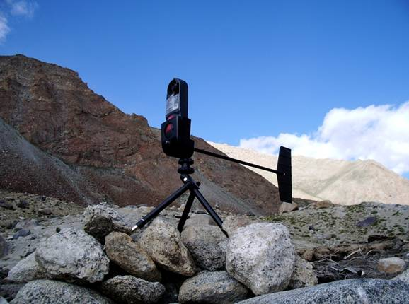
Different weather stations around the world!
A portable or hand-held weather station
A school weather station in the Himalayas

Slide 11
The following slides show other ways of gaining weather data. Whilst looking at the images, discuss…
What can these instruments measure that weather stations can’t?

Slide 12
Observations: Planes Commercial aircraft routinely carry digital instruments to record weather conditions on their flight path. Smaller aircraft can be used to make very detailed observations.
Did you know?: During the Corona virus pandemic, the quality of the weather forecast fell by around 10% because so much less data from aeroplanes was being collected.
Notes:
Images copyright Andrew McGrath/ Airborne Research Australia

Slide 13
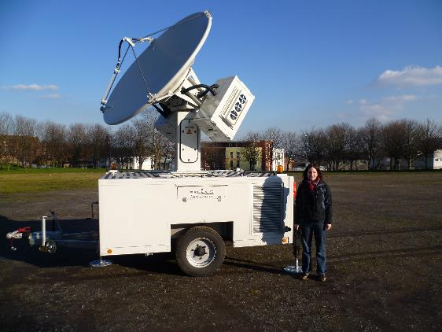
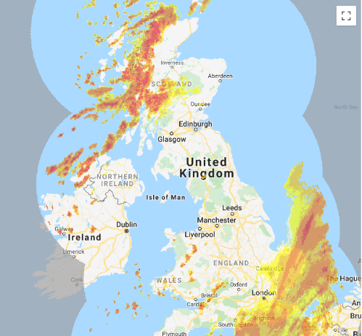
Observations: Radar instruments on the ground measure rainfall
Image courtesy of Lindsay Bennett, Leeds University
DID YOU KNOW? Weather radar instruments can detect migrating insects!
Image courtesy of MeteoGroup and DTN. Originally published on RainToday.Co.UK.
Notes:
Images copyright Lindsay Bennett/ Meteogroup

Slide 14
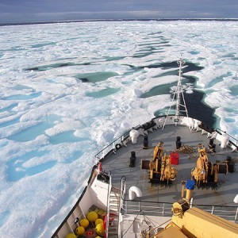
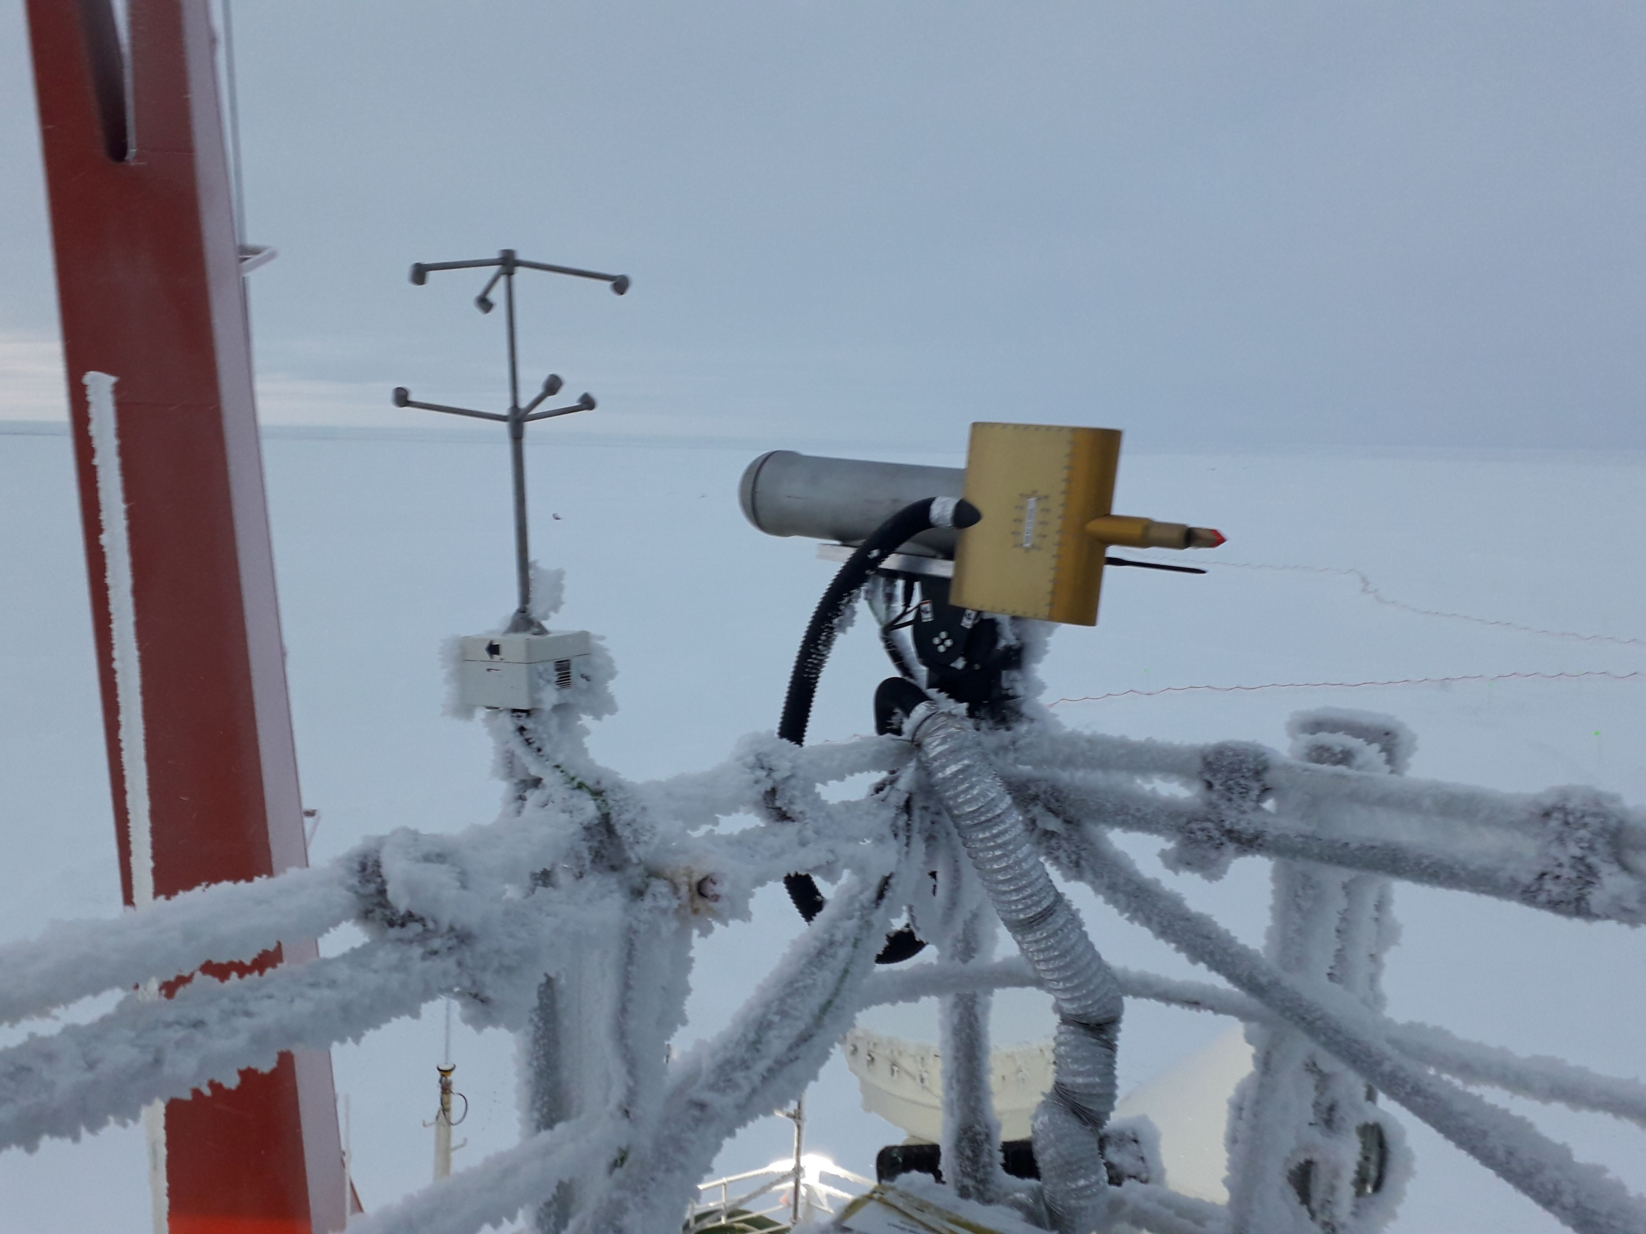
Observations: Ocean based instruments, on buoys and ships, make measurements at sea
Notes:
Images copyright Helen Johnson/ British Antarctic Survey

Slide 15
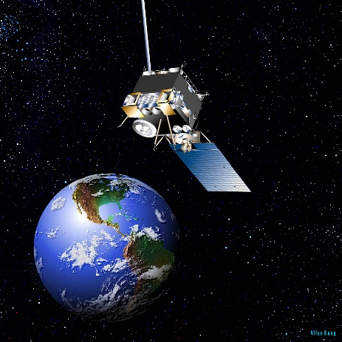
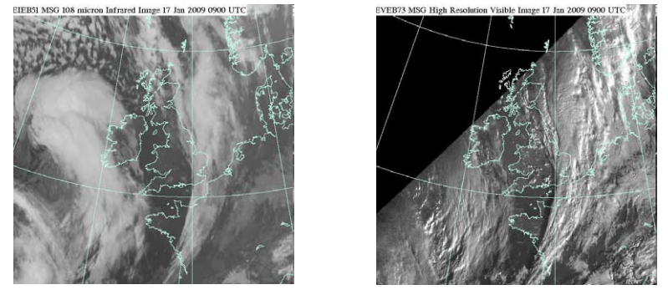
Observations: Satellites collect a huge amount of weather information from around the world
Satellites look at the world with different sensors:
Infrared sensors – this makes a temperature map. Cloud tops are cold!
Visible light
Source: NASA
© Crown copyright, Met Office
Notes:
Images copyright NASA and ECMWF

Slide 16
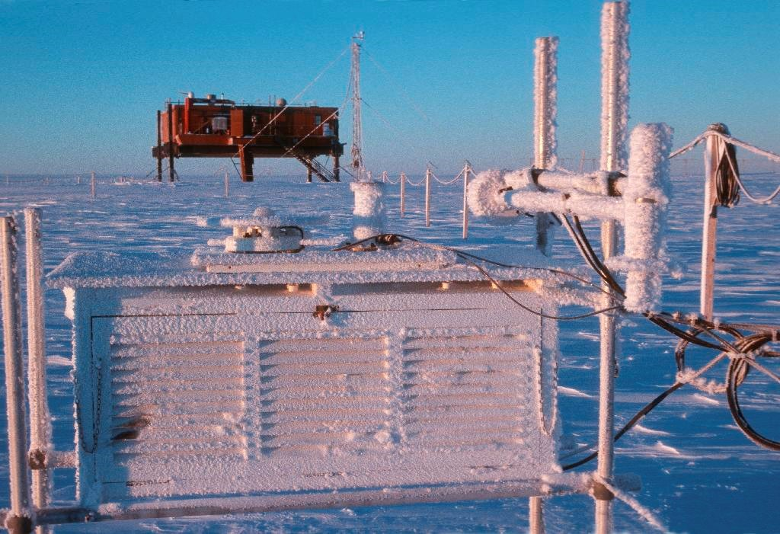
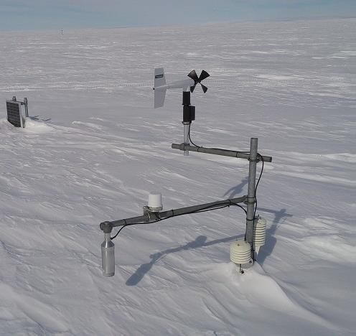
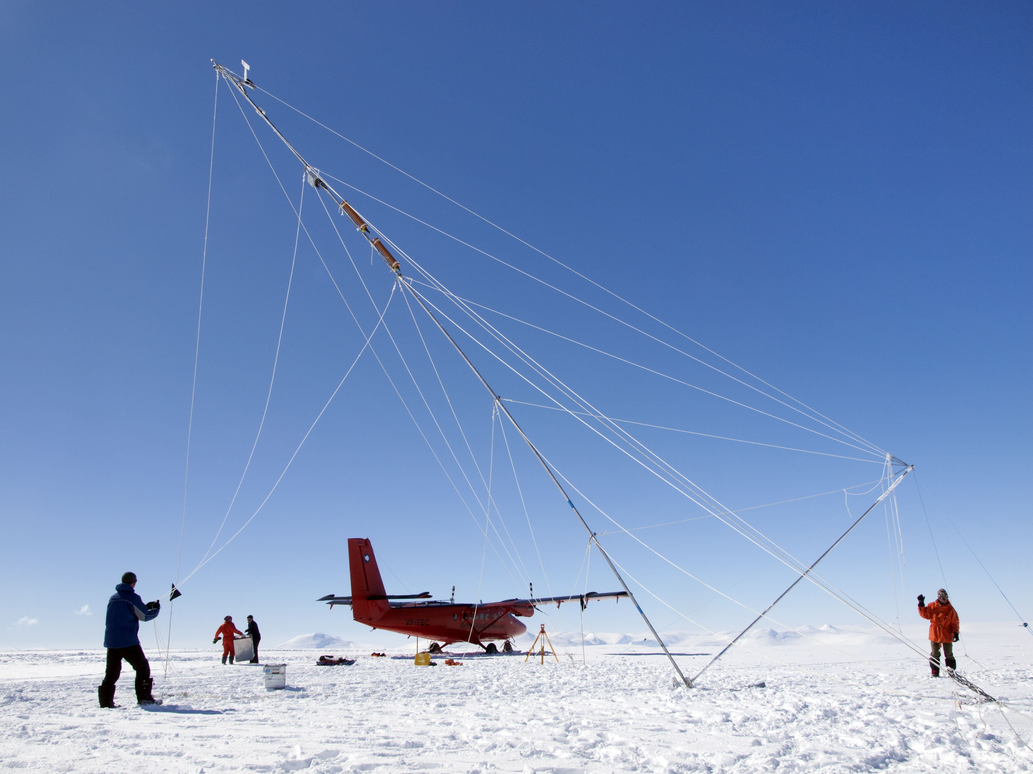
The British Antarctic Survey – why collect data here? What difficulties might there be?
All images kindly supplied by the British Antarctic Survey

Slide 17
According to the Met Office “Weather station sites are selected to ensure that the observations are representative of the wider area around the station and not unduly influenced by local effects.”
For the Met Office, the Ideal site would have the following;
Level ground.
No trees; buildings, or steep ground nearby that might influence the measurements.
However, Undesirable sites to avoid would include;
Warming effect of buildings on the measurement of temperature
Sheltering or shading effects of trees on the measurement of sunshine and wind.
Frost hollow where overnight temperatures on still clear nights may be far lower than at neighbouring locations.
Top of a hill or steep escarpment where winds will be unrepresentative of the wider area.
https://www.metoffice.gov.uk/weather/learn-about/how-forecasts-are-made/observations/weather-stations

Slide 18
Where would you place a weather station at Reading University and why?
According to the Met Office “Weather station sites are selected to ensure that the observations are representative of the wider area around the station and not unduly influenced by local effects.”
For the Met Office, the Ideal site would have the following;
Level ground.
No trees; buildings, or steep ground nearby that might influence the measurements.
However, Undesirable sites to avoid would include;
Warming effect of buildings on the measurement of temperature
Sheltering or shading effects of trees on the measurement of sunshine and wind.
Frost hollow where overnight temperatures on still clear nights may be far lower than at neighbouring locations.
Top of a hill or steep escarpment where winds will be unrepresentative of the wider area.
https://www.metoffice.gov.uk/weather/learn-about/how-forecasts-are-made/observations/weather-stations
2
4
3
5
1
TASK
For the 5 sites shown on the map EVALUATE their site characteristics for a weather station. Consider completing a table like the one opposite
Site | Level ground | No trees that influence measurements | No buildings that influence measurements | In a Frost Hollow | Close to water source which affects humidity measurement
1
2
3
4
5
Notes:
Image source: Google Maps with CNES / Airbus, Getmapping pls, Infoterra Ltd & Bluesky, Landsat / Copernicus, Maxar Technologies

Slide 19
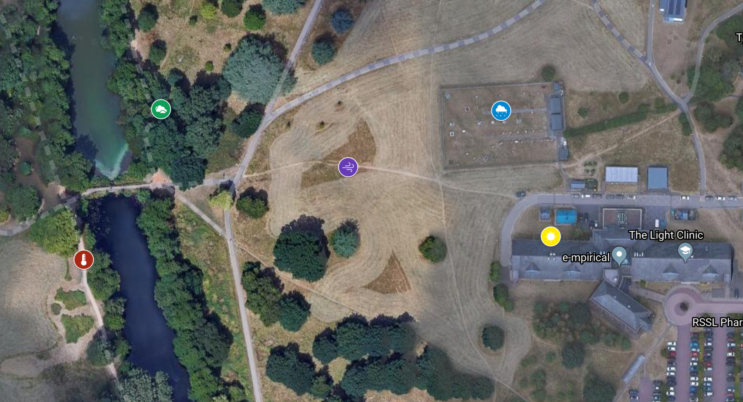
2
4
3
5
1
The actual site for the weather station is site 4 – in pairs consider why this was the best site. Did you select the correct place?
Do the 2 photographs opposite provide more evidence as to why this area was chosen for a weather station?
Image credits: the University of Reading
Notes:
Image source: Google Maps with CNES / Airbus, Getmapping pls, Infoterra Ltd & Bluesky, Landsat / Copernicus, Maxar Technologies

Slide 20
1850
1900
2000
2018
How do weather measurements at sites around the country relate to the weather maps you see on the forecast?
Notes:
The weather data collected is input into computer models, which generate both the maps of current weather and the forecasts of future weather

Slide 21
What do we do with the weather data?
Drawing isotherms
Isotherms are a type of isoline map.
If they are closely spaced, the temperature is changing quickly; if they are far apart the change is slower.
Isotherms connect equal temperatures, in the same way that isobars connect equal pressures on a weather map.
The isotherms in this exercise are at intervals of 4°C.
Drawing isotherms is as simple as connecting the numbers with a line, but there are some basic rules:
An isotherm can’t stop in the middle of the land. It must either form a circle or continue to the edge of the land.
Isotherms can’t divide or combine.
Isotherms can never touch or cross (you’d have two temperatures in the same place).
Tips
Draw in pencil so you can erase mistakes.
Look and think, then draw. Isotherms often follow their neighbours but they are also affected by many other things including relief, land and water.

Slide 22
What do we do with the weather data?
TASKS
Complete the map by adding the 34 and 37°C Isotherms
Describe your map – what does it show about patterns of temperatures in the UK? You can use the sentence starters below and place names to hep
My map shows me that…
The hottest temperatures can be found….
As you progress North…

Slide 23
Review - Why do we measure the weather?
Look at the rainfall radar for today - at https://www.netweather.tv/live-weather/radar
What does this animation show?
How can we use this information (as a forecast)
OR https://quizlet.com/_8y575t?x=1jqt&i=38anvz
EXTENSION
How has that data been collected?
How accurate is it?
Why do we need this information in the UK?
What other data could be represented on maps like these?

Slide 24
Weather measurements and climate change
1850
1900
1950
2000
2018
How do weather measurements help our understanding of climate change?

