Slide 1
Connect your learning - Climate in the UK - Zones
Which zone do the following descriptors go with?
Can you explain verbally in pairs;
Why it is generally wetter in the West
Why it is generally wetter in our mountainous areas
Why it gets colder as we progress NORTH?
B
Descriptor | Zone
Cold winters, cool summers, lower rainfall
Cold winters, warm summers, lower rainfall
Mild winters, cool summers, heavy rainfall
Mild winters, warm summers, heavier rainfall
B
B
D
A
A
A
C
D
C
D
C

Slide 2
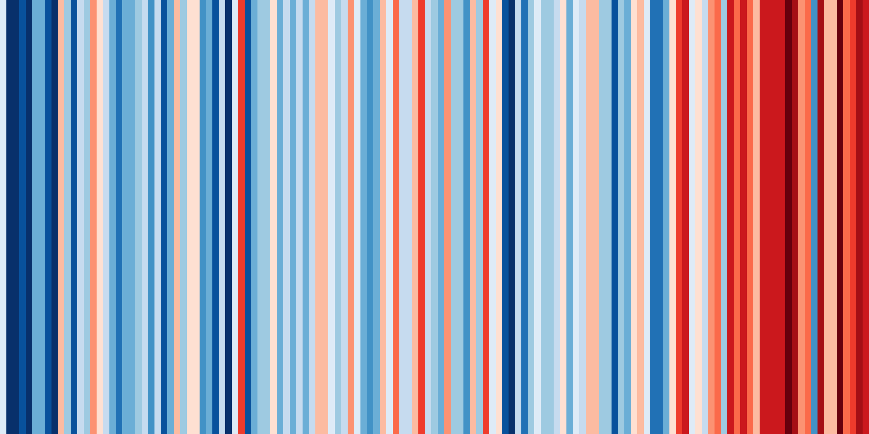
Changing UK Climate
Climate stripes representative of temperature for the UK over time
You can find your own climate stripes: https://showyourstripes.info/

Slide 3
Changing UK Climate
Objectives
Outcomes
To understand how climate (precipitation & temperature) has changed over time in the UK.
To be able to classify the potential impacts of changing climate on the UK.
A summary table of changes to both temperature and precipitation in the UK.
A colour coded table on the impacts of climate change on the UK.

Slide 4
How has the UK climate changed?

Slide 5
Changing UK Climate - The Central England Temperature (CET) Record
Look carefully at the data opposite from the Central England Temperature record. It shows the average monthly temperatures for 2 time periods. The monthly average has been calculated from 30 years' worth of data.
Tasks
Calculate the Mean for both time periods
Calculate the Range for both time periods
What has happened to temperature over time?
Is this pattern the same for all months?
Overall what does this show us about the climate in the UK?
The graph on the next slide will help visualise these answers.
 | 1901-1930 temperature averages | 1991-2020 temperature averages
JAN | 4.2 | 4.7
FEB | 4.2 | 5.0
MAR | 5.5 | 6.7
APR | 7.6 | 9.0
MAY | 11.3 | 11.9
JUN | 13.8 | 14.6
JUL | 15.8 | 16.8
AUG | 15.2 | 16.6
SEP | 13.1 | 14.2
OCT | 9.8 | 10.8
NOV | 5.8 | 7.3
DEC | 4.5 | 4.8
Mean
Range
Mean = All results added together
Range = Largest value – Smallest value
Number of results

Slide 6
Changing UK weather - The Central England Temperature (CET) Record
DID YOU KNOW? The Hadley Centre Central England Temperature (HadCET) dataset is the longest instrumental record of temperature in the world.
The mean, minimum and maximum datasets are updated monthly.
The mean daily data series begins in 1772 and the mean monthly data in 1659.
These daily and monthly temperatures are representative of a roughly triangular area of the United Kingdom enclosed by Lancashire, London and Bristol.
 | 1901-1930 temperature averages | 1991-2020 temperature averages
JAN | 4.2 | 4.7
FEB | 4.2 | 5.0
MAR | 5.5 | 6.7
APR | 7.6 | 9.0
MAY | 11.3 | 11.9
JUN | 13.8 | 14.6
JUL | 15.8 | 16.8
AUG | 15.2 | 16.6
SEP | 13.1 | 14.2
OCT | 9.8 | 10.8
NOV | 5.8 | 7.3
DEC | 4.5 | 4.8
Mean
Range

Slide 7
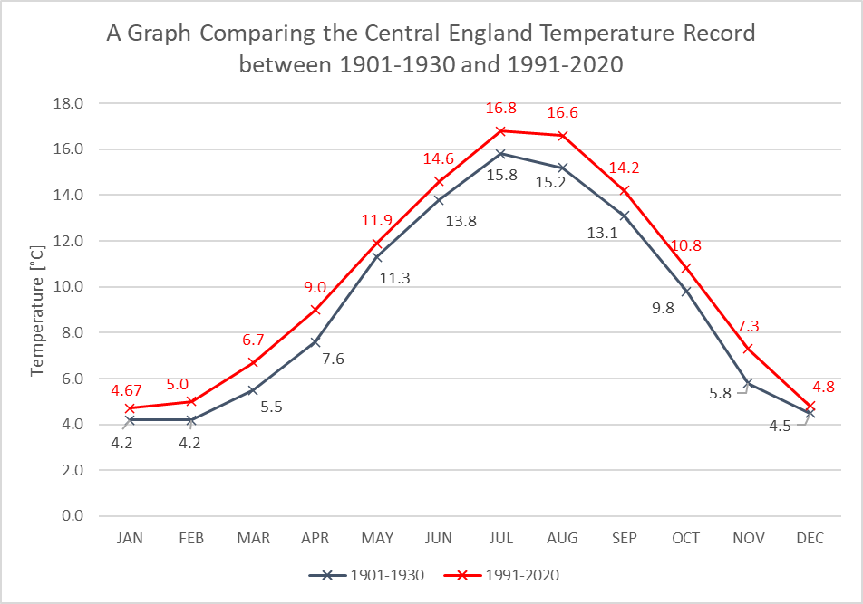
Overall what does this show us about the climate in the UK?

Slide 8
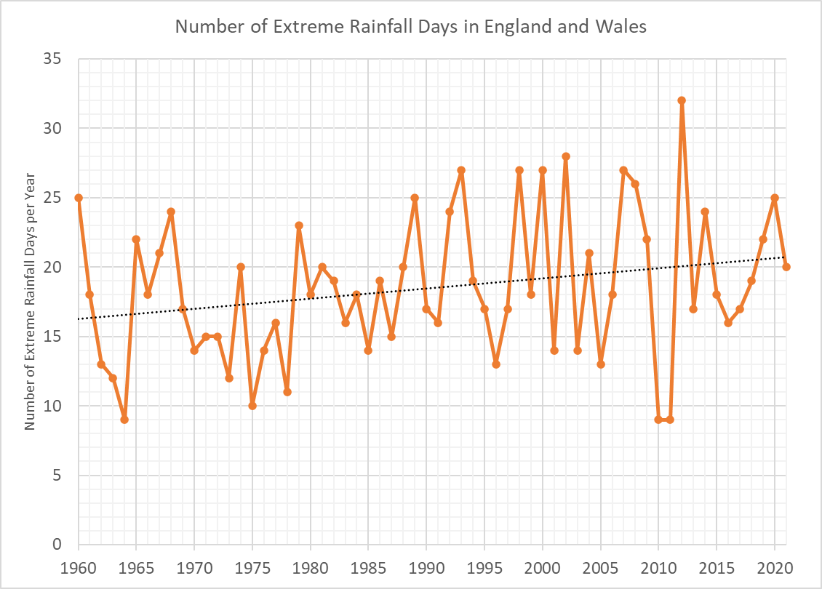
Changing UK Weather – the evidence for Precipitation Change
What does this graph show:
About the change in extreme rainfall from 1960 to 2014?
How could this impact upon people?
EXTRA!
The graph shows the 5% of days when there is most rain.
The rain on those days had to be above 9.4mm.
Original graph source - https://rmets.onlinelibrary.wiley.com/doi/epdf/10.1002/joc.6213
https://www.metoffice.gov.uk/hadobs/hadukp/data/daily/HadEWP_daily_totals.txt

Slide 9
In summary
 | What happens over time?
Average temperatures
Number of extreme rainfall days
https://www.youtube.com/watch?v=SDxmlvGiV9k&feature=youtu.be

Slide 10
What impacts could a changing climate have on the UK in the FUTURE?

Slide 11
What impacts could a changing climate have on the UK in the FUTURE? classification activity
2. Overall does it look as though the UK is ready for the risks and opportunities faced by climate change?
Classify the slips in the table as either OPPORTUNITIES or RISKS
The goal is to understand what could happen to the UK climate in the future and what impacts this could have on human life
1. In cities heatwave temperatures will become a normal summer by 2040 | 2. There could be a move to electric vehicles which will also reduce urban air pollution | 3. Coastal regions will experience more tidal flooding and coastal erosion | 4. UK sea waters will become warmer and this will affect fish stocks
5. Hospitals, care homes and schools are not being adapted for warmer weather | 6. More variation in rainfall could lead to water shortages | 7. The area of urban greenspaces in the UK is no longer falling and could even increase | 8. There is evidence that plankton (the base of ocean food chains) is becoming less abundant in UK waters
9. 11,000 homes were protected against coastal erosion between 2010 and 2015 | 10. Climate change will increase the frequency and intensity of floods, with 4 million homes in England already at risk | 11. Sewerage networks lack the capacity for heavier rainfall | 12. Fewer people will die from cold related deaths and fuel poverty
13. £15 million has been given for natural flood management projects | 14. Extreme rainfall will bring more flooding to our rivers | 15. Habitats and natural flood protection will be lost to sea level rise | 16. There are opportunities to use more sustainable energy such as solar and wind. These could provide local energy rather than imports of fossil fuels.
17. More coastal storms threaten coastal infrastructure such as power stations and ports | 18. There could be more water borne pathogens, pests and diseases | 19. Coastal areas will see an increase in tourism and leisure visitors | 20. New species will colonise our seas and our land
21. Some crops will see an increase in productivity | 22. Moving away from coal and oil to wind and solar energy also improves air quality. | 23. There will be more heat related health impacts for people | 24. There will be more wildfire risks to farming and forestry
Extension: Further classify the slips of information as Social (S), Economic (Ec) or Environmental (En)

Slide 12
Review - Based upon what you have discovered today – should the UK government act on climate change? Discuss in pairs
OR https://quizlet.com/_8y58nw?x=1jqt&i=38anvz

Slide 13
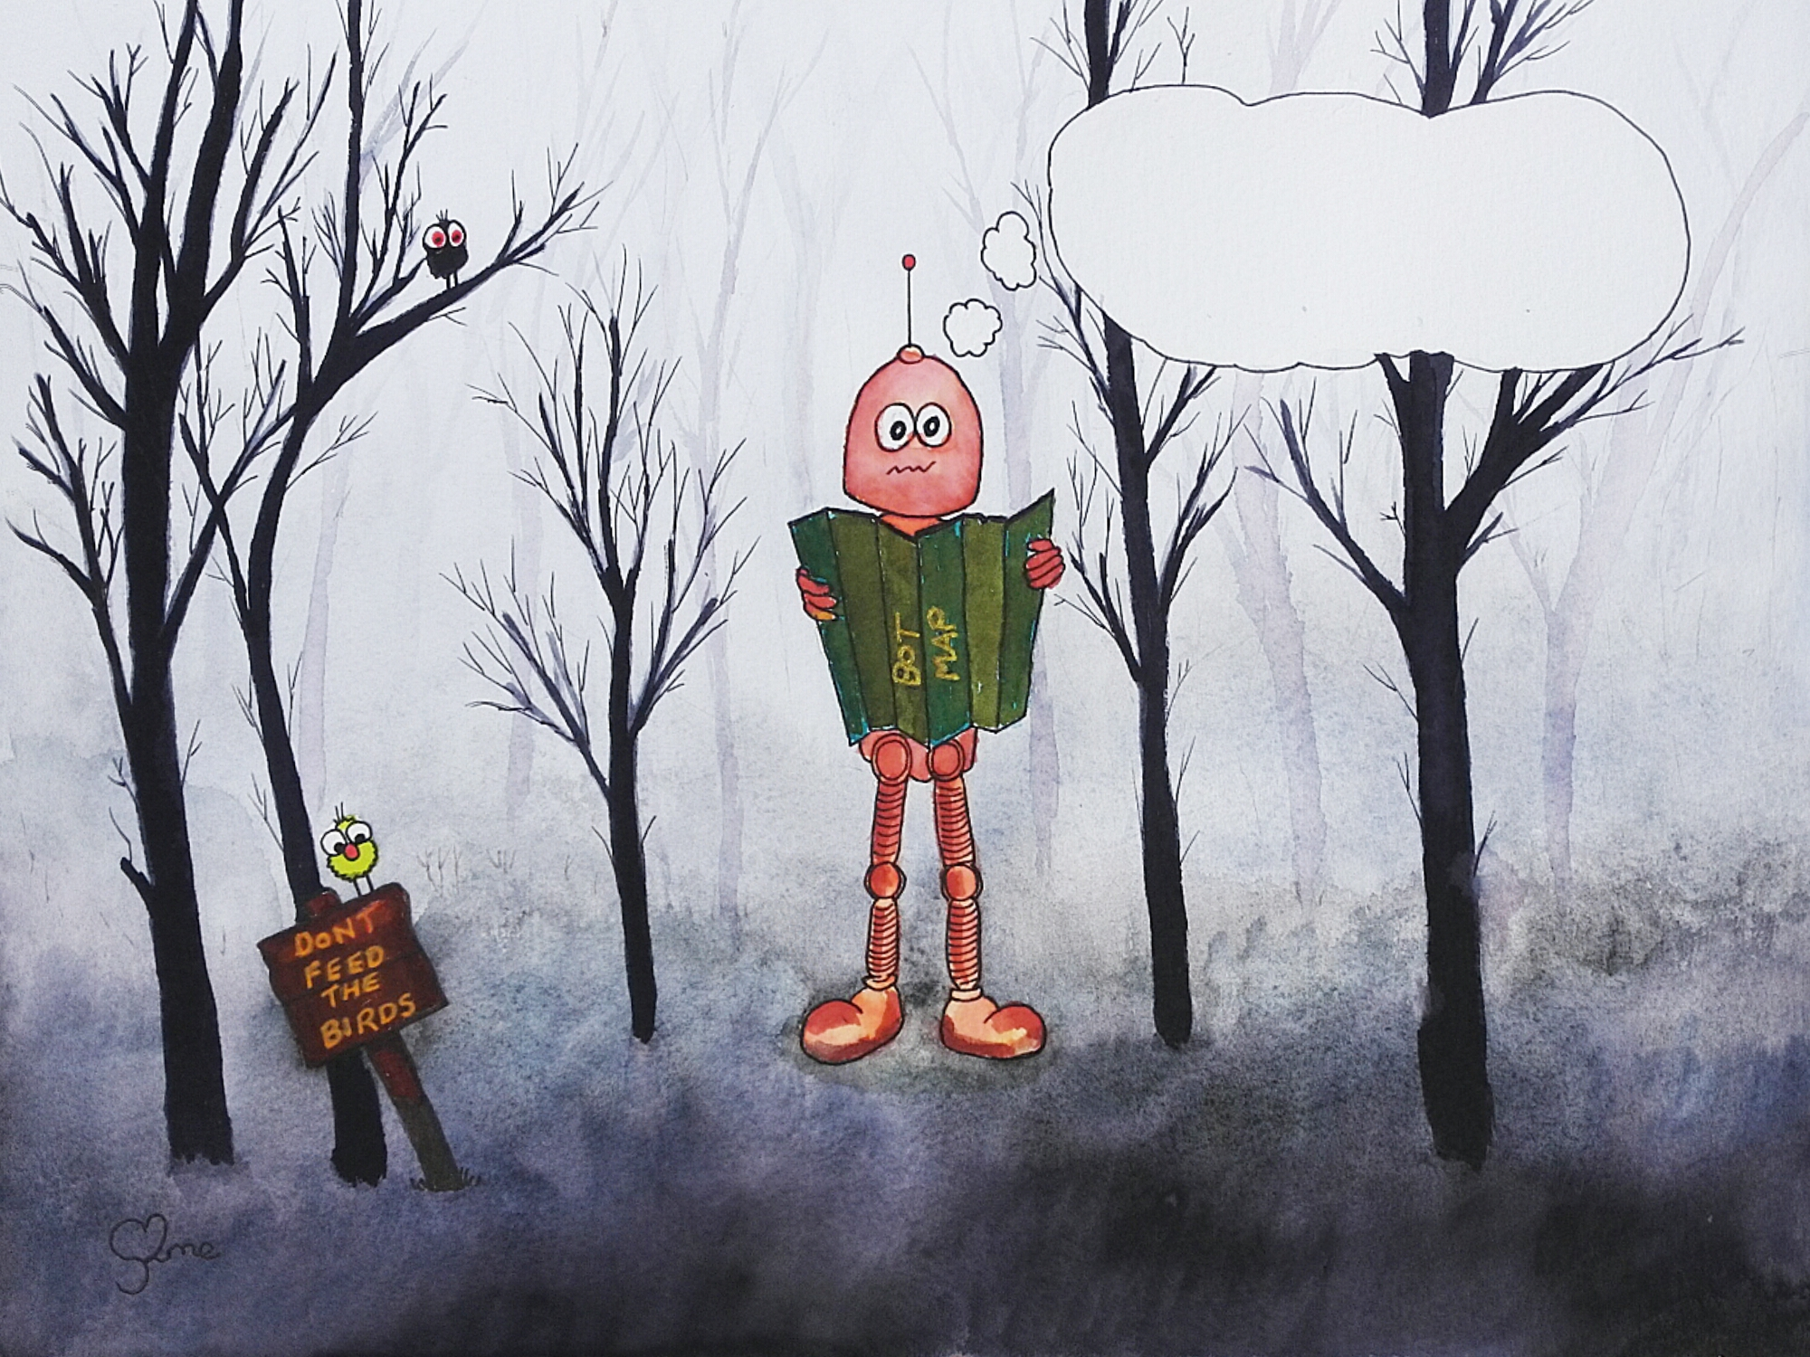
Thunk Question
Who owns the water in clouds?

Slide 14
Climate change and the UK
1850
1900
1950
2000
2018
Out of these options, which climate change impact in the UK do you think will impact on you most?
Summer heat and fires;
Summer flash floods;
Winter river floods;
Winter storms;
Climate migrants to the UK;
Coastal flooding

Slide 15
Homework
Look carefully at the graph from the Central England temperature record
What was the lowest temperature recorded?
In which year was the lowest average temperature recorded?
What was the highest temperature recorded?
In which year was the highest average temperature recorded?
How many times does the average temperature go above 10°C in the 250 years prior to 1900? (count up the RED dots)
How many times does the average temperature go above 10°C in the just over 100 years since 1900?
Use the TREND line – what temperature does it start and end at? By how much has the temperature changed?

