Slide 1
Connect your learning - Climate in the UK - Zones
Which zone do the following descriptors go with?
Can you explain verbally in pairs;
Why it is generally wetter in the West
Why it is generally wetter in our mountainous areas
Why it gets colder as we progress NORTH?
Descriptor | Zone
Cold winters, cool summers, lower rainfall
Cold winters, warm summers, lower rainfall
Mild winters, cool summers, heavy rainfall
Mild winters, warm summers, heavier rainfall
B
B
B
A
A
D
A
C
D
C
D
C

Slide 2
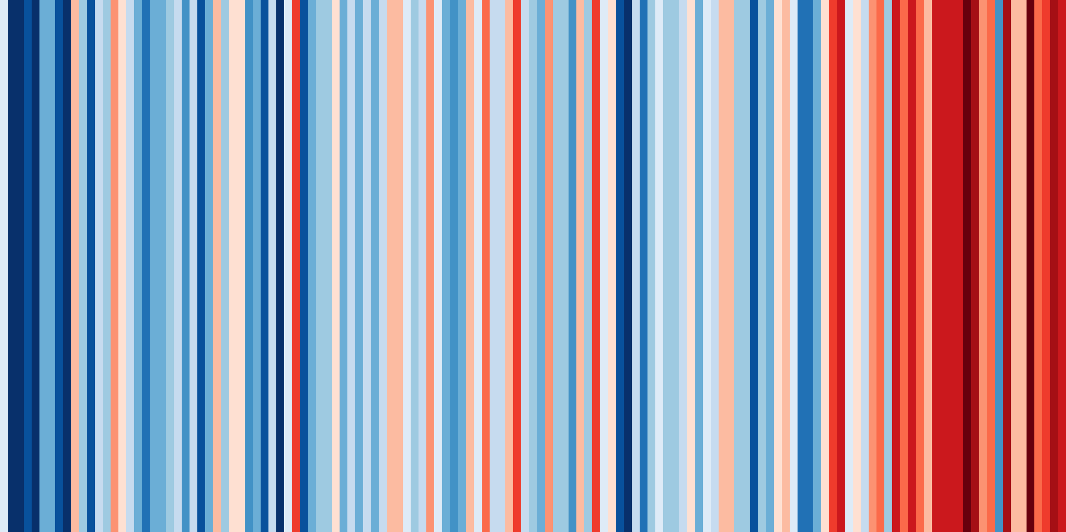
Changing UK Climate
Climate stripes representative of temperature for the UK over time
You can find your own climate stripes: https://showyourstripes.info/
Notes:
In 2022 we updated the graphics in this image to the updated base climate period of 1991-2020. However, not all the necessary data and images are available, so there are still some references to 1981-2010.

Slide 3
Changing UK Climate
Objectives
Outcomes
To understand how climate (precipitation & temperature) has changed over time in the UK
To be able to classify the potential impacts of changing climate on the UK
A summary table of changes to both temperature and precipitation in the UK
A colour coded table on the impacts of climate change on the UK

Slide 4
How has the UK climate changed? Note to teachers – we have included 5 graphics, 2 would suffice for most groups

Slide 5
Changing UK Climate - The Central England Temperature (CET) Record
 | 1901-1930 temperature averages | 1991-2020 temperature averages
JAN | 4.2 | 4.7
FEB | 4.2 | 5.0
MAR | 5.5 | 6.7
APR | 7.6 | 9.0
MAY | 11.3 | 11.9
JUN | 13.8 | 14.6
JUL | 15.8 | 16.8
AUG | 15.2 | 16.6
SEP | 13.1 | 14.2
OCT | 9.8 | 10.8
NOV | 5.8 | 7.3
DEC | 4.5 | 4.8
Mean
Range
Look carefully at the data opposite from the Central England Temperature record. It shows the average monthly temperatures for 2 time periods. The monthly average has been calculated from 30 years’ worth of data.
Tasks
Calculate the Mean for both time periods
Calculate the Range for both time periods
What has happened to temperature over time?
Is this pattern the same for all months?
Overall what does this show us about the climate in the UK?
The graph on the next slide will help visualise these answers.
Mean = All results added together
Range = Largest value – Smallest value
Number of results

Slide 6
Changing UK weather - The Central England Temperature (CET) Record
DID YOU KNOW? The Hadley Centre Central England Temperature (HadCET) dataset is the longest instrumental record of temperature in the world.
The mean, minimum and maximum datasets are updated monthly.
The mean daily data series begins in 1772 and the mean monthly data in 1659.
These daily and monthly temperatures are representative of a roughly triangular area of the United Kingdom enclosed by Lancashire, London and Bristol.
 | 1901-1930 temperature averages | 1991-2020 temperature averages
JAN | 4.2 | 4.7
FEB | 4.2 | 5.0
MAR | 5.5 | 6.7
APR | 7.6 | 9.0
MAY | 11.3 | 11.9
JUN | 13.8 | 14.6
JUL | 15.8 | 16.8
AUG | 15.2 | 16.6
SEP | 13.1 | 14.2
OCT | 9.8 | 10.8
NOV | 5.8 | 7.3
DEC | 4.5 | 4.8
Mean
Range
Mean = All results added together
Range = Largest value – Smallest value
Number of results

Slide 7
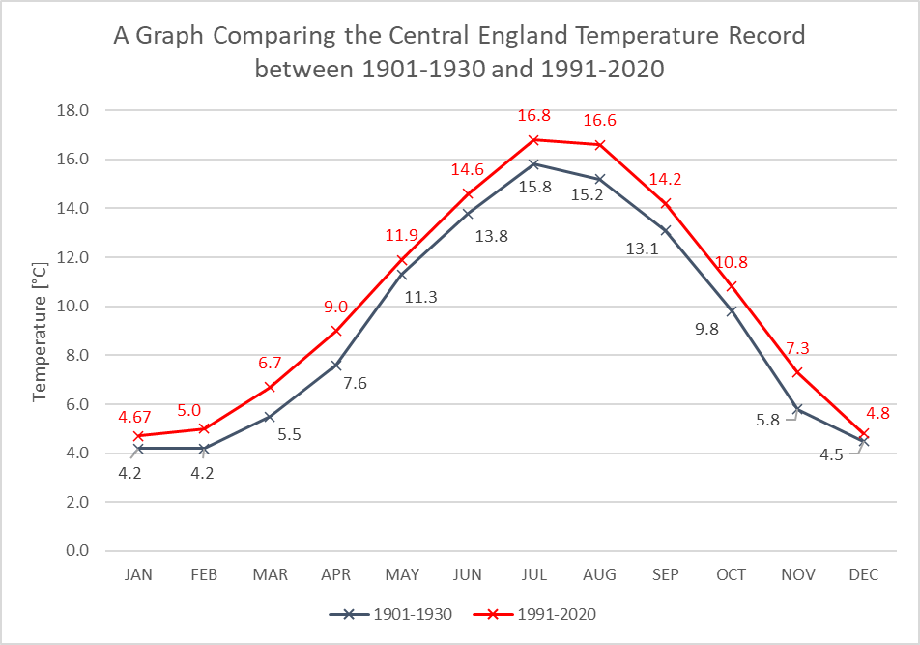
Overall what does this show us about the climate in the UK?
Good words to use – Fluctuating, rising, any figures and dates, Higher, lower, Long term mean (average)

Slide 8
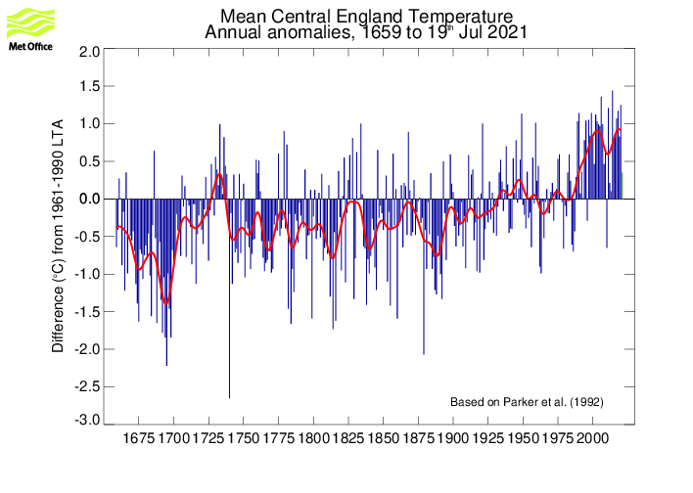
Changing UK Weather – the evidence for Temperature Change
Describe the patterns on the graph below – what is happening to temperature over time?
Values ABOVE the line mean that year was WARMER than normal for Central England
The average period (long term average) shown on the graph is 1961 to 1990. Don’t forget we use 30 year periods to show climate.
The long term average represented as 0.
Values BELOW the line mean that year was COLDER than normal for Central England
© Crown copyright, Met Office

Slide 9
What does this graph show:
About the change in precipita-tion from 1910 to 2018?
About how much the rainfall varies (changes) over the last 30 years?
Mean 1910 to 1929 – 1101mm
Mean 1989 to 2018 – 1145mm
Average for whole time period (1910 to 2018) is 1096mm

Slide 10
Changing UK Weather – the evidence for Precipitation Change
What does this graph show:
About the change in extreme rainfall from 1960 to 2014?
How could this impact upon people?
EXTRA!
The graph shows the number of days when the 95th percentile of UK daily average rainfall from 1961 -2010 are exceeded.
The rain on those days had to be above 9.4mm.
They are the top 5% of rain days.
Original graph source https://rmets.onlinelibrary.wiley.com/doi/epdf/10.1002/joc.6213
https://www.metoffice.gov.uk/hadobs/hadukp/data/daily/HadEWP_daily_totals.txt

Slide 11
In summary
 | What happens over time?
Average temperatures
Annual rainfall
Number of extreme rainfall days
https://www.youtube.com/watch?v=SDxmlvGiV9k&feature=youtu.be

Slide 12
What impacts could a changing climate have on the UK in the FUTURE?

Slide 13
Climate change – opportunities and risks
Climate change will make it possible for us to do new things and explore new activities. These are the OPPORTUNITIES of climate change.
However, many people are concerned that climate change will remove current human activities and make our lives increasingly hazardous and difficult. These are the risks of climate change.
On the next slide and on your worksheet classify the information slips in the table as either OPPORTUNITIES or RISKS.

Slide 14
What impacts could a changing climate have on the UK in the FUTURE? classification activity
Classify the slips in the table as either OPPORTUNITIES or RISKS
The goal is to understand what could happen to the UK climate in the future and what impacts this could have on human life
2. What could the UK to prepare for the risks and opportunities posed by climate change?
1. In cities heatwave temperatures will become a normal summer by 2040 | 2. The ability of UK ports to cope with sea level rise is not known and they are under threat | 3. Coastal regions will experience more tidal flooding and coastal erosion | 4. UK sea waters will become warmer and this will affect fish stocks
5. Hospitals, care homes and schools are not being adapted for warmer weather | 6. Moving away from coal and oil to wind and solar energy also improves air quality. | 7. The area of urban greenspaces in the UK is no longer falling and could even increase | 8. There is evidence that plankton (the base of ocean food chains) is becoming less abundant in UK waters
9. 11,000 homes were protected against coastal erosion between 2010 and 2015 | 10. Climate change will increase the frequency and intensity of floods, with 4 million homes in England already at risk | 11. Sewerage networks lack the capacity for heavier rainfall | 12. There could be a move to electric vehicles which will also reduce urban air pollution
13. Long term declines in key wildlife species continue | 14. Storm Desmond in 2015 showed broadband and bridges infrastructure are vulnerable to flooding | 15. Farming efficiency has been increased so we have more food | 16. More extreme weather will disrupt infrastructure such as electricity and transport
17. £15 million has been given for natural flood management projects | 18.There are opportunities to use more sustainable energy such as solar and wind. These could provide local energy rather than imports of fossil fuels. | 19. Habitats and natural flood protection will be lost to sea level rise | 20. Some coastal communities will be lost
21. More coastal storms threaten coastal infrastructure such as power stations and ports | 22. There could be more water borne pathogens, pests and diseases | 23. Coastal areas will see an increase in tourism and leisure visitors | 24. New species will colonise our seas and our land
25. Some crops will see an increase in productivity | 26. Air quality could get worse | 27. There will be more heat related health impacts for people | 28. There will be more wildfire risks to farming and forestry
29. Our peatlands will be under threat | 30. Extreme rainfall will bring more flooding to our rivers | 31. More variation in rainfall could lead to water shortages | 32. Fewer people will die from cold related deaths and fuel poverty
Extension: Further classify the slips of information as Social (S), Economic (Ec) or Environmental (En)

Slide 15
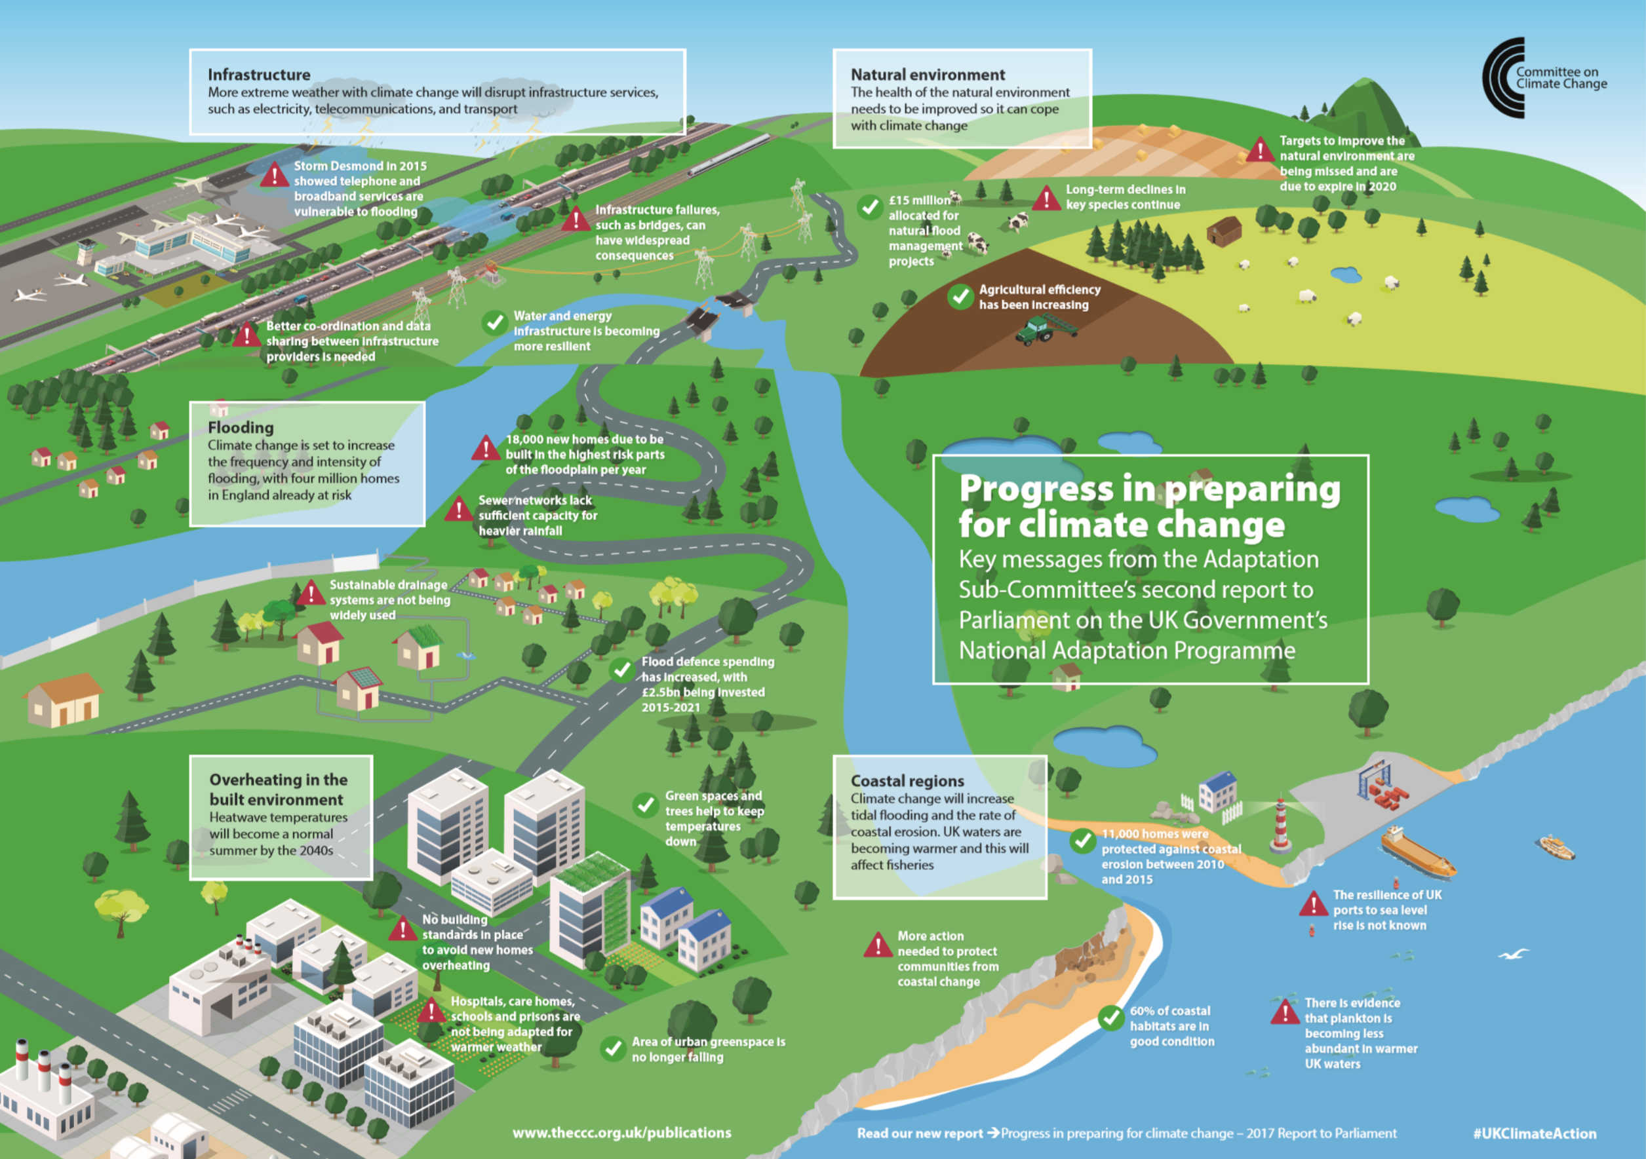
Warning triangles flag risks to the UK
Based upon your table of information;
What are the greatest dangers to the UK of climate change?
What needs doing?
What is the most important?
Ticks flag opportunities for the UK
https://www.theccc.org.uk/wp-content/uploads/2013/01/Progress-in-preparing-snip.jpg

Slide 16
Review - Based upon what you have discovered today – should the UK government act on climate change? Discuss in pairs
OR https://quizlet.com/_8y58nw?x=1jqt&i=38anvz

Slide 17
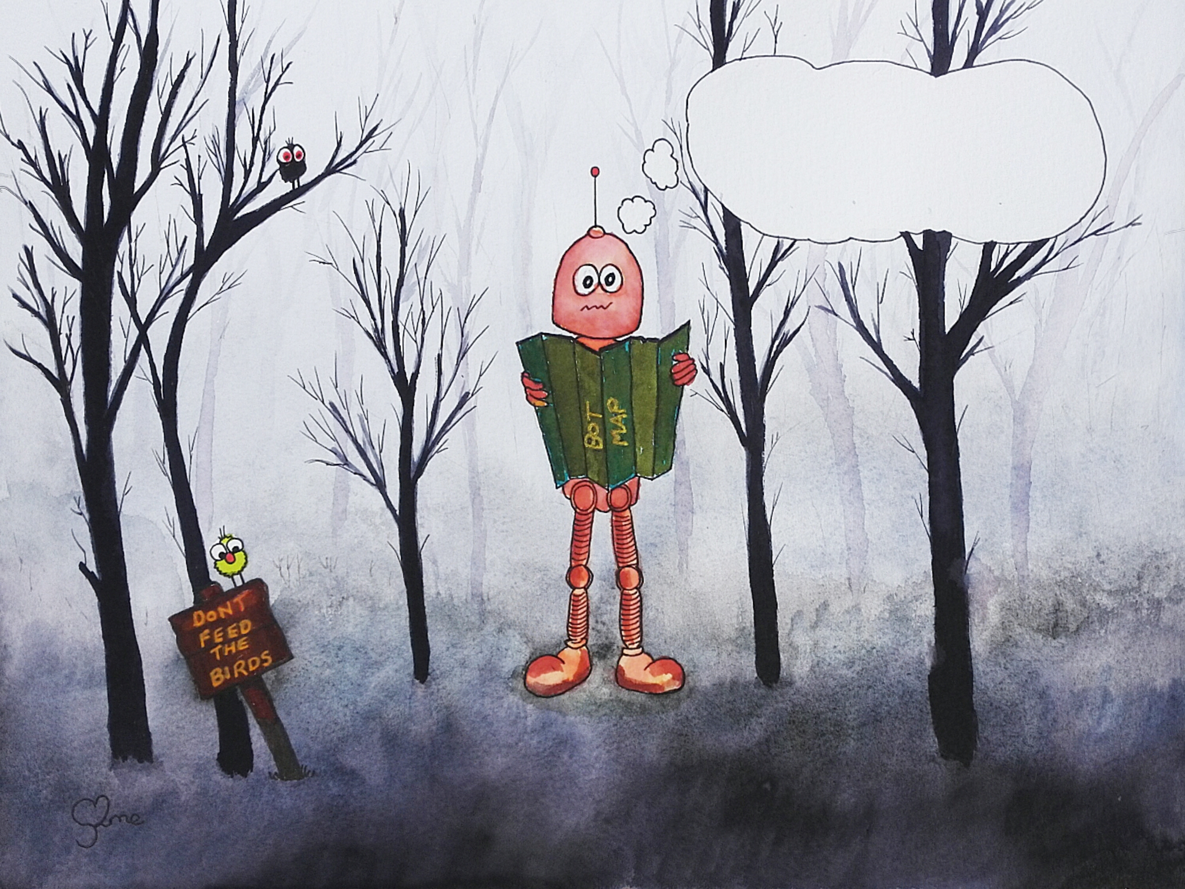
Thunk Question
Who owns the water in clouds?
Thunk question
“A Thunk question is a…simple-looking question about everyday things that stops you in your tracks and helps you start to look at the world in a whole new light.” https://www.independentthinking.co.uk/thunks/
n.b. Thunk in this sense is not an official word in the Cambridge English Dictionary!

Slide 18
Climate change and the UK
1850
1900
1950
2000
2018
Out of these options, which climate change impact in the UK do you think will impact on you most?
Summer heat and fires;
Summer flash floods;
Winter river floods;
Winter storms;
Climate migrants to the UK;
Coastal flooding

Slide 19
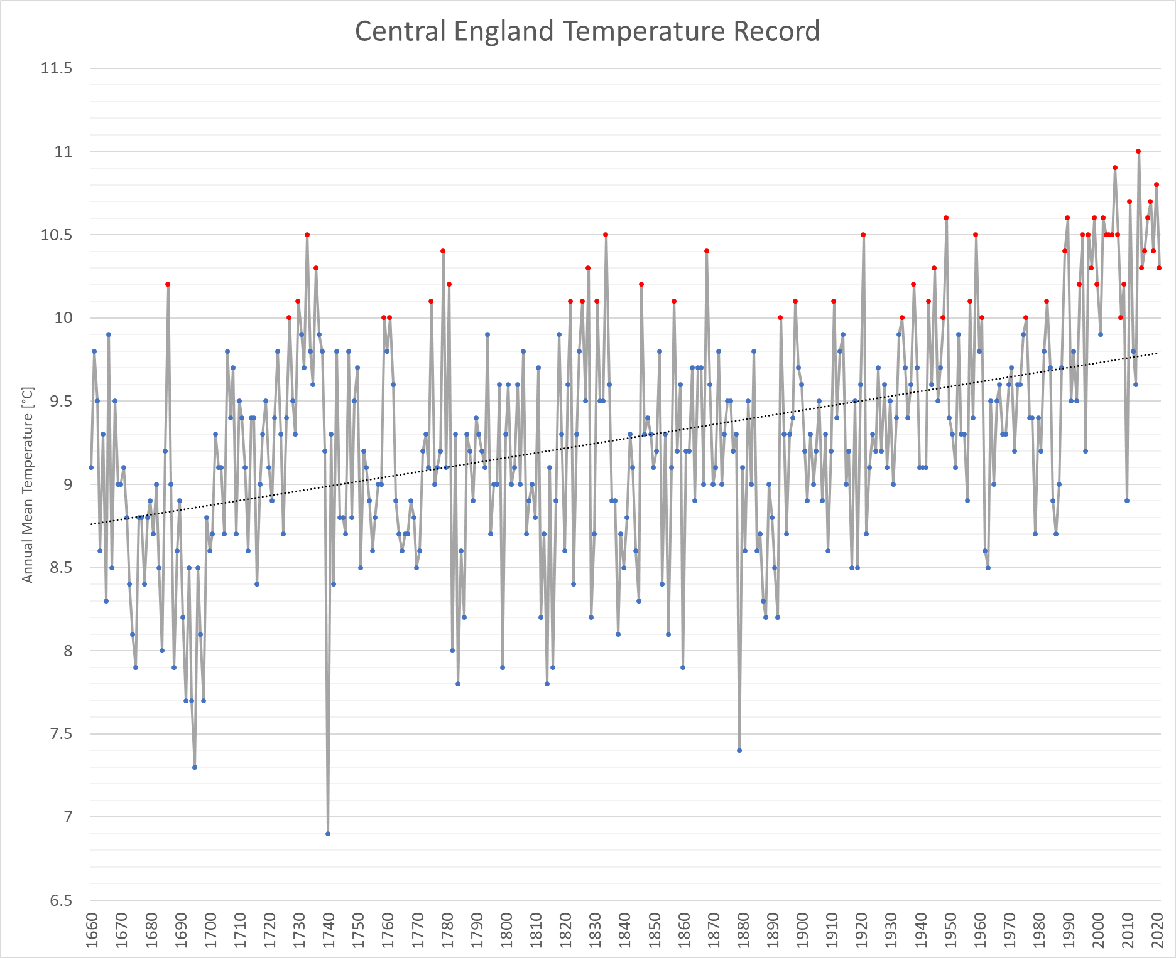
Homework
Look carefully at the graph from the Central England temperature record
What was the lowest temperature recorded?
In which year was the lowest average temperature recorded?
What was the highest temperature recorded?
In which year was the highest average temperature recorded?
How many times does the average temperature go above 10°C in the 250 years prior to 1900? (count up the RED dots)
How many times does the average temperature go above 10°C in the just over 100 years since 1900?
Use the TREND line – what temperature does it start and end at? By how much has the temperature changed?

