Slide 1
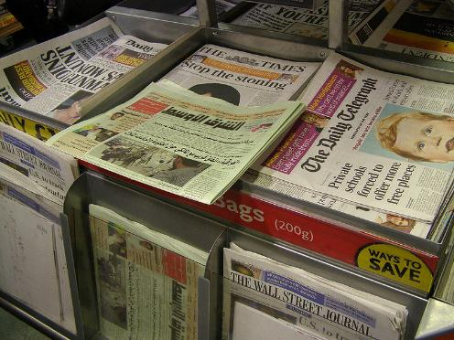
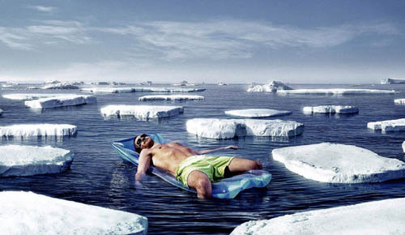
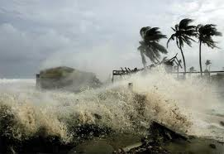
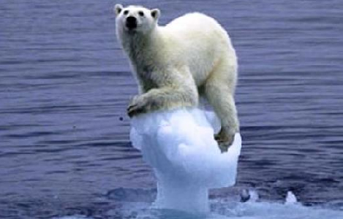

Climate Change Impacts
Notes:
Slide 1:
Are any of the students able to explain what they think ‘Climate Change Scepticsm’ is? – Pictures will act as clues.
Would be a good idea to let a number of students answer but not to explain the actual meaning, leaving them to think.

Slide 2
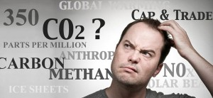
What is Climate Change?
Everyone has heard the phrase, but what does it actually mean?
Climate Change = The change in average conditions of a particular place over a long period of time. (We usually link ‘climate change’ to rising temperatures but this is NOT the full story).
It’s better to think of climate change causing more extreme and unpredictable events around the world.
HINT: Climate is what you expect, Weather is what you get!
Notes:
Slide 3:
Are the students able to explain what ‘Climate Change’ is?
Explain that ‘climate’ is different to ‘weather’: Make sure the students understand that the climate=the average temperature + atmospheric pressure + precipitation + humidity + wind of a particular place (long-term...meteorologists usually take 30 years as the average time)
You might need to explain the terms;
-Atmospheric Pressure: The force from the weight of the air (think about how the air pressure is different if you stand at the
top of a mountain).
-Humidity: Amount of moisture in the air.
-Precipitation- Rain, hail, snow.
Do the students know why this is an important topic?

Slide 3
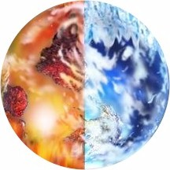
Earth’s climate is not constant.
It has warmed…
…and cooled
For BILLIONS of years!
It is the RATE that current climate change is happening that is different from what happened in the past. Since ~1800, the average global surface temperature has risen by about 1 degree Celsius.
Notes:
Slide 4:
1 degree C is a lot for the global average temperature to rise in such a short time-span (~200 years), although the number sounds small.
A few hundred thousand years ago, the UK was more like an African savannah with average temperatures only 2-3 degrees C warmer than present. 20,000 years ago, the UK was in the grips of the last Ice Age when global temperatures were 5 degrees C colder than present – a 1km thick ice sheet covered parts of the UK.
Compared to climate records from the past 800,000 years found in polar ice cores, we know that the rate of current climate change is unprecedented. (We will come back to this...)
Do the students know WHY we are making a difference to the rate of climate change?

Slide 4

Climate Change vs. Global Warming
What’s the difference?
Global warming refers to the rise in average surface temperature of the earth.
Climate change refers to all changing factors of Earth’s climate including temperature, rain, wind and humidity. Temperature is not the only thing that is changing and it is not just getting hotter.
Notes:
Slide 6:
These terms are often confused with each other and cannot be used interchangeably, ensure the pupils understand this before moving on.

Slide 5
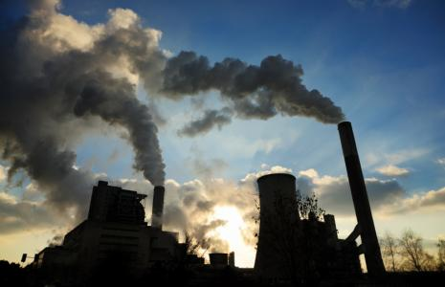
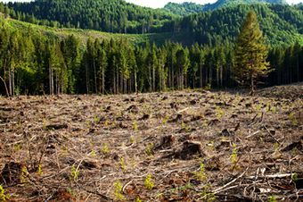
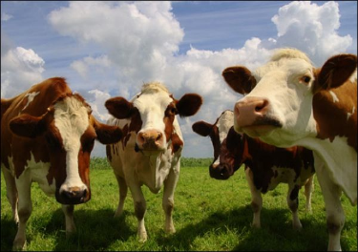
Where do WE come into this?
Everyday we do many things that are not good for our environment. By burning fossil fuels, cutting down entire forests and even breeding cows, we are polluting our atmosphere.
MOO!
Burning Fossil Fuels
Deforestation
Agriculture
By burning fossil fuels for energy such as coal, oil and gas, we are releasing extra CO2 into the atmosphere.
Trees use CO2 in the atmosphere for photosynthesis and to provide us with oxygen, but some trees are cut down for agricultural purposes.
We breed many cows for milk and meat, but when cows are ‘windy’… they release methane (another greenhouse gas) into the atmosphere. Lots of cows = lots of extra methane!
Notes:
Slide 5:
Everyone has a ‘Carbon footprint’- the total amount of greenhouse gasses produced by a person/ group of people.
Useful links: http://carboncalculator.direct.gov.uk/index.html – to work out your carbon footprints.
Or http://www.cooltheworld.com/kidscarboncalculator.php – for younger students.
Ask students if they know how to lower their carbon footprints? (Turn unnecessary electrical items and lights off, take public transport). Why does this help?
Cows are responsible for around 16% of the worlds methane emissions every year.

Slide 6
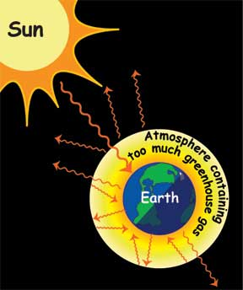
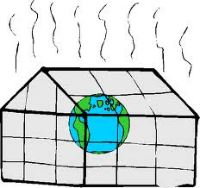
The greenhouse effect
Greenhouse gasses (including CO₂) accumulate in the atmosphere. They absorb thermal radiation (heat) from the Earth’s surface, and redirect it back down to the Earth, heating up our planet. This is called the GREENHOUSE EFFECT.
The greenhouse effect is natural.
Notes:
Slide 7:
Why is it called the greenhouse effect? – Atmosphere acts like a greenhouse, trapping the heat from the sun. Without it, this heat would be radiated from the earth and lost into space.
The parts per million of CO2 in the atmosphere at present is around 380.
Diagram (appears on click) shows how greenhouse gasses trap heat.

Slide 7
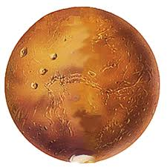
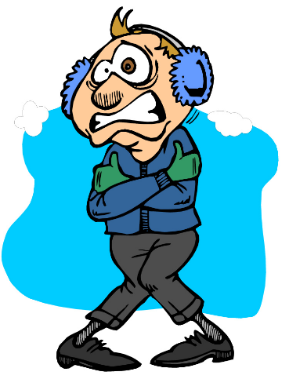
…without the Greenhouse Effect, the Earth would be too cold for life (we certainly wouldn’t be here). In fact, scientists say it might look a bit like MARS…
… Adding millions of tonnes of greenhouse gasses (including extra CO₂) to the atmosphere each year makes the greenhouse effect ‘too efficient’, causing climate change.
Notes:
Slide : 8
Make sure that the students understand that the greenhouse effect is not a ‘bad’ thing.
If Mars had a thick enough atmosphere it could be suitable for human life!
The average temperature of Earth without the greenhouse effect would be around -18 degrees Celsius.

Slide 8
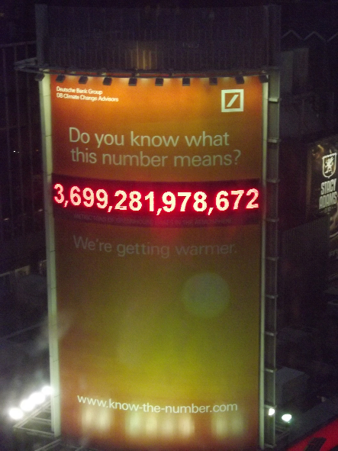
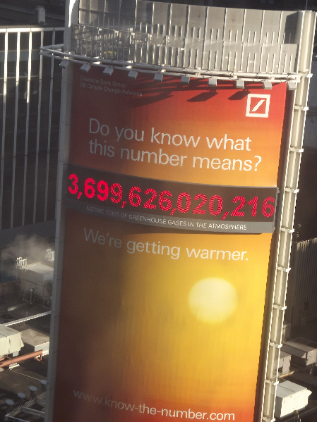
DAY 1
DAY 6
This giant sign in New York City illustrates ‘the number of metric tones of greenhouse gasses in the atmosphere’. In less than 6 days, the total had gone up by over 344,041,589…so the number of metric tones rises by 1000 every second…the weight of 700 cars!
Notes:
Slide 9:
Link to www.know-the-number.com to see how many tonnes there is now compared to the photo (taken end of March 2012) and to see the number going up.

Slide 9
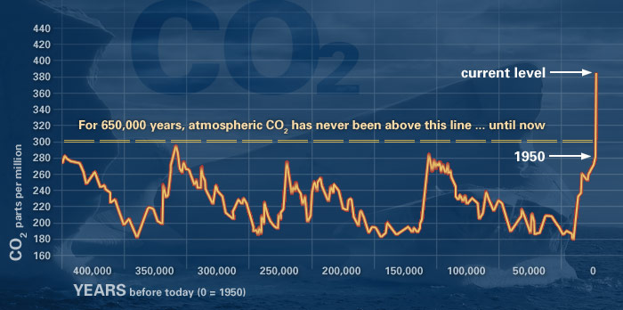
Scientific Evidence for Human Induced Climate Change
The amount of CO₂ in the atmosphere has always fluctuated. However the amount of CO₂ has quickly risen during the last 150 years.
This graph from NASA shows that since 1950, atmospheric CO2 has gone up by 100 ppm (parts per million).
www.climate.nasa.gov/evidence
Notes:
Slide 10:
GRAPH INCREASES IN SIZE ON CLICK
Highlight how modern conveniences such as fuel powered vehicles and electricity have had an impact on the amount of greenhouse gasses in the atmosphere.
The CO₂ in the atmosphere is appx. 35% higher than records show for the past 400,000 years. A rise of 100ppm would usually take at least 6000 years where as here it has taken around 100 years.
Note: Even if we made enough changes to reduce greenhouse gas emissions, it would take at least 50 years for the effects to be reversed.

Slide 10
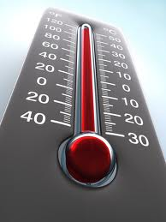

Climate Change vs Accelerating Climate change
So how is human induced climate change different? According to NASA, the rate of change is TEN times faster than the Earth’s usual rate of recovery to warmer temperatures after an ice age.
The IPCC project that the average global temperature will probably rise more than 2 degrees Celsius in the next 100 years.
Notes:
Slide 11:
Make sure the students understand that climate change is a natural phenomenon, however accelerating climate change may be linked to human activity.

Slide 11

What have you learned so far?
3. What would Earth be like without a greenhouse effect?
1. What is the difference between ‘Climate’ and ‘Weather’?
2. What is ‘Human induced Climate Change’?
Answer:
The accelerated rate of change in the Earth’s average climate due to increased human emissions of greenhouse gasses such as CO₂
Answer:
Climate is what you expect, weather is what you get!
Answer:
Earth would be too cold to support life. It could look similar to the planet Mars.
Notes:
Slide 12:
Use this slide to check that the students understand what they have learned so far. Further discussion may be needed.

Slide 12
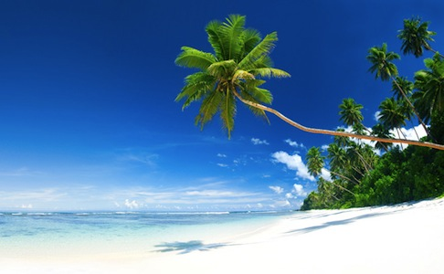
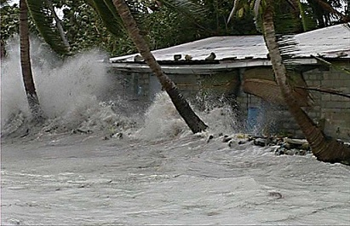
The Effects of Climate Change
‘Great! Its going to get a little bit warmer! There’s nothing wrong with that, is there?’…
…People of the small island nations in the South Pacific would strongly disagree.
Notes:
Slide 13:
Images show the contrast between the idyllic setting of a Pacific island and the harsh reality of what can happen.

Slide 13
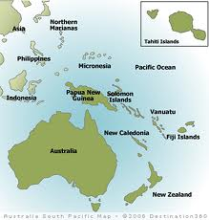
Climate Change in the South Pacific
Where?
22 countries scattered across appx. 20,000 small islands in the South Pacific.
The island are very low lying, some barely reaching a meter above sea level.
Most of the human populations on these islands live by the coast.
They are often very poor and underdeveloped countries.
Effects from climate change in these vulnerable countries are being seen NOW…
Notes:
Slide 14:
Countries such as Fiji, The Solomon Islands and Tuvalu

Slide 14
ISLANDS ABANDONED
FLOODING
ILLNESS
STORMS
DIARRHEOA
DIRTY WATER
Tropical Storms
FOOD SHORTAGE
HOMES DESTROYED
Notes:
Slide 15:
Before clicking and bringing up the effects of climate change (one with each click), ask the students what they think the effects are.

Slide 15
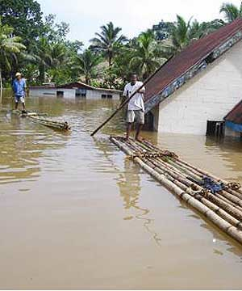
Climate Change in the South Pacific
Sound like paradise?
Climate change is linked to sea levels rising, an increase in storm surges and a whole host of other problems…
Lets take a look…
Notes:
Slide 16:
Image shows extreme flooding, a contrast to the idyllic image of a tropical island most would picture.

Slide 16
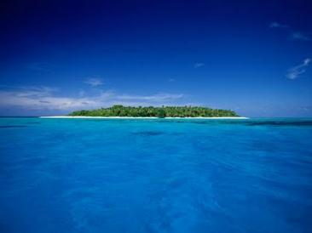
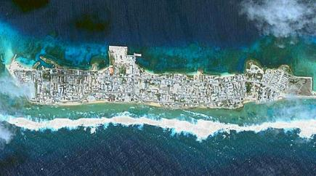
Sea Level Rise
Rising temperatures are linked to sea-levels rising. Ice sheets and glaciers are melting, and sea water is getting warmer and expanding.
This is bad news for inhabitants for these small Pacific Island nations. A slight rise in sea level can have drastic effects. Coastlines are getting smaller, almost like their islands are ‘shrinking’.
Inhabitants are forced to move further inland, abandoning their homes, crowding the islands, as there is increasingly less space to live.
Notes:
Slide 17:
The islands are not actually ‘shrinking’ , this is just how it appears. The land is disappearing under the sea.
Image top right shows an extremely low lying island in Fiji, this demonstrates why a small sea level rise could have a major impact
Image bottom left shows how crowded some islands can get, there is no ‘unused’ land

Slide 17
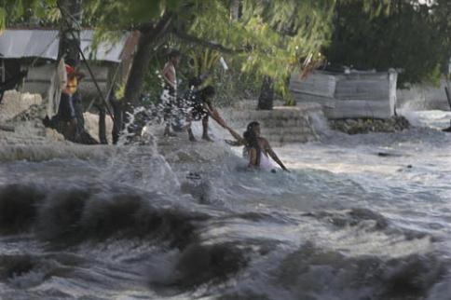
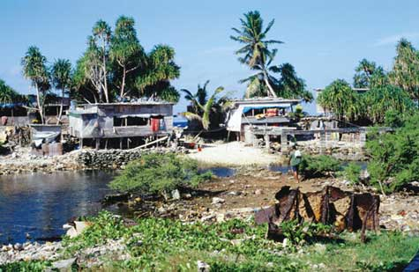
Storm Surges and Extreme Events
“The weather forecast for today is cloudy with a good chance of a cyclone induced storm surge”. Best bring an umbrella then eh?
We might complain when it’s raining, but, in the South Pacific, rising sea levels bring an increased risk of storm surges.
Storm surges are a threat to the people who live by the coast. They can destroy homes, crops and water supplies. Along with sea level rise, they could make islands uninhabitable.
Notes:
Slide 18:
A storm surge happens when there is an unusual rise in sea level during a storm (caused by strong onshore winds and low atmospheric pressure), waves can reach as high as 25m (the height of 8 elephants!).
They are extremely dangerous.

Slide 18
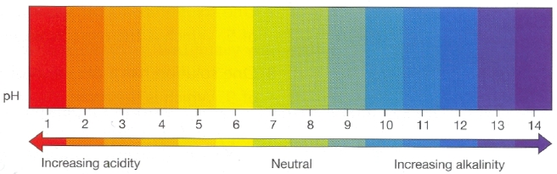
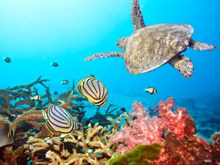
Ocean Acidification
Some of the excess CO₂ in the atmosphere is also being dissolved into the ocean. This is causing the water to become more acidic.
This is bad news for marine ecosystems, especially to coral reefs, fish, marine mammals and other animals who call the ocean their home. It is also bad news for those who rely on fishing for their businesses or as a source of food.
Notes:
Slide 19:
A coral reef is mainly composed of Calcium Carbonate which dissolves when the water becomes acidic- as Coral reefs are a vital habitat for many marine species, this can cause many knock on effects.

Slide 19
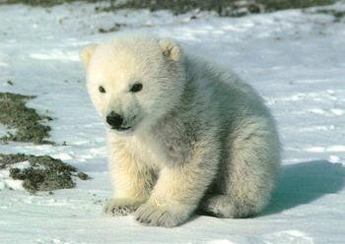

Other Effects
The impacts of climate change are numerous and will affect all sorts of plant and animal species.
That’s what they think!!!
The climate in some areas will become unsuitable for some animal and plant species, causing mass migration or population declines e.g. Polar bears in the Arctic
Some species will be able to live in places that they never could before. This means that many places will see an increase in alien species (and that doesn't mean little green men!)
Notes:
Slide 20:
Polar bears use the sea-ice as hunting grounds for seals. Without the ice, they are unable to find food as readily. Females hibernate during the harsh Arctic winters and re-emerge (usually with young cubs) in the spring. Soon after this, the ice slowly begins to break up and disappear. This makes it very hard for the female to provide food for her young. This is a normal cycle for a polar bear, however the ice is melting earlier in the year and forming later, leaving less time for crucial hunting.

Slide 20

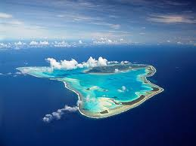
Health and Disease
It might not be obvious, but climate change can cause people to get sick, and not just from injury or drowning.
Malnutrition- Storms and rising sea levels can destroy food sources and crops.
Sickness and Diarrhoea - Often the islands only have only one source of fresh water, and storms can often cause this supply to be contaminated, making it dangerous to drink.
Notes:
Slide 21:
A coral atoll is an island which surrounds a fresh water lagoon. This lens of freshwater can become contaminated when there is a storm surge or the waves overlap the coral surrounding the lagoon.
Many South Pacific islands have very few healthcare amenities.
Rates of illnesses such as diarrhoea have been linked with climate change by some studies.

Slide 21
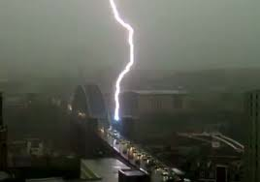
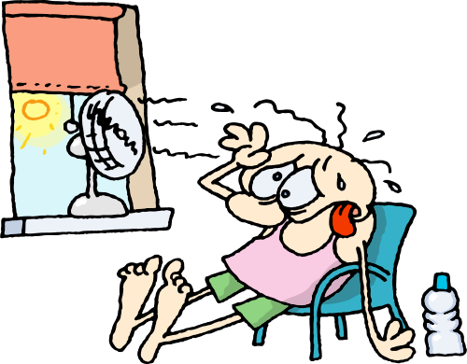

Extreme events have also been experienced recently in England…
Increased number of heat waves. Remember the unusually hot, sunny weather in March 2012?
Increased storms and flooding. Remember the flash flooding in the North East in June 2012?
So even though scientists have given us evidence and we can even SEE it happening…why are some people saying that ‘human induced’ climate change is not real?
Notes:
Slide 22:
Click to bring up different effects.
Ensure students know that changes are happening here in the UK and not just in other parts of the world.
Useful document: http://www.adaptne.org/– Summarises the effects of climate change and the adaption strategies to cope with climate impacts in the North East of England.
Useful document showing many effects of climate change in North East England: http://www.eci.ox.ac.uk/publications/downloads/berry11-northeast.pdf
In recent years we have seen:
Decreased snowfall in winter months (though still with some extremes).
Increased levels of flooding due to the overflow of rivers and lakes.
Increased number of heat waves.
Wetter winters and drier summers.

Slide 22
What have you learned so far?
2. Why are the islands of the South Pacific vulnerable to climate change?
1. Name 3 major effects of climate change.
Answer:
They are very low lying, some averaging only 2m above sea level
Many are simple coral atolls, meaning that storm surges can easily cause an over wash of sea water into fresh water supplies
Many are developing nations which have limited healthcare facilities
Answer:
There are many effects of climate change;
Sea Level Rise
Ocean acidification
Storm surges and flooding
Increase in disease
Notes:
Slide 23:
Use this slide to check that the students understand what they have learned in this section. Further explanaions may be needed.

