Slide 1
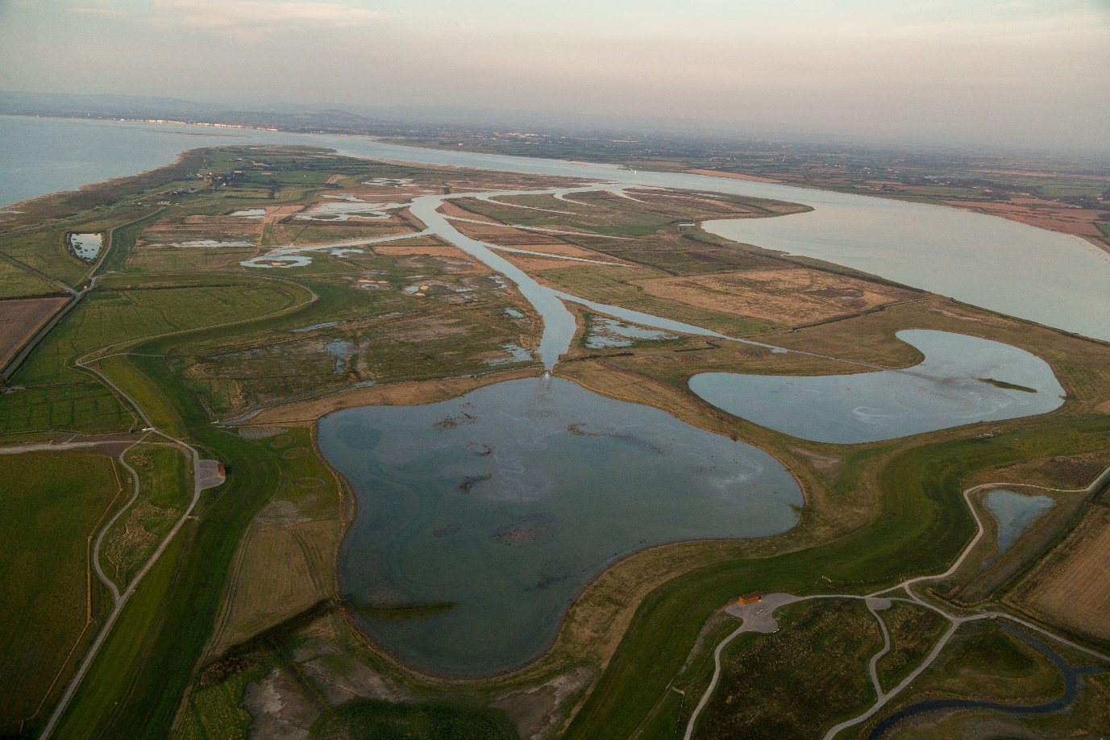
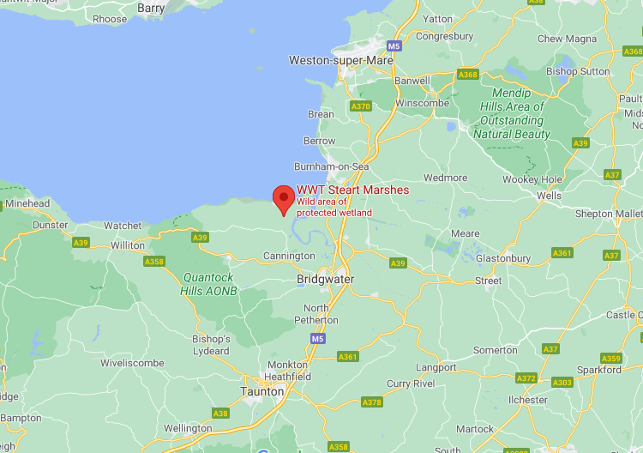
Steart Marshes - A Salt Marsh Designed to Adapt to Climate Change
Location:
What is managed retreat?
Disadvantages of managed retreat?
How is the marsh being created?
Ways the marshes can protect the surrounding area?
Advantages of managed retreat?
Steart Marshes Image Source: Wildfowl and Wetlands Trust/ Sacha Dench
Why are sea levels rising?
In the UK?
Why is the area prone to flooding?
How is climate change affecting the flooding?
Steart Marshes Image Source: Google Maps

