Slide 1
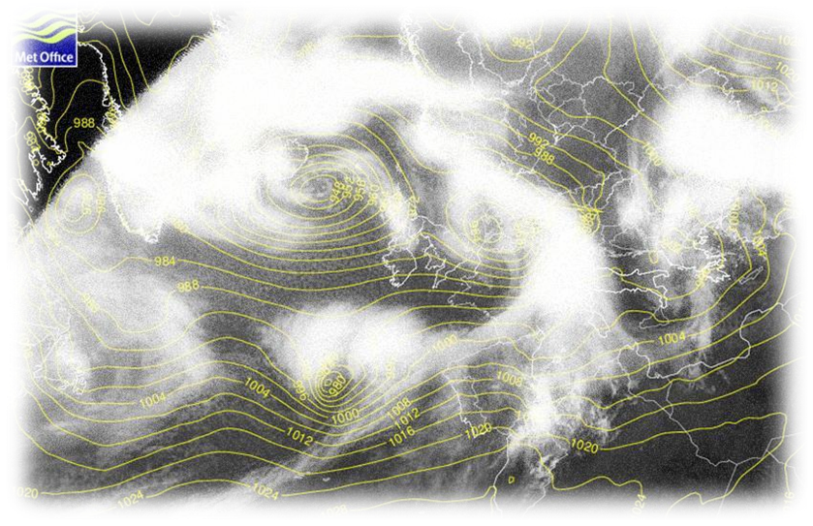
Depressions- associated weather

Slide 2
Objectives
Be able to describe and explain the type of weather associated with the different fronts in a depression.
Be able to describe how the weather changes with the passage of a depression.
Be able to reproduce a diagram of a cross-section of a depression.

Slide 3
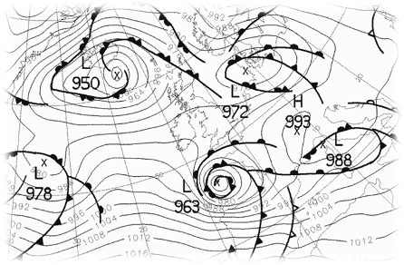
The different types of air…
Cold arctic or polar air
Cold Front
Warm Sector
Warm front
Tropical area

Slide 4
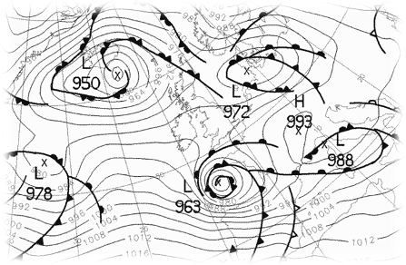
Cross-section through depression Klaus…
Warm Sector
Cold Air
Cold Air
Direction

Slide 5
Cross-section through the depression…
Cumulonimbus
Cirrus
Warm Sector
2
1
Cold
Warm
Cold
Nimbostratus
Showers
Heavy rain
Intermittent rain
Continuous rainfall
Direction

Slide 6
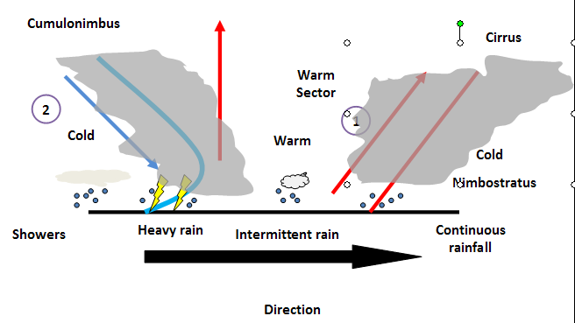
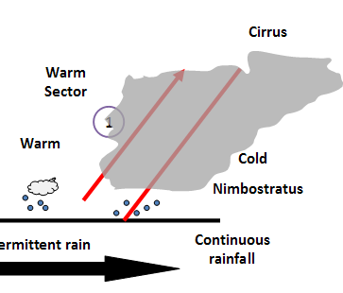
As the warm air meets the cold air it is forced to rise, as it is less dense.
As it rises moisture within the air cools, condenses and forms clouds.
Clouds are found along the warm front. Where the front is high in the sky we get cirrus clouds, and where its lower we see nimbostratus.
If the warm front is near the ground, we can expect continuous rainfall.

Slide 7
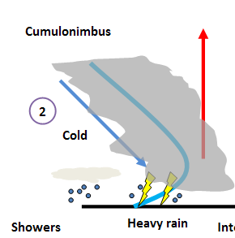
As the cold air pushes forward, it forces the warm air to rise as it is less dense.
As it rises moisture within the air cools, condenses and forms clouds.
The uplift caused by the cold air is much more violent than at the warm front. Towering cumulonimbus clouds are formed.
Along the cold front we can expect heavy rain, and sometimes thunder and lightening.

Slide 8
