Slide 1
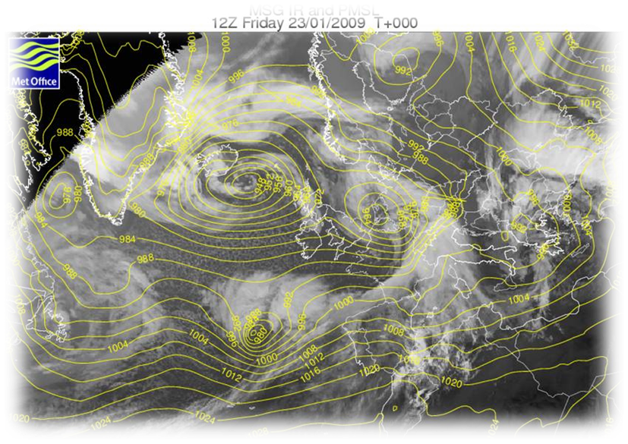
Formation of a depression

Slide 2
Objectives
Be able to describe the formation of a depression weather system.
Be able to describe the air movement within a depression weather system.
Be able to identify the features of a depression upon a satellite image.
Be able to identify the features of a depression upon a synoptic weather chart.

Slide 3
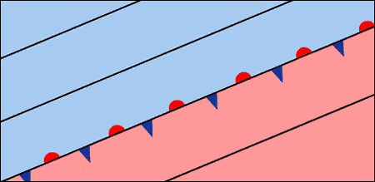
Depressions form at the boundary between cold artic/polar air in the North and tropical air in the South.
Cold arctic or polar air
Somewhere over the Atlantic…
Polar Front
Tropical air
You may like to show this video
https://www.youtube.com/embed/knxrOk8Jsok

Slide 4
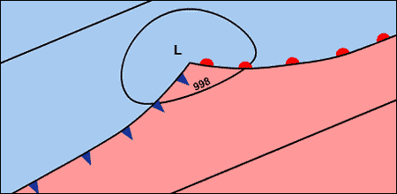
The cold air is pushing south and the warm air is pushing north, this creates a bulge along the polar front.
Cold artic or polar air
Tropical air

Slide 5
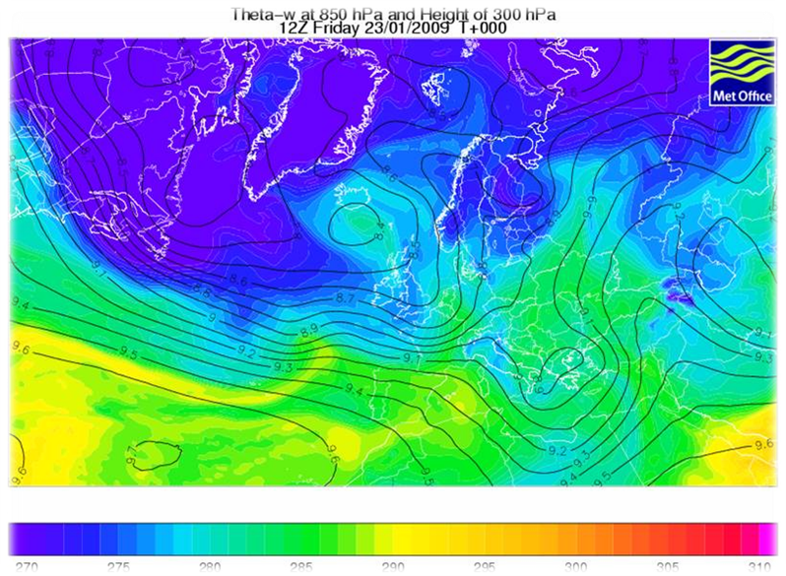
Can you identify the bulge along the polar front signifying the start of a depression?

Slide 6
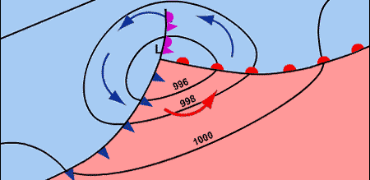
Due to the Coriolis Effect, caused by the rotation of the Earth, the air moves around an area of low pressure in an anti-clockwise direction.
Cold arctic or polar air
Tropical air

Slide 7
We can now see three fronts within the depression.
Cold arctic or polar air
Occluded front
Warm Front
Cold Front
Tropical air

Slide 8
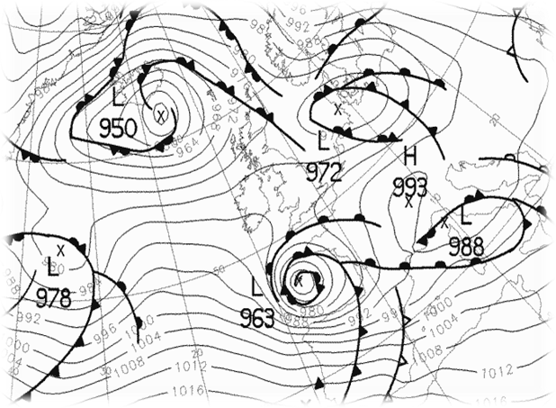
Identifying a depression on a synoptic chart. Can you identify?
Areas of low pressure
Isobars tightly packed
Characteristic fronts, warm, cold and occluded

Slide 9
Depression or not?…
Which of the following would you associate with a depression?
Statement | True | False
Depressions begin when two types of cold air meet.
Depressions are associated with low pressure.
The air moves in a clockwise direction within a depression.
Depressions usually bring rainfall.
In a depression we could expect to see isobars packed closely together.
There is usually no wind in a depression.

Slide 10
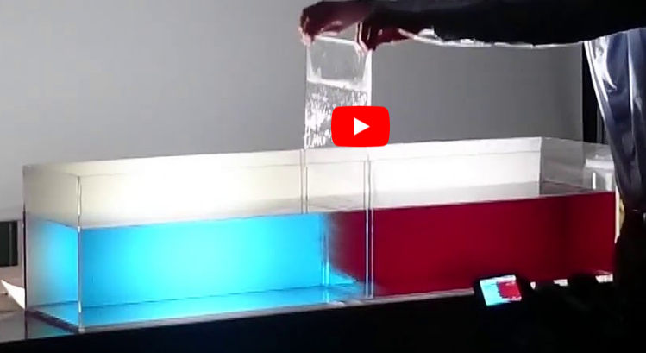
Fronts in a Lab
https://www.youtube.com/watch?v=knxrOk8Jsok

