Slide 1
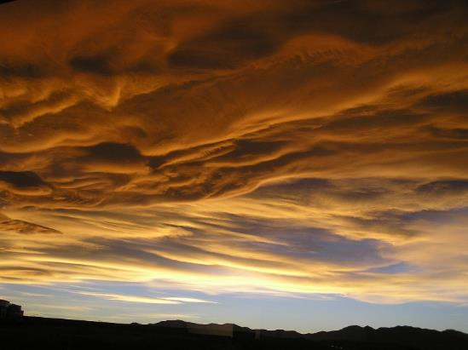
S4 – Weather Unit
Notes:
Image copyright Joseph Kerski

Slide 2
A good way to describe climate is to use a climate graph.
The next few slides are a reminder how to construct a climate graph.

Slide 3
1. On graph paper draw some axes like the ones below
15cm
15cm
12cm

Slide 4
2. Label the bottom axis with the months of the year
15cm
15cm
J F M A M J J A S O N D
Months

Slide 5
3. Label the right hand axes with the rainfall
300
280
260
240
220
200
180
160
140
120
100
80
60
40
20
0
15cm
Rainfall in mm
J F M A M J J A S O N D

Slide 6
4. Label the left hand axis with temperature
30
28
26
24
22
20
18
16
14
12
10
8
6
4
2
0
300
280
260
240
220
200
180
160
140
120
100
80
60
40
20
0
Temp °C
Rainfall in mm
J F M A M J J A S O N D

Slide 7
5. Plot the rainfall data as a bar chart
30
28
26
24
22
20
18
16
14
12
10
8
6
4
2
0
300
280
260
240
220
200
180
160
140
120
100
80
60
40
20
0
Temp °C
Rainfall in mm
J F M A M J J A S O N D

Slide 8
5. Plot the temperature data as a line graph
30
28
26
24
22
20
18
16
14
12
10
8
6
4
2
0
300
280
260
240
220
200
180
160
140
120
100
80
60
40
20
0
Temp °C
Rainfall in mm
J F M A M J J A S O N D

