Slide 1
Would I lie to you?
One of these isn’t true. Which one?
The wettest tropical cyclone dumped 102,195,000,000,000 litres of water (102 trillion litres) – about 102 cubic kilometres!
The largest ever tropical cyclone was over 2000 miles across.
A large tropical storm releases as much energy every 20 minutes as a large nuclear bomb detonation.
The furthest a hurricane has travelled is 7165 miles (London to Tokyo is 6000 miles and a 12-hour flight).
Hurricanes used to only have girls names
There are no Hurricanes beginning with Q, X, U or Z.
A nuclear bomb (even the largest one) won’t stop a hurricane
Notes:
The lie is the second bullet point – the largest tropical cyclone ever is Typhoon Tip (1979) – it was only 1350 miles across.
A nuclear bomb won’t stop a hurricane - https://www.aoml.noaa.gov/hrd/tcfaq/C5c.html
https://commons.wikimedia.org/wiki/File:Castle_Romeo.jpg

Slide 2
Would I lie to you?
One of these isn’t true. Which one?
Hurricane Harvey dumped 102,195,000,000,000 litres of water on Texas (102 trillion litres) – about 102 cubic kilometres!
The largest ever tropical cyclone was over 2000 miles across.
The furthest a hurricane has travelled is 7165 miles (London to Tokyo is 6000 miles and a 12-hour flight).
Hurricanes used to only have girls names
There are no Hurricanes beginning with Q, X, U or Z.
A large tropical storm releases as much energy every 20 minutes as a large nuclear bomb
A nuclear bomb (even the largest one) won’t stop a hurricane
The largest tropical cyclone was Typhoon Tip in 1979.
It was only 1350 miles across.
Notes:
The lie is the second bullet point – the largest tropical cyclone ever is Typhoon Tip (1979) – it was only 1350 miles across.
A nuclear bomb won’t stop a hurricane - https://www.aoml.noaa.gov/hrd/tcfaq/C5c.html
https://commons.wikimedia.org/wiki/File:Castle_Romeo.jpg

Slide 3
Tropical Cyclones
Tropical cyclones Where, Why & How?

Slide 4
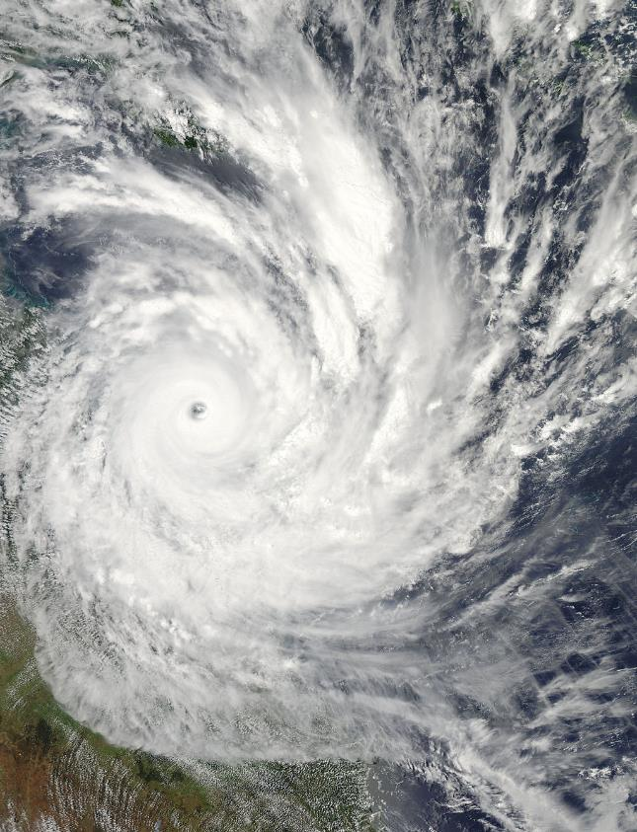
Here’s one I made earlier…
Rain bands spiral out from eye
Central eye is clear of cloud
Storm rotates
(Tropical cyclone Yasi over Australia in 2011)
Notes:
https://en.wikipedia.org/wiki/Cyclone_Yasi#/media/File:Cyclone_Yasi_2_February_2011_approaching_Queensland.jpg

Slide 5
Lets make a tropical cyclone
Recipe
1 large area of thunderstorms
1 large area of warm ocean (26.5ºC or hotter) (a few thousand square kilometres will do)
Winds blowing in the same direction up to 10km height
At least 300km (186 miles) from the equator (otherwise your storm won’t spin)

Slide 6
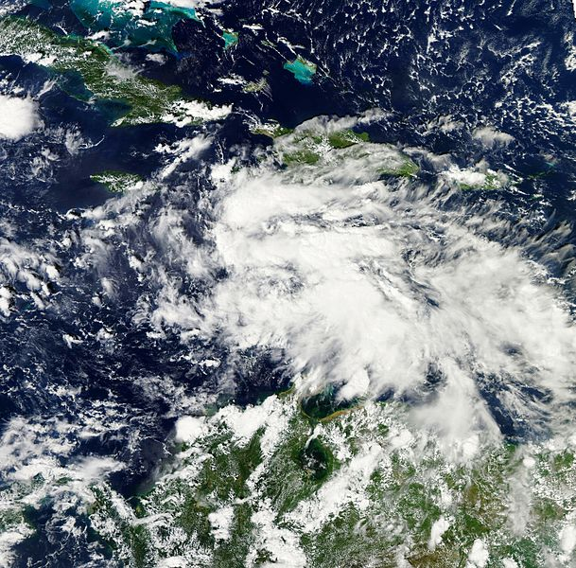
Lets make a tropical cyclone
Step one - A lot of hot air (one large area of thunderstorms)
We need a few Thunderstorms – a ‘tropical disturbance’ – that has formed near the equator
Thunderstorms are unorganised storms – they don’t have a specific shape or size.
Notes:
https://en.wikipedia.org/wiki/File:Sandy_as_a_tropical_disturbance_Oct_20_2012.jpg

Slide 7
Lets make a tropical cyclone
Step one - A lot of hot air (one large area of thunderstorms)
Task: We need to know how a thunderstorm forms, but the recipe is a bit jumbled up.
Write the sentences provided into the correct spaces
Notes:
Handout 1
https://en.wikipedia.org/wiki/File:Sandy_as_a_tropical_disturbance_Oct_20_2012.jpg

Slide 8
Lets make a tropical cyclone
Step two - 1 large area of warm ocean at 26.5ºC or hotter (a few thousand square kilometres will do)
The Earth’s surface is heated by energy received from the Sun.
The energy from the Sun that hits the Earth is strongest above the equator (where the Sun is overhead), and weakest near the poles (when the Sun is very low in the sky).
Notes:
https://earthobservatory.nasa.gov/global-maps/CERES_NETFLUX_M
https://en.wikipedia.org/wiki/Solar_irradiance#/media/File:Insolation.png

Slide 9
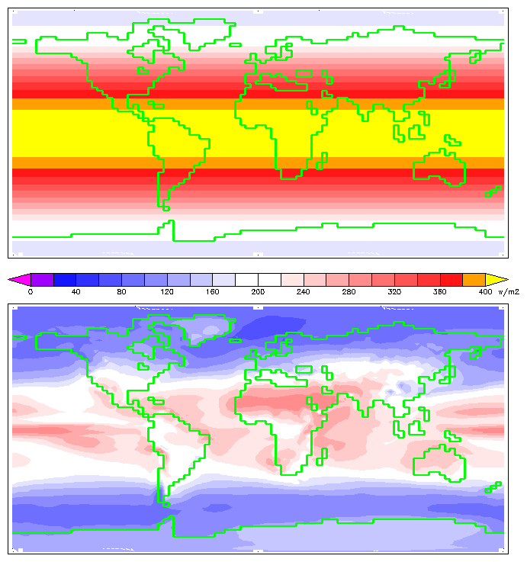
If you were above the atmosphere a map the incoming energy would look like this.
Notes:
https://earthobservatory.nasa.gov/global-maps/CERES_NETFLUX_M
https://en.wikipedia.org/wiki/Solar_irradiance#/media/File:Insolation.png. By William M. Connolley using HadCM3 data. - Own work, CC BY-SA 3.0, https://commons.wikimedia.org/w/index.php?curid=1335849

Slide 10
But…
The atmosphere only lets some of the heat reach the surface, so we end up with a map like this one.
Notes:
https://earthobservatory.nasa.gov/global-maps/CERES_NETFLUX_M
https://en.wikipedia.org/wiki/Solar_irradiance#/media/File:Insolation.png. By William M. Connolley using HadCM3 data. - Own work, CC BY-SA 3.0, https://commons.wikimedia.org/w/index.php?curid=1335849

Slide 11
Lets make a tropical cyclone
But it’s a bit more complicated than that…
The amount of energy received from the Sun also varies with the seasons – from March to September the Northern Hemisphere gets the most; from September to February its the Southern Hemisphere.
Notes:
https://earthobservatory.nasa.gov/global-maps/CERES_NETFLUX_M
https://en.wikipedia.org/wiki/Solar_irradiance#/media/File:Insolation.png

Slide 12
Annual variation in heat from the sun
Notes:
https://earthobservatory.nasa.gov/global-maps/CERES_NETFLUX_M
https://en.wikipedia.org/wiki/Solar_irradiance#/media/File:Insolation.png

Slide 13
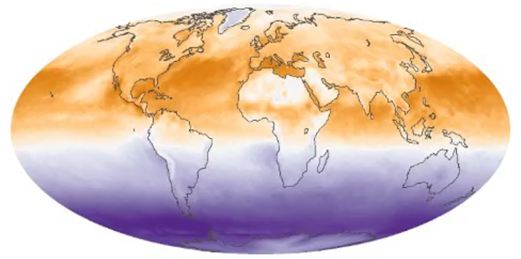
So… the parts of the ocean most likely to reach 26.5ºC or hotter are shows as dark orange/red on these maps.
They’re not evenly spread around, and they move with the seasons.
Notes:
https://earthobservatory.nasa.gov/global-maps/CERES_NETFLUX_M
https://en.wikipedia.org/wiki/Solar_irradiance#/media/File:Insolation.png

Slide 14
Lets make a tropical cyclone
Step three - Winds blowing in the same direction up to 10km height
Although air doesn’t weigh much – it’s 1000x lighter than water, for instance - it does weigh something.
At sea level, air pressure – the weight of air above you – is about 100,000Kg over every square metre of the Earth’s surface!
When warm air rises you end up with less air above you and the pressure drops, creating low pressure.
When cold air sinks, you end up with more air above you and the pressure rises, creating high pressure.
Notes:
https://earthobservatory.nasa.gov/global-maps/CERES_NETFLUX_M
https://en.wikipedia.org/wiki/Solar_irradiance#/media/File:Insolation.png

Slide 15
Step 2 – getting organised
The atmosphere tries to even out bits of low pressure (where there is less air), and high pressure (where there is more air).
This is wind.
Notes:
We’re not squashed by 1000Kg of air as it’s pushing in all directions at once – the force gets cancelled out.

Slide 16
Making Wind
If you have two tubs, one with more water and one with less, and take the barrier between them away, you know from experience that water will flow from where there is more to where there is less.
It’s exactly the same with air.
Air tries to get from where there is more (high pressure) to where there is less (low pressure). It’s the same reason a balloon flies around the room if you let it go (high pressure in the balloon, low pressure in the room). This is wind.
Notes:
https://earthobservatory.nasa.gov/global-maps/CERES_NETFLUX_M
https://en.wikipedia.org/wiki/Solar_irradiance#/media/File:Insolation.png

Slide 17
Step 2 – getting organised
Notes:
The wind direction changes from 55 degrees to 100 degrees to 10km height – see the top of text bottom left of the frame.
Tropical cyclone formation is unlikely in these conditions (and indeed no TCs formed in the days following the recording of the video).

Slide 18
Lets make a tropical cyclone
Step four - At least 300km (186 miles) from the equator (otherwise your storm won’t spin)
The spin of the Earth causes something called the Coriolis effect.
This makes winds turn right in the Northern hemisphere, and left in the southern hemisphere. Within about 300km from the equator there isn’t enough spin to make the air rotate.
Together, hot air rising, winds and the Coriolis effect explain why cyclones spin.
Notes:
https://earthobservatory.nasa.gov/global-maps/CERES_NETFLUX_M
https://en.wikipedia.org/wiki/Solar_irradiance#/media/File:Insolation.png

Slide 19
Coriolis step-by-step
The Coriolis effect
Step 1 – The Coriolis effect is caused by the rotation of the earth.
Step 2 – North of the equator, it turns winds to the right, and South of the equator it turns them to the left.
Step 3 – Where there is a tropical cyclone there is low pressure. So air is pulled towards the cyclone, and being turned by the Coriolis effect.
Notes:
https://earthobservatory.nasa.gov/global-maps/CERES_NETFLUX_M
https://en.wikipedia.org/wiki/Solar_irradiance#/media/File:Insolation.png

Slide 20
Air moves from high
to low pressure
The Coriolis effect turns
the air to the right
(north of equator)
As air moves from all directions,
it creates a rotation around the low pressure.
Low pressure
Low pressure
Low
High pressure
High pressure
Notes:
Introduce it, teach it – physically moving around the classroom normally helps as it can seem counter intuitive – why does turning to the right cause an anti-clockwise spiral?! – then reinforce with the handout.
There are many videos online showing the Coriolis effect, e.g. https://youtu.be/WB4dxpUS530

Slide 21
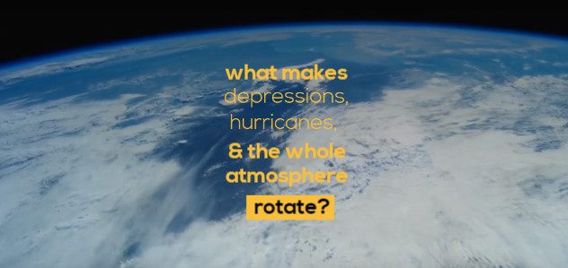
Coriolis Effect
Notes:
This visualisation of low/high pressure systems can help describe Coriolis but needs some teacher input too to help it make sense.

Slide 22
In your own words
Use your handout to explain why air rises and cyclones spin in your own words.
Hints
Why does air rise?
What causes wind?
What makes wind turn?
Using numbers to show a sequence is a great idea!
Notes:
Give pupils Handout 2 – Making things spin. 1 copy per pupil, single-sided A4.

Slide 23
For high pressure – where air is sinking and piling up near the ground - everything is reversed…
Air flows away from the high pressure towards nearby low pressure
It is turned to the right by the Coriolis effect (in the Northern hemisphere)
It creates a clockwise rotation (in the Northern hemisphere)

Slide 24
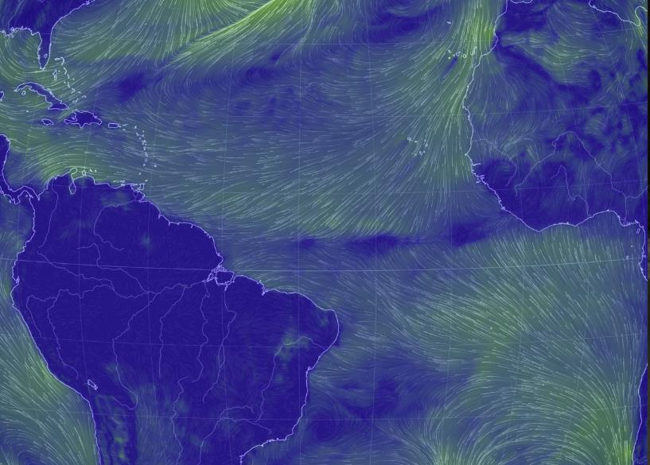
Bigger, Faster, Stronger
Winds that circle the Earth – turned to the right by the Coriolis effect, too – push the cyclones west in the Northern Hemisphere, and East in the Southern hemisphere.
The process that formed thunderstorms continues and gets bigger as more and more warm, moist air is sucked into the spinning storm.
As long as there is warm water, heat, no strong winds to interfere, and we stay away from the equator to keep the Coriolis effect our storm will grow and grow.
Notes:
Expanding this to include more detail about the atmospheric cells is an option, but this lesson is aimed at Year 8.

Slide 25
Working out where storms will happen
A mapping puzzle
Your map shows oceans that are 26ºC or warmer on 12 September 2018 – the end of summer in the Northern hemisphere.
Follow the instructions below the map to see if you can work out which areas of the world might be in danger of being hit!
Remember!
Tropical cyclones only form over oceans where the water temperature is over 26.5ºC.
They also need to be a few degrees away from the equator to get their spin.
The direction of global winds will move them once they’ve formed, and the Coriolis force will make them move in a curve.
Notes:
Handout 3 – SST exercise – 1 per pupil. This will print OK in B+W.
Pupils may need an example location completed to get them started!
Link to previous lesson.
The spin of a tropical cyclone is created by the Coriolis force. Within 5-8 degrees latitude of the equator the effect isn’t strong enough to create the rotational movement of a tropical cyclone.

Slide 26
Working out where storms will happen
How did you do?
Let’s ask a few questions, and correct our own work, then look at the correct answers.
Remember – our map is from the end of the Northern hemisphere summer.
Notes:
This is a good opportunity for differentiated questioning.

Slide 27
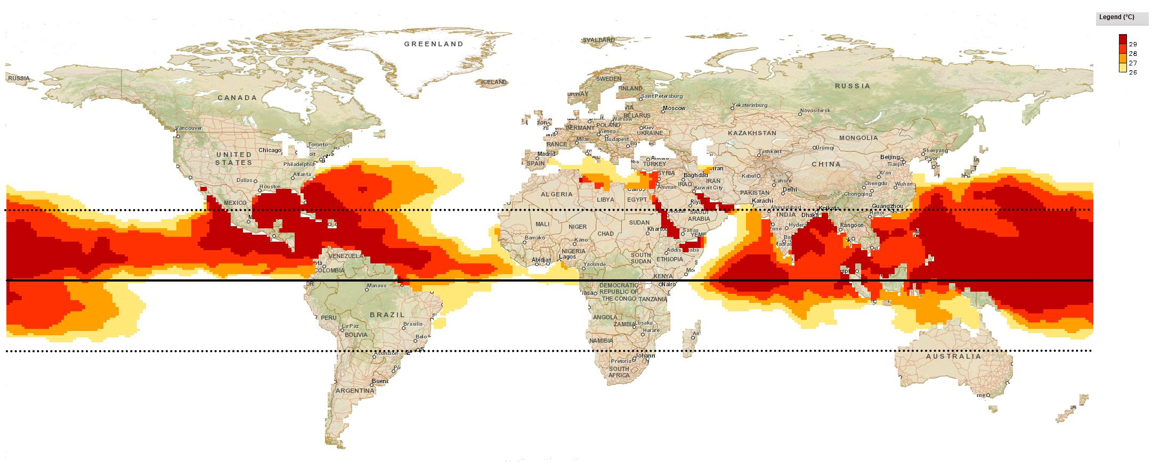
Why won’t tropical cyclones happen here?
Notes:
Link to previous lesson. Water isn’t warm enough. Cooler water in the North is further from the equator as it’s the end of summer; South of the equator it is only the start of Spring.

Slide 28
What about here?
Notes:
Link to previous lesson. These areas are too close to the equator – there is no Coriolis force to make the tropical cyclones spin.

Slide 29
How about here?
Notes:
These locations all meet the criteria – SST is 26.5C or higher, and they are all far enough away from the equator to spin.

Slide 30
What do you notice about their track?
Notes:
These locations all meet the criteria – SST is 26.5C or higher, and they are all far enough away from the equator to spin.
The Coriolis effect makes storms from each areas turn to the right as they travel.

Slide 31
Would I lie to you?
The Earth’s rotation causes tropical cyclones to spin.
A large tropical cyclone will hit you with 1 tonne of air every 6 seconds if you’re standing still. (You won’t be).
A hurricane could hit the West coast of Africa, the coast of India, or the coast of the USA.
You can fly right through a hurricane.
Notes:
We’re not squashed by 1000Kg of air as it’s pushing in all directions at once – the force gets cancelled out.
WILTU – True, True, True, False, False (the great storm of 1987 was not a hurricane – it didn’t originate in the tropics and didn’t have sustained and widespread winds (though it had some powerful gusts)).

