Slide 1
OPHELIA
The remnants of Hurricane Ophelia made landfall in the British Isles on the 30th anniversary of the Great Storm.

Slide 2
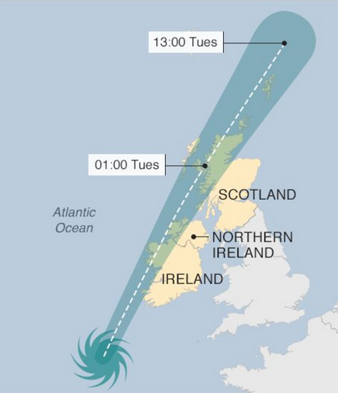
Notes:
16/ 17 October

Slide 3
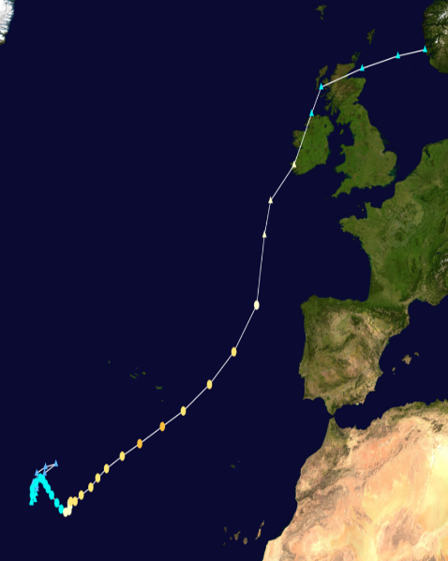
Conditions for Tropical Cyclone Formations
1) Warm ocean waters (of at least 26.5°C) throughout a sufficient depth.
2) An atmosphere which cools fast with height.
3) Relatively moist layers near the mid-troposphere.
4) A minimum distance of at least 500 km from the equator.
5) A pre-existing near-surface disturbance.
6) Low values of vertical wind shear between the surface and the upper troposphere.
Notes:
Darkest dots – category 3 hurricane
Easternmost major atlantic hurricane on record, unusual in lots of ways
The tenth consecutive hurricane and the sixth major hurricane of the very active 2017 Atlantic hurricane season. After a weak La Niña at the end of 2016, there were signs that an El Niño was building early this year, but it dissipated. The failure of an El Niño to develop may have contributed in part to the more active North Atlantic hurricane season.
Conditions needed for a tropical cyclone to form
1) Warm ocean waters (of at least 26.5°C) throughout a sufficient depth (unknown how deep, but at least on the order of 50 m). Warm waters are necessary to fuel the heat engine of the tropical cyclone.
2) An atmosphere which cools fast enough with height such that it is potentially unstable to moist convection. It is the thunderstorm activity which allows the heat stored in the ocean waters to be liberated for the tropical cyclone development.
3) Relatively moist layers near the mid-troposphere (5 km). Dry mid levels are not conducive for allowing the continuing development of widespread thunderstorm activity.
4)A minimum distance of at least 500 km from the equator. For tropical cyclogenesis to occur, there is a requirement for non-negligible amounts of the Coriolis force to provide for near gradient wind balance to occur. Without the Coriolis force, the low pressure of the disturbance is filled by air from the surrounding higher pressure areas.
5) A pre-existing near-surface disturbance with sufficient vorticity and convergence. Tropical cyclones cannot be generated spontaneously. To develop, they require a weakly organized system with sizable spin and low level inflow.
6) Low values (less than about 10 m/s) of vertical wind shear between the surface and the upper troposphere. Vertical wind shear is the magnitude of wind change with height. Large values of vertical wind shear disrupt the incipient tropical cyclone and can prevent genesis, or, if a tropical cyclone has already formed, large vertical shear can weaken or destroy the tropical cyclone by interfering with the organization of deep convection around the cyclone centre
Despite marginally warm sea surface temperatures of around 26 °C, the effects of below-average temperatures aloft and low wind shear allowed Ophelia to gradually strengthen; with banding features becoming more prominent as it drifted northwards in an area of weak steering currents. In addition, the large temperature contrast between the ocean surface and extremely cold temperatures in the upper atmosphere allowed the storm to continue strengthening, despite it being over normally suboptimal ocean temperatures. A slight degradation of the structure of the storm resulted in some weakening early on 11th October, but this was short-lived as deep convection wrapped around the entire storm. It was upgraded to a hurricane at 21:00 UTC that day after a ragged eye developed.
The tenth consecutive hurricane and the sixth major hurricane of the very active 2017 Atlantic hurricane season, Ophelia had non-tropical origins from a decaying cold front on 6th October. Located within a favourable environment, the storm steadily strengthened over the next two days, drifting north and then southeastwards before becoming a hurricane on 11th October. After becoming a Category 2 hurricane and fluctuating in intensity for a day, Ophelia intensified into a major hurricane on 14th October south of the Azores, brushing the archipelago with high winds and heavy rainfall. Shortly after achieving peak intensity, Ophelia began weakening as it accelerated over progressively colder waters to its northeast towards Ireland and Great Britain. Completing an extratropical transition early on 16th October, Ophelia became the second storm of the 2017–18 UK and Ireland season. Early on 17th October, the cyclone crossed the North Sea and struck western Norway, with wind gusts up to 70 kilometres per hour in Rogaland county, before weakening during the evening. The system made additional landfalls in Sweden and Finland before dissipating over Russia.
Five deaths can be attributed to Ophelia, all of which occurred in Ireland. The total losses from the storm are estimated at €1 billion, mostly from economic losses; insured damage claims as of 24th October reached €6 million in Ireland and £5–10 million in the United Kingdom.

Slide 4
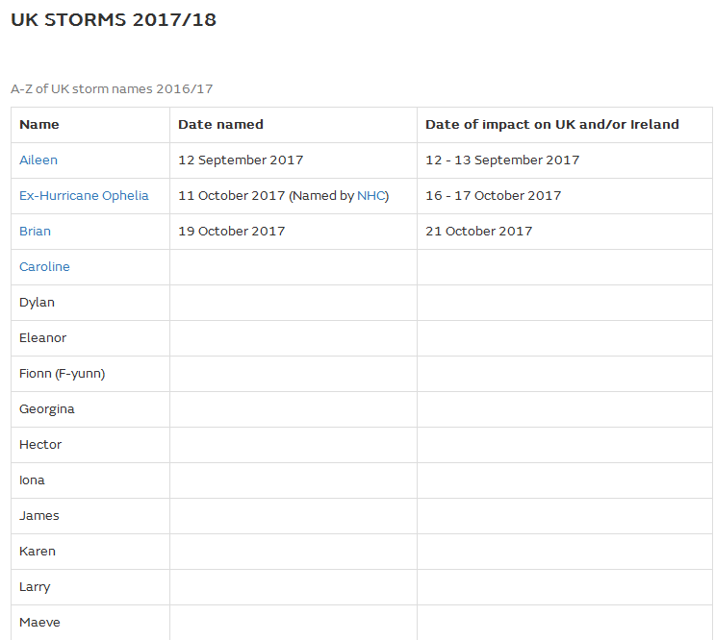
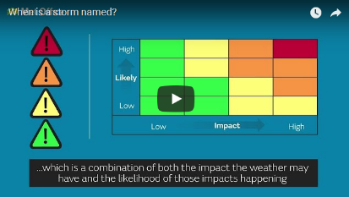
The Naming of Storms
Notes:
Ophelia kept its hurricane name to avoid confusion
Any storm which is amber or red on the matrix is named

Slide 5
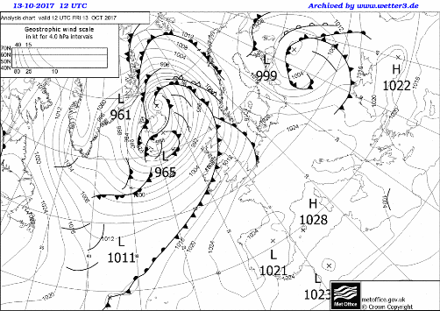
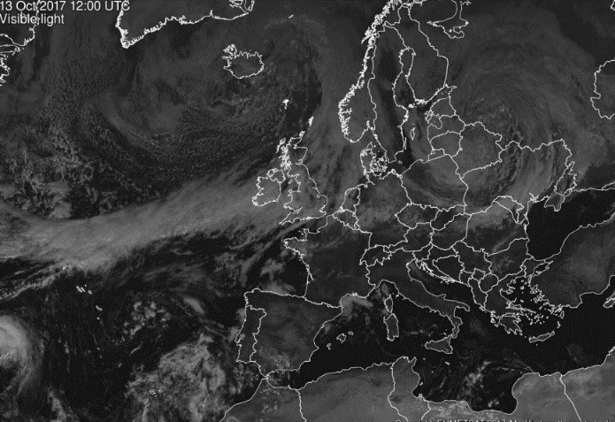
The Preceding Weekend…
Notes:
In the preceding weeks:
High pressure over France/ Spain/ Portugal – clear skies – high land surface temperatures

Slide 6
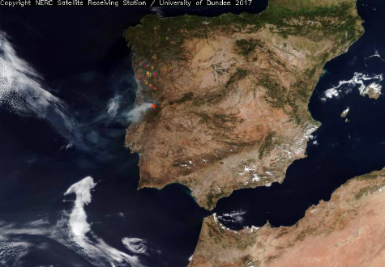
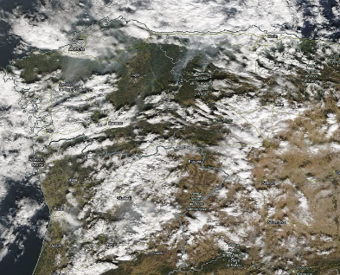
Early October
Notes:
The warm temperatures gave rise to forest fires in Spain and Portugal

Slide 7
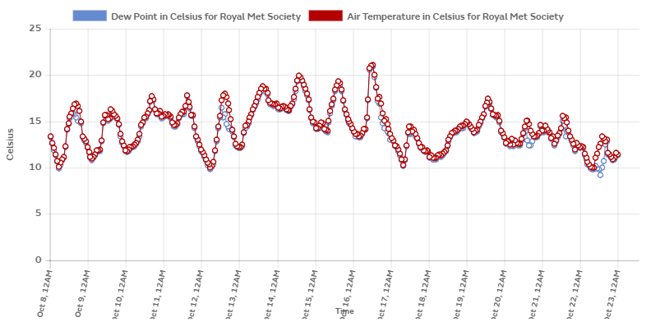
In the UK, it was warm…
Notes:
The weekend preceding Ophelia’s arrival, it was warm in the UK. Particularly on Friday night (13/14th) temperatures were unseasonably warm.

Slide 8
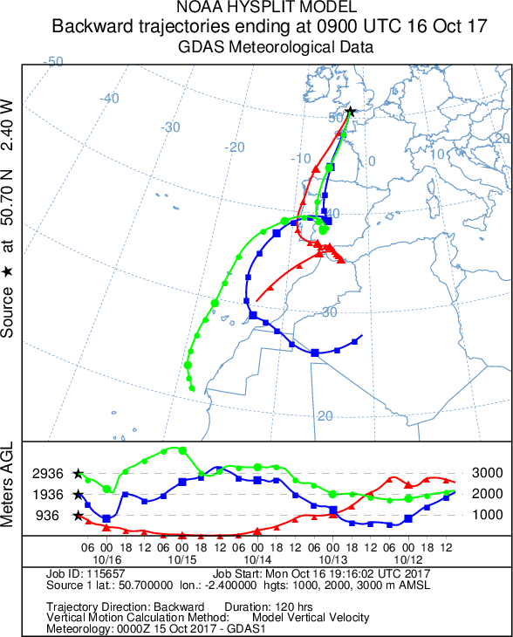
‘Smell of smoke’ caused several flights to land
Source: NOAA Air Resources Laboratory https://www.arl.noaa.gov/
Notes:
back trajectory: green line is air that was high over the UK, red line is air that was low in the sky over the UK. Map shows where that air came from over the preceding 4 days and the graph shows how it changed in height.
The air brought with it Saharan sand and smoke from the fires in Iberia, and warm temperatures. It was tropical maritime/ continental air.

Slide 9
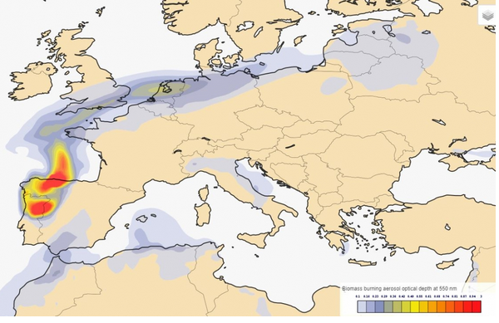
17th October
Notes:
17th – the map shows the density of biomass burning aerosol (ash from forest fires) in the air. Source is clearly Spain and Portugal with the ash being carries over the south of England to the Netherlands and Baltic States. The south of England mainly had ash in the air, whereas further north Saharan dust dominated.

Slide 10
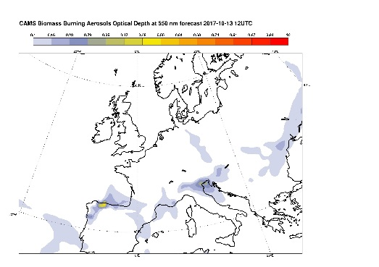
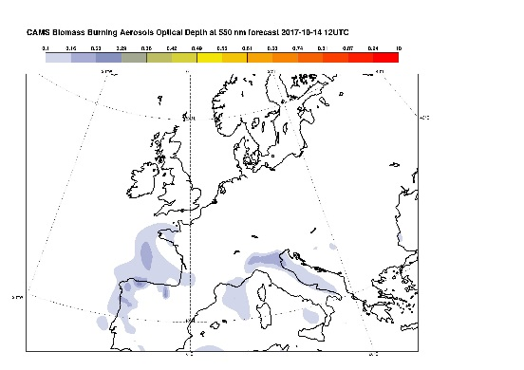
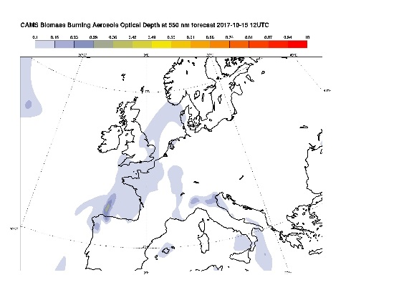
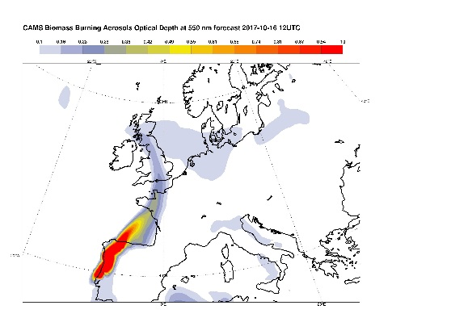
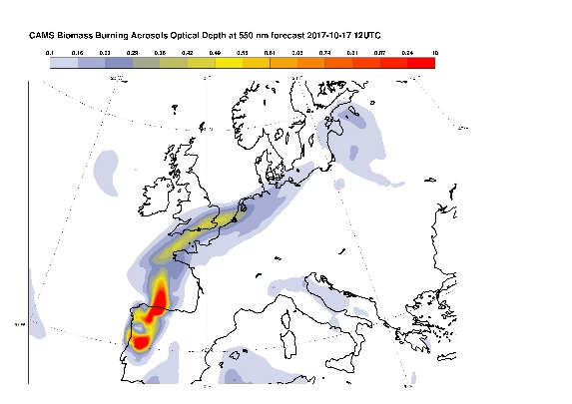
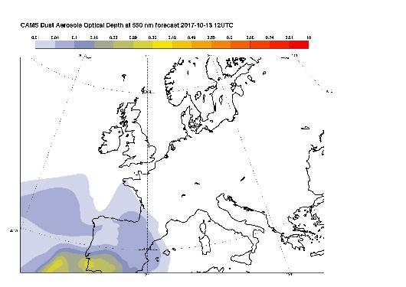
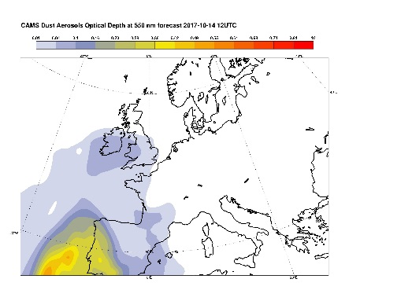
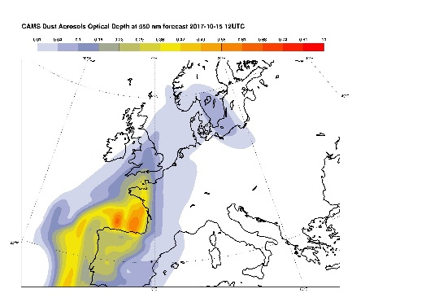
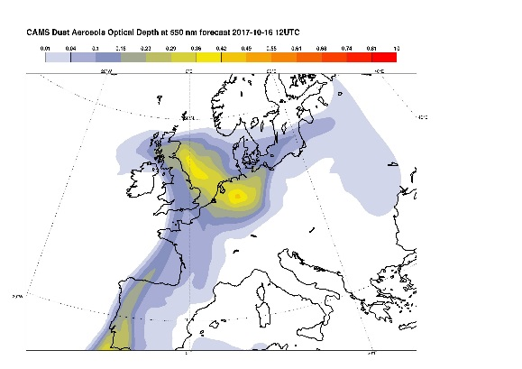
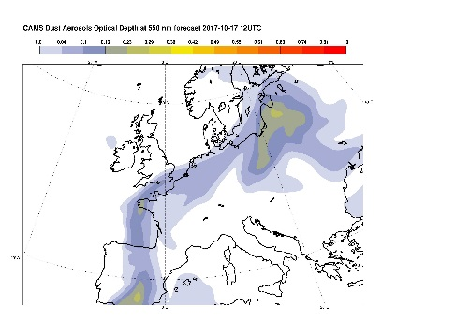
Notes:
The top line shows the biomass burning aerosol in the atmosphere at 12 UTC on the 13, 14, 15, 16th and 17th
The bottom line shows the amount of dust in the atmosphere at 12 UTC on the 13, 14, 15, 16th and 17
You can clearly see that the south of England had more biomass aerosol, whereas the north was more affected by the Saharan dust

Slide 11
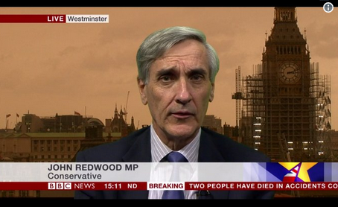
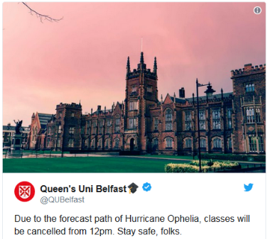
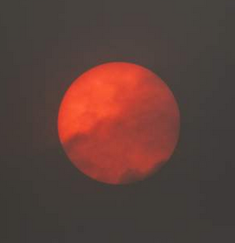
Notes:
Orange/ red skies on Monday October 16th caused by the dust and ash in the air

Slide 12
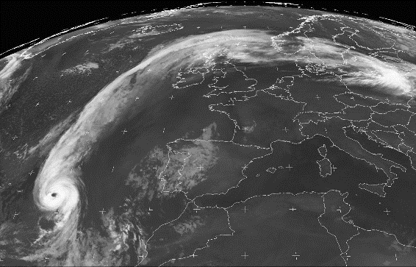
15th October, 3am
Notes:
15th oct 3am – Ophelia is a tropical cyclone on the end of a trailing cold front

Slide 13
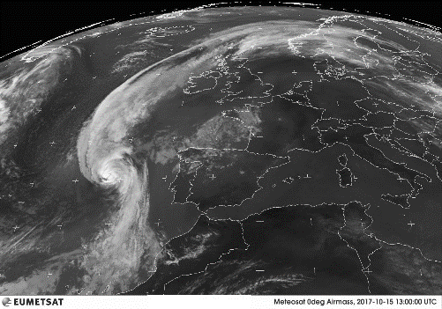
15th October, 1pm
Notes:
Ophelia has lost its eye

Slide 14
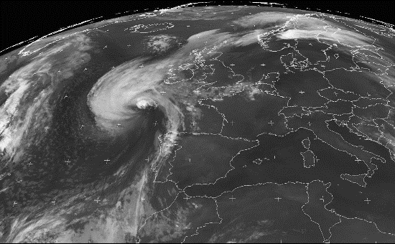
15th October 2300
Notes:
15th Oct 2300
Ophelia has lost its circular symmetry and has clear cold and warm fronts

Slide 15
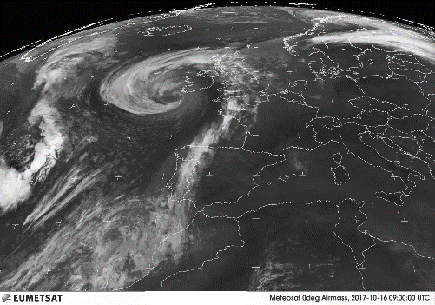
16th October 0900
Notes:
Now an extra-tropical depression

Slide 16
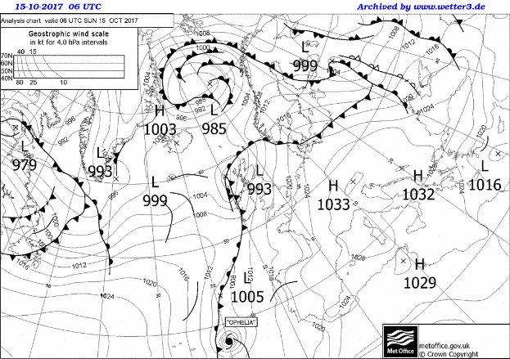
Ophelia wasn’t a classic depression
Notes:
We don’t often see the hurricane symbol on our Met Office synoptic charts where the region shown is chosen to focus on the area where our weather usually comes from.
Ophelia is at the end of a weak cold front. This front provided the disturbance needed for the tropical cyclone to begin developing.

Slide 17
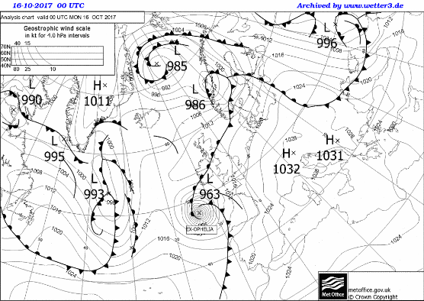
Notes:
There is a gap between the cold and warm fronts – this isn’t a ‘classical’ depression, the structure and processes are slightly different
The pressure in the centre of Ophelia dropped significantly through the 16th – it was a weather ‘bomb’

Slide 18
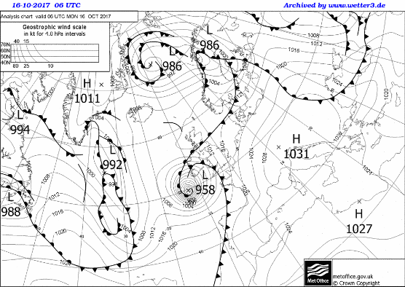
Notes:
The pressure contours are very close together implying fast wind speeds.

Slide 19
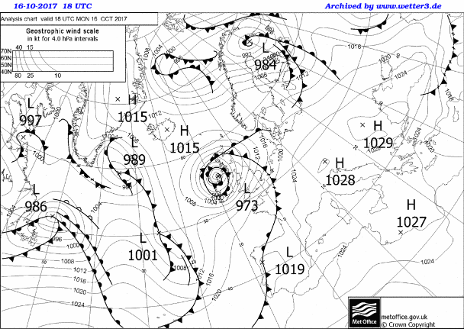
Notes:
Storm is now decaying and we have an occluded front

Slide 20
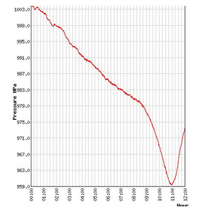
Pressure at Valentia, Country Kerry
A weather ‘bomb’ is a low pressure system where the pressure drops by more than 24hPa in 24 hours. Ophelia deepened faster than this through the 15th October.
The pressure also fell rapidly in Ireland as Ophelia approached.
Notes:
Valentia, Kerry, 16th Oct

Slide 21
Notes:
Very tight pressure contours = very fast winds!

Slide 22
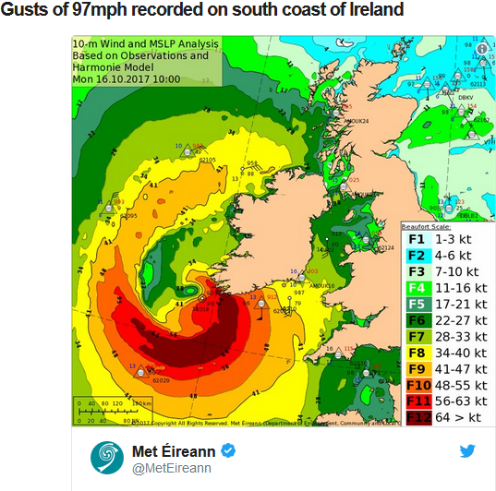
Fastnet lighthouse 119mph (191 km/h)
Roches Point at 97mph (156 km/h)
Kinsale Platform got 88mph (141 km/h)
Notes:
Met Eireann has posted gust speeds. The highest was at Fastnet Lighthouse where it reached 119mph (191 km/h).
Followed by Roches Point at 97mph (156 km/h) and Kinsale Platform 88mph (141 km/h)
16th pm – Wales – roads closed due to high winds,
Barrow football stadium lost roof, stand collapsed in Cork, Roof blown off school gym in Cork
High winds in Scotland caused disruption

Slide 23
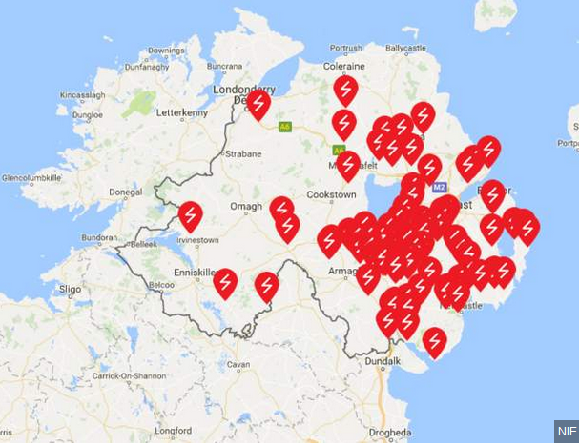
Notes:
NIE Networks reported about 18,500 homes and businesses lost power across Northern Ireland. The number of customers without power in the Republic of Ireland was more than 100,000. Over 4,000 properties were without power in west Wales as high winds from Ophelia hit coastal areas. Western Power Distribution reported homes in Carmarthenshire, Pembrokeshire, Ceredigion and Powys are affected.
69,000 people are also without water in Ireland.

Slide 24
Wind Speeds at 12UTC (13GMT)
Roads closed
Flights cancelled
Football stadia and schools damaged
Power loss: 18,500 homes and businesses across Northern Ireland, more than 100,000 in the Republic of Ireland, more than 4000 in Wales
69,000 people without water
Notes:
Most of the estimated cost of the storm is associated with economic loss (due to cancelled flights, industries shutting down for the duration of the storm etc.) rather than insurance claims associated with storm damage. In Ireland, economic losses are estimated at €1 billion.

Slide 25
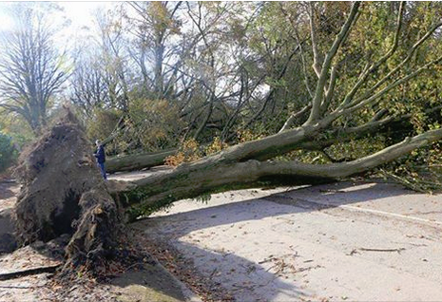
At least three tree related deaths across Ireland.
Notes:
A third person has died in the Republic of Ireland as a result of Storm Ophelia. Gardai say a tree fell on the man's car in Ravensdale, Dundalk. All deaths tree related

Slide 26
Schools shut in Republic of Ireland, N. Ireland and Wales
Notes:
16th & 17th –schools shut in NI
Around 130 schools closed across Wales including all 70 schools in Pembrokeshire.

Slide 27
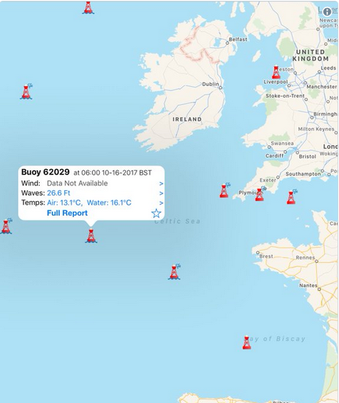
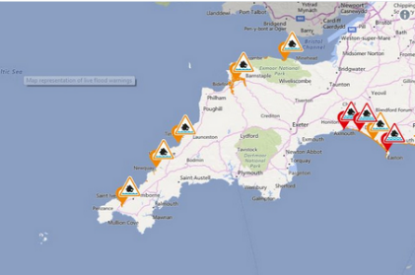
Notes:
Wind means waves- the faster the wind speed, the higher the waves.
When atmospheric pressure drops by 1 hPa/ millibar, sea level rises by 1cm
Two of the factors which can lead to coastal flooding

Slide 28
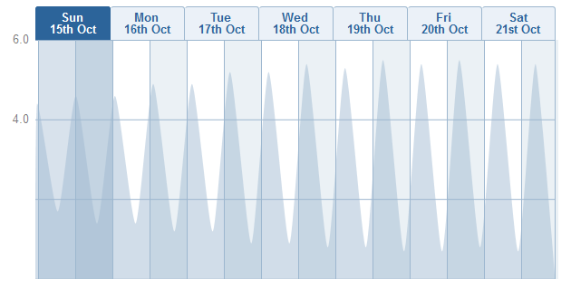
Porthlevel, Cornwall
Notes:
Coastal flooding can be associated with a depression because of
Raised water and wave height associated with the winds blowing surface water
When pressure falls 1millibar, sea level rises 1cm
If this coincides with a spring tide, things can be particularly bad. Luckily, Ophelia came at the time of a neap tide.

Slide 29
Sting Jets
Strongest surface winds associated with a depression
First identified retrospectively in 1987 storm
A jet of fast moving air descends from high in the atmosphere, accelerating as it moves down.
The yellow circle shows the spot on the Earth’s surface where the jet hits the ground
This is where maximum damage can be expected.
Sting Jet
Notes:
There was some talk of there being a sting jet associated with Ophelia

Slide 30
Notes:
There is a gap between the cold and warm fronts – which is one of the characteristics of a depression with a sting jet, but this was because it was left over from a tropical cyclone and probably isn’t a sign that there was a sting jet developing.
From the satellite image we can say that:
-there is a gap opening between the cold front and the warm front
-there is an impressive development of the cloud head which is actually showing some banding, suggesting the presence of instabilities (which is not surprising given the cyclone history)
-however, vigorous convection is still visible at the centre of the cyclone, very close to the cloud-head tip, a remnant of the tropical cyclone
-strong winds are already present behind the cold front so it would be hard to attribute any extra windiness to a sting jet

Slide 31
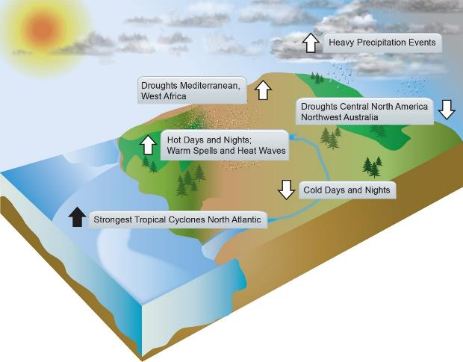
Climate Change and Tropical Cyclones
Source: IPCC Climate Change 2013, WG1 Physical Science Basis, FAQ 2.2 Figure 2
Notes:
In the North Atlantic, tropical cyclone numbers and intensity have increased but it cannot yet be said whether these are related to climate change or not, due to a lack of historical data. In the future, it is likely that the global frequency of tropical cyclones will decrease or stay the same, although maximum wind speeds and rainfall will increase.

