Slide 1
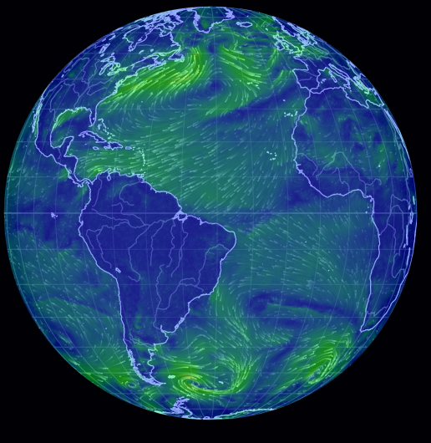
Global Atmospheric Circulation Practice
Divide your A3 sheet into four.
For each round, draw and label what you see in the presentation, in one box.
On the next round, swap your sheet with a partner, do the same as in point 2, but in a new box.
It gets faster and harder with each round.

Slide 3
COLD
HOT
COLD

Slide 4
COLD
sinking
rising
HOT
COLD

Slide 5
COLD
sinking
rising
HOT
COLD

Slide 6
COLD
Low pressure
sinking
High pressure
rising
Low pressure
HOT
High pressure
Low pressure
COLD

Slide 7
COLD
Low pressure
westerlies
sinking
High pressure
Easterly
Trade winds
rising
Low pressure
HOT
Easterly
Trade winds
High pressure
westerlies
Low pressure
COLD

Slide 9
COLD
HOT
COLD

Slide 10
COLD
sinking
rising
HOT
COLD

Slide 11
COLD
sinking
rising
HOT
COLD

Slide 12
COLD
Low pressure
sinking
High pressure
rising
Low pressure
HOT
High pressure
Low pressure
COLD

Slide 13
COLD
Low pressure
westerlies
sinking
High pressure
Easterly
Trade winds
rising
Low pressure
HOT
Easterly
Trade winds
High pressure
westerlies
Low pressure
COLD

Slide 15
COLD
HOT
COLD

Slide 16
COLD
sinking
rising
HOT
COLD

Slide 17
COLD
sinking
rising
HOT
COLD

Slide 18
COLD
Low pressure
sinking
High pressure
rising
Low pressure
HOT
High pressure
Low pressure
COLD

Slide 19
COLD
Low pressure
westerlies
sinking
High pressure
Easterly
Trade winds
rising
Low pressure
HOT
Easterly
Trade winds
High pressure
westerlies
Low pressure
COLD

Slide 21
COLD
HOT
COLD

Slide 22
COLD
sinking
rising
HOT
COLD

Slide 23
COLD
sinking
rising
HOT
COLD

Slide 24
COLD
Low pressure
sinking
High pressure
rising
Low pressure
HOT
High pressure
Low pressure
COLD

Slide 25
COLD
Low pressure
westerlies
sinking
High pressure
Easterly
Trade winds
rising
Low pressure
HOT
Easterly
Trade winds
High pressure
westerlies
Low pressure
COLD

Slide 26
Turn over your sheet, and see how much you can draw from memory!

