Slide 1
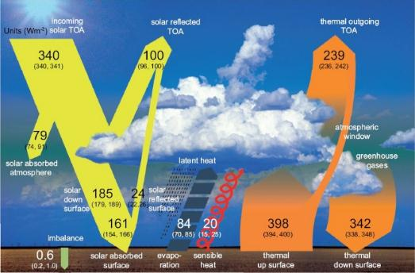
The Sun and the Earth’s Climate
Notes:
Grantham Institute for Climate Change Briefing paper No 5
February 2011, Prof. Joanna Haigh,
Solar influences on Climate

Slide 2
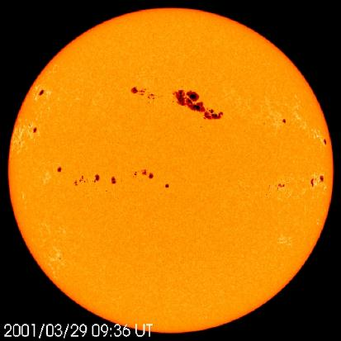
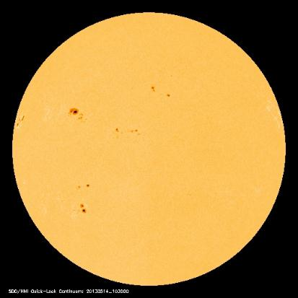
Sunspots and the Solar Constant
29 Mar 2001
16 Jan 2009
14 May 2013
Images from http://sohowww.nascom.nasa.gov/
Notes:
The more electromagnetic radiation (light, UV light and heat) the Sun emits, the more energy arrives at the top of the atmosphere – the ‘solar constant’ is higher.
The Sun’s output of electromagnetic radiation is linked to the level of sunspot activity. Even though sunspots are darker than the rest of the solar photosphere, the Sun is actually slightly brighter (and the solar constant therefore slightly higher) when there are sunspots, because the Sun emits far more ultraviolet radiation, and because of other changes on the surface of the Sun
.
From a global perspective the processes through which changes in incident solar radiation affect the temperature of the Earth’s atmosphere, and the climate at the surface, are reasonably well understood. The spectral composition of the radiation is of crucial importance. For example, visible radiation reaches and warms the oceans and land surface, ultraviolet radiation is absorbed by atmospheric oxygen and ozone, while water vapour and carbon dioxide absorb infrared radiation. The production and destruction of some gases, such as stratospheric ozone, also depend on solar ultraviolet radiation.
However, the response of climate on regional scales to changes in the composition and intensity of incident solar radiation is more complex. This is an area of active research and, while significant progress has been made, definitive answers require further investigation into effects such as the role of stratospheric ozone, ocean-atmosphere interactions and the role of clouds.

Slide 3
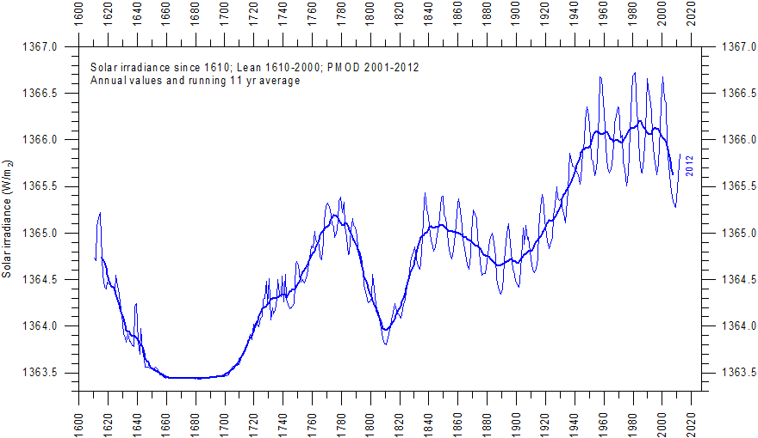
“The number of polar bears, the length of women's skirts, the stock market: Everything imaginable has been correlated with the solar cycle”
Notes:
Scientific observations of sunspots began after the invention of the telescope, in 1610, and the approximately 11 year solar cycle, which can be seen clearly in figure 8, was identified in 1843. Changes in the solar constant through an 11 year cycle are typically less than 0.1% (note the y axis scale on the graph), with an estimated global temperature response of less than 0.03ºC. Nevertheless, some correlation has been noted with droughts, temperature, ozone etc. suggesting that there may be some feedback mechanisms.
From 1645-1710 there were virtually no sun-spots; a period known as the Maunder minimum which has been linked to the ‘little ice age’ in the Northern Hemisphere.
It can be said definitely that when the Sun is more active, more visible radiation heats the sea surface. More ultraviolet radiation means that more UV is absorbed by the ozone in the stratosphere, and is released as heat there.
A cautionary note was added by Harry van Loon of the National Center for Atmospheric Research:
"The number of polar bears, the length of women's skirts, the stock market: Everything imaginable has been correlated with the solar cycle'. That doesn’t mean that there is a mechanism linking these things to the solar cycle; they just happen to vary on the same timescale.
There has been no net increase in solar brightness since the 1970s, and the Sun is currently in decline. Predictions for the next century suggest that there may continue to be a slight reduction in sunspot number.

Slide 4
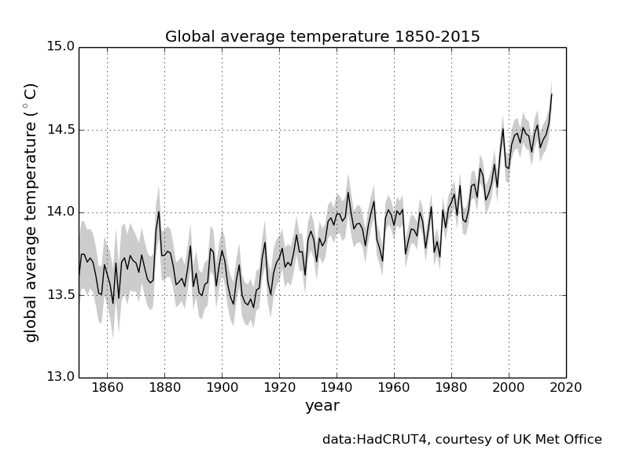
Notes:
This graph shows global temperatures from 1850.
The warming 1900-1950 was due to already increasing greenhouse gases + increase in solar activity + a lack of volcanic activity
The Sun may have introduced an overall global warming (disregarding 11-year cycle modulation) of approximately 0.07 °C before about 1960 but has had little effect since.
The cooling in 50s and 60s was due to aerosols – other atmospheric pollutants we were emitting which were making it cloudier, reflecting the Sun’s light. Clean air acts, designed to reduce acid rain and improve air quality, have started to reduce these, at least in Europe.
Subsequent warming as greenhouse gases increase rapidly with their related feedbacks

Slide 5
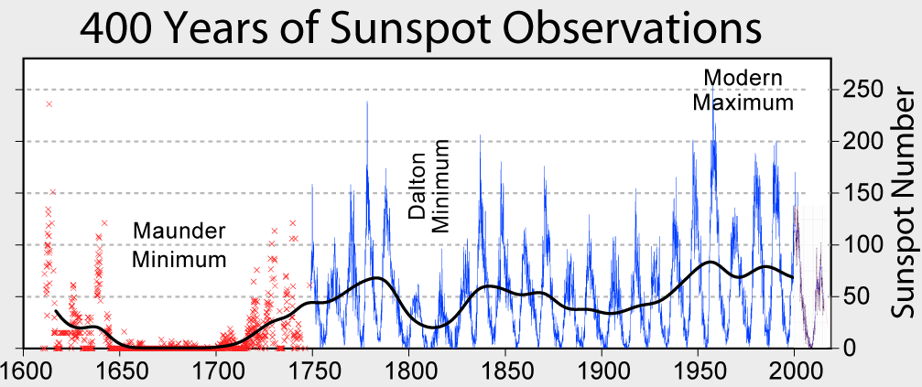
Notes:
Maunder Minimum is connected with the Little Ice Age – a period of general cooling, at least in the Northern Hemisphere, although this has also been linked to major volcanic eruptions in the 13th century onwards, coupled with ice feedbacks.
The Dalton Minimum may have contributed to the bad weather, and related failures of harvests and general distress, at the start of the 19th Century.

Slide 6
Space Weather
Solar Flares or
Coronal Mass Ejections
Notes:
As well as energy, the Sun emits energetic particles. When the Sun is more active, it emits more radiation and more particles.
These give us the aurorae; natural light displays commonly called the Northern or Southern Lights. Aurorae are produced when energetic particles in the solar wind—a stream of high-energy, ionised particles emitted by the Sun—interact with the atmosphere and are more frequently observed when the Sun is more active. Aurorae are also associated with an electric current in the upper atmosphere which causes disturbances in the Earth’s magnetic field and can have important consequences for communications with satellites and other telecommunications. The energetic particles can warm the very outer atmosphere – the thermosphere.

Slide 7
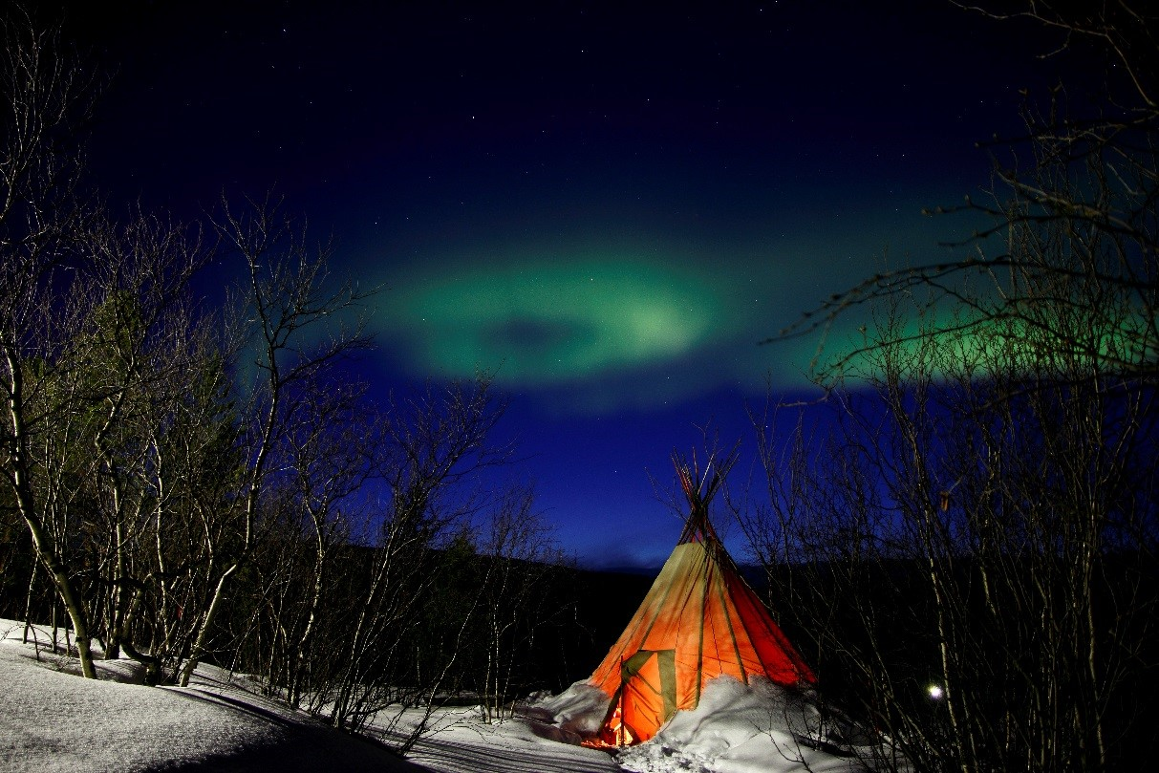
The Aurora Borealis
Copyright Martin Schaefer
Notes:
In addition to the effect of variations in the amount of energy and charged particles we get from the Sun:
The solar wind and the solar magnetic field provide protection for the Earth from galactic cosmic rays (GCRs), which are high energy charged particles originating outside the solar system.
When the Sun is less active, more cosmic rays reach the Earth.
Any factor influencing cloud cover clearly has the potential to significantly affect climate and it has been proposed that cosmic rays could provide a mechanism for this through their role in atmospheric ionisation. No evidence has yet been found for this in the atmosphere.

