Slide 1
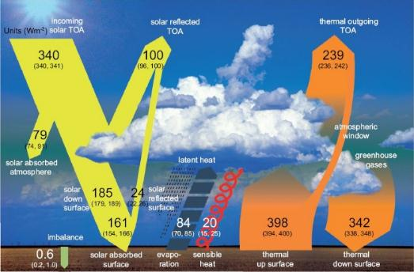
The Earth’s Orbit and Climate
Notes:
Grantham Institute for Climate Change Briefing paper No 5
February 2011, Prof. Joanna Haigh,
Solar influences on Climate – includes much on Milankovitch

Slide 2
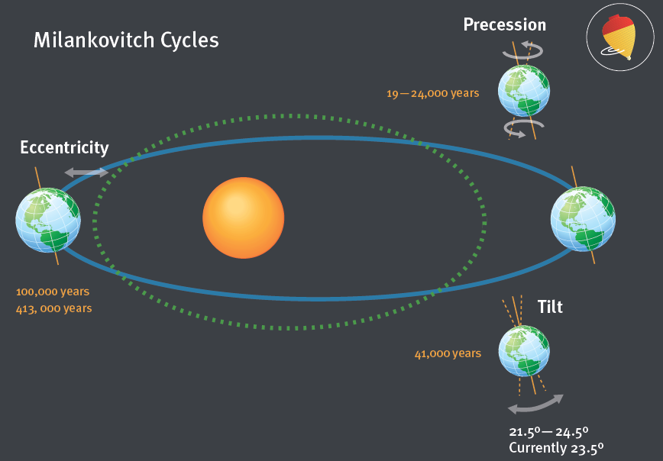
The Milankovitch Cycles
Source: Grantham Institute
Notes:
Let’s look at the Sun first, and specifically the orbit of the Earth around the Sun. There are three ways in which the Earth’s orbit changes over time, known as the Milankovitch cycles.
.

Slide 3
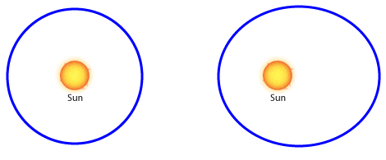
Eccentricity
The combined gravitational pull of the Sun, Saturn, Jupiter and other planets cause the shape of the Earth’s orbit to vary from its most elliptical to almost circular.
It has a 110,000 year time scale.
The Earth is currently closer to the Sun in January than in July, meaning that the seasons are more extreme in the Southern Hemisphere than in the Northern Hemisphere.
http://www.skepticalscience.com/Milankovitch.html
Notes:
This means that the northern hemisphere receives about 7% less radiation in its summer, and 7% more in its winter, than the southern in its equivalent seasons because the Earth is closer to the Sun in January than in July.

Slide 4
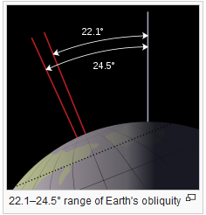
Tilt
The tilt or obliquity of the Earth’s axis varies over time
41,000 year cycle
If the Earth’s axis were vertical, we wouldn’t have any seasons at – the same part of the Earth’s surface would be facing the Sun throughout the year.
The more angled the axis, the more extreme the seasons. Currently, the Earth is tilted at 23.44° from its orbital plane, half way between its maximum and minimum value.
The angle is currently decreasing.

Slide 5
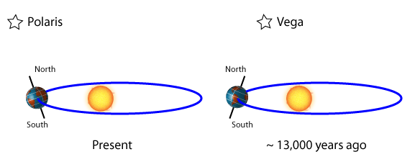
The axis also precesses or traces a circle in space.
26,000 year time period.
This is a gyroscopic motion due to the tidal forces exerted by the Sun and the moon on the solid Earth, associated with the fact that the Earth is not a perfect sphere but has an equatorial bulge.
It changes which star we see as the North Star – currently it is Polaris, but 13,000 years ago, it would have been Vega
Precession

Slide 6
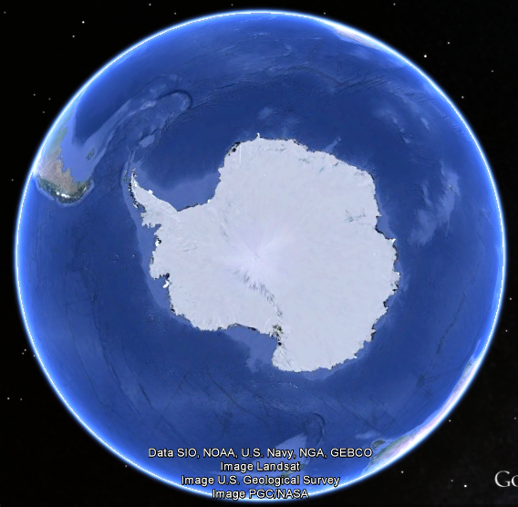
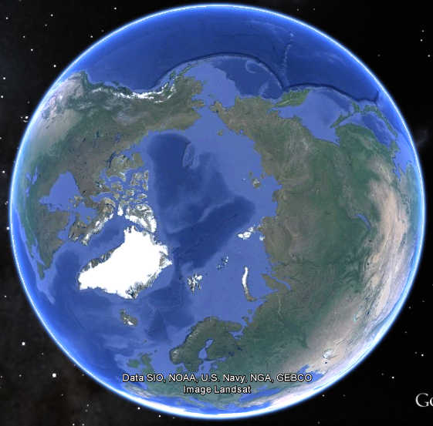
Notes:
These processes have an impact on which part of the Earth’s surface gets most energy through the year. If you have a look at a globe or a map of the world, you’ll see that there is far more land in the Northern Hemisphere than in the South. As the way land and vegetation interact with light and heat are very different to the way in which water does, this has an impact on the global climate.
Coupled with feedback mechanisms (for example, if a polar region receives less sunlight, it cools, allowing more ice to grow, this reflects more light leading to further cooling) these three mechanisms can lead to significant changes in the Earth’s climate, including the transition to and from ice ages. Another strong feedback mechanism is associated with the release of greenhouse gases from the ocean as the atmosphere warms, leading to further warming.

Slide 7
The amount of energy arriving in summer at high latitudes (near the poles) determines whether the winter growth of the ice cap will recede or whether the climate will be precipitated into an ice age.
Change in global temperature from 5 Ma (Million years ago) to present. Source:wikipedia
Notes:
Tropical sea-surface temperature from 3.5 Ma (Million years ago) to present. This figure shows that there was a slow cooling of climate over the last 3 million years as polar ice sheets grew partly in response to continental drift. At the Mid-Pleistocene Transition around 1.2 million to 700,000 years ago, the Milankovitch cycles started interacting differently with a shift to a dominant 100,000 year climate signal.

Slide 8
Other useful resources:
http://www.sciencecourseware.org/eec/globalwarming/tutorials/milankovitch/
https://www.google.co.uk/url?url=https://www.imperial.ac.uk/media/imperial-college/grantham-institute/public/publications/briefing-papers/Solar-Influences-on-Climate---Grantham-BP-5.pdf&rct=j&q=&esrc=s&sa=U&ved=0ahUKEwi4prnyicPMAhWqI8AKHaAOCkMQFggXMAA&sig2=uPVS6gS9fOH28Wt7ZeS3ng&usg=AFQjCNF6uHfm_DNrQ0jOlBUVqQrJlM7qRg
http://climatica.org.uk/climate-science-information/long-term-climate-change-milankovitch-cycles
https://www.youtube.com/watch?v=6lbJrvtxWNE
https://www.aip.org/history/climate/cycles.htm

