Slide 1
Lesson 2
Create a graph that demonstrates how the earth’s atmosphere has evolved

Slide 2
Task
Produce a graph showing the evolution of the earth’s atmosphere
Your graph will need to show:
Changes in Oxygen Concentrations
Changes in Carbon Dioxide, Nitrogen and other gases
It will need to be annotated to explain changes in these gases
You will need to use the posters and materials provided to achieve this

Slide 3
Stick an A4 piece of graph paper at the centre of a sheet of A3 plain paper (this gives you room to annotate)
Use Resource 1 to decide how long the X axis should be (Tip: how many millions of years ago did the earth evolve)
The Y axis will need to range from 0-100%. Some gases will always remain very low <1% but are still very important. You might like to use a second axis to plot these. Ask your teacher how.
Use the data sheet to plot the changes in gas composition since the Earth formed.
Include a key
For each gas write a description of the changes since the Earth formed on the outer A3 sheet. Remember: When you describe – say what you see. A good description will include numbers.
Label 4 points on your graph with a * that you think need explaining.
Now Use resource 1 to identify at least 3 things that have happened that could change the composition of the atmosphere. You will need to think about this as it does not say. Look at the timeline for clues. These events can now be added to your poster. Do any of them match the change in gas composition?
Task Instructions

Slide 4
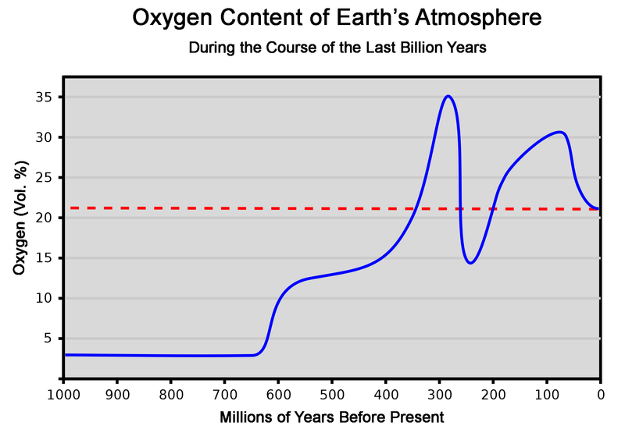
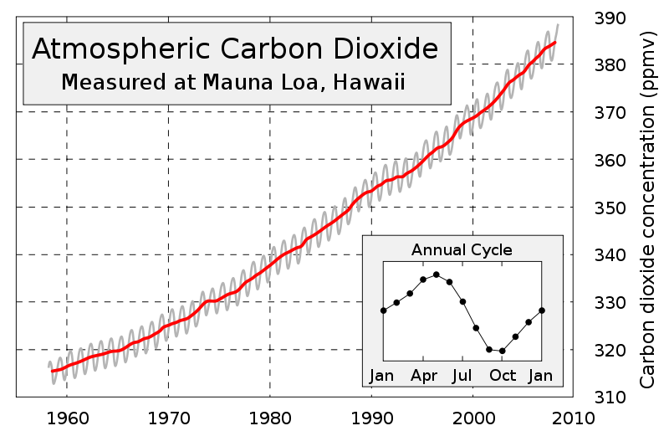
Data sheet 1
MYA | Carbon Dioxide% | Nitrogen % | Hydrogen % | Oxygen %
4500 | 80 | 8 | 11 | 0
4000 | 38 | 38 | 8 | 0
3500 | 20 | 60 | 7 | 0
3000 | 18 | 75 | 4 | 0
2500 | 15 | 77 | 0 | 0
2000 | 11 | 78 | 0 | 1
1500 | 8 | 78 | 0 | 8
1000 | 5 | 78 | 0 | 16
500 | 1 | 78 | 0 | 18
0 | 0.04 | 78 | 0 | 18
Data taken from http://www.scotese.com/precamb_chart.htm
Approximate figures shown to illustrate trends.
Extension:
You only need to plot the data above. Why do you think the graph in the top right is different to the data shown.
The second graph shows how CO₂ has changed in the last 50 years. Is this significant given the larger picture?

Slide 5
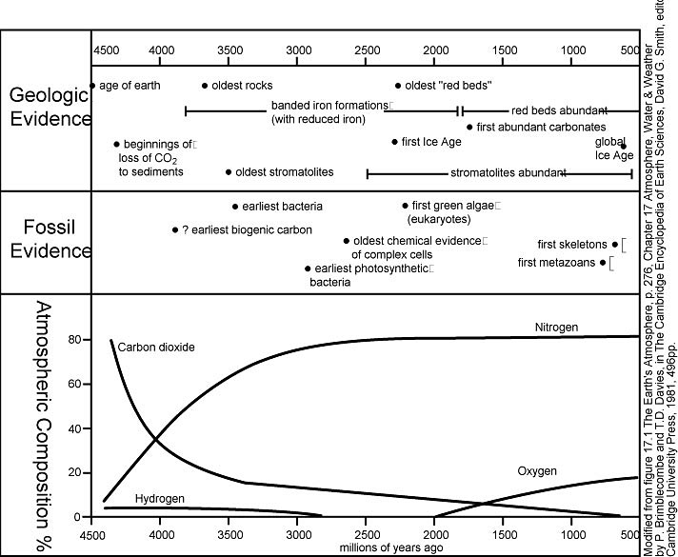
This graph was used to generate the data set.

Slide 6
Sample Work

Slide 7
← True False →
The first bacteria to evolve produced oxygen
Carbon dioxide has fallen because it gets locked up as carbonates in rocks
Recent human activities have been responsible for the biggest change in carbon dioxide concentrations ever
Photosynthesis is responsible for the production of oxygen
Xenon makes your voice go squeaky
Carbon dioxide has been reduced because trees have used it up
Burning fossil fuels such as oil has released carbon that has been absorbed by trees over millions of years.

Slide 8
Assessment
Triangle
Name the process that led to the production of oxygen and where this process happens
Give two reasons for the reduction in carbon dioxide concentration
Name three gases whose abundance has changed in the atmosphere since the earth formed

