Slide 1
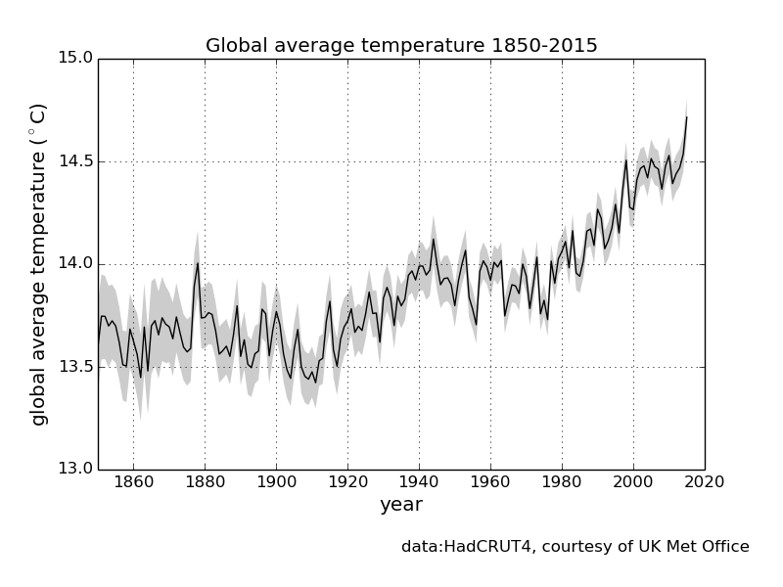
The Greenhouse Effect, Global Dimming and the Hiatus
Notes:
The temperature of the Earth has been increasing since early last century, due to a combination of land use changes and emissions of greenhouse gases.
Far more information is available at http://www.metlink.org/ipcc-updates-geography-teachers/

Slide 2
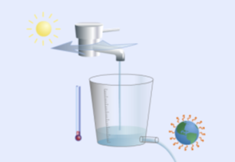
A Leaky Bucket
Notes:
How are the flow of energy we get from the Sun and the flow of energy the Earth loses to space related to each other? A useful analogy is a leaky bucket.
Consider a bucket with a hole in it, and water flowing in to the bucket at a constant rate from a tap. At the moment, the flow of water in to the bucket is the same as the flow of water out through the hole, and the level of water in the bucket is staying the same. What happens if you open the tap some more?
Initially, there will be more water coming in to the bucket than flowing out, and the level of water will rise. However, remember that the water pressure is related to the depth of the water. As the water level rises, so does the water pressure and this forces more water out through the hole in the bottom. Eventually, the rate of flow out balances the flow in again, and the level of water in the bucket stays the same, albeit at a higher level than it was before.
The tap is like the Sun, with the water coming out of it being like the energy entering the top of the atmosphere from the Sun. The bucket is the Earth, with the flow of water out of the bucket being like the energy the Earth loses to space. This is proportional to T⁴, so if the Earth gets more energy from the Sun (the tap is opened more), the Earth heats up (the water level rises) and as it does so the Earth loses more energy to space (more water is forced through the hole) until again the amount of energy the Earth gets is balanced by the amount it loses, albeit with the Earth at a warmer temperature.
NB if you just put some extra water in the bucket in one go, without changing the flow rate from the tap, the level will slowly fall back to where it was originally. Similarly, if something emits heat on the Earth’s surface (maybe from a large fire), that heat is slowly lost to space and the temperature of the Earth slowly falls back to where it was originally. This is why it is the greenhouse gases emitted by burning fossil fuels, rather than the heat, which causes climate change.
But, it’s not so simple. This is mainly because the Earth has an atmosphere, which also has an impact on the flow of energy to and from our planet.

Slide 3
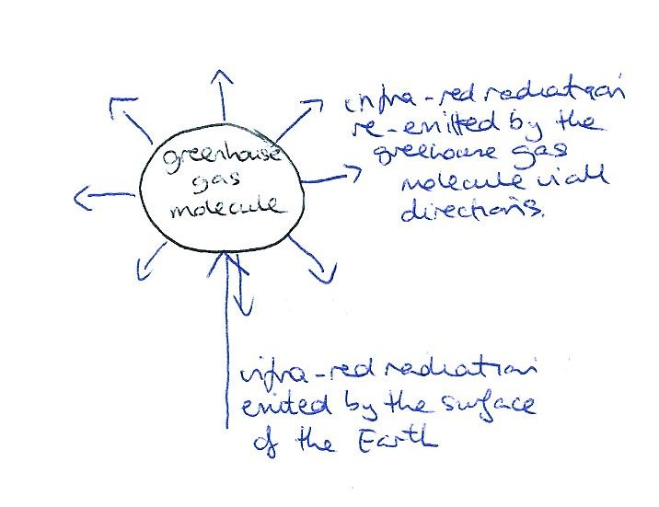
The Greenhouse Effect
Notes:
Greenhouse gases - In 1859, John Tyndall's laboratory experiments showed that greenhouse gases absorb infra-red radiation. In fact, greenhouse gases absorb much of the long-wave radiation, heat, emitted by the surface of the Earth. These gases include water vapour (the most important), carbon dioxide, methane and nitrous oxide. Without them, the surface of the Earth would be about 33°C cooler. The effective temperature of the Earth, or the temperature of the Earth as calculated by an observer far out in space based on the amount of energy the Earth is losing to space, is only about -23°C.
Thermal down surface - Each greenhouse gas molecule absorbs energy coming at it from one direction and re-emits it in all directions. So, if the energy it absorbed was heading upwards initially, half of it will end up heading downwards once it is re-emitted.
The net effect of this happening over and over again is that the warm atmosphere radiates energy in two directions – some upwards, so that it is lost to space, but more downwards, back towards the surface of the Earth.

Slide 4
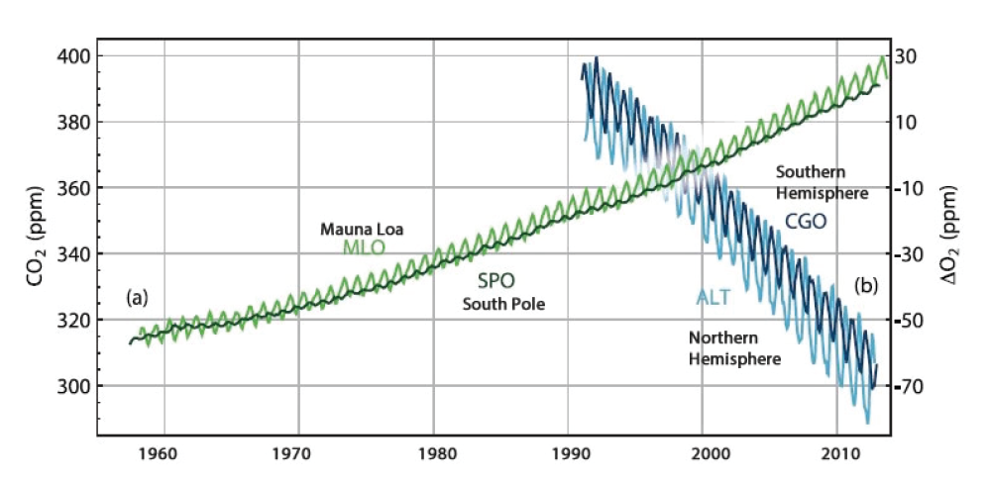
Increasing Greenhouse Gases
Concentrations of carbon dioxide and oxygen in the atmosphere. Atmospheric concentration of a) carbon dioxide in parts per million by volume from Mauna Loa (MLO, light green) in the Northern Hemisphere and the South Pole (SPO, dark green) and of b) changes in the atmospheric concentration of O₂ from the northern hemisphere (ALT, light blue) and the southern hemisphere (CGO, dark blue).
Notes:
Now let’s look at greenhouse gases and how their concentration has been changing in the atmosphere.
Carbon Dioxide concentrations in the atmosphere increased by over 40% from 278 ppm (parts per million) in 1750 to 400 ppm in 2015.
Most of the fossil fuel CO₂ emissions take place in the industrialised countries north of the equator. Consistent with this, the annual average atmospheric CO₂ measurement stations in the Northern Hemisphere record slightly higher CO₂ concentrations than stations in the Southern Hemisphere. As the difference in fossil fuel combustion between the hemispheres has increased, so has the difference in concentration between measuring stations at the South Pole and Mauna Loa (Hawaii, northern hemisphere).
The atmospheric CO₂ concentration increased by around 20 ppm during 2002–2011. This decadal rate of increase is higher than during any previous decade since direct atmospheric concentration measurements began in 1958.
Because CO₂ uptake by photosynthesis occurs only during the growing season, whereas CO₂ release by respiration occurs nearly year-round, both the Mauna Loa and South Pole concentrations show an annual cycle, with more CO₂ in the atmosphere in winter. However, as there is far more land mass and therefore vegetation in the Northern Hemisphere, the annual cycle is more pronounced at Mauna Loa.
Past changes in atmospheric greenhouse gas concentrations can be determined with very high confidence from polar ice cores. During the 800,000 years prior to 1750, atmospheric CO₂ varied from 180 ppm during glacial (cold) up to 300 ppm during interglacial (warm) periods. Present-day (2011) concentrations of atmospheric carbon dioxide far exceed this range. The current rate of CO₂ rise in atmospheric concentrations is unprecedented with respect to the highest resolution ice core records which cover the last 22,000 years.
Atmospheric oxygen is tightly coupled with the global carbon cycle. The burning of fossil fuels removes oxygen from the atmosphere. As a consequence of the burning of fossil fuels, atmospheric O₂ levels have been observed to decrease slowly but steadily over the last 20 years (shown by the blue lines in the graph above). Compared to the atmospheric oxygen content of about 21% this decrease is very small and has no impact on health; however, it provides independent evidence that the rise in CO₂ must be due to an oxidation process, that is, fossil fuel combustion and/or organic carbon oxidation, and is not caused by volcanic emissions or a warming ocean releasing carbon dioxide (CO₂ is less soluble in warm water than cold).

Slide 5
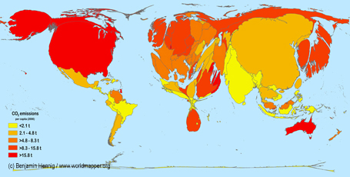
Carbon Emissions Map, resizing the territories according to their proportion of global carbon dioxide emissions and colouring them according to their per capita emissions.
Reproduced with permission from Dr. Benjamin Hennig http://www.viewsoftheworld.net/

Slide 6
Global Dimming
Notes:
The amount of the Sun’s energy reaching the surface changed after 1950, with
a) decreases (‘dimming’) until the 1980s, because atmospheric pollutants (aerosols) make the atmosphere more reflective and also clouds, by increasing the number of water droplets in the clouds, which in turn increases the amount of sunlight reflected, and subsequent
b) increases (‘brightening’) as national and international legislation in the 1980s reduced the amount of pollutants in the atmosphere which increased the amount of energy reaching the surface.
During this period, the amount of greenhouse gas in the atmosphere was still increasing.

Slide 7
The ‘Hiatus’
Notes:
There was some evidence that the observed global mean surface temperature increase slowed over the period 2000- 2010 compared to the past 30 to 60 years.
The media dubbed this slowdown the ‘hiatus’, but more recent analysis has shown it to be an artefact – key Arctic data was missing in analyses of global temperature.
2000-2010 has been the warmest decade in the instrumental record, which began in the mid 19th century. The climate system has continued to accumulate energy, for example energy accumulation in the oceans has caused the global mean sea level to continue rising.
A combination of changes in forcing, uptake of heat by the oceans, natural variability and incomplete observational coverage reconciles models and data. Combined with stronger recent warming trends in newer datasets, we are now more confident than ever that human influence is dominant in long-term warming.

