Slide 1
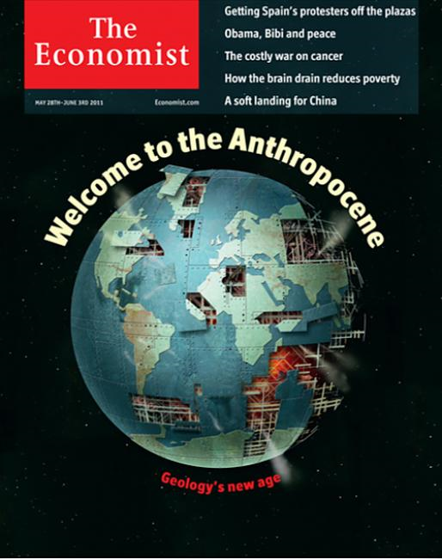
Debating the Anthropocene
Ecological footprints
Categorising the role of humans in the Earth system.
Geological timescales & stratigraphy (layers)
Definitions under ideologies
Notes:
Does the Anthropocene exist?
If so, how do we define it?

Slide 2
Introduction
Humans are significantly altering the planet – physically, chemically and biologically
They are now a geological force that can control evolution of climate
Earth’s history is divided up into sections – partly according to forces at play
“Anthropocene” is the name of a proposed new section where Humans dominate
Each boundary has a distinct marker
When should the start of Anthropocene be?

Slide 3
Learning Objectives
The Anthropocene is an active research topic and no conclusions have yet been reached
Here we’ll touch upon about the same questions that university geographers are struggling with.
Understanding what evidence from Humanity’s presence will remain is non-trivial.
There is active debate around several proposed start dates for the Anthropocene
The societal and political implications of each of those dates differs.

Slide 4
Traces of Humanity
Objective A

Slide 5
Scenario: Imagine you are a scientist from the future looking back at the Earth.
What evidence would you look for that people had altered the nature of the whole planet?
Consider how we learn about
What the climate was in past
How stone-age people lived
What killed off the dinosaurs
Even the remotest parts of the ocean have been impacted by humans

Slide 6
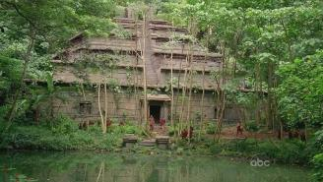
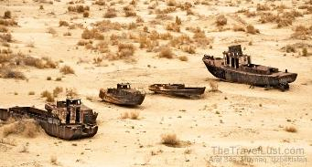
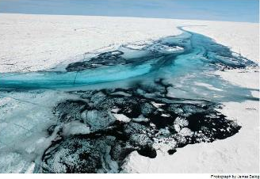
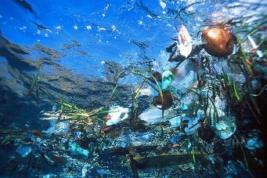
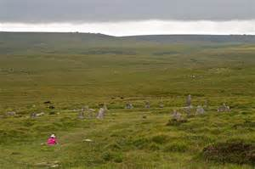
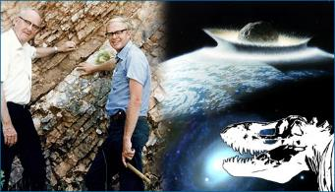
Notes:
This page contains some pictures to help students think about the questions. They are (clockwise from top left):
Ruined Aztec temple reclaimed by the jungle - this shows how (stone) buildings will last for a a few hundred years. However, they can be hard to find (lost cities) and interpret once found.
The Aral Sea. This has nearly all (95%) dried up due to Soviet era farmland (cotton) irrigation from the rivers that fed the sea. You would not spot it was once an inland sea if it wasn't for the rusting ships.
Plastic in the great Pacific garbage patch – 70% of the Earth is ocean, so thinking about human impacts on the ocean are important – especially as the biology and chemistry of sediments from the sea floor as the source of much of knowledge of the past climate. The plastics start in the 1950s and will very slowly biodegrade on century timescales.
The discoverers of the meteor impact that wiped out the dinosaurs standing next to the rock layer from which they found its odd chemical signature (iridium). Clearly changes in the fossil assemblage (bones etc) also mark this boundary (dinosaurs before, but not after)
Standing stones in Dartmoor. A) there is a stone circle in the foreground – further evidence of built infrastructure persisting for thousand years. B) the deforestation by the ancient Britons has permanently converted the landscape to moor. Much larger scale, so easier to spot – but not obvious. Could detect vegetation shift from pollen in soil layers.
Black carbon (basically fossil-fuel soot) on snow in the middle of Greenland (blue is meltwater). Drilling down through ice sheets provides evidence of past CO2 levels (trapped air bubbles) and climate (stable isotope chemistry). This is an important climate feedback and remote human impact.

Slide 7
Traces of Humanity - summary
Human’s impact on has environment varied with time, but non doubts that it exists everywhere at present
Evidence of activity can be hard to spot and then identify
There are multiple different recorders of our impact
Biological (e.g. fossils, pollen)
Chemical (e.g. carbon dioxide, radioactivity)
Physical (e.g. built infrastructure, unnatural particles such as CFCs, plastic)

Slide 8
four Proposed dates
Objective B

Slide 9
Early Anthropocene
Reason
Merits
Early agricultural and civilisation led to alterations in the carbon cycle
Deforestation
Methane emissions from rice paddies
This prevented natural start of next ice phase 5000 years ago
Pro: recognises first human influence
Con: needs rather precise knowledge of what climate would have done without Humans

Slide 10
“Orbis” (joining the whole planet together)
Reason
Merits
Once new world was founds, crops and animals transplanted
This merging of biota is irreversible.
Associated with American depopulation (90% death rate of natives)
Forest regrowth may have impacted carbon levels
Pro: Fossil record evidence undisputable
Con: climate impact debatable

Slide 11
Industrial Revolution
Reason
Merits
Discovery of steam engine (in 1712)
Start of whole-scale changes in atmosphere and land cover
Initially based in Western Europe and then slowly expanding
Coal use for energy
Pro: “Preindustrial” already used to measure climate changes from in Paris agreement
Con: Hard to pick up exact threshold in geologic record
Con: temporal effect different across globe

Slide 12
Great Acceleration (1950-60s)
Reason
Merits
Post-war population increase and consumer power
Nuclear tests have global signal
Dramatic increase in rate environmental change
Wholesale extinctions and deforestation
Pro: No-one disputable global human influence by this date
Pro: Many different possible markers
Con: Radioactive evidence will decay away

Slide 13
Your vote?
Think about the relative merits of the 4 options.
Which date would you pick?
3070 BCE – Early Anthropocene
1610 CE – Orbis and the New World
1712 CE – Industrial revolution
1963 CE – Great acceleration

Slide 14
Implications of Choice
Objective C

Slide 15
Perceptions of selection
Start Date | Implications
Early Anthropocene (3070 BCE) | Farming and civilisation was root of Anthropocene. Highlights prehistoric contribution - drawing attention away from current activities.
Orbis (1610 CE) | Colonialism and global trade was root of Anthropocene. Highlights social concerns surrounding the unequal power relationships (such as slavery) and globalisation.
Industrial Revolution (1712 CE) | Coal and industrialisation was root of Anthropocene. Highlights social concerns surrounding the global economy and reliance of fossil fuels.
Great Acceleration (1964 CE) | Nuclear bomb and consumerism was root of Anthropocene. Highlights that technology in hands of a few threatens planet-wide destruction. Population growth combined with western lifestyle also at fault.

