Slide 1
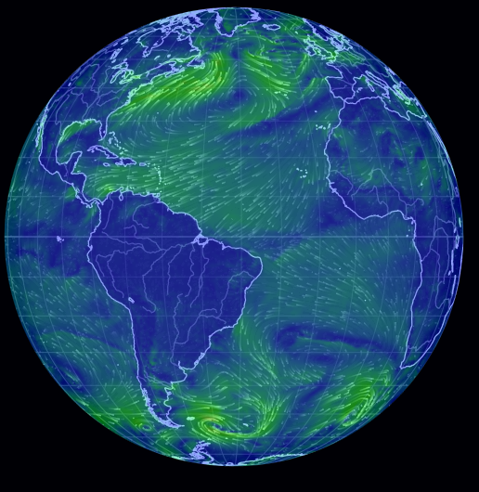
Connect your learning - Global Atmospheric Circulation Practice
Fold your A3 sheet into four.
For each round, draw and label what you see in the presentation, in one box.
On the next round, swap your sheet with a partner, do the same as in point 2, but in a new box. No peeking at the previous box(es) – this is a memory exercise!
It gets faster and harder with each round – work quickly!!!
Round 1 | Round 2
Round 3 | Round 4

Slide 2
Round 1 – 20 seconds between animations!

Slide 3
Sinking
Rising
COLD
Low Pressure
Westerlies
Sinking
High Pressure
Easterly
Trade winds
Rising
Low Pressure
HOT
Easterly
Trade winds
High Pressure
Sinking
Westerlies
Rising
Low Pressure
COLD
Sinking

Slide 4
Round 2 – 15 seconds between animations!

Slide 5
Sinking
Rising
COLD
Low Pressure
Westerlies
Sinking
High Pressure
Easterly
Trade winds
Rising
Low Pressure
HOT
Easterly
Trade winds
High Pressure
Sinking
Westerlies
Rising
Low Pressure
COLD
Sinking

Slide 6
Round 3 – 10 seconds between animations!

Slide 7
Sinking
Rising
COLD
Low Pressure
Westerlies
Sinking
High Pressure
Easterly
Trade winds
Rising
Low Pressure
HOT
Easterly
Trade winds
High Pressure
Sinking
Westerlies
Rising
Low Pressure
COLD
Sinking

Slide 8
Round 4 – 6 seconds between animations!

Slide 9
Sinking
Rising
COLD
Low Pressure
Westerlies
Sinking
High Pressure
Easterly
Trade winds
Rising
Low Pressure
HOT
Easterly
Trade winds
High Pressure
Sinking
Westerlies
Rising
Low Pressure
COLD
Sinking

Slide 10
Finally
Turn over your sheet and see how much you can draw from memory!

Slide 11
Alternative Connect your Learning:
Try this Quizlet set;
https://quizlet.com/_8y57ol?x=1jqt&i=38anvz

Slide 12
Air Masses

Slide 13
Air Masses
Objectives
Outcomes
To be able to describe the 5 major air masses that affect the UK.
To be able to explain what weather the major air masses bring to the UK.
To be able to draw compass rose diagrams and infer which air masses affect the UK most.
To consider how air masses affect day to day life in the UK.
Video notes and a completed table on the 5 air masses affecting the UK.
A completed compass rose diagram.
Explained decisions on air mass “most likely to” statements.

Slide 14
Air masses – diagrams from text
1. Task - Try to draw the words as I speak them – no words allowed, only pictures/sketches
2. Read your diagrams back to a partner
3. Now use the definition below to write 2 sentences summarising what an air mass is.
An air mass is a volume of air with very similar temperature and humidity characteristics.
Air masses cover many hundreds or thousands of miles.
They adapt to the characteristics of the surface below them.
They are classified by where they come from and which path the wind takes.
Fronts mark the boundary between two distinct air masses.
Notes:
Text for task 1: An air mass is a volume of air with very similar temperature and humidity characteristics.
Air masses cover many hundreds or thousands of miles.
They are classified by where they come from and which path the wind takes.
Fronts mark the boundary between two distinct air masses.

Slide 15
What are air masses?
https://www.youtube.com/watch?v=kvk-hBFnBTI
Watch the video and take some notes as it plays

Slide 16
What are air masses?
RECAP Exercise- try to answer the questions now. If you have any gaps complete them as the video plays a second time.
What characteristics do air masses have that sit over hot deserts like in North Africa?
What is their special name?
What does the term “continental” mean?
What is a polar continental air mass?
What weather does a Polar continental air mass bring to the UK?
Where do Polar Maritime air masses originate?
What does the warm sea water do to a Polar Maritime air mass as it travels over it?
What weather does Polar Maritime bring to the UK?
When does the UK get its most severe weather?
https://youtu.be/kvk-hBFnBTI
DID YOU KNOW? Winds are named by the direction that they are blowing from!

Slide 17
What are air masses?
https://youtu.be/kvk-hBFnBTI
In summary – copy these definitions into your books;
Polar or Arctic airmasses come from colder regions
Tropical air masses come from warmer regions
Continental means the air mass is generally dry or lacking in humidity as it has passed over the LAND
Maritime means the air mass is generally humid as it has passed over the OCEAN

Slide 18
Polar Maritime
(PM)
Source: Greenland and Canada
Arctic Maritime (AM)
Source: Within the Arctic Circle
Polar Continental
(PC)
Source: Eastern Europe and Siberia
Tropical Maritime
(TM)
Source: Caribbean, moves with the Westerlies
Tropical Continental
(TC)
Source: North Africa and the Sahara
Note – these air masses can affect the whole of the UK, not necessarily where the arrow points!

Slide 19
Air Masses
 | Code | Source regions | Surface travelled over? | Air temperature | Direction of Travel | Humidity increasing or not? | Temperature increasing or decreasing? | Convection? | Rainfall?
Polar Maritime
Polar Continental
Tropical Maritime
Tropical Continental
Arctic Maritime
Use the information sheet on Air Masses to complete the table describing each air mass
Extension –
What would the weather be like if a Tropical air mass arrived in the UK in WINTER?
What would the weather be like if a Polar maritime air mass arrived in SUMMER?

Slide 20
 | Code | Source regions | Surface travelled over? | Air temperature | Direction of Travel | Humidity increasing or not? | Temperature increasing or decreasing? | Convection? | Rainfall?
Polar Maritime | Pm | Eastern Canada and Greenland | Ocean | Cold | towards the south-east | Yes, it picks up a lot of moisture over the Atlantic | Increasing (it warms as it moves south) | Yes, warm air rises | Yes, especially on west coast
Polar Continental | Pc | Siberia and Scandinavia | Mostly land | Very cold | towards the west or south-west | Very dry but picks up moisture as it passes over the North Sea | Increasing | Yes, warm air rises | Some on east coast
Tropical Maritime | Tm | Atlantic, at the edge of the Tropics | Ocean | Warm | towards the north-east | Yes, it picks up a lot of moisture over the Atlantic | Being cooled from below as it moves North | No, no convection in cooling air | Drizzle
Tropical Continental | Tc | North Africa | Land | the warmest air the UK gets | towards the north | Not, it is the driest air the UK gets | decreasing | No – only some isolated thunderstorms | Only in some isolated thunderstorms
Arctic Maritime | Am | Arctic regions | Ocean | Extremely cold | Towards the south | Yes, moisture from the Ocean | Increasing | Yes | Yes, particularly in the north

Slide 21
Polar Continental
(PC)
Source: Eastern Europe and Siberia
Think, Pair, Share:
What do you think Polar Continental air is like
In Winter
In Summer?

Slide 22
Title:
Plot the compass rose diagram using the data in the table
What does the diagram reveal to you about the most common wind direction?
Which Air masses could this be?
NNW
N
NNE
NW
NE
1 2 3 4 5 6 7 8 9 10 11 12 13 14 15
Compass direction | %
North | 2
North North East (NNE) | 3
North East (NE) | 6
East North East (ENE) | 4
East | 3
East South East (ESE) | 3
South East (SE) | 2
South South East (SSE) | 2
South | 4
South South West (SSW) | 7
South West (SW) | 14
West South West (WSW) | 13
West | 11
West North West (WNW) | 15
North West (NW) | 8
North North West | 3
WNW
ENE
W
E
15 14 13 12 11 10 9 8 7 6 5 4 3 2 1
1 2 3 4 5 6 7 8 9 10 11 12 13 14 15
WSW
ESE
1 2 3 4 5 6 7 8 9 10 11 12 13 14 15
SW
SE
SSW
SSE
S
Remember that winds are named by the direction they are blowing FROM

Slide 23
Title: A wind compass rose for Cardington, UK
N
Plot the compass rose diagram using the data in the table
What does the diagram reveal to you about the most common wind direction?
Which Air masses could this be?
NNW
NNE
NW
NE
1 2 3 4 5 6 7 8 9 10 11 12 13 14 15
Compass direction | %
North | 2
North North East (NNE) | 3
North East (NE) | 6
East North East (ENE) | 4
East | 3
East South East (ESE) | 3
South East (SE) | 2
South South East (SSE) | 2
South | 4
South South West (SSW) | 7
South West (SW) | 14
West South West (WSW) | 13
West | 11
West North West (WNW) | 15
North West (NW) | 8
North North West | 3
WNW
ENE
E
W
15 14 13 12 11 10 9 8 7 6 5 4 3 2 1
1 2 3 4 5 6 7 8 9 10 11 12 13 14 15
WSW
ESE
1 2 3 4 5 6 7 8 9 10 11 12 13 14 15
SW
SE
SSW
SSE
S

Slide 24
Which air mass is most likely to…
Have children reaching for their sledges?
Increase the sales of ice cream?
Cause water shortages?
Creating problems for flooding on the nations rivers?
Affect the West of the country the most?
Bring snow to Northern Scotland?
Bring snow to Eastern England?
Bring out the brollies?
Travel over the North Atlantic?
Make people turn up their heating?
Bring Saharan dust to the UK?

Slide 25
Air Masses - Review
Quizlet time
Key terms – https://quizlet.com/500963386/rmets-air-masses-flash-cards/
Images task - https://quizlet.com/_8tb293?x=1qqt&i=ay3h

Slide 26
Air masses and climate change
1850
1900
1950
2000
2018
How might Polar maritime air, our dominant air mass, change as the Atlantic warms?

Slide 27
Extension – Can you work out what the air masses affecting the UK have to do with global atmospheric circulation?
Sinking
Rising
COLD
Low Pressure
Westerlies
Sinking
High Pressure
Easterly
Trade winds
Rising
Low Pressure
HOT
Easterly
Trade winds
High Pressure
Sinking
Westerlies
Rising
Low Pressure
COLD
Sinking

Slide 28
Thunk Question
Where in the UK is there the most weather?
Thunk question
“A Thunk question is a…simple-looking question about everyday things that stops you in your tracks and helps you start to look at the world in a whole new light.” https://www.independentthinking.co.uk/thunks/
n.b. Thunk in this sense is not an official word in the Cambridge English Dictionary!

Slide 29
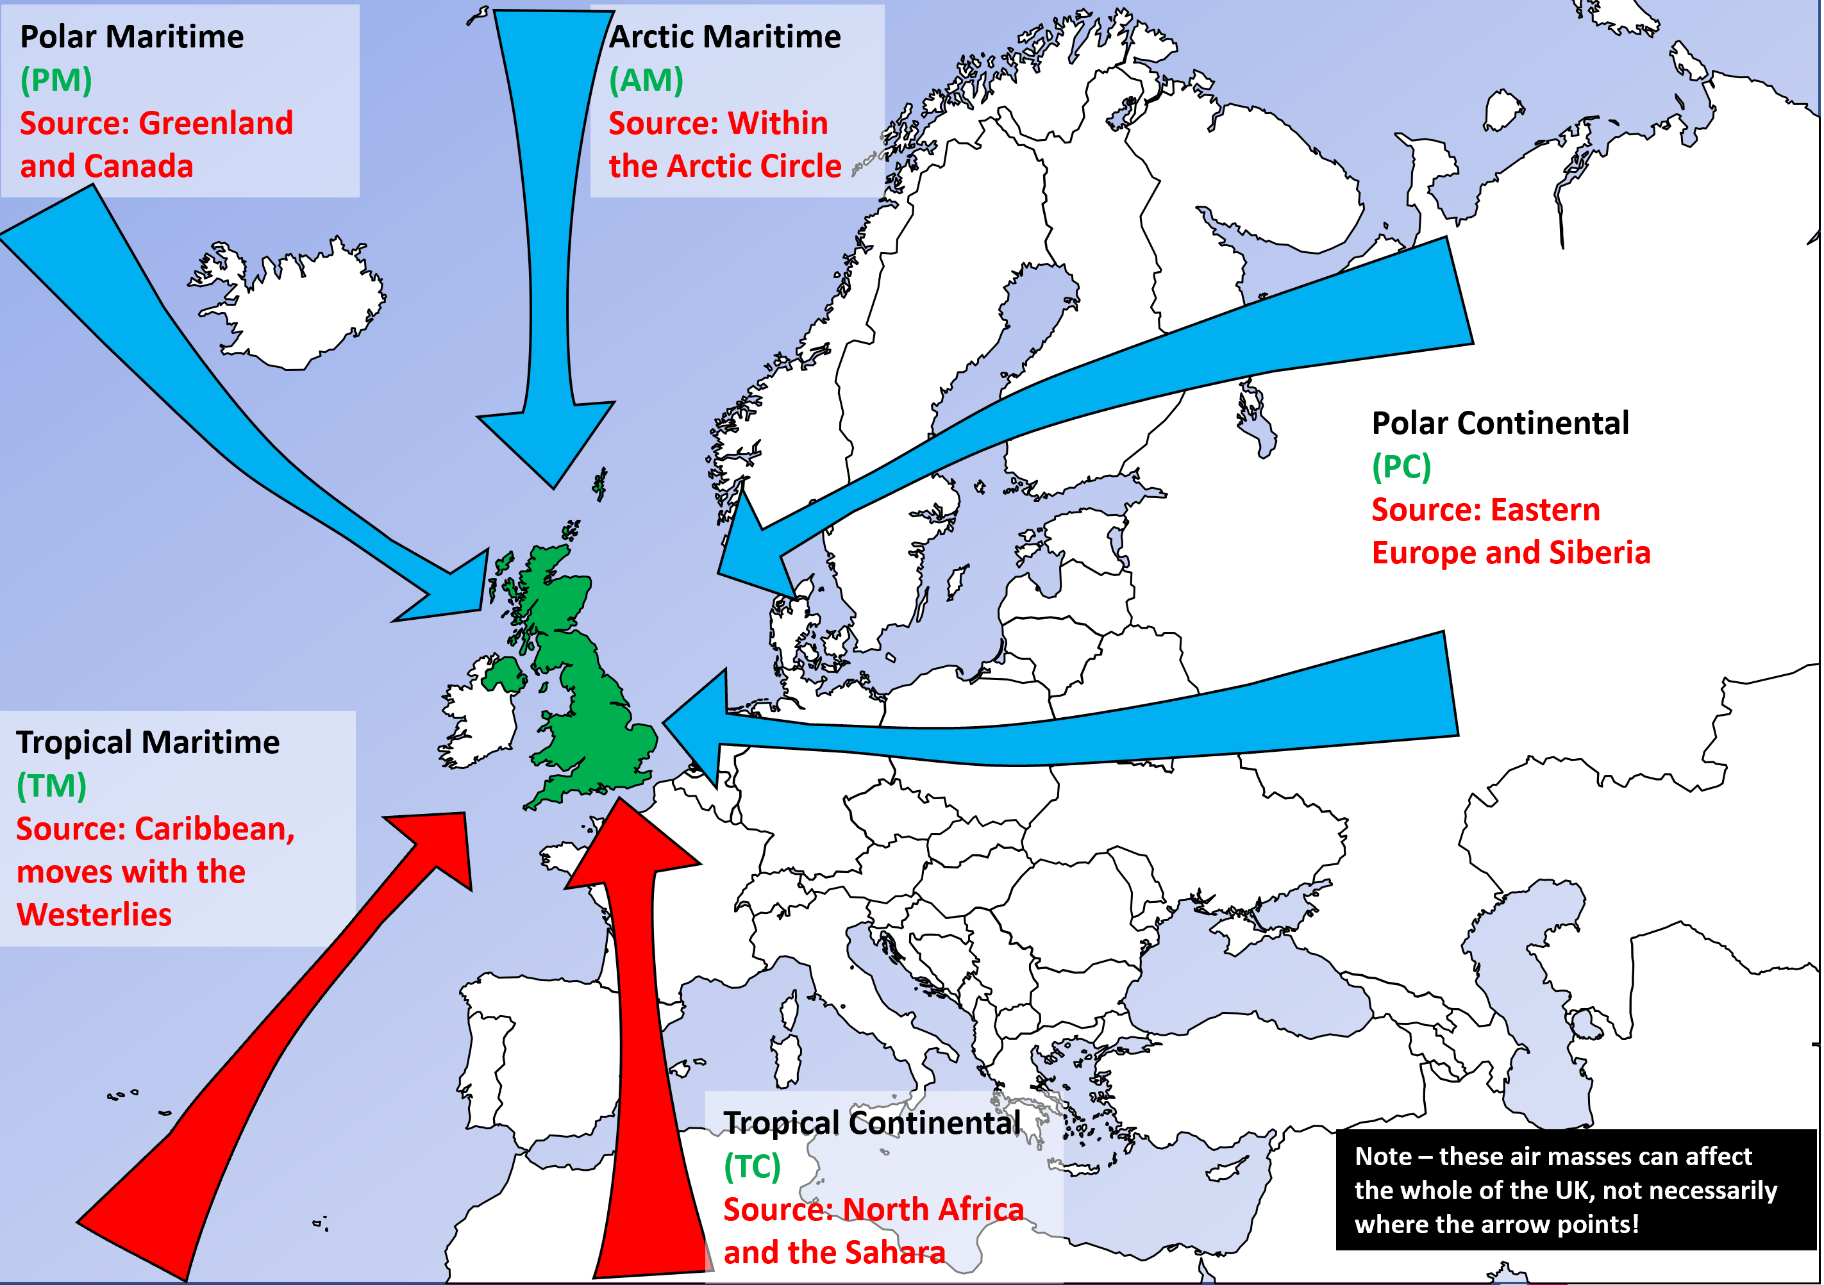
A word on simplification….
Air masses often meet over the UK, this gives rise to depressions (the UK’s storm systems) and fronts
Size of air masses and arrows are representative ONLY. Air masses vary in size and can affect much of the UK at the same time
Returning Polar Maritime is another air mass that exists – it dips south through the Atlantic and warms as it then “returns” North Eastwards to the UK

