Slide 1
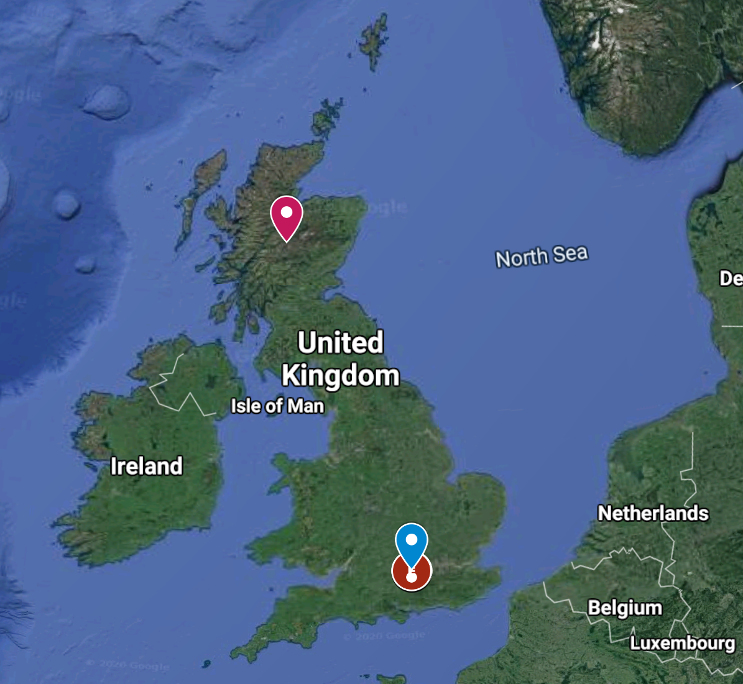
CONNECT YOUR LEARNING
How are weather and climate different?
Describe the differences between the climate of Dalwhinnie and Reading
Dalwhinnie, Scotland, 351m asl
56.9°N
51.45°N
Reading, England, 52m asl

Slide 2
Weather and climate
Objectives
Outcomes
To be able to contrast climate characteristics for different parts of the UK
To be able to explain which areas of the UK would be best for certain activities/events
A completed table of climate characteristics for Reading and Dalwhinnie
Answers to the most likely place questions

Slide 3
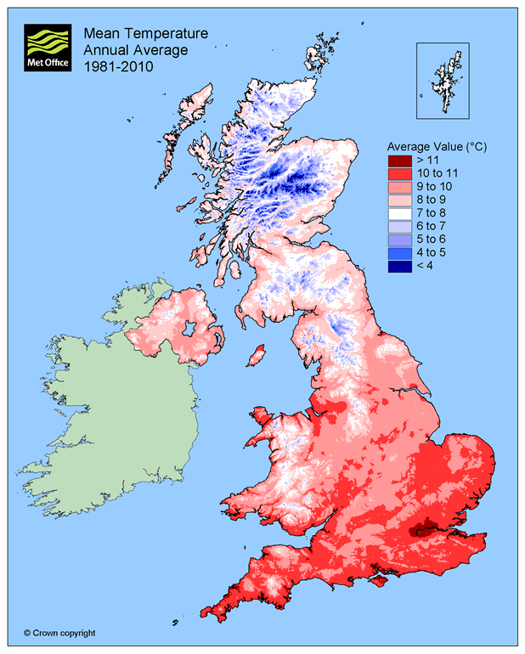
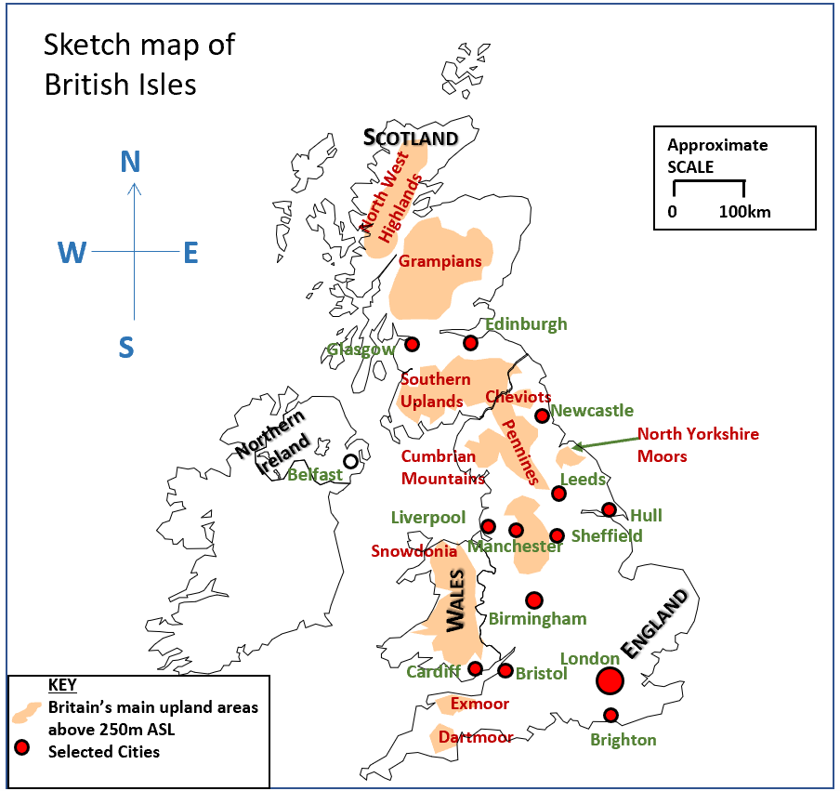
Climate across the United Kingdom
1. Identify the average temperatures from the map for the following places;
London
Newcastle
Edinburgh
Northwest Highlands
2. What is the general pattern of temperature across the UK?
3. Can you suggest why some of the areas in the UK are warmer than others?
Extension – the average values are low across the country – can you think of a mathematical explanation for this?

Slide 4
Climate across the United Kingdom
Complete the table on the next slide using the weather maps from the Met Office
In which of these 2 places (Dalwhinnie and Reading) would you be most likely to…
Enjoy an ice cream
Go Skiing
Use an umbrella
Get hit by lightning
Use solar panels on your house
Experience a flood
Experience a heat wave
Have a hose pipe ban
Wear a woolly hat
Wear a rain mac
Build a snow man
Swim in a river
Walk up hills and mountains
Annual averages | Dalwhinnie | Reading
Rainfall amount (mm)
Sunshine duration (hours)
Days of Thunder
Days of Snow lying
Mean Temperature

Slide 5
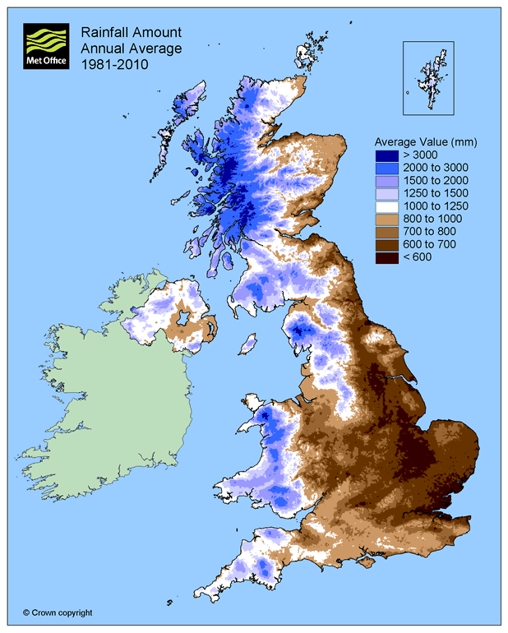
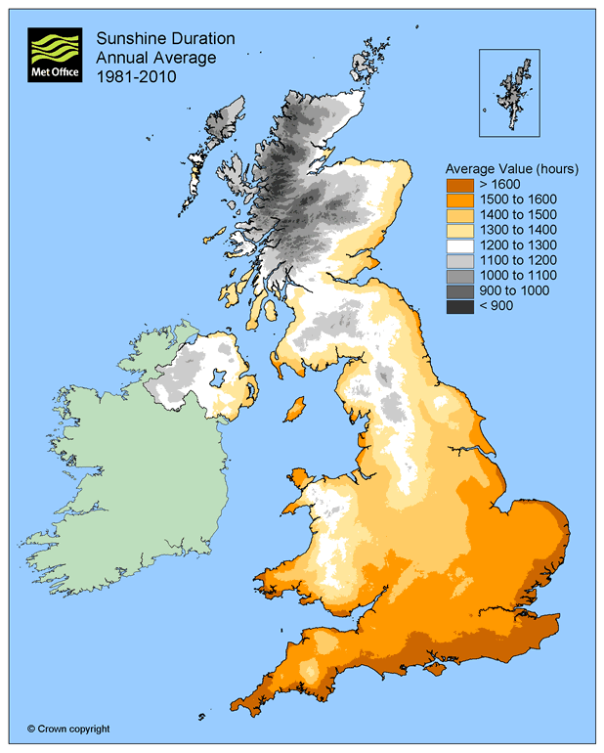
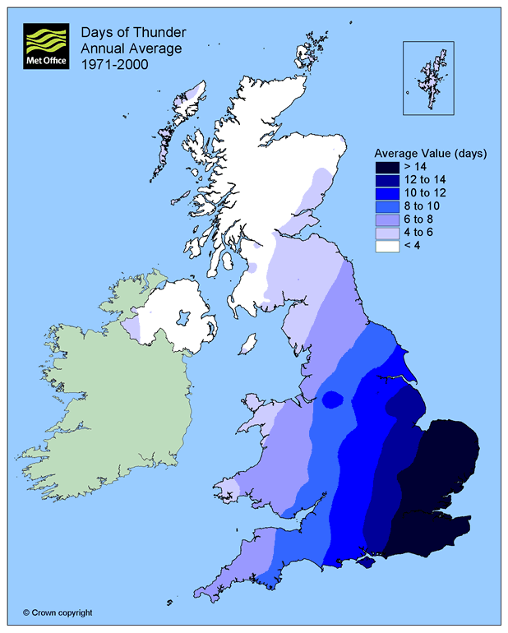
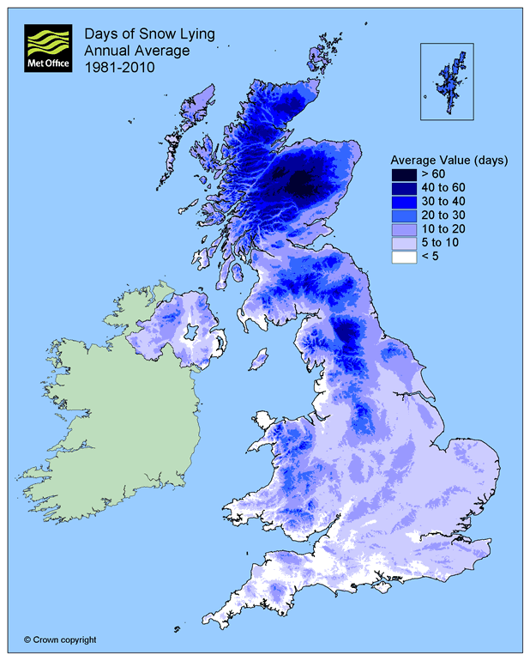
Dalwhinnie, Scotland, 351m asl
56.9°N
51.45°N
Reading, England, 52m asl
Annual averages | Dalwhinnie | Reading
Rainfall amount (mm)
Sunshine duration (hours)
Days of Thunder
Days of Snow lying
Mean Temperature

Slide 6
Review – True or False?
Southern England is warmer than northern Scotland
Western areas of the UK are wetter than Eastern areas
Dalwhinnie is more likely to experience a heatwave than Reading
OR https://quizlet.com/_8a4x92?x=1qqt&i=ay3h

