Slide 1
Connect your learning
Name the weather instruments for the following variables;
Weather variable | Instrument
Temperature
Wind speed
Wind direction
Air pressure

Slide 2
Weather and climate

Slide 3
Weather and climate
Objectives
Outcomes
To be able to distinguish between WEATHER and CLIMATE
To understand and be able to PLOT a climate graph
To be able to INTERPRET climate graphs for different places and make COMPARISONS
Sentences contrasting weather and climate
A completed climate graph for Dalwhinnie in Scotland, accurately drawn with temperature and precipitation plotted on the correct axis
Sentences contrasting the climate in Dalwhinnie and Reading

Slide 4
Weather and climate
Copy the following definitions in purple;
Weather describes the short-term state of our atmosphere. This may include information about the air temperature, precipitation, air pressure and cloud cover. Our local weather changes daily due to the movement of air in our atmosphere.
Climate is the average weather over a long time period (usually 30 years) for a particular region or place. The climate affects a number of environmental factors within the region including the type and growth of vegetation and wildlife. The climate is determined by large scale factors such as the Earth’s orbit around the Sun, the position of the continents and the composition (make up) of the atmosphere.

Slide 5
Weather and climate
In pairs try to decide what period of time you have to look at the weather before you can say it is climate.
https://youtu.be/e0vj-0imOLw
Weather describes the short-term state of our atmosphere. This may include information about the air temperature, precipitation, air pressure and cloud cover.
Climate is the average weather over a long time period (usually 30 years) for a particular region or place.

Slide 6
Weather or climate?
High winds shut the Forth Road Bridge last night
Richard booked his holiday to Malaga in July as it is usually very hot then
Arjun relies on the May to September Monsoon in India to water his crops every year
Ski resorts in the Alps do their best business in January and February as that is when there is the most snow
Wayoh Reservoir in Bolton completely dried up in the heat of July 2018
The Central England Temperature record shows that July is the warmest month on average
Heavy rainfall caused flooding to farmers’ fields over 5 days
Weather
Climate
Climate
Climate
Weather
Climate
Weather

Slide 7
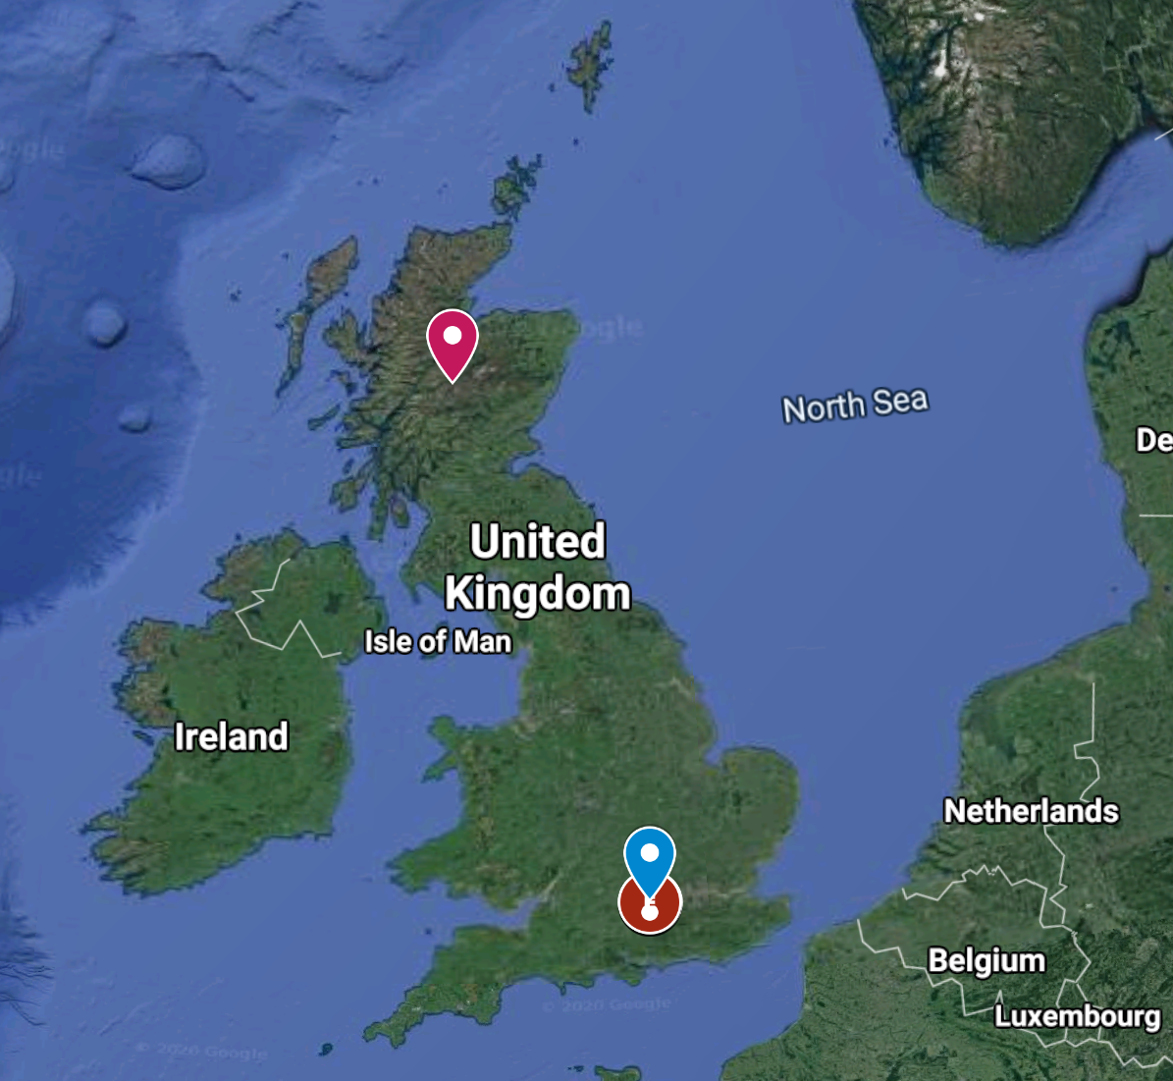
How do we present the climate?
The simplest way is to show the averages in a table.
Using the table;
When is the best period to go skiing?
When would you most need an umbrella?
Identify the warmest month
When would be the best month for a camping holiday in Dalwhinnie?
Climate averages for Dalwhinnie in Northern Scotland, 1981 to 2010
Month | Maximum temperature (°C) | Minimum temperature (°C) | Days of air frost (days) | Sunshine (hours) | Rainfall (mm) | Days of rainfall ≥1 mm (days)
January | 4.3 | -1.4 | 17.6 | 24.9 | 179 | 18.5
February | 4.5 | -1.4 | 16.4 | 56.4 | 123.7 | 15.4
March | 6.4 | -0.2 | 14.3 | 87.7 | 127 | 17.4
April | 9.4 | 1.3 | 10.2 | 127.3 | 63.7 | 13.7
May | 13 | 3.6 | 4.7 | 165.6 | 70 | 12.9
June | 15.3 | 6.6 | 0.6 | 135.8 | 64.5 | 12.6
July | 17.2 | 8.9 | 0 | 135.1 | 68.7 | 13.2
August | 16.6 | 8.5 | 0.1 | 128.2 | 79.9 | 13.6
September | 13.9 | 6.5 | 1.4 | 99.9 | 99.8 | 14.1
October | 10.2 | 3.9 | 5 | 66.7 | 147.2 | 18.5
November | 6.8 | 1.2 | 9.9 | 31.8 | 143.1 | 17.4
December | 4.6 | -1.5 | 17 | 17.6 | 137.4 | 16.3
Annual | 10.2 | 3 | 97.2 | 1077.2 | 1304 | 183.6
56.9°N
Dalwhinnie, Scotland, 351m asl
51.45°N
Reading, England, 52m asl
Notes:
Image source: Google maps, GeoBasis-DE/BKG
Note for TEACHERS – we have used 2 examples from very different parts of the UK on purpose. You might want to replace one with climate data closer to where your students live. You could use websites such as https://en.climate-data.org/ or https://weather-averages.co.uk/

Slide 8
This is a Climate graph
This axis shows the temperature, shown by the line on the graph
Climate graphs plot 30 years of data about a place.
This axis shows the PRECIPITATION – shown by the BARS on the graph
The temperature in July is 22°C
The precipitation in January is just over 60mm

Slide 9
Climate graphs - a way to display climate data
Climate data for Dalwhinnie, Scotland
Month | January | February | March | April | May | June | July | August | September | October | November | December
Maximum temperature (°C) | 4.3 | 4.5 | 6.4 | 9.4 | 13 | 15.3 | 17.2 | 16.6 | 13.9 | 10.2 | 6.8 | 4.6
Precipitation (mm) | 179 | 123.7 | 127 | 63.7 | 70 | 64.5 | 68.7 | 79.9 | 99.8 | 147.2 | 143.1 | 137.4
TASKS
Plot the data for Dalwhinnie in Scotland. To do this;
Plot the precipitation as a BAR graph using the left hand axis
Plot the temperature as crosses in the middle of the month. Then join the crosses together as a line.
Complete the key on the graph

Slide 10
Climate graphs - a way to display climate data
Contrast the graphs;
Which of the places gets the most precipitation?
Which of the places is hotter in the summer?
Which of the places is colder in the winter?
Which of the places has the most VARIATION in its precipitation?
In which of the 2 places would you like to live?
EXTENSION – calculate some differences between the 2 places (maximum temperatures, maximum precipitation)

Slide 11
Can you SUGGEST reasons why the climates of these 2 places are so different?
Dalwhinnie, Scotland, 351m asl
56.9°N
51.45°N
Reading, England, 52m asl
Notes:
Image source: Google maps, GeoBasis-DE/BKG

Slide 12
Weather and climate
Objectives
Score out of 5 on how you did
To be able to distinguish between WEATHER and CLIMATE
To understand and be able to PLOT a climate graph
To be able to INTERPRET climate graphs for different places and make COMPARISONS
1.
2.
3.

Slide 13
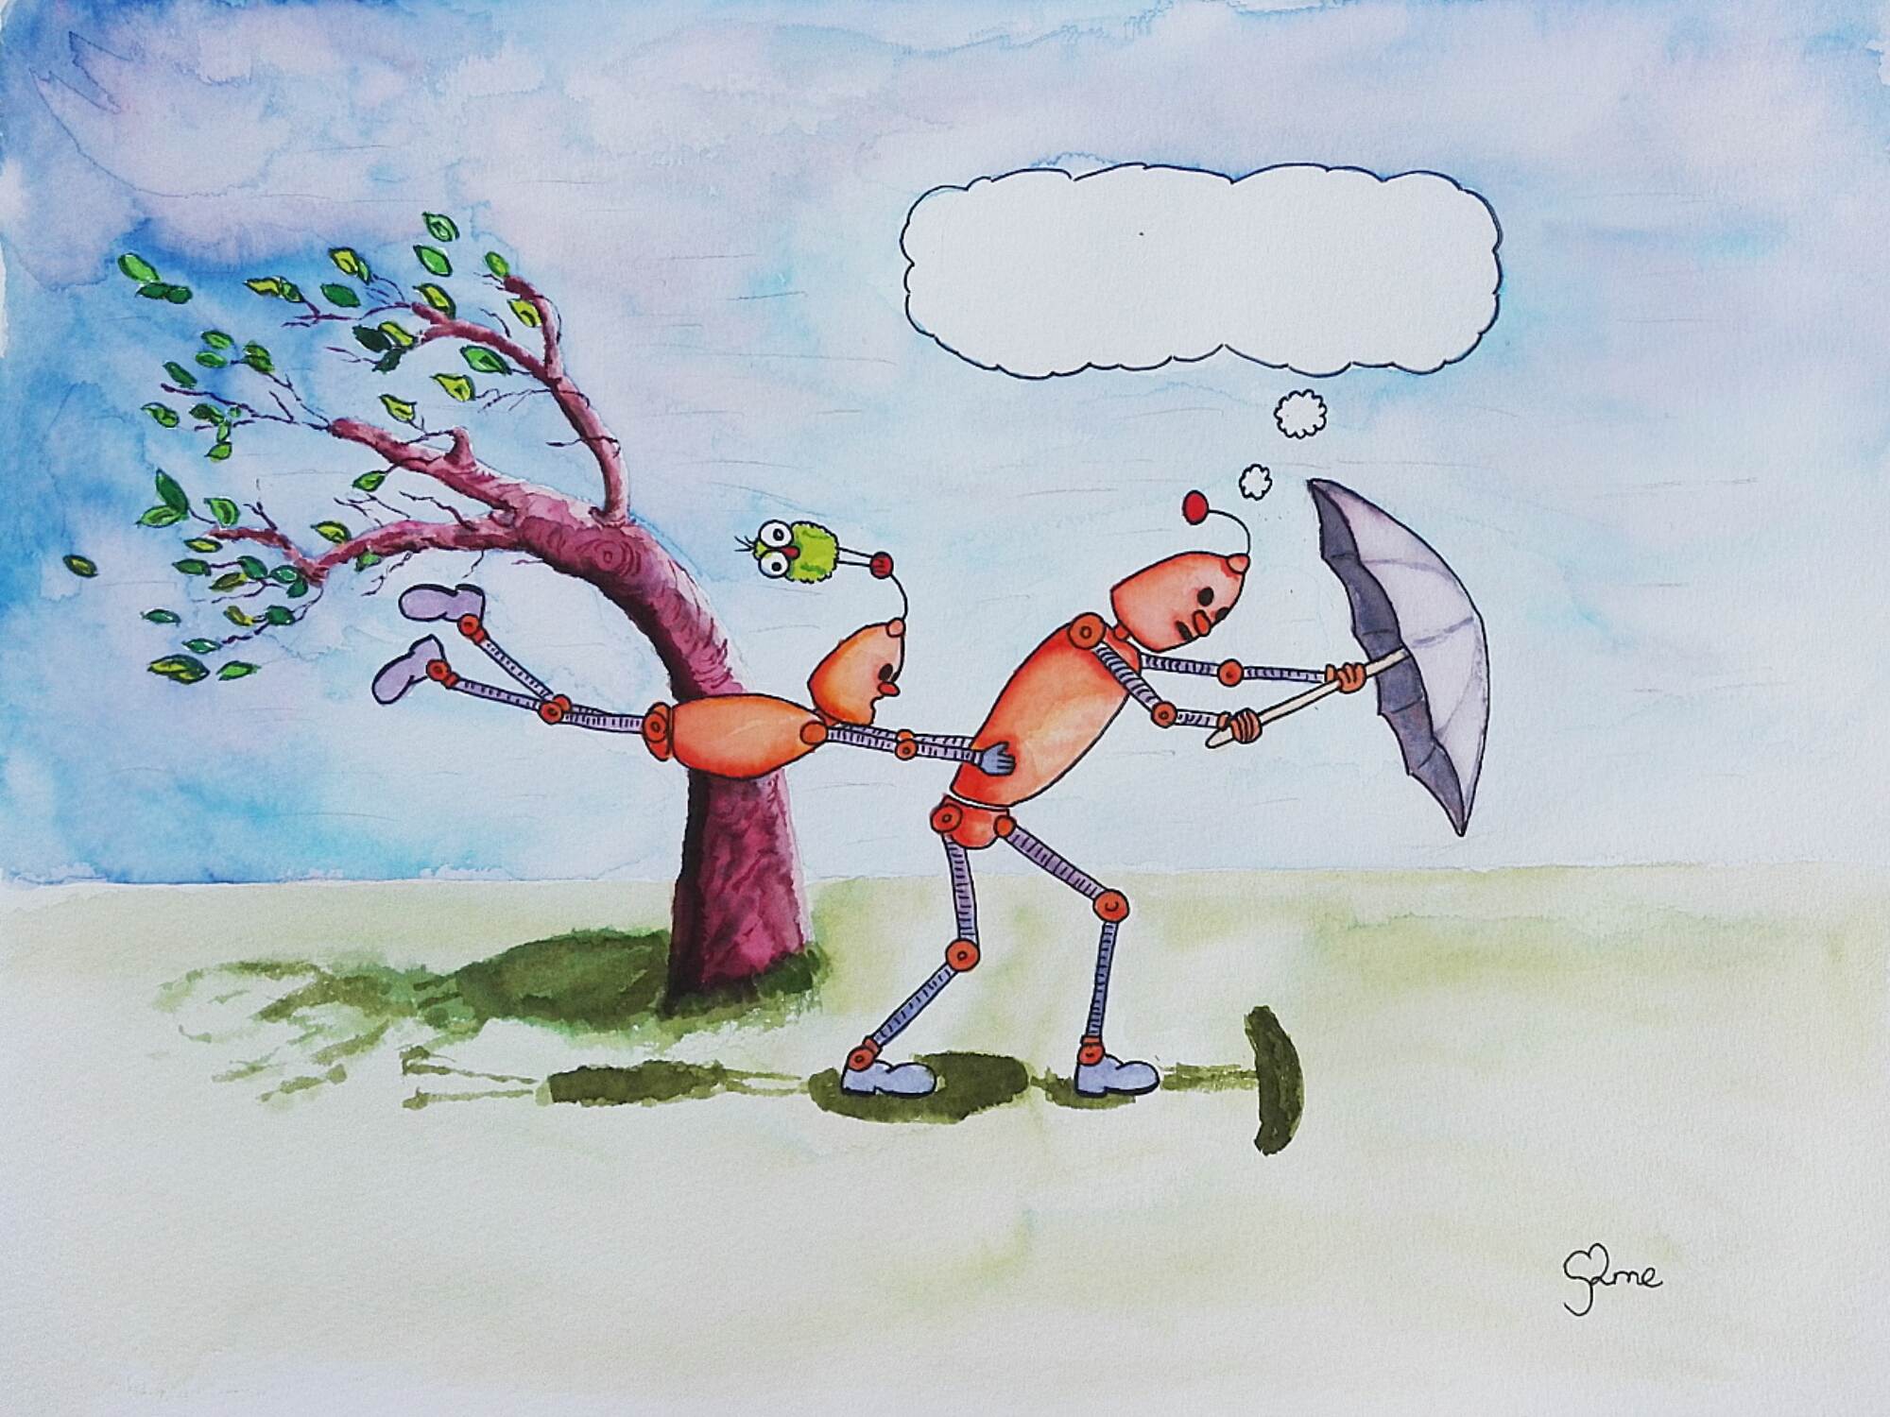
Thunk Question
Do you talk more about weather or climate?
Thunk question
“A Thunk question is a…simple-looking question about everyday things that stops you in your tracks and helps you start to look at the world in a whole new light.” https://www.independentthinking.co.uk/thunks/
n.b. Thunk in this sense is not an official word in the Cambridge English Dictionary!

Slide 14
Weather & Climate and climate change
1850
1900
1950
2000
2018
If climate is the average of 30 years’ weather, how much weather data do you need before you can talk about climate change?

