Slide 1
In pairs consider the following - How did the weather affect you on the way into school today?
Consider;
What the weather was like
The time you left (earlier or later than normal)
The clothes you wore
Your transport method and route
Your mood or mentality
Your level of comfort

Slide 2
Weather in our lives

Slide 3
Weather in our lives
Objectives
Outcomes
To be able to define what the weather is
To explain how the weather can have a direct impact upon our lives
To think about how the weather can VARY from place to place and time to time
A completed definition of weather written down
Written explanations of how the weather affects sporting events
Annotations of the school building explaining how weather varies around it plus verbal answers in the lesson review

Slide 4
What is weather?
Diagrams from text - Try to draw the text as I speak, you can only use simple sketches
Try to “read” your diagrams back to the person next to you in as much detail as possible
3. Now copy the definition
“Weather describes the short-term state of our atmosphere. This may include information about the air temperature, precipitation, wind speed, air pressure and cloud cover. Our local weather changes daily due to the movement of air in our atmosphere.”
Notes:
Words for diagrams from text – “Weather is the short-term state of our atmosphere. This may include information about the air temperature, precipitation, wind speed, air pressure and cloud cover. Our local weather changes daily due to the movement of air in our atmosphere. “

Slide 5
Can you think of any examples of weather?
Examples of weather:
Are these ‘weather’?
Too wet to go the park today
Flights not able to land in the local airport
Smoke from a factory fire closed roads
Heavy snow caused problems for sheep farmers
I will need to put on sun cream today

Slide 6
Causes and Effects
A cause is an event, thing, or person that makes something happen
An effect is a change which is a result or consequence of an action or other cause.
For example, the weather is a “cause” as it can make other things happen. The wind can make leaves move for example. The leaves moving are an effect….

Slide 7
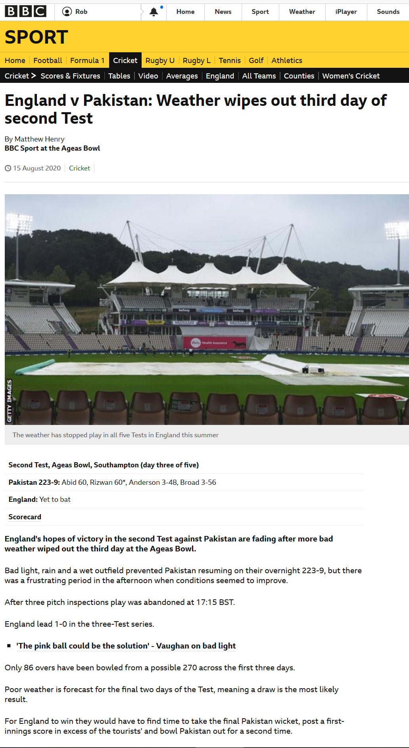
How the weather affects sport
Activities
Explain how this sporting event has been affected by the weather. Be sure to mention what the weather conditions are and why it affected the sport.
Can you think of any other weather conditions and how they could affect sport? Produce a mind map to show this.
Source: https://www.bbc.co.uk/sport/cricket/53787108
Football matches abandoned
The Weather and sports
Boat races cancelled
Fog
Reduces visibility

Slide 8
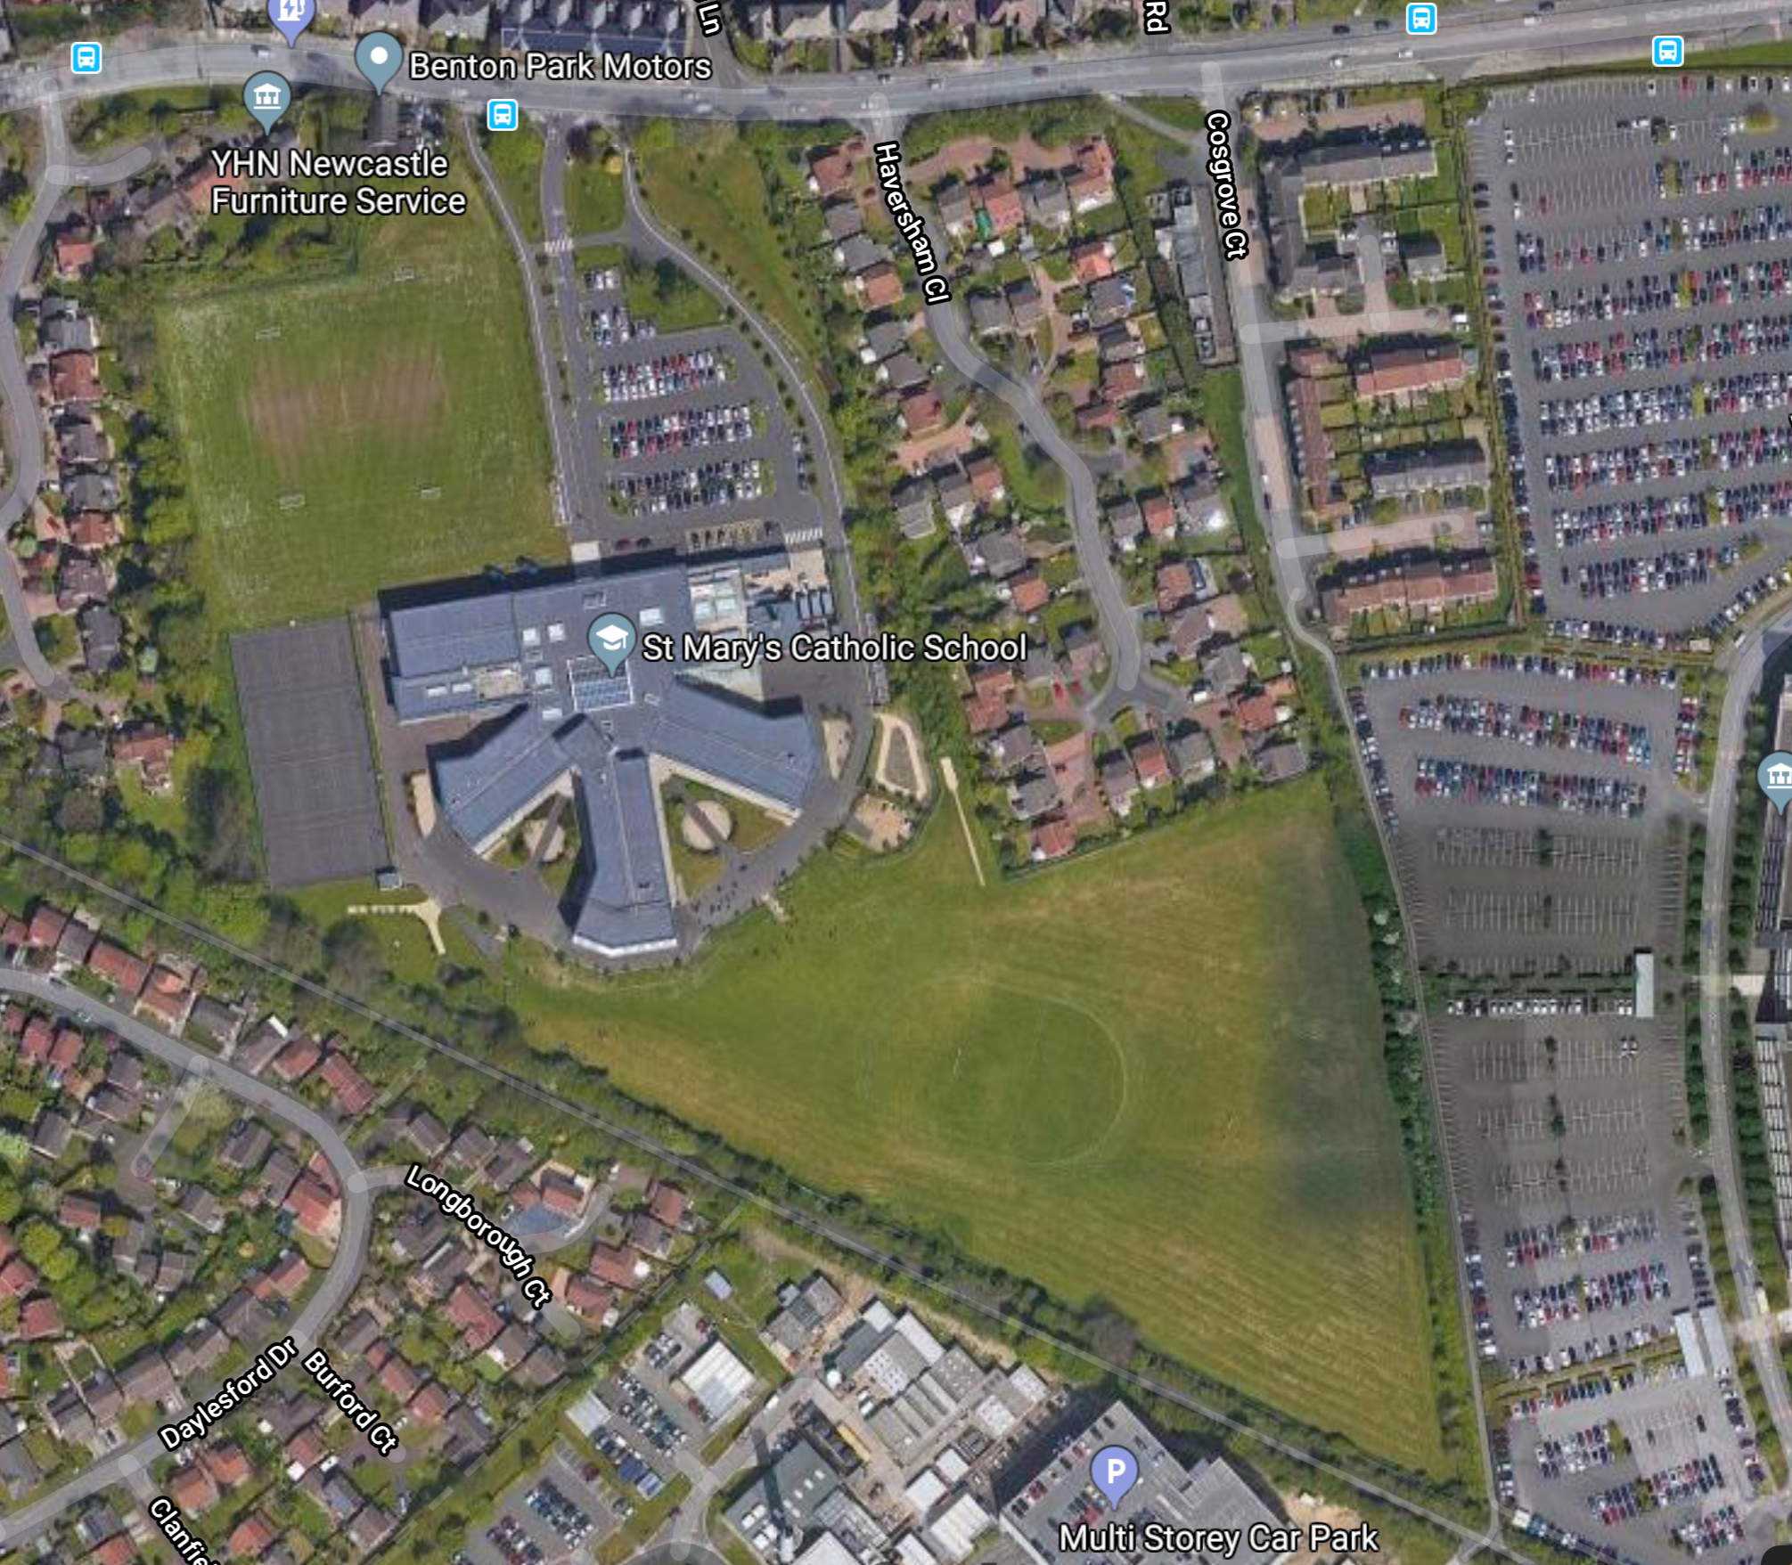
Do we get different weather in different parts of the school grounds?
Think carefully about your school, it will have slightly different weather in different parts of it.
Air temperature is a measure of how hot or cold the air is.
Precipitation is any form of water that falls from clouds such as drizzle, rain, sleet and snow.
Wind is the natural movement of the air, especially in the form of a current of air blowing from a particular direction.
Cloud cover is the fraction of the sky obscured by clouds when observed from a particular location.
EXAMPLE
Close to the building there are dry areas sheltered from rain which tends to come from the west
Temperature tends to be warmer in this yard as it faces the South
The field tends to be windier as it is exposed with no shelter

Slide 9
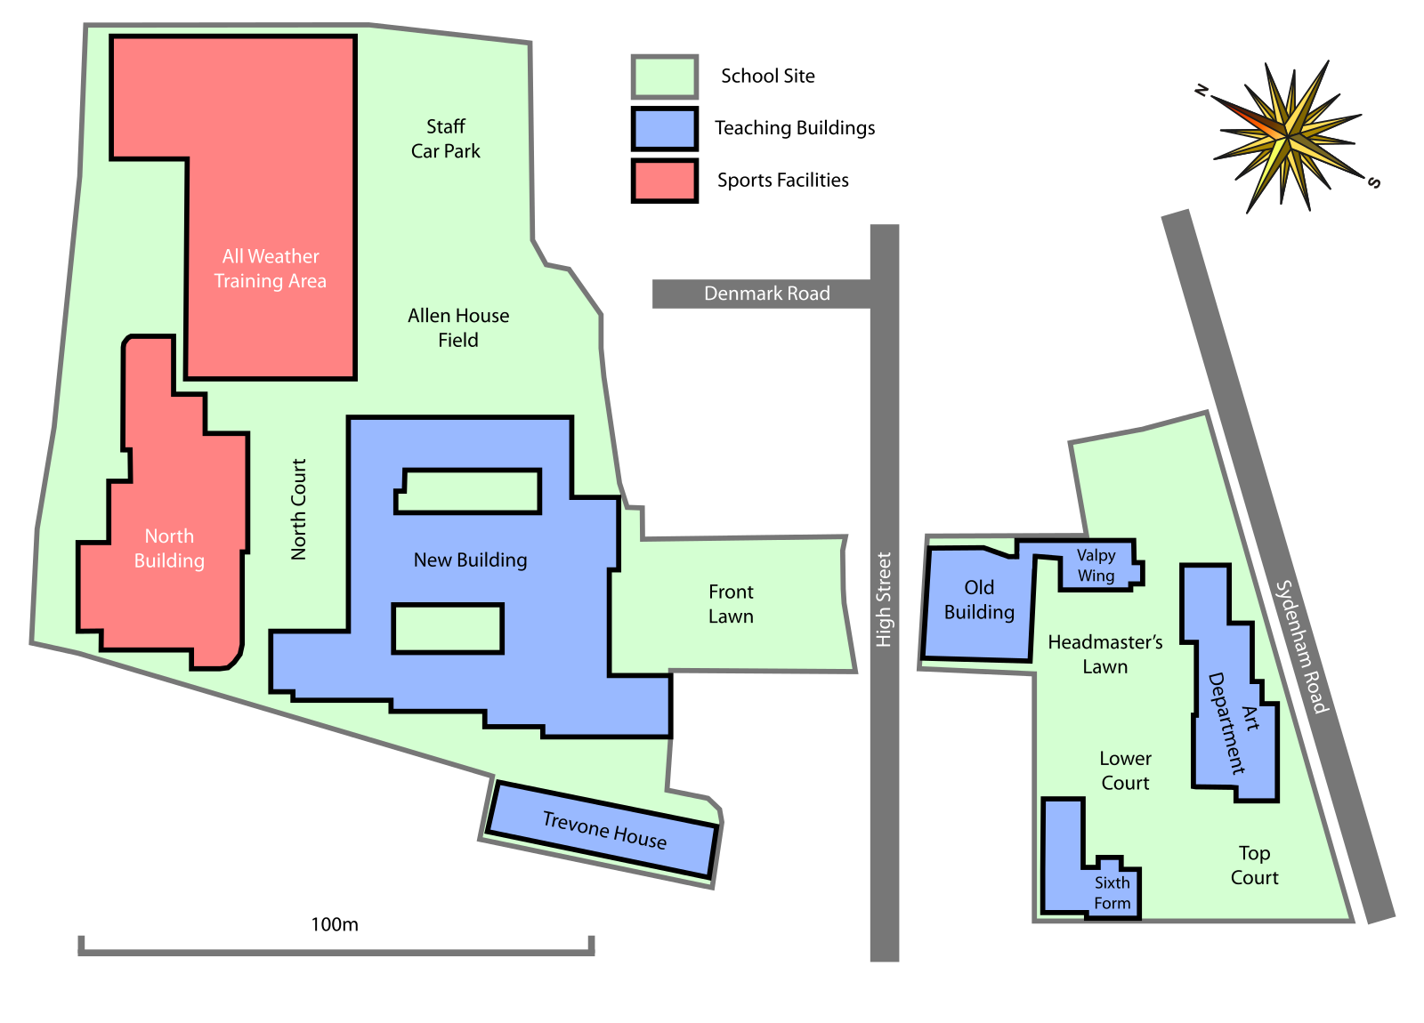
Do we get different weather in different parts of the school grounds?
Google satellite image or map of your school to go here!
Think carefully about our school, it will have slightly different weather in different parts of it.
ACTIVITY - On your map of the school try to annotate how the weather varies for different areas of it and what affects the weather.
CHALLENGE - Can you consider all 4 of the variables from our definition of “WEATHER”? Air temperature, precipitation, wind and cloud cover.
EXAMPLE
Royal Grammar School Guildford Site Map - Glanis / CC BY-SA (https://creativecommons.org/licenses/by-sa/3.0)
At https://commons.wikimedia.org/wiki/File:Royal_Grammar_School_Guildford_Site_Map.svg

Slide 10
Homework – complete the weekly weather diary
 | Sunday | Monday | Tuesday | Wednesday | Thursday | Friday | Saturday
What was the weather like (consider temperature, cloud cover, and wind)
Draw some of the weather symbols that are used on the television weather forecasts to best represent the day
How did the weather affect everything? You could think about how it affected: what you wore; what you ate and drank; how you travelled; how you felt; your school, work or leisure activities

Slide 11
Review
In pairs, describe 3 ways that the weather can vary from place to place and time to time.
Describe 2 ways that the weather can have a positive impact on human lives and activities and 2 ways it can have a negative impact.
QUIZLET - https://quizlet.com/_8y56zy?x=1jqt&i=38anvz
Source: https://www.nasa.gov/topics/earth/images/index.html

Slide 12
Weather in our lives and climate change
1850
1900
1950
2000
2018
Climate change will mean stormier winters and drier hotter summers for the UK, with a greater risk of coastal and river flooding.
What will affect you most?

Slide 13
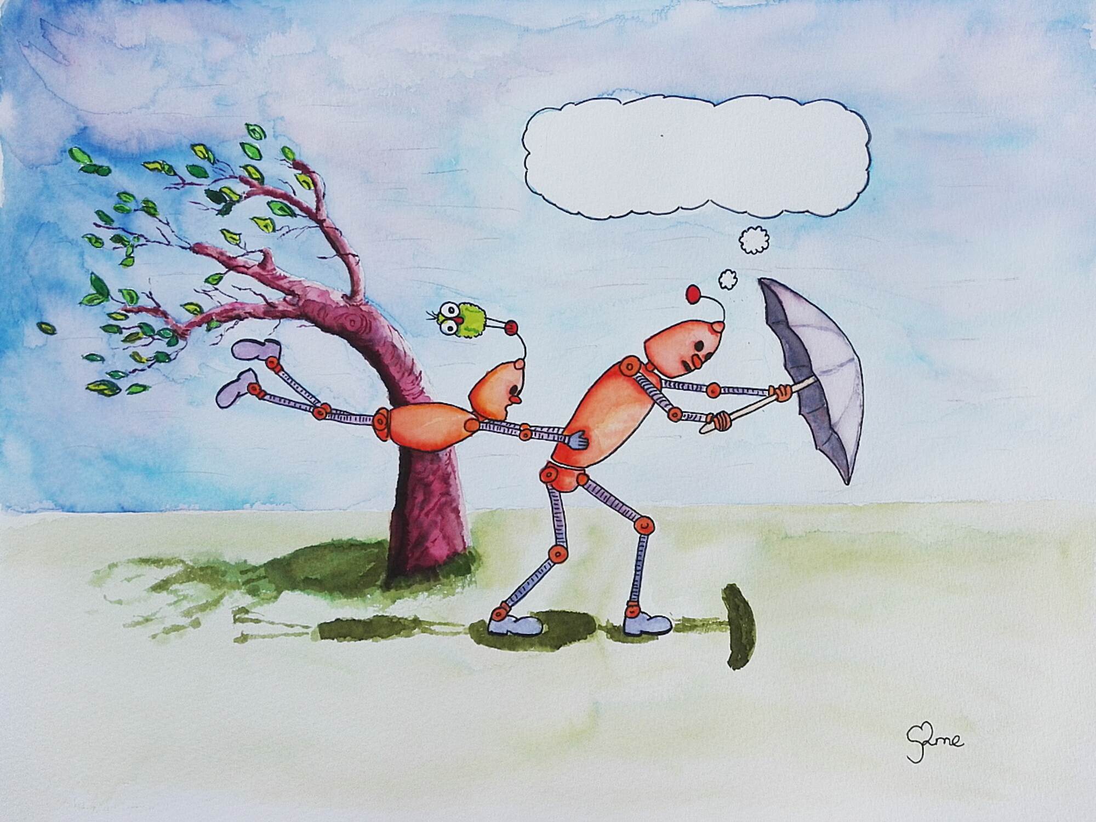
Thunk Question
Do tall people experience the weather differently to short people?
Thunk question
“A Thunk question is a…simple-looking question about everyday things that stops you in your tracks and helps you start to look at the world in a whole new light.” https://www.independentthinking.co.uk/thunks/
n.b. Thunk in this sense is not an official word in the Cambridge English Dictionary!

