Slide 1
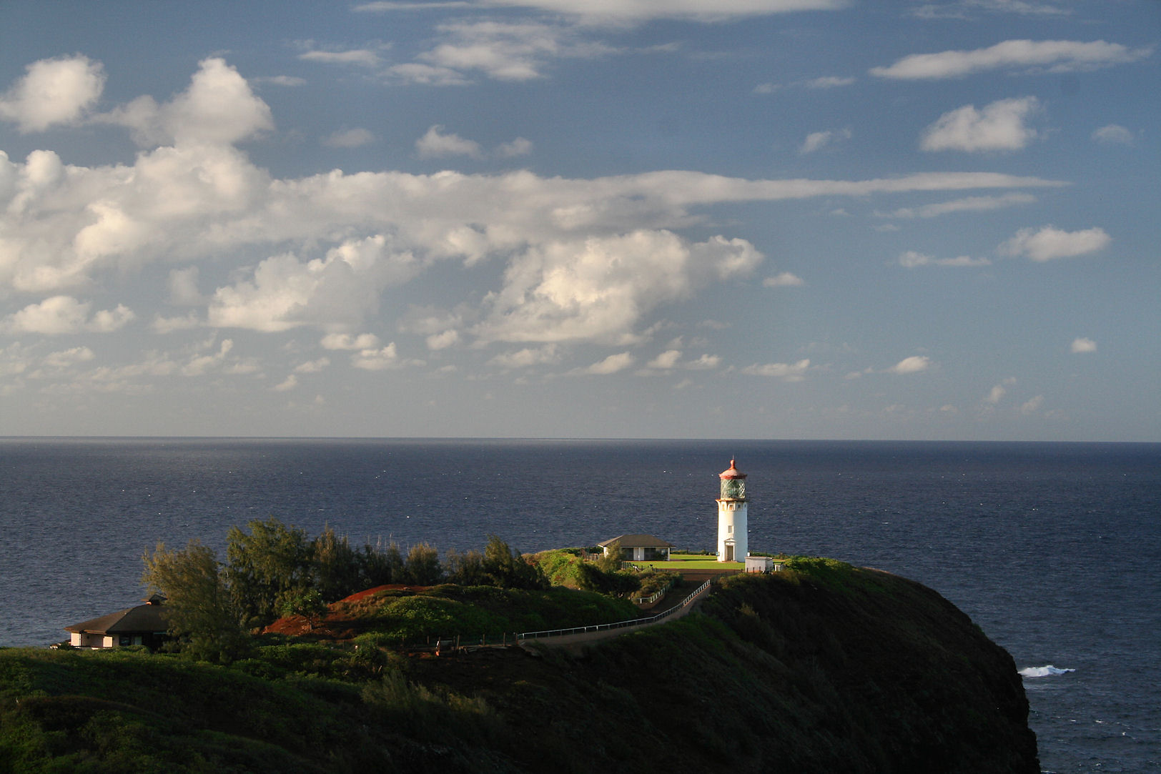

Water, Carbon, Weather and Climate
“Carbon and water cycles are crucially important processes for our ability to predict future weather and climate and their influence on society through, for example, food and water availability.”
Martin Best and Chris Jones
Notes:
This talk focusses on the changes we are currently seeing in the carbon and water cycles, and the processes which link the two cycles
Other sources
https://earthobservatory.nasa.gov/Features/CarbonCycle/page5.php
http://www.metlink.org/climate/ipcc-updates-for-a-level-geography/
Linking carbon and water cycles with forests, Antonarakis, Geography, 103, Spring 2018

Slide 2
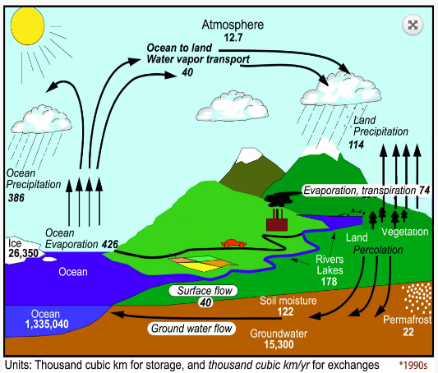

The Changing Water Cycle
Atmospheric rivers
Source: IPCC 2013/2014
Notes:
The water cycle consists of a set of reservoirs, and fluxes or flows between those reservoirs
We don’t think about the transport of water (vapour) in the atmosphere, but Atmospheric rivers are relatively long, narrow regions in the atmosphere – like rivers in the sky – that transport most of the water vapour outside of the tropics. These columns of vapour move with the weather, carrying an amount of water vapour roughly equivalent to the average flow of water at the mouth of the Mississippi River.

Slide 3
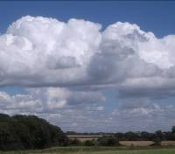

What drives the Water Cycle?
As warm air rises, the pressure falls and it cools
The rate of evaporation becomes less than the rate of condensation
Cloud droplets form
Latent heat is released (there is enough heat released in a small cumulus cloud to power an average home for 17 years)
Conversely latent heat is needed for water to evaporate
Notes:
Take a step back and remember what is driving the water cycle. It is a great visual reminder to show a teabag rocket and/ or a cloud in a bottle (with a thermometer) at this stage – details of both are available on the ‘experiments and demonstrations’ page of MetLink.

Slide 4

About 10% of the water evaporated from the ocean is transported over land by the winds and finds its way back to the ocean
In general, precipitation is limited by the availability of water, energy, or both.
The world’s oceans contain an effectively unlimited supply of water but locally, especially over land, a shortage of water can limit precipitation.
Many human and natural systems are highly sensitive to changes in precipitation, river flow, soil and groundwater.
Flood and drought.
Notes:
About 10% of the water evaporated from the ocean is transported over land by the winds and finds its way back to the ocean following condensation into clouds, eventual precipitation as rain or snow and subsequent surface runoff and sub-surface flows

Slide 5

As the climate warms, the water cycle intensifies.
Driven by an increase in evapotranspiration at the ground, controlled by the temperature of the troposphere, which determines condensation.
Globally, water vapour concentration in the lower atmosphere has increased by 3-4% since the 1970s.
Over the last century, northern mid-latitude precipitation has increased, particularly in extreme events.
Water vapour is a strong and fast feedback that amplifies changes in surface temperature in response to other changes (for example increasing CO₂) by about a factor of 2.
As the climate warms, and there is more energy available to drive evaporation, the amount and intensity of precipitation is expected to increase.
Evapotranspiration also increases over most land areas in a warmer climate.
However, changes in vegetation and soil moisture availability can also affect evapotranspiration rates.
Notes:
Water vapour responds and amplifies climate change
As the climate warms, the water cycle intensifies. This is driven by an increase in evapotranspiration at the ground but is controlled by the temperature of the troposphere, which determines how much condensation, and hence precipitation, occurs.
The latent heat released by water as it condenses, warms the troposphere. This heat is lost to space.
Over the last century, northern mid-latitude precipitation has increased and the number of heavy precipitation events over land has increased in more regions than it has decreased, particularly in Europe and North America.
Globally, water vapour concentration in the lower atmosphere has increased by 3-4% since the 1970s.
Water vapour is a strong and fast feedback that amplifies changes in surface temperature in response to other changes (for example increasing CO₂) by about a factor of 2.
Many human and natural systems are highly sensitive to changes in precipitation, river flow, soil and groundwater.
In general, precipitation is limited by the availability of water, energy, or both. The world’s oceans contain an effectively unlimited supply of water but locally, especially over land, a shortage of water can limit precipitation. As the climate warms, and there is more energy available to drive evaporation, the amount and intensity of precipitation is expected to increase. Evapotranspiration also increases over most land areas in a warmer climate, thereby accelerating the water cycle. However, changes in vegetation and soil moisture availability can also affect evapotranspiration rates.

Slide 6
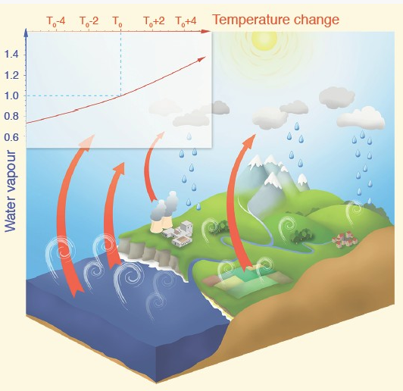
With every degree of air temperature, the atmosphere can retain around 7% more water vapour
Source: IPCC 2013/2014
Notes:
Illustration of the water cycle and its interaction with the greenhouse effect: the relative increase of potential water vapour content in the air with an increase of temperature (roughly 7% per degree). The white curls illustrate evaporation, which is compensated by precipitation to close the water budget. The red arrows illustrate the outgoing infrared radiation that is partly absorbed by water vapour and other gases, a process that is one component of the greenhouse effect. The stratospheric processes are not included in this figure.
As the largest contributor to the natural greenhouse effect, water vapour plays an essential role in the Earth’s climate. However, the amount of water vapour in the atmosphere is controlled mostly by air temperature, rather than by emissions. For that reason, scientists consider it a feedback agent, rather than a forcing to climate change. Anthropogenic emissions of water vapour through irrigation or power plant cooling have a negligible impact on the global climate.
Water vapour is the primary greenhouse gas in the Earth’s atmosphere. The contribution of water vapour to the natural greenhouse effect relative to that of carbon dioxide (CO₂) depends on the accounting method, but can be considered to be approximately two to three times greater. Additional water vapour is injected into the atmosphere from anthropogenic activities, mostly through increased evaporation from irrigated crops, but also through power plant cooling, and marginally through the combustion of fossil fuel. One may therefore question why there is so much focus on CO₂, and not on water vapour, as a forcing to climate change.
Water vapour behaves differently from CO₂ in one fundamental way: it can condense and precipitate. When air with high humidity cools, some of the vapour condenses into water droplets or ice particles and precipitates. The typical residence time of water vapour in the atmosphere is ten days. The flux of water vapour into the atmosphere from anthropogenic sources is considerably less than from ‘natural’ evaporation. Therefore, it has a negligible impact on overall concentrations, and does not contribute significantly to the long-term greenhouse effect. This is the main reason why tropospheric water vapour (typically below 10km altitude) is not considered to be an anthropogenic gas contributing to radiative forcing.
Anthropogenic emissions do have a significant impact on water vapour in the stratosphere, which is the part of the atmosphere above about 10 km. Increased concentrations of methane (CH₄) due to human activities lead to an additional source of water, through oxidation, which partly explains the observed changes in that atmospheric layer. That stratospheric water change has a radiative impact, is considered a forcing, and can be evaluated. Stratospheric concentrations of water have varied significantly in past decades. The full extent of these variations is not well understood and is probably less a forcing than a feedback process added to natural variability. The contribution of stratospheric water vapour to warming, both forcing and feedback, is much smaller than from CH₄ or CO₂.
The maximum amount of water vapour in the air is controlled by temperature. A typical column of air extending from the surface to the stratosphere (about 10km in height) in polar regions may contain only a few kilograms of water vapour per square metre, while a similar column of air in the tropics may contain up to 70 kg. With every extra degree of air temperature, the atmosphere can retain around 7% more water vapour. This increase in concentration amplifies the green­house effect, and therefore leads to more warming. This process, referred to as the water vapour feedback, is well understood and quantified. It occurs in all models used to estimate climate change, where its strength is consistent with observations. Although an increase in atmospheric water vapour has been observed, this change is recognized as a climate feedback (from increased atmospheric temperature) and should not be interpreted as coming directly from anthropogenic emissions or water vapour.
Currently, water vapour has the largest greenhouse effect in the Earth’s atmosphere. However, other greenhouse gases, primarily CO₂, are necessary to sustain the presence of water vapour in the atmosphere. Indeed, if these other gases were removed from the atmosphere, its temperature would drop sufficiently to induce a decrease of water vapour, leading to a runaway drop of the greenhouse effect that would plunge the Earth into a frozen state. So greenhouse gases other than water vapour provide the temperature structure that sustains current levels of atmospheric water vapour. Therefore, although CO₂ is the main anthropogenic control knob on climate, water vapour is a strong and fast feedback that amplifies any initial forcing by a typical factor between two and three. Water vapour is not a significant initial forcing, but is nevertheless a fundamental agent of climate change.

Slide 7
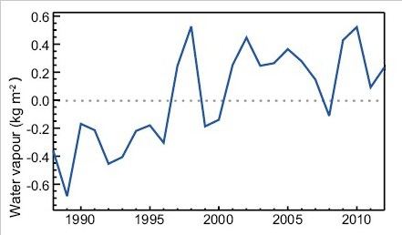
In Europe, evaporation is energy limited, not moisture limited… but it’s never “too cold for snow”
Source: IPCC 2013/2014
Notes:
Europe – evaporation is energy limited not moisture limited – there are plenty of relatively warm seas around. It can be too cold for snow in large continental areas such as Siberia, North America, Antarctica where it can be so cold that there is very, very little evaporation going on and the air is very dry.
Global and annual averages of total atmospheric water vapour over ocean surfaces, shown relative to the average for the period 1988-2007.
Satellite evidence has shown an increase in the amount of water vapour in the troposphere, the lowest part of the atmosphere. The year-to-year variability and long term trend in atmospheric water vapour content are closely linked to changes in global sea surface temperature, partly because warmer temperatures cause increased evaporation and partly because warmer air can carry more water vapour. Tropospheric water vapour is an important climate change feedback mechanism (through its powerful greenhouse effect) and is essential to the formation of clouds and precipitation. No significant change to the amount or type of clouds globally has been detected yet, although locally changes have been observed and linked to changing wind patterns.
Changes in the water cycle also have an impact on the world’s oceans, with surface waters in the evaporation dominated sub-tropics becoming more saline and surface waters in the rainfall-dominated tropical and polar regions becoming fresher.

Slide 8
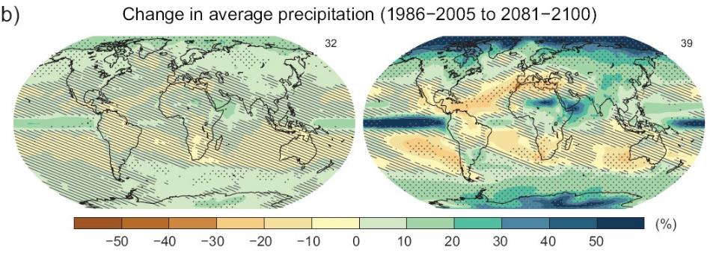
Hatched areas = low confidence
Low Emission Scenario
High Emission Scenario
Source: IPCC 2013/2014
Notes:
Maps of modelled annual mean precipitation changes between 1986-2005 and 2081-2100 for low and high greenhouse gas emissions scenarios. Hatching indicates regions where there is low confidence in the projected change. Stippling indicates regions where there is more confidence in the projected precipitation change
We can see areas where precipitation is projected to increase and others where it is projected to decrease. On the whole, the projected changes are greater with higher emissions of greenhouse gases. However, its worth noting that most of the map is hatched – we can reasonably confidently say that precipitation will change, and where we expect it to increase and where we expect it to fall, but we cant yet say precisely how much.

Slide 9
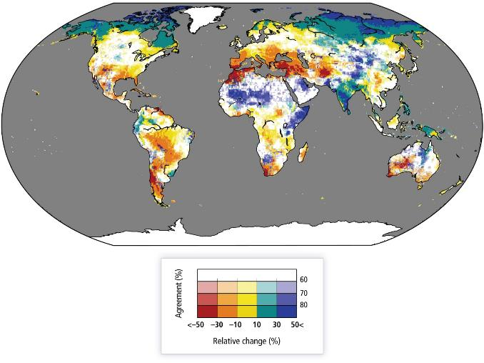
Percentage change of mean annual streamflow for a global mean temperature rise of 2.7°C above pre-industrial
Source: IPCC 2013/2014
Notes:
Percentage change of mean annual streamflow for a global mean temperature rise of 2°C above 1980–2010 (2.7°C above pre-industrial). Colour hues show the amount of change and saturation shows the agreement on the sign of change (i.e. the darker the colour, the more confidence in the result).
Extreme Precipitation and Flooding
Since 1951 there have been statistically significant increases in the number of heavy precipitation events in more regions than there have been decreases, but there are many regional and seasonal variations in the trend. The most consistent trend is seen in North America, where there has been an increase in the frequency and intensity of extreme precipitation. In the future, the number of tropical cyclones globally may fall but their maximum wind speed and precipitation is expected to increase, in a warmer and more energetic atmosphere. Freshwater-related risks (e.g. river flooding) of climate change increase significantly with increasing greenhouse gas concentrations.
Drought Increased evapotranspiration over land can lead to more intense and frequent periods of agricultural drought. There has been an increase in the frequency and intensity of drought in the Mediterranean and West Africa, but a decrease in central North America and north-west Australia.
ENSO We cannot yet predict how the El Niño Southern Oscillation (ENSO), which has a significant impact on precipitation patterns around the world in both its El Niño and La Niño phases, may change in the 21st century.
The Cryosphere Frozen stores of water form an important component of the water cycle and are depended upon by societies and ecosystems. The Arctic and Antarctic sea-ice covers are projected to shrink in the 21st century. The Arctic may become almost entirely ice-free in late summer. Polar amplification occurs if the magnitude of the surface temperature change at high latitudes exceeds the globally averaged temperature change on time scales greater than the annual cycle. One of the ways this can happen is in response to rising CO₂ levels in the atmosphere. As the air temperature warms, sea ice retreats and snow cover reduced, the surface albedo decreases, air temperatures increase and the ocean can absorb more heat – a positive feedback mechanism which result in a local amplification of the warming.
This polar amplification can have consequences for the melting of ice sheets, global sea level and on the carbon cycle through the melting of the permafrost.
Ice sheets also play an essential role in the Earth’s climate. They interact with the atmosphere, the ocean–sea ice system, the lithosphere and the surrounding vegetation, respond to greenhouse gas changes and affect global climate on a variety of time scales. Ice sheets grow when annual snow accumulation exceeds melting. Growing ice sheets expand on previously darker vegetated areas, thus leading to an increase of surface albedo, further cooling and a local drying of the air as the ice sheets grow upwards into colder air. Massive freshwater release from retreating ice sheets, can feed back to the climate system by altering sea level, oceanic deep convection, ocean circulation, heat transport, sea ice and the global atmospheric circulation. Whereas the initial response of ice sheets to external forcings (such as greenhouse gas changes) can be quite fast, involving for instance ice shelf processes and outlet glaciers (10 to 1000 years), their long-term adjustment can take much longer.

Slide 10
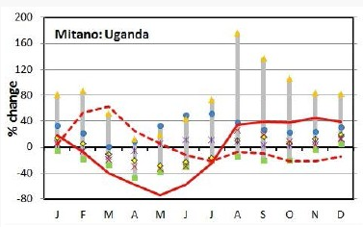
4 degree increase
Effect of the short rains lost
2 degree increase
Source: IPCC 2013/2014
Notes:
Simulated change in mean monthly runoff of the Mitano River in Uganda, for a 2°C increase in global mean temperature above the 1961-1990 average, showing changes for both a 2°C increase (dotted line) and a 4°C increase (solid line).
Precipitation is the main driver of changes to river runoff and the seasonal changes in precipitation are usually reflected in seasonal streamflow variability. However, changes in groundwater recharge also affect streamflow. As global temperatures rise, evapotranspiration increases, reducing the amount of groundwater. Human and natural systems in the Upper Nile region have historically been very vulnerable to changes in river flow. People are particularly reliant on the river for fishing and hydro-electric power production, so, although it can be hard for models to accurately recreate local rainfall patterns, it is important to try to project how they might change in the future.
The Mitano river is in the Upper Nile basin in Uganda, which has a humid, tropical climate. Usually, the effect of the ‘short’ (March-May) and ‘long’ (September- November) rains determine the river’s discharge. However, mean global temperature increases of 4°C or more with respect to the 1961-1990 average are projected to decrease groundwater outflow to the river so much that the annual mean discharge will fall, even though annual mean precipitation will be higher. The spring discharge peak disappears and the river flow regime changes from having two seasonal peaks to only one – the effect of the ‘short rains’ could be lost. This is because, for the Mitano, groundwater flow is far more important than lateral (quickflow within the upper soil profile) or surface flow. Increasing evapotranspiration limits the amount of water penetrating the soil profile and replenishing the shallow groundwater store during the first, short, wet season.
Changing groundwater levels also affect land surface energy fluxes, including through evaporation, and thus feedback on the climate system, particularly in semi-arid areas.

Slide 11
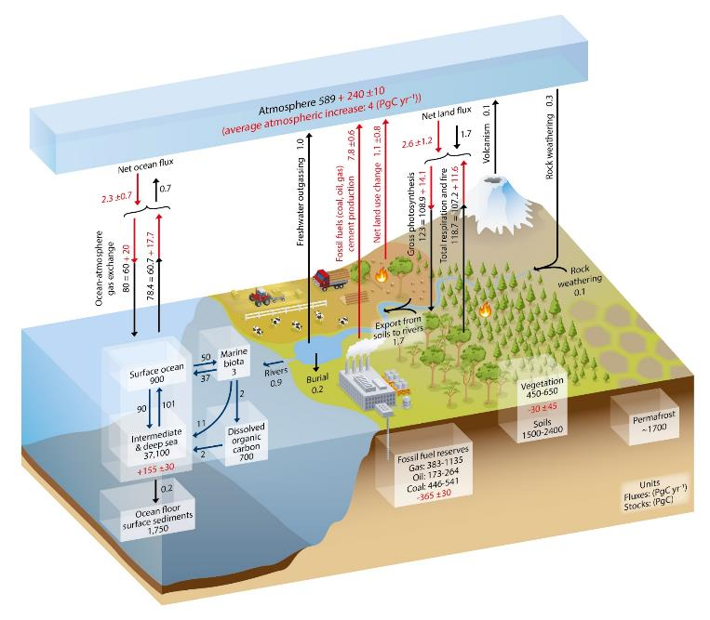
The Changing Carbon Cycle
Units are petagrams.
1 petagram = 1,000,000,000,000,000 kg
Black arrows = prior to IR
Red arrows = ‘anthropogenic’ fluxes
Source: IPCC 2013/2014
Source: IPCC 2013/2014
Notes:
Carbon cycle viewed as reservoirs and fluxes. Black arrows show natural fluxes, red ones show anthropogenic ones
Source: IPCC WG1 2013 chapter 6
Processes are operating at tiny scales
The global carbon cycle can be viewed as a series of reservoirs of carbon in the Earth System, which are connected by exchange fluxes of carbon. An exchange flux is the amount of carbon which moves between reservoirs each year.
Before human activities such as land use changes and industrial processes had a significant impact, the global carbon cycle was roughly balanced.CO₂ increased by over 40% from around 280 ppm in 1750 to 400 ppm in 2015.Higher atmospheric CO₂ concentrations, and associated climate impacts of present emissions, will persist for hundreds of years into the future.

Slide 12
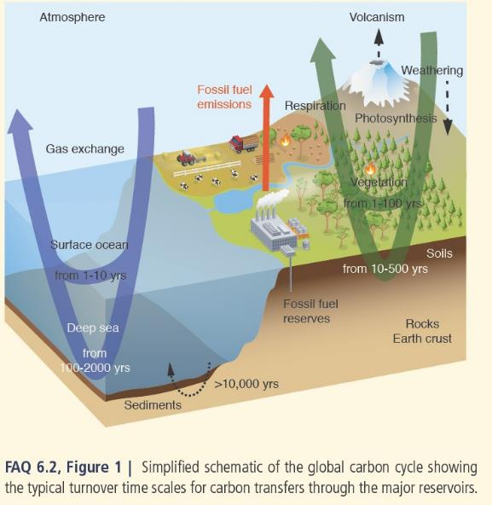
Source: IPCC 2013/2014
Notes:
There are two domains in the global carbon cycle, fast and slow. The fast domain has large exchange fluxes and relatively ‘rapid’ reservoir turnovers. This includes carbon on land in vegetation, soils, peat and freshwater and in the atmosphere, ocean and surface ocean sediments. Reservoir turnover times (a measure of how long the carbon stays in the reservoir) range from a few years for the atmosphere to decades to millennia for the major carbon reservoirs of the land vegetation and soil and the various domains in the ocean.
The slow domain consists of the huge carbon stores in rocks and sediments which exchange carbon with the fast domain through volcanic emissions of CO₂, erosion and sediment formation on the sea floor. Reservoir turnover times of the slow domain are 10,000 years or longer.
Before the Industrial Era, the fast domain was close to a steady state. Data from ice cores show little change in the atmospheric CO₂ levels over millennia despite changes in land use and small emissions from humans. By contrast, since the beginning of the Industrial Era (around 1750), fossil fuel extraction and its combustion have resulted in the transfer of a significant amount of fossil carbon from the slow domain into the fast domain, causing a major change to the carbon cycle.
Some reservoirs of carbon:
In the atmosphere, CO₂ is the dominant carbon containing trace gas with a mass of 828 PgC (Petagrams of Carbon or x1015gC). Additional trace gases include methane (CH₄, currently about 3.7 PgC) and carbon monoxide (CO, around 0.2 PgC), with still smaller amounts of hydrocarbons, black carbon aerosols and other organic compounds.
The terrestrial biosphere reservoir contains carbon in organic compounds in vegetation (living biomass) (450 to 650 PgC) and in dead organic matter in litter and soils (1500 to 2400 PgC). There is an additional amount of old soil carbon in wetland soils (300 to 700 PgC) and in permafrost (1700 PgC).
Some fluxes of carbon:
CO₂ is removed from the atmosphere by plant photosynthesis (123±8 PgC/ year). Carbon fixed into plants is then cycled through plant tissues, litter and soil carbon and can be released back into the atmosphere by plant, microbial and animal respiration and other processes (e.g. forest fires) on a very wide range of time scales (seconds to millennia).
A significant amount of terrestrial carbon (1.7 PgC/year) is transported from soils to rivers. A fraction of this carbon is released as CO₂ by rivers and lakes to the atmosphere, a fraction is buried in freshwater organic sediments and the remaining amount (~0.9 PgC/ year) is delivered by rivers to the coastal ocean. Atmospheric CO₂ is exchanged with the surface ocean through gas exchange.
Carbon is transported within the ocean by three mechanisms;
(1) the ‘solubility pump’ (see glossary),
(2) the ‘biological pump’ (see case study),
(3) the ‘marine carbonate pump’ which is caused by marine organisms forming shells in the surface ocean. These sink, are buried in the sediments and eventually form sedimentary rocks (such as limestone or chalk).

Slide 13
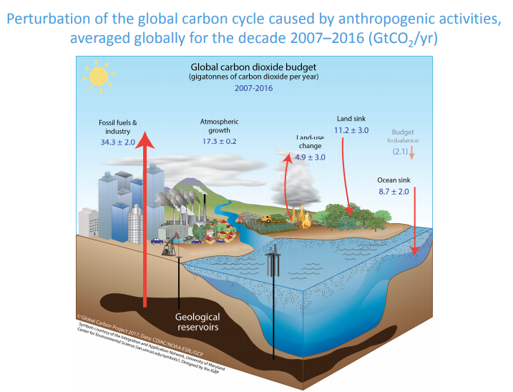
Source: Global Carbon Budget 2017
Notes:
Source: Global carbon budget 2017 http://www.globalcarbonproject.org/carbonbudget/17/files/GCP_CarbonBudget_2017.pdf

Slide 14
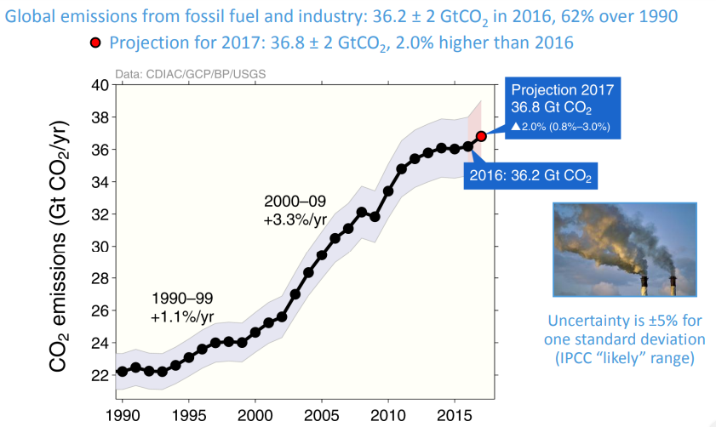
Source: Global Carbon Budget 2017
Notes:
Source: Global carbon budget 2017
Fossil fuel and industry includes cement production

Slide 15
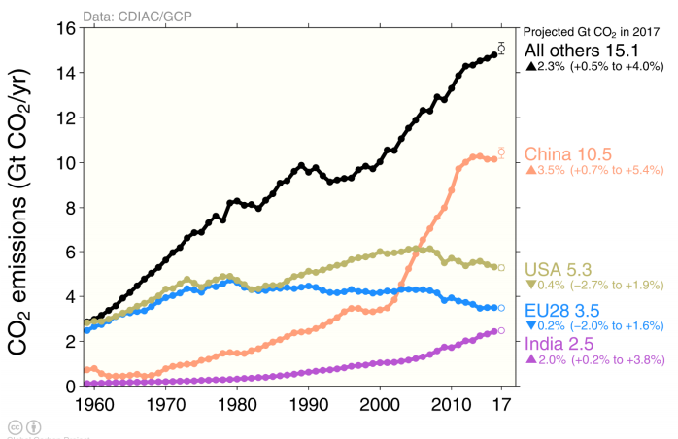
Source: Global Carbon Budget 2017
Notes:
The black line in this graph corresponds to the previous graph, but goes back further in time (to 1960)
Emissions from selected countries:
Source: Global carbon budget 2017
China – economy booming, emissions not

Slide 16
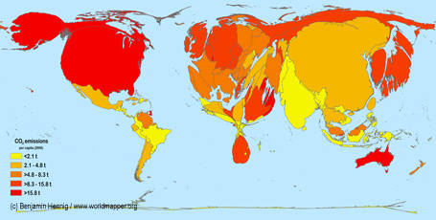
Notes:
Carbon Emissions Map, resizing the territories according to their proportion of global carbon dioxide emissions and colouring them according to their per capita emissions.
So, for example, China has massive emissions and looks disproportionately large on this map, but it has so many people, that actually its per capita emissions are ok. India does even better.
The USA, Canada and Australia have the highest per capita emissions – “more than their fair share”

Slide 17
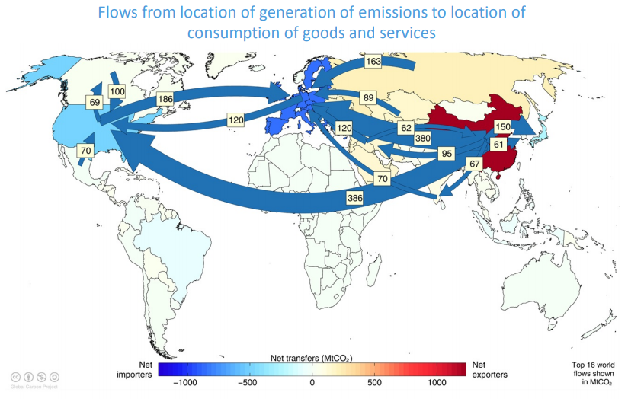
Source: Global Carbon Budget 2017
Notes:
Source: Global carbon budget 2017 http://www.globalcarbonproject.org/carbonbudget/17/files/GCP_CarbonBudget_2017.pdf
Are we working towards a future where we pay not just for the financial costs of goods and services we buy in from other countries, but also for the pollution their production generated?

Slide 18
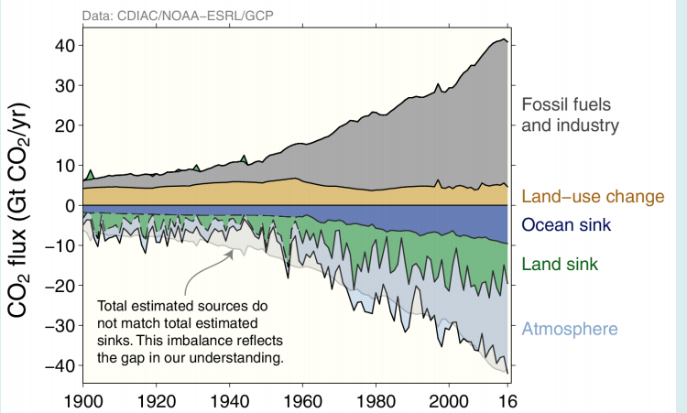
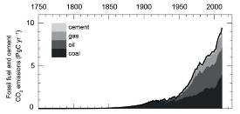
Peatland fires
Source: Global Carbon Budget 2017
Source: IPCC 2013/2014
Notes:
See big peatland fires on this – rapid release of carbon
Anthropogenic CO₂ emissions to the atmosphere were 555 ± 85 PgC between 1750 and 2011. Of this, fossil fuel combustion and cement production contributed 375 ± 30 PgC and land use change (including deforestation, afforestation (planting new forest) and reforestation) contributed 180 ± 80 PgC. In 2002–2011, average fossil fuel and cement manufacturing emissions were 7.6 to 9.0 PgC/ year, with an average increase of 3.2%/ year compared with 1.0%/ year during the 1990s. In 2011, fossil fuel emissions were in the range of 8.7 to 10.3 PgC.
Emissions due to land use changes (primarily tropical deforestation) between 2002 and 2011 are estimated to range between 0.1 to 1.7 PgC/year. This includes emissions from deforestation of around 3 PgC/ year compensated by an uptake of around 2 PgC/year by forest regrowth (mainly on abandoned agricultural land).
The IPCC concluded that the increase in CO₂ emissions from both fossil fuel burning and land use change are the dominant cause of the observed increase in atmospheric CO₂ concentration.
Land
Plants on land have taken up approximately 25 percent of the carbon dioxide that humans have put into the atmosphere. The amount of carbon that plants take up varies greatly from year to year, but in general, the world’s plants have increased the amount of carbon dioxide they absorb since 1960. Only some of this increase occurred as a direct result of fossil fuel emissions.
With more atmospheric carbon dioxide available to convert to plant matter in photosynthesis, plants were able to grow more. This increased growth is referred to as carbon fertilization. Models predict that plants might grow anywhere from 12 to 76 percent more if atmospheric carbon dioxide is doubled, as long as nothing else, like water shortages, limits their growth. However, scientists don’t know how much carbon dioxide is increasing plant growth in the real world, because plants need more than carbon dioxide to grow.
Plants also need water, sunlight, and nutrients, especially nitrogen. If a plant doesn’t have one of these things, it won’t grow regardless of how abundant the other necessities are. There is a limit to how much carbon plants can take out of the atmosphere, and that limit varies from region to region. So far, it appears that carbon dioxide fertilization increases plant growth until the plant reaches a limit in the amount of water or nitrogen available.
Some of the changes in carbon absorption are the result of land use decisions. Agriculture has become much more intensive, so we can grow more food on less land. In high and mid-latitudes, abandoned farmland is reverting to forest, and these forests store much more carbon, both in wood and soil, than crops would. In many places, we prevent plant carbon from entering the atmosphere by extinguishing wildfires. This allows woody material (which stores carbon) to build up. All of these land use decisions are helping plants absorb human-released carbon in the Northern Hemisphere.
In the tropics, however, forests are being removed, often through fire, and this releases carbon dioxide. As of 2008, deforestation accounted for about 12 percent of all human carbon dioxide emissions.
The biggest changes in the land carbon cycle are likely to come because of climate change. Carbon dioxide increases temperatures, extending the growing season and increasing humidity. Both factors have led to some additional plant growth. However, warmer temperatures also stress plants. With a longer, warmer growing season, plants need more water to survive. Scientists are already seeing evidence that plants in the Northern Hemisphere slow their growth in the summer because of warm temperatures and water shortages.
Dry, water-stressed plants are also more susceptible to fire and insects when growing seasons become longer. In the far north, where an increase in temperature has the greatest impact, the forests have already started to burn more, releasing carbon from the plants and the soil into the atmosphere. Tropical forests may also be extremely susceptible to drying. With less water, tropical trees slow their growth and take up less carbon, or die and release their stored carbon to the atmosphere.
The warming caused by rising greenhouse gases may also “bake” the soil, accelerating the rate at which carbon seeps out in some places. This is of particular concern in the far north, where frozen soil—permafrost—is thawing. Permafrost contains rich deposits of carbon from plant matter that has accumulated for thousands of years because the cold slows decay. When the soil warms, the organic matter decays and carbon—in the form of methane and carbon dioxide—seeps into the atmosphere.
Current research estimates that permafrost in the Northern Hemisphere holds 1,672 billion tons (Petagrams) of organic carbon. If just 10 % of this permafrost were to thaw, it could release enough extra carbon dioxide to the atmosphere to raise temperatures an additional 0.7 degrees Celsius (1.3 degrees Fahrenheit) by 2100.
https://earthobservatory.nasa.gov/Features/CarbonCycle/page5.php

Slide 19
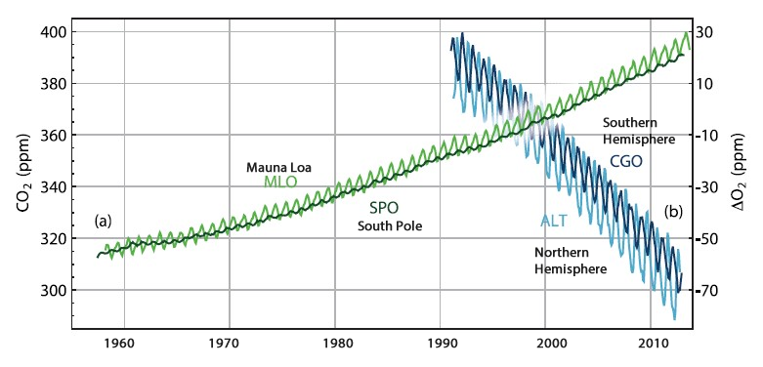
Source: IPCC 2013/2014
Notes:
Carbon Dioxide concentrations in the atmosphere increased by over 40% from 278 ppm in 1750 to 400 ppm in 2015.
Most of the fossil fuel CO₂ emissions take place in the industrialised countries north of the equator. Consistent with this, the annual average atmospheric CO₂ measurement stations in the Northern Hemisphere (NH) record slightly higher CO₂ concentrations than stations in the Southern Hemisphere (SH). As the difference in fossil fuel combustion between the hemispheres has increased, so has the difference in concentration between measuring stations at the South Pole and Mauna Loa (Hawaii, NH).
The atmospheric CO₂ concentration increased by around 20 ppm during 2002–2011. This decadal rate of increase is higher than during any previous decade since direct atmospheric concentration measurements began in 1958.
Because CO₂ uptake by photosynthesis occurs only during the growing season, whereas CO₂release by respiration occurs nearly year-round, both the Mauna Loa and South Pole concentrations show an annual cycle, with more CO₂ in the atmosphere in winter. However, as there is far more land mass and therefore vegetation in the Northern Hemisphere, the annual cycle is more pronounced at Mauna Loa. Note how the seasonal cycles are out of phase in the two hemispheres.
Note also how the two curves diverge between 1960 and 2010 – CO2 is growing faster in the northern hemisphere (because there are more emissions there, and co2 mixes relatively slowly between the two hemispheres).
Past changes in atmospheric greenhouse gas concentrations can be determined with very high confidence from polar ice cores. During the 800,000 years prior to 1750, atmospheric CO₂ varied from 180 ppm during glacial (cold) up to 300 ppm during interglacial (warm) periods. Present-day (2011) concentrations of atmospheric carbon dioxide far exceed this range. The current rate of CO₂ rise in atmospheric concentrations is unprecedented with respect to the highest resolution ice core records which cover the last 22,000 years.

Slide 20
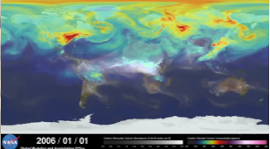
A year in the life of earths CO₂
https://youtu.be/x1SgmFa0r04
Notes:
Note the scale – they look like dramatic differences, but actually the range on the scale is pretty small. Over time, CO2 is well mixed between the Northern and Southern Hemispheres.

Slide 21
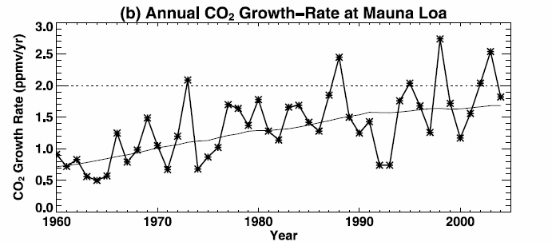
Increased forest fires
due to climate change – hot dry summer of 2003, and reduced land uptake
Dry and warm Tropics during El Niño years leads to higher CO₂ emissions
Low growth in La Niña years
Low growth following eruption of Pinatubo
Source: Jones and Cox, 2005
Notes:
Looking in more detail, the growth rate has been growing
Massive year to year variations because the natural carbon cycle responds to differences in weather
Source Jones and Cox GEOPHYSICAL RESEARCH LETTERS, VOL. 32, L14816, doi:10.1029/2005GL023027, 2005
Cold years (after large explosive, tropical volcanic eruptions or during La Nina) – feedbacks from ocean and vegetation (fewer fires).
– less co2 in atmosphere
Warm years (eg El Nino) – net emissions from land to atmosphere

Slide 22
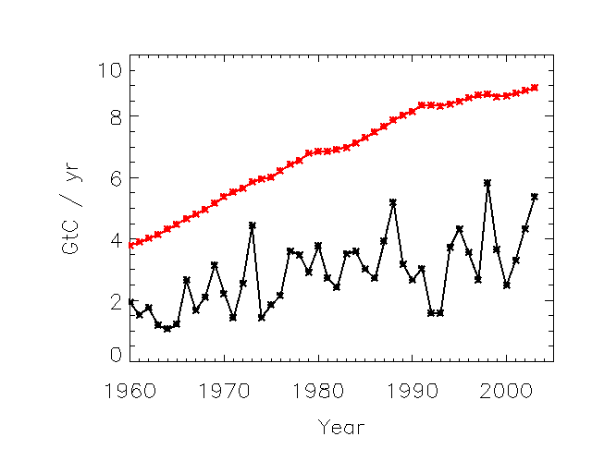
Carbon cycle “protection”
Currently, the global carbon cycle absorbs about half of our emissions
CO₂ emissions
CO₂ growth in the atmosphere
Source: Jones and Cox, 2005
Notes:
This is annual mean – so seasonal cycle averaged out.
Globally, the combined natural land and ocean sinks of CO₂ kept up with the atmospheric rate of increase, removing 55% of the total anthropogenic emissions every year on average during 1958–2011. The ocean reservoir stored 155 ± 30 PgC. Vegetation biomass and soils stored 160 ± 90 PgC.

Slide 23
Balancing the carbon
What we emit…
100
Notes:
Slide courtesy Chris Jones

Slide 24
Balancing the carbon
What we emit… Must go somewhere
=
100
50
25
25
atmosphere
land
ocean
Notes:
Land = vegetation + soils
Slide courtesy Chris Jones

Slide 25
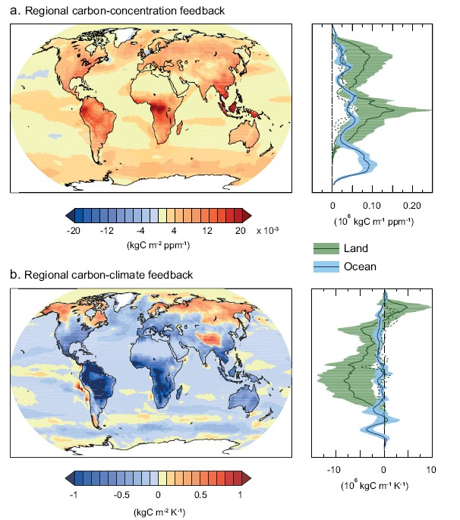
Change in carbon uptake for each ppm increase in atmospheric CO₂
Change in carbon uptake for each °C increase in temperature
Source: IPCC 2013/2014
Notes:
WG1 Chapter 6, Figure 22. Maps of the changes in carbon uptake in kg of Carbon/ m² for:
a) each ppm increase in atmospheric CO₂. Orange and red colours indicate that, as the amount of carbon dioxide in the atmosphere increases, more carbon is taken up, whereas blue colours show where extra carbon is released.
b) each degree Celsius increase in temperature. Orange and red colours indicate that, as the temperature rises, more carbon is taken up, whereas blue colours show where extra carbon is released.
The graphs on the right show the mean carbon uptake by land and ocean for each latitude line corresponding with the adjacent maps.
As carbon dioxide concentrations in the atmosphere increase:
– The oceans will take up more CO₂ almost everywhere, but particularly in the North Atlantic and Southern Oceans.
– The take up of CO₂ by land areas will increase everywhere, particularly over tropical land and in humid regions where the amount of biomass is high. There is also a relatively large increase over Northern Hemisphere temperate and boreal latitudes, because of the greater land area and large areas of forest.
– Without this increased uptake of CO₂ by the land and ocean, annual increases in atmospheric carbon dioxide concentration would be around double the observed rates
The co2 fertilisation effect is limited by the availability of nitrogen in temperate and boreal regions and by phosphorous in tropical regions
As the atmosphere warms:
– Tropical ecosystems will store less carbon, as will mid-latitudes.
– At high latitudes, the amount of carbon stored on land will increase, although this may be offset by the decomposition of carbon in permafrost.
– As sea-ice melts, more water is exposed and therefore more CO₂ can be taken into the water.
– As water warms, the solubility of CO₂ in water decreases and so less is taken up by the oceans.
– Ocean warming and circulation changes will reduce the rate of carbon uptake in the Southern Ocean and North Atlantic.
The physical, biogeochemical carbon cycle in the ocean and on land will continue to respond to climate change and rising atmospheric CO₂ concentrations during the 21stcentury.The effects of increasing carbon dioxide in the atmosphere and increasing temperature do not necessarily have the same impact on the carbon cycle. There is high confidence that climate change (temperature change) will partially offset increases in global land and ocean carbon sinks caused by rising atmospheric CO₂.Between about 15 to 40% of human-emitted CO₂ will remain in the atmosphere longer than 1,000 years

Slide 26
Balancing the carbon
What we emit… Must go somewhere
If these go down due to climate change…
=
100
50
25
25
atmosphere
land
ocean
Notes:
Slide courtesy Chris Jones

Slide 27
Balancing the carbon
What we emit… Must go somewhere
This must go up
=
If these go down due to climate change…
100
50
25
25
atmosphere
land
ocean
Notes:
Slide courtesy Chris Jones

Slide 28
Balancing the carbon
For given emissions, carbon cycle feedback means:
More CO₂ stays in atmosphere
We will see greater climate change
=
100
> 50
50
atmosphere
Notes:
Slide courtesy Chris Jones

Slide 29
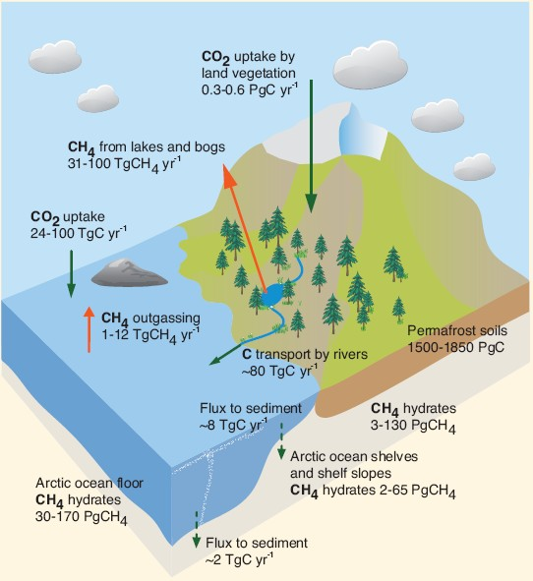
The Carbon Cycle in the Arctic
Source: IPCC 2013/2014
Notes:
At the moment, vegetation in the Arctic is responsible for about 10% of the CO₂ uptake by land globally. Permafrost soils on land and in ocean shelves contain large pools of organic carbon. If permafrost melts, microbes decompose the carbon, releasing it as CO₂ or, where oxygen is limited (for example if the soil is covered in standing water), as methane. As the climate of the Arctic warms, more permafrost will thaw. However, warmer Arctic summers would also mean an increase in the amount of vegetation and therefore photosynthesis and CO₂ uptake in the Arctic. As yet, scientists don’t know which process will dominate over the next few decades. To complicate matters further, the microbes decomposing the carbon also release heat, causing further melting – a positive feedback.
Methane hydrates are another form of frozen carbon, found in deeper soils. Changes to the temperature and pressure of permafrost soils (and ocean waters) could lead to methane, a gas with a much stronger greenhouse warming potential than carbon dioxide, being released. However, most of the methane is virtually certain to remain trapped underground and will not reach the atmosphere.
The release of carbon dioxide and methane from the Arctic will provide a positive feedback to climate change which will be more important over longer timescales – millennia and longer.
As Arctic and sub-Arctic regions warm more than the global average, the increase in temperature could lead to more regular fire damage to vegetation and soils and carbon release. More generally, increased vegetation cover lowers albedo, meaning that more of the sun’s light is absorbed which in turn warms the climate locally (another positive feedback), as well as increasing evapotranspiration and carbon uptake.

Slide 30
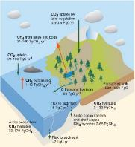
The COMPLICATED Carbon Cycle in the Arctic
Vegetation in the Arctic is responsible for about 10% of the CO₂ uptake by land.
Permafrost soils on land and in ocean shelves contain large pools of organic carbon.
If permafrost melts, microbes decompose the carbon, releasing it as CO₂ or methane.
As the climate of the Arctic warms, more permafrost will thaw.
Warmer Arctic summers mean an increase in the amount of vegetation
Increased vegetation increases carbon uptake.
Increased vegetation cover lowers albedo,
The microbes decomposing the carbon also release heat.
Methane hydrates are found in deeper soils.
Changes to the temperature and pressure of permafrost soils could lead to methane release.
Most will remain trapped underground.
Arctic and sub-Arctic regions projected to warm more than the global average
More regular fire damage to vegetation and soils.
Notes:
At the moment, vegetation in the Arctic is responsible for about 10% of the CO₂ uptake by land globally. Permafrost soils on land and in ocean shelves contain large pools of organic carbon. If permafrost melts, microbes decompose the carbon, releasing it as CO₂ or, where oxygen is limited (for example if the soil is covered in standing water), as methane. As the climate of the Arctic warms, more permafrost will thaw. However, warmer Arctic summers would also mean an increase in the amount of vegetation and therefore photosynthesis and CO₂ uptake in the Arctic. As yet, scientists don’t know which process will dominate over the next few decades. To complicate matters further, the microbes decomposing the carbon also release heat, causing further melting – a positive feedback.
Methane hydrates are another form of frozen carbon, found in deeper soils. Changes to the temperature and pressure of permafrost soils (and ocean waters) could lead to methane, a gas with a much stronger greenhouse warming potential than carbon dioxide, being released. However, most of the methane is virtually certain to remain trapped underground and will not reach the atmosphere.
The release of carbon dioxide and methane from the Arctic will provide a positive feedback to climate change which will be more important over longer timescales – millennia and longer.
As Arctic and sub-Arctic regions warm more than the global average, the increase in temperature could lead to more regular fire damage to vegetation and soils and carbon release. More generally, increased vegetation cover lowers albedo, meaning that more of the sun’s light is absorbed which in turn warms the climate locally (another positive feedback), as well as increasing evapotranspiration and carbon uptake.

Slide 31
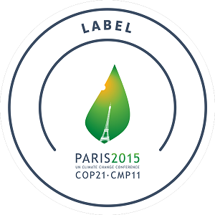
In 2015, the 21st UNFCCC Conference of the Parties (“COP21”) drew up the Paris Agreement
Emphasises the need to stay below 2°C and “pursue efforts” to keep within 1.5°C
Climate science can help determine how we can best achieve these targets.

Slide 32
Alternative view – carbon targets
lets say we have a CO₂ target to stabilise climate…
This is our fixed target
e.g. 450ppm
=
100
50
25
25
atmosphere
land
ocean
Notes:
Slide courtesy Chris Jones

Slide 33
Alternative view – carbon targets
lets say we have a CO₂ target to stabilise climate…
This is our fixed target
e.g. 450ppm
=
100
If these go down, as before, due to climate change…
50
25
25
atmosphere
land
ocean
Notes:
Slide courtesy Chris Jones

Slide 34
Alternative view – carbon targets
lets say we have a CO₂ target to stabilise climate…
This must go down to balance
This is our fixed target
e.g. 450ppm
=
100
If these go down, as before, due to climate change…
50
25
25
atmosphere
land
ocean
Notes:
Slide courtesy Chris Jones

Slide 35
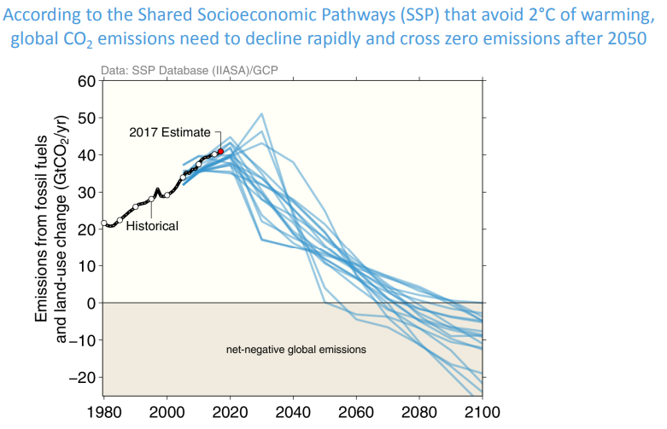
Notes:
Source: Global carbon budget 2017 http://www.globalcarbonproject.org/carbonbudget/17/files/GCP_CarbonBudget_2017.pdf
To avoid 2C warming, we’ve not just got to reduce our emissions down to zero, we’ve got to start removing greenhouse gases from the atmosphere

Slide 36
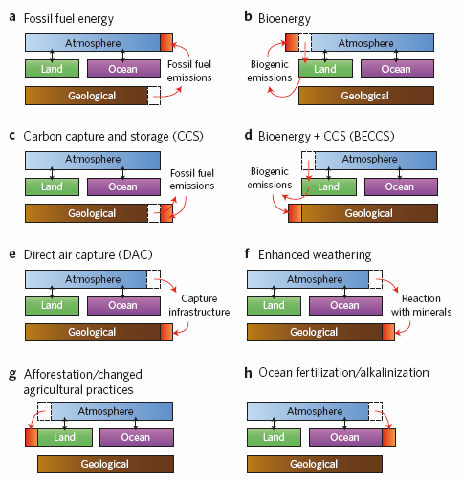
D – H are Negative Emission Technologies
Smith et al., Nature Climate Change, 2015
Notes:
Smith et al, Nature Climate Change, DOI: 10.1038/NCLIMATE2870
To have a >50% chance of limiting warming below 2 °C, most recent scenarios from integrated assessment models (IAMs) require large-scale deployment of negative emissions technologies (NETs). These are technologies that result in the net removal of greenhouse gases from the atmosphere. We quantify potential global impacts of the different NETs on various factors (such as land, greenhouse gas emissions, water, albedo, nutrients and energy) to determine the biophysical limits to, and economic costs of, their widespread application. Resource implications vary between technologies and need to be satisfactorily addressed if NETs are to have a significant role in achieving climate goals.
Schematic representation of carbon flows among atmospheric,
land, ocean and geological reservoirs. a, Climate change results from
the addition of geological carbon to the atmosphere through combustion
or other processing of fossil fuels for energy. Carbon is indicated in red.
b, Bioenergy seeks to avoid the net addition of carbon to the atmosphere
by instead using biomass energy at a rate that matches the uptake of
carbon by re-growing bioenergy feedstocks. c, Carbon capture and storage
(CCS) technologies intervene to capture most of the potential carbon
emissions from fossil fuels, and return them to a geological (or possibly
ocean) reservoir. d–h, Negative Emissions Technologies remove carbon from the atmosphere, either
through biological uptake (g,h), uptake by biological or industrial processes
with CCS (d,e) or enhanced weathering of minerals (dissolve silicate and carbon – this removes carbon dioxide from the ocean or atmosphere, eventually ends up in shells or as solid carbon) (f).

Slide 37
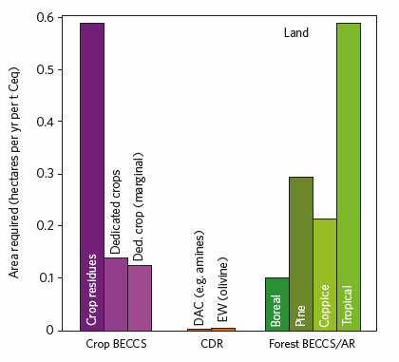
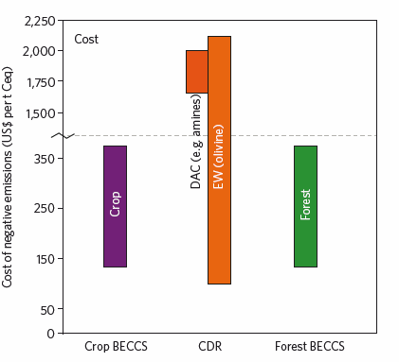
d
e
f
Smith et al., Nature Climate Change, 2015
Also water, nitrogen, albedo changes..
Notes:
There are many implications of Negative Emission Technologies: here are just a couple – land area and cost. Others involve water required, energy generated, nitrogen required, albedo changes
Crop BECCS = bioenergy with carbon capture and storage
CDR – carbon dioxide removal by direct air capture or enhanced weathering

Slide 38
“there is no NET (or combination of NETs) currently available that
could be implemented to meet the <2 °C target without significant
impact on either land, energy, water, nutrient, albedo or cost, and
so ‘plan A’ must be to immediately and aggressively reduce GHG
emissions.”
Smith et al., Nature Climate Change, 2015

Slide 39
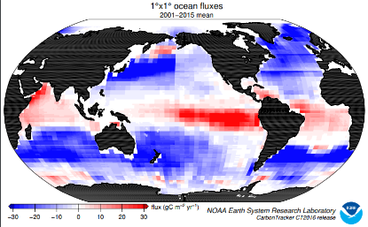
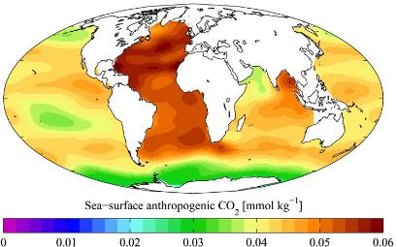
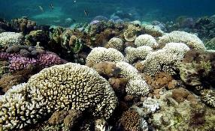
Oceanic carbon
CO₂ rich air meets seawater containing less
The greenhouse gas diffuses into the ocean.
This warm, CO₂-rich surface water flows to colder parts of the globe, releasing its heat.
The now-cool water sinks several km deep, carrying carbon to deep water.
Oceanic organisms also store carbon.
Blue = CO₂ uptake by the ocean
Notes:
https://www.esrl.noaa.gov/gmd/ccgg/carbontracker/
https://www.esrl.noaa.gov/gmd/webdata/ccgg/CT2016/fluxmaps/ocn/longterm_CT2016.flux1x1_ocn_ltm.pdf
Remember the solubility of CO2 in water reduces as the temperature rises.

Slide 40
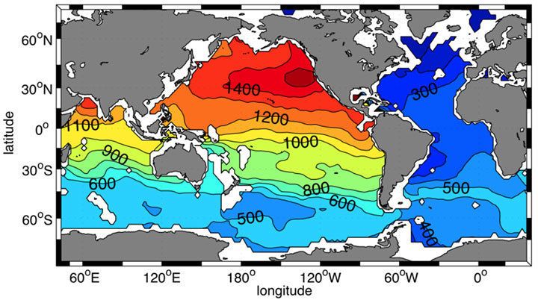
Time in years since water was last at the sea surface, of ocean waters lying at 2500 meters depth
The solubility of CO₂ in water falls as the water temperature rises
Some phytoplankton and plants grow better in CO₂ rich water
Notes:
The “age”, or time in years since water was last at the sea surface, of ocean waters lying at 2500 meters depth (deep water).
Source: Gebbie et al 2011. Gives a sense of how long it takes water to store carbon.
Carbon dioxide readily dissolves in water and the oceans provide a huge reservoir of carbon. Across the world's oceans there is a continual cycle of equilibration of dissolved carbon dioxide in water with carbon dioxide in the atmosphere.
Through increasing global temperatures, via human induced global warming, rising sea temperatures may have significant effects on the oceanic carbon dioxide sink. Increasing carbon dioxide concentrations in the atmosphere may slightly reduce oceanic pH and so lead to a small increase in carbon dioxide uptake. However, as water temperatures increase the solubility of carbon dioxide is reduced and the likelihood of water stratification is increased - both leading to a overall reduction in oceanic carbon dioxide uptake.
http://www.ghgonline.org/co2sinkocean.htm
Ocean acidification affects marine organisms in two ways. First, carbonic acid reacts with carbonate ions in the water to form bicarbonate. However, those same carbonate ions are what shell-building animals like coral need to create calcium carbonate shells. With less carbonate available, the animals need to expend more energy to build their shells. As a result, the shells end up being thinner and more fragile.
Second, the more acidic water is, the better it dissolves calcium carbonate. In the long run, this reaction will allow the ocean to soak up excess carbon dioxide because more acidic water will dissolve more rock, release more carbonate ions, and increase the ocean’s capacity to absorb carbon dioxide. In the meantime, though, more acidic water will dissolve the carbonate shells of marine organisms, making them pitted and weak.
Warmer oceans—a product of the greenhouse effect—could also decrease the abundance of phytoplankton, which grow better in cool, nutrient-rich waters. This could limit the ocean’s ability to take carbon from the atmosphere through the fast carbon cycle.
On the other hand, carbon dioxide is essential for plant and phytoplankton growth. An increase in carbon dioxide could increase growth by fertilizing those few species of phytoplankton and ocean plants (like sea grasses) that take carbon dioxide directly from the water. However, most species are not helped by the increased availability of carbon dioxide.
https://earthobservatory.nasa.gov/Features/CarbonCycle/page5.php

Slide 41
The differences between the carbon and water cycles:
– Human emissions of water have no effect on the concentration of water in the atmosphere; the concentration of water in the atmosphere is largely controlled by temperature. However, human emissions of carbon have increased the concentration of carbon in the atmosphere by over 40%.
– The effective lifetime of water in the atmosphere is of order 10 days, whereas that of CO₂ ranges between a few years to thousands of years.
– The concentration of water in the atmosphere is extremely variable spatially, ranging from close to zero at high altitudes to about 20g per kg of dry air near the tropical ocean surface, whereas, because of its long effective lifetime, that of carbon dioxide has a range of around only 2% both seasonally and geographically.
– The cryosphere (ice on land and sea) is an important part of the water cycle, but not of the carbon cycle. Humans have indirectly, through temperature change, caused impacts on the cryosphere.

Slide 42
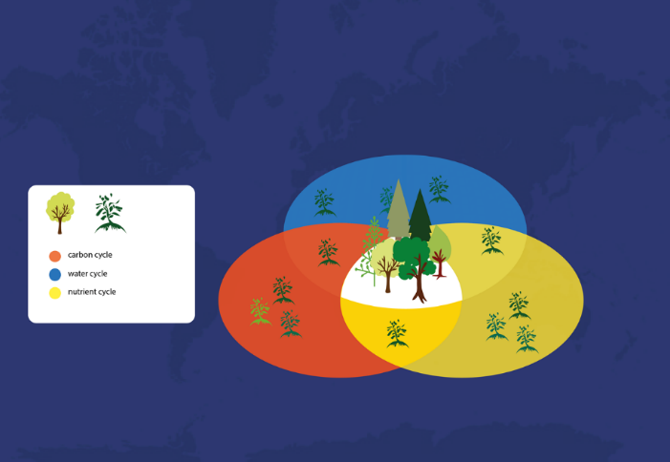
weather
climate
Notes:
Climate change can affect terrestrial and marine ecosystems which in turn has impacts on both the water and carbon cycles and then feeds back to the climate.
Direct human influence on vegetation can also lead to impacts on the climate, through the energy, water and carbon cycles.
Both changes in carbon dioxide and changes in climate have impacts on vegetation.
The interactive effects of elevated CO₂ and other global changes (such as climate change, nitrogen deposition and biodiversity loss) on ecosystem function are extremely complex.
Extreme weather events can have long lasting impacts on vegetation and the carbon and water cycles.

Slide 43

This is a leaf.
It’s a major reason why present climate change is only half as much as we might expect.
Notes:
Energy, carbon and water go into leaf
Slide courtesy Chris Jones

Slide 44
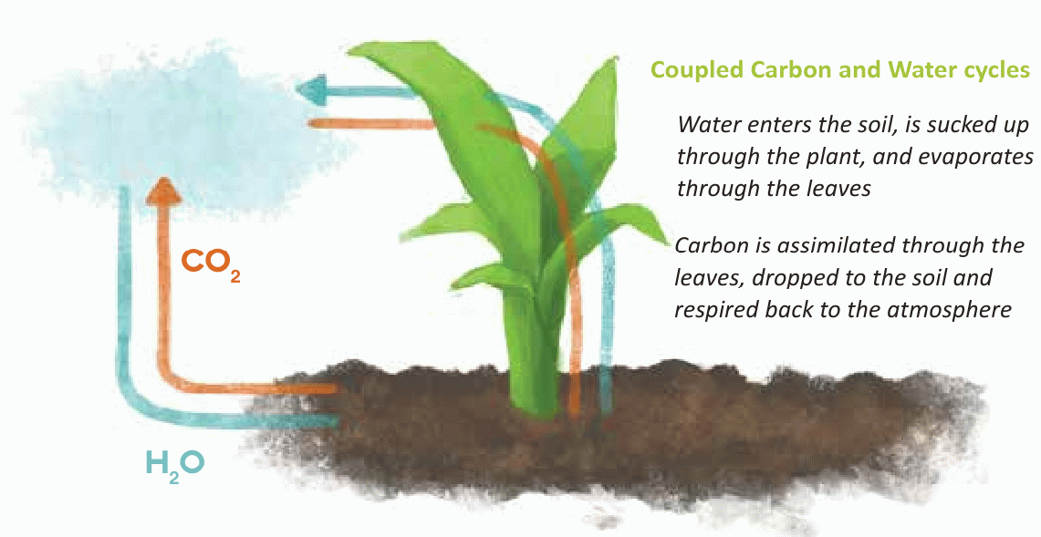
Notes:
Same path, different directions
Best and Jones, 2013, ileaps
Synergies between water and carbon cycles as they move in opposite directions but around a similar pathway across the land surface interface. Whereas rainwater enters through the soil, is sucked up by the plant and evaporates through the leaves, carbon is taken up through the leaves, allocated to the plant, deposited into the soil and eventually decomposed back into co2. at each stage the presence or cycling of water and carbon affects the presence and cycling of the other – for example, soil moisture affects plant growth and carbon uptake, whereas co2 affects stomatal opening and evapotranspiration. Both are strongly affected by energy partitioning and transformation.

Slide 45
Stomata control the diffusion of CO₂ into and water out of the leaf
As trees become moisture stressed, guard cells around the leaf pores enlarge to reduce evaporative loss of water and in doing so, reduce the passage of CO₂
In air with a higher CO₂ concentration, the stomata need to stay open for less long, reducing evapotranspiration
Sunlight and temperature also have an impact on a plant’s ability to fix carbon into carbohydrates
Notes:
Loader et al 2013

Slide 46
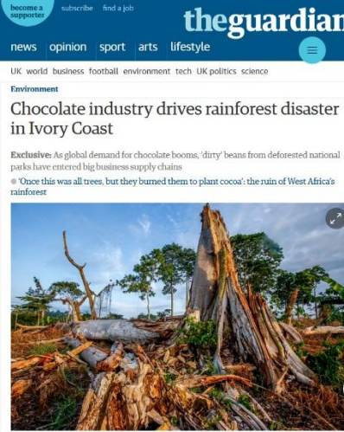
Satellite-derived rainfall shows air masses that have travelled over extensive vegetated surfaces can generate at least twice as much rainfall as air masses that have flowed over deforested lands
Implication: tropical deforestation can reduce rainfall 100s-1000s kms away
Removing remaining patches of rainforest can have a big impact on rainfall
Notes:
Spracklen et al Nature, 2012
Mechanism related to when and where there is deep convection as well as evapotranspiration
http://leaf.leeds.ac.uk/scientists-identify-specific-climate-shifts-responsible-for-an-increase-in-the-land-carbon-sink/

Slide 47
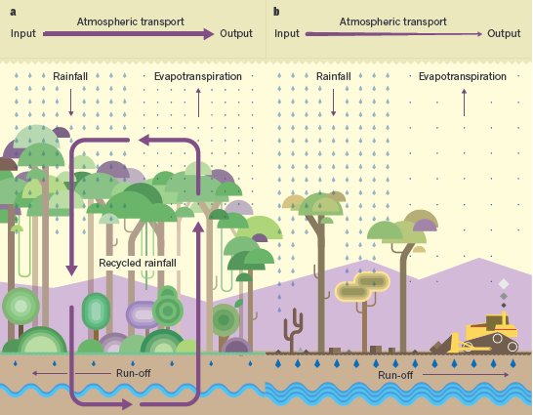
Effect of Deforestation on Rainfall in the Tropics
LUIZ E. O. C. ARAGÃO, 1 8, N AT U R E, VO L 4 8 9, 1 3 S E P T E M B E R 2 0 1 2.
Notes:
Effect of deforestation on rainfall in the tropics. a, Much of the rainfall over tropical forests comes from water vapour that is carried by the atmosphere from elsewhere. But a large component is ‘recycled’ rain — water that is pumped by trees from soil into the atmosphere through a process called evapotranspiration2. Water exits from forests either as run-off into streams and rivers, or as evapo-transpirated vapour that is carried away by the atmosphere. The atmospheric transport of water vapour into the forest is balanced by the exit of water in the form of vapour and run-off. b, Spracklen and colleagues’ analysis suggests that deforestation reduces evapotranspiration and so inhibits water recycling. This decreases the amount of moisture carried away by the atmosphere, reducing rainfall in regions to which the moisture is transported. Decreasing evapotranspiration may also increase localized run-off and raise river levels.
Large scale forest clearance in the amazon (currently 13-15%) has led to an increase in river discharge by as much as 20% in the southeastern amazon (Dias et al 2015)

Slide 48
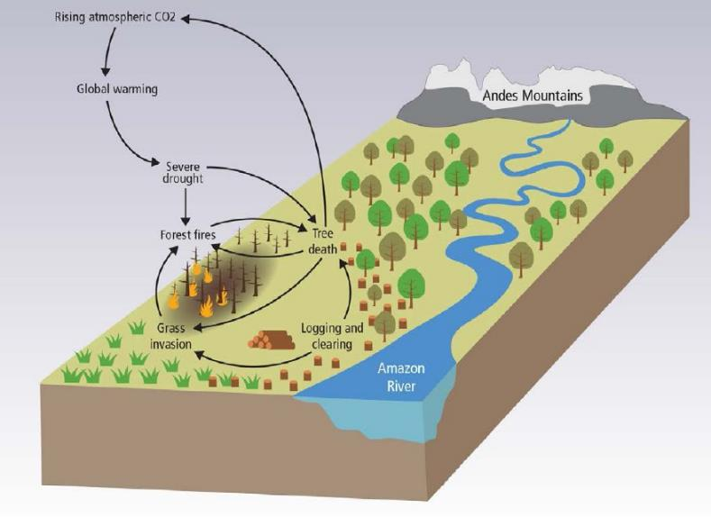
Amazon Basin
Source: IPCC 2013/2014
Notes:
WG2 Chapter 4, Figure 8. The forests of the Amazon Basin are already being altered through severe droughts, changes in land use (deforestation, logging), and increased frequencies of forest fire. Some of these processes are self-reinforcing through positive feedbacks, and create the potential for a large-scale tipping point. For example, forest fire kills trees, increasing the likelihood of subsequent burning. This effect is magnified when tree death allows forests to be invaded by flammable grasses. Deforestation provides ignition sources to flammable forests, contributing to this dieback. Climate change contributes to this tipping point by increasing drought severity, reducing rainfall and raising air temperatures, particularly in the eastern Amazon Basin.
There is a high risk that the large magnitudes and high rates of climate change this century will result in abrupt and irreversible regional-scale changes to terrestrial and freshwater ecosystems, especially in the Amazon and Arctic, leading to additional climate change.
There are plausible mechanisms, supported by experimental evidence, observations, and climate model simulations, for the existence of ecosystem tipping points in the rainforests of the Amazon basin. Climate change (temperature and precipitation changes) alone is not projected to lead to abrupt widespread loss of forest cover in the Amazon during this century. However, a projected increase in severe drought episodes, related to stronger El Niño events, together with land-use change and forest fires, would cause much of the Amazon forest to transform to less dense, drought- and fire-adapted ecosystems. This would risk reducing biodiversity in an important ecosystem, and would reduce the amount of carbon absorbed from the atmosphere through photosynthesis. It would also reduce the amount of evaporation, increasing the warming locally. Large reductions in deforestation, as well as wider application of effective wildfire management would lower the risk of abrupt change in the Amazon.
Amazonian forests were estimated to have lost 1.6 PgC and 2.2 PgC following the severe droughts of 2005 and 2010, respectively.

Slide 49
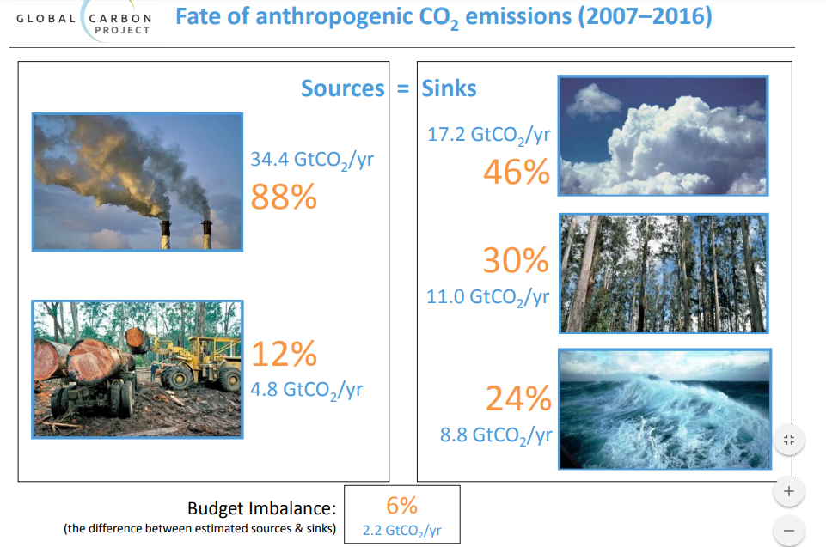
Source: Global Carbon Budget 2017
Notes:
Looking at it another way…
Emissions from land use change/ fossil fuels and cement
Source: Global carbon budget 2017 http://www.globalcarbonproject.org/carbonbudget/17/files/GCP_CarbonBudget_2017.pdf

Slide 50
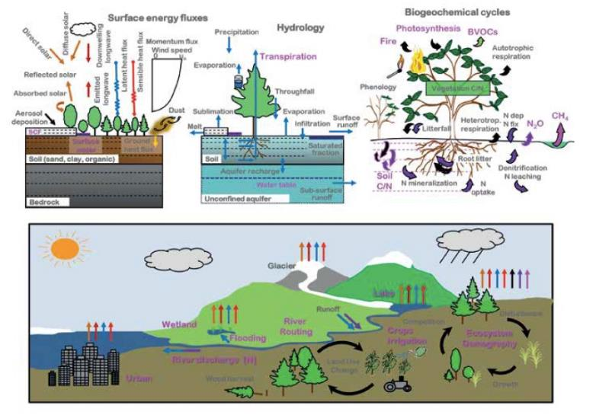
Lawrence and Fisher, ileaps, 2013
Notes:
Lawrence and Fisher, ileaps, 2013, coupled carbon and water cycles

Slide 51
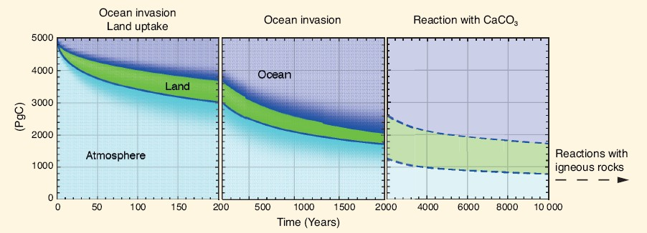
In the VERY long term…
Source: IPCC 2013/2014
Notes:
illustrates the decay of a large excess amount of CO₂ (5000 PgC, or about 10 times the cumulative CO₂ emitted so far since the beginning of the industrial Era) emitted into the atmosphere, and how it is redistributed among land and the ocean over time. During the first 200 years, the ocean and land take up similar amounts of carbon. On longer time scales, the ocean uptake dominates mainly because of its larger reservoir size (~38,000 PgC) as compared to land (~4000 PgC) and atmosphere (589 PgC prior to the Industrial Era). Because of ocean chemistry the size of the initial input is important: higher emissions imply that a larger fraction of CO₂ will remain in the atmosphere. After 2000 years, the atmosphere will still contain between 15% and 40% of those initial CO₂ emissions. A further reduction by carbonate sediment dissolution, and reactions with igneous rocks, such as silicate weathering and sediment burial, will take anything from tens to hundreds of thousands of years, or even longer.

